Slide 1
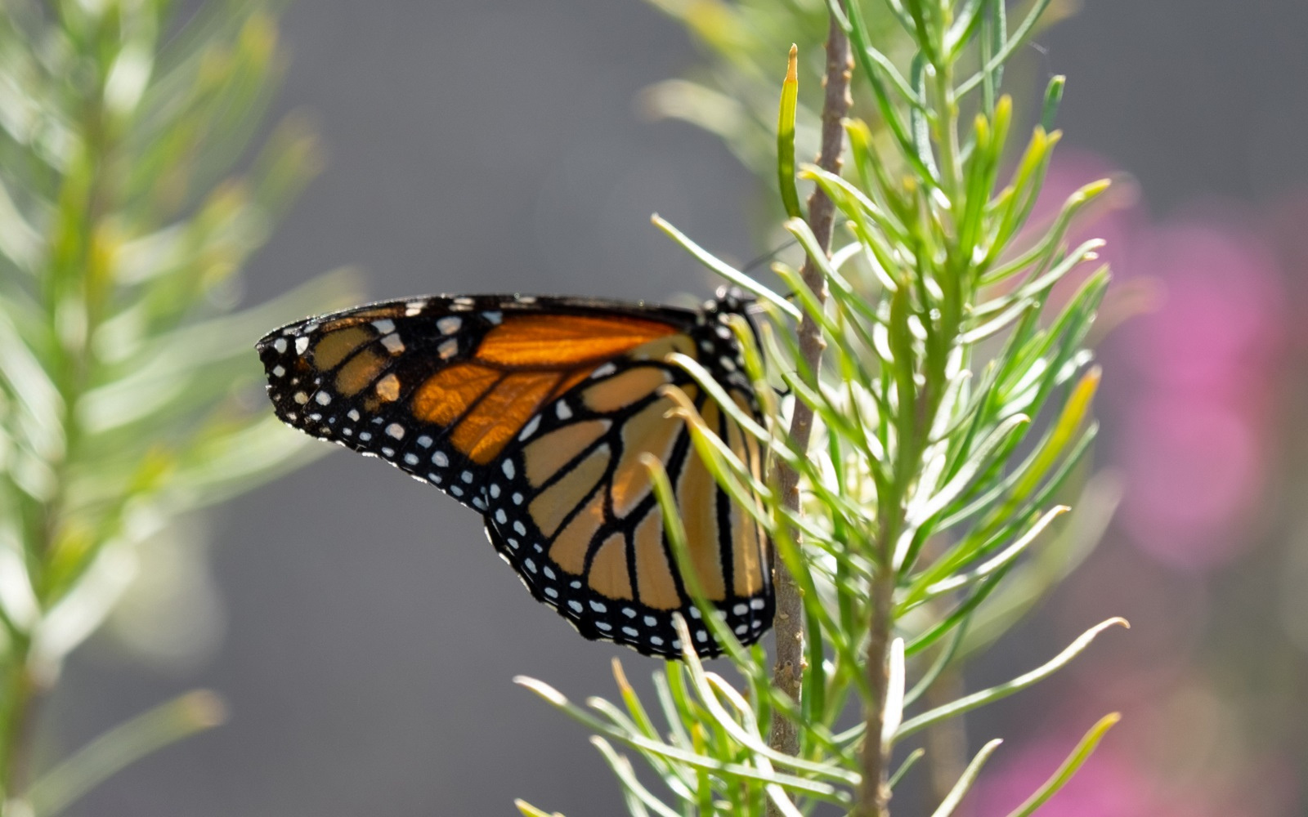



How phenology has changed
Nature’s Notebook video series

Slide 2
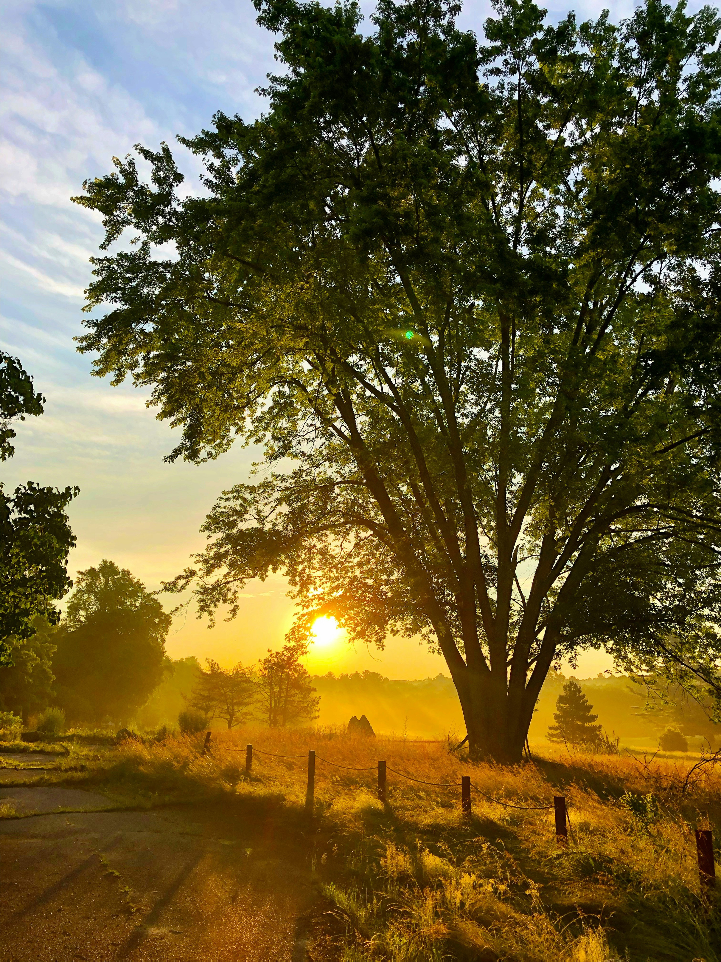

Photo: Tom Hennell via Unsplash, Public Domain
Notes:
Imagine if your alarm clock suddenly started going off earlier every year. That's essentially what's happening to plants and animals around the world.

Slide 3
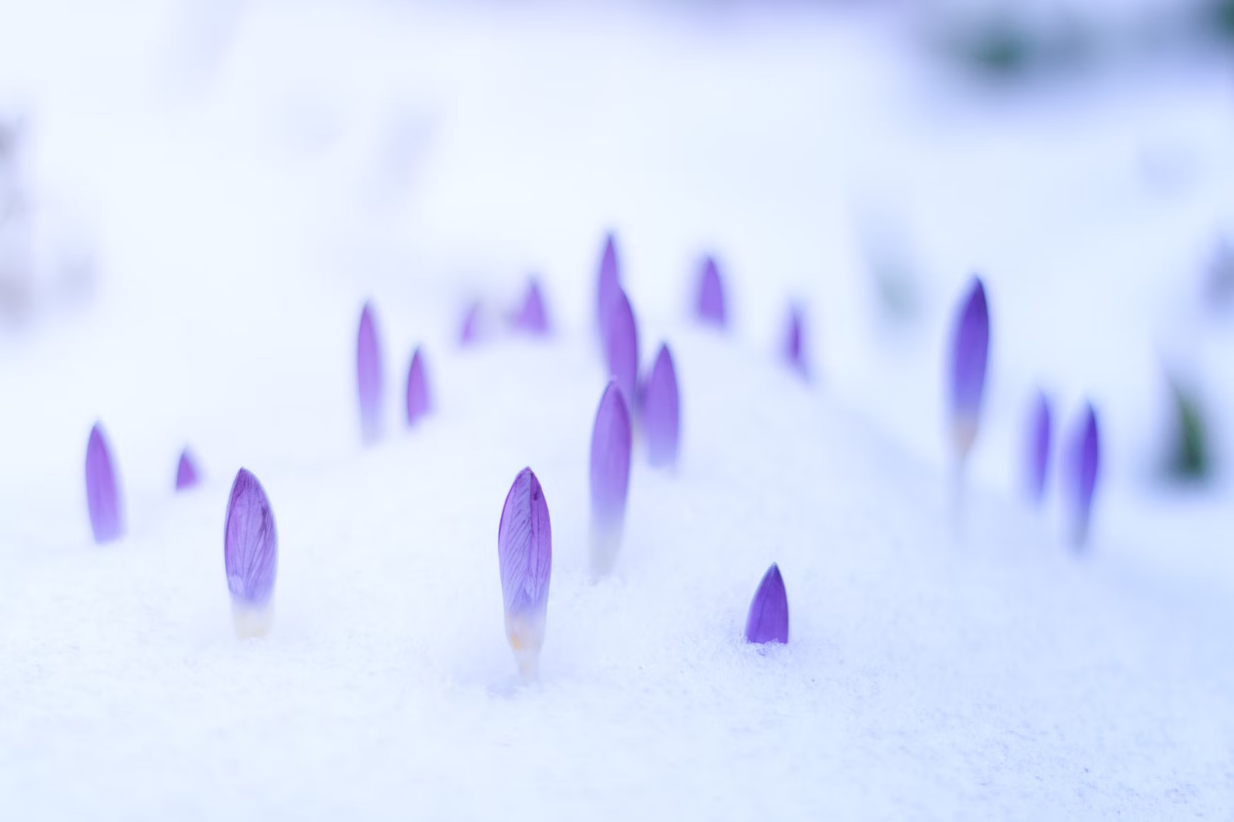


Photo: Johannes Plenio via Unsplash, Public Domain
Notes:
Climate change isn't just making things warmer; it's resetting nature's internal clock, causing species everywhere to advance or delay the timing of important life events.

Slide 4
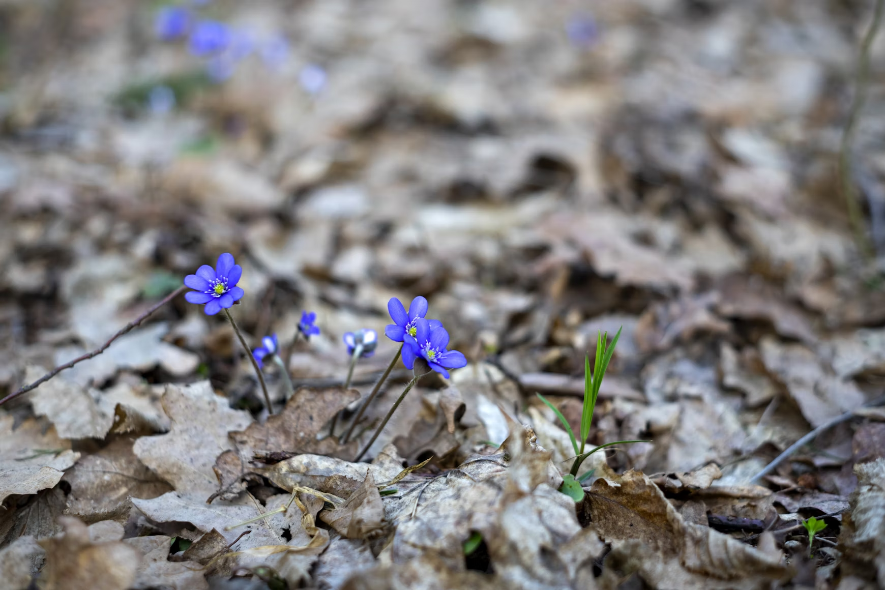
Photo: Rasa Kasparaviciene via Unsplash, Public Domain
Notes:
In this video we're looking at real examples of how certain species are shifting their schedules, with changes measured not just in days, but sometimes in weeks, or even months.

Slide 5
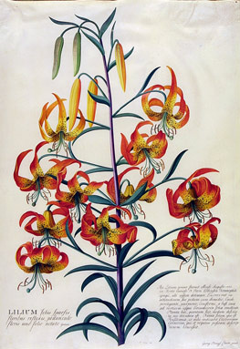
Photo: Georg Dionysius Ehret via Wikipedia, Public Domain
Notes:
Let's start with plants. Some of our best measures of change are possible because people carefully documented when various plants leafed out and bloomed hundreds of years ago.

Slide 6
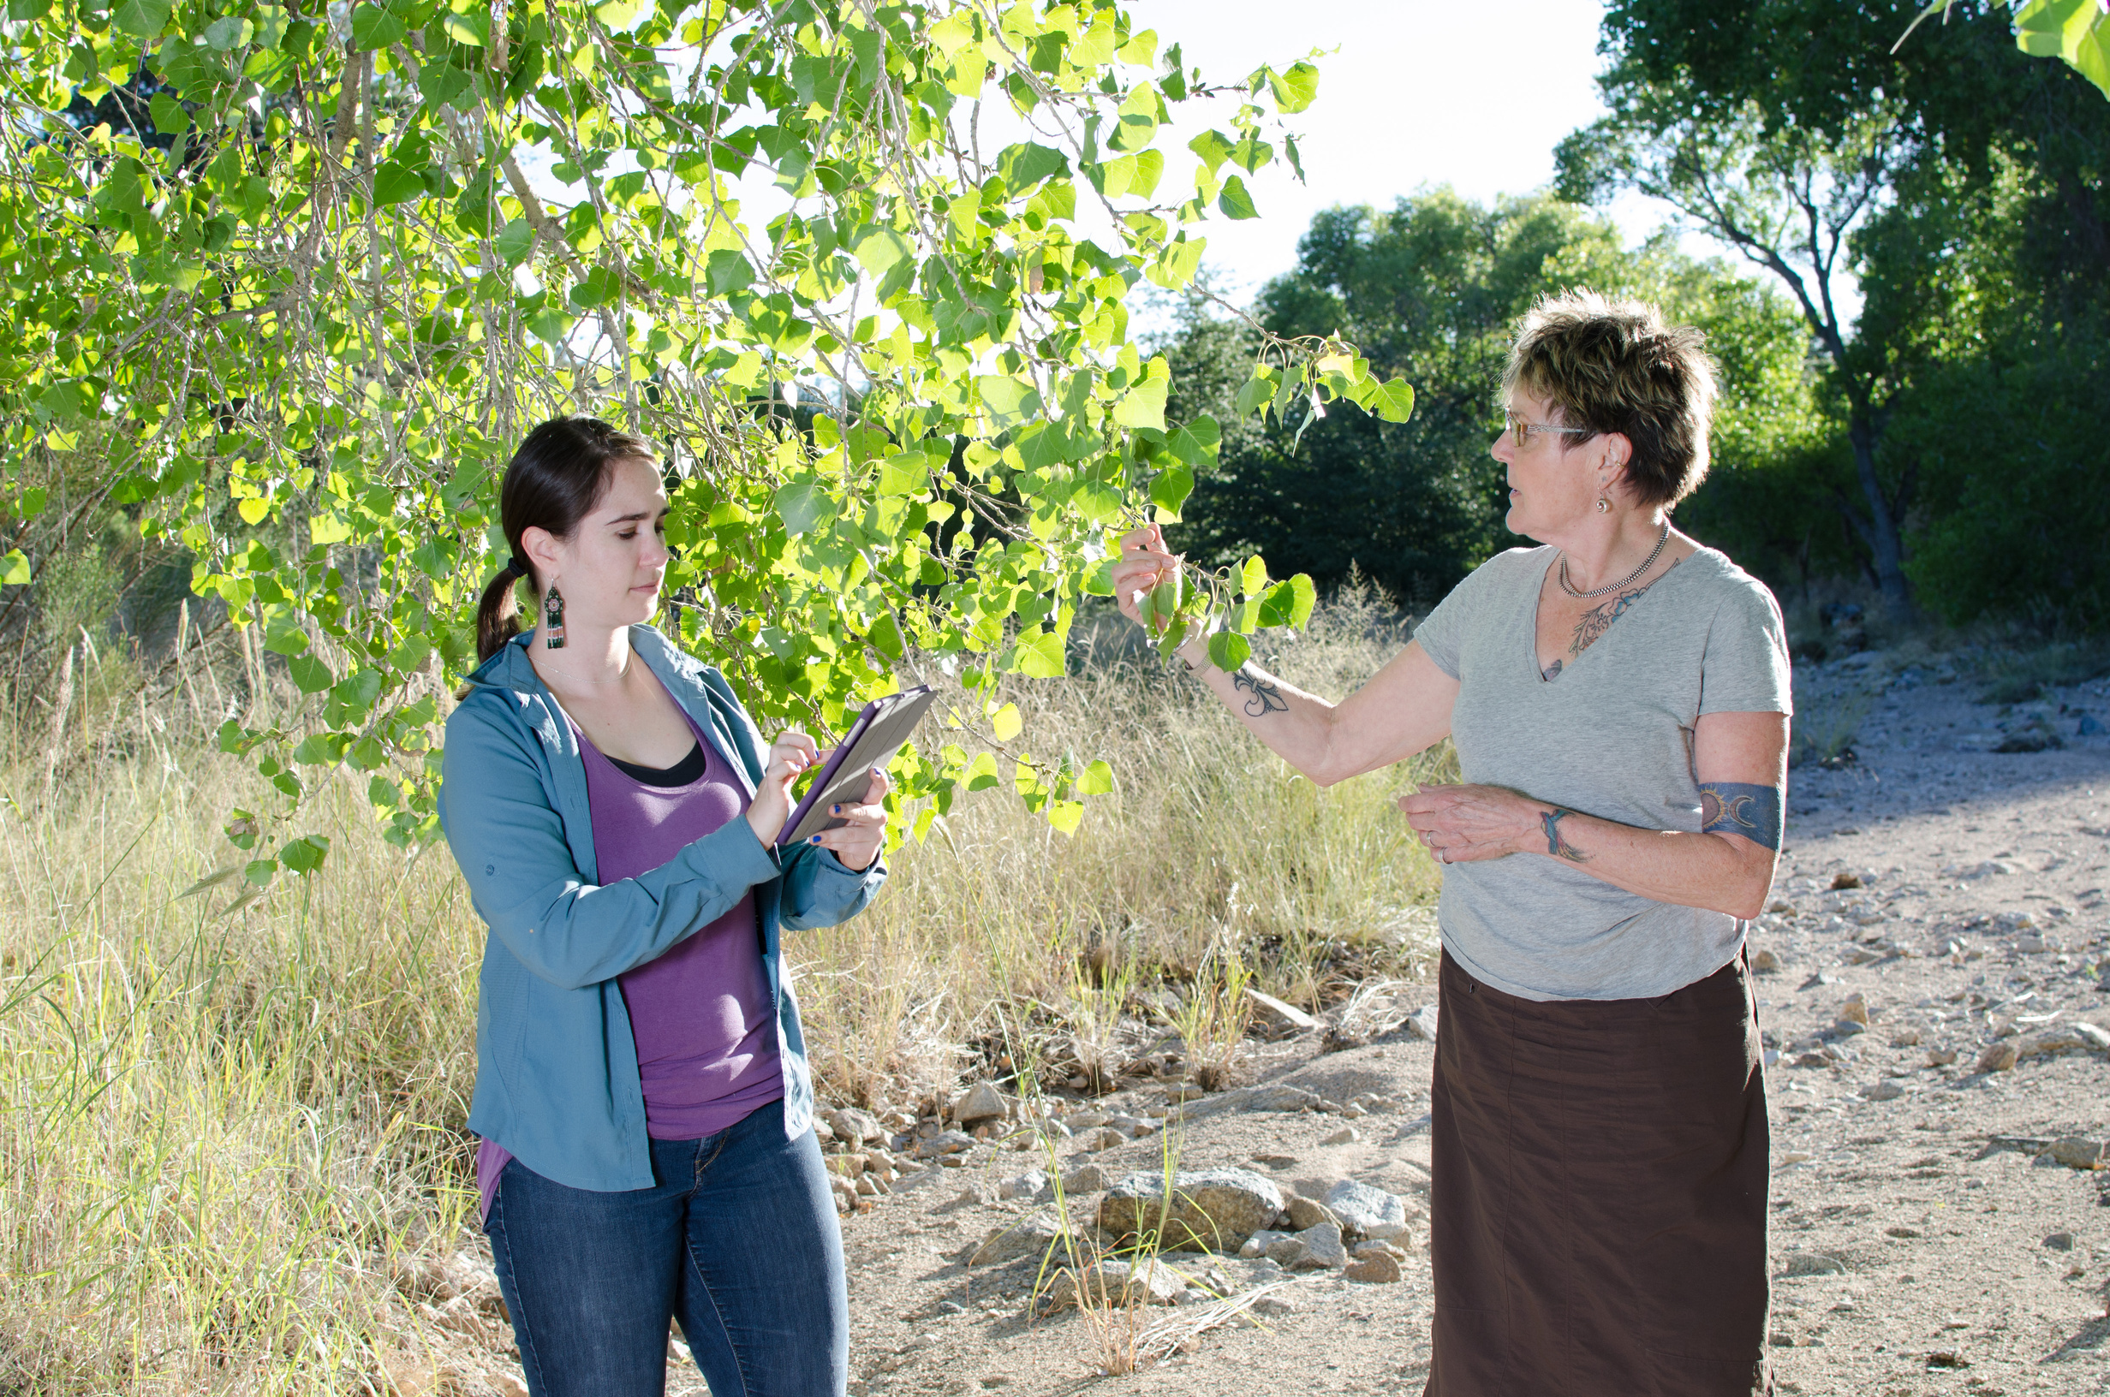
Photo: Brian F Powell
Notes:
By comparing observations collected today with those records collected hundreds of years ago, we can see clear evidence of change in many species.

Slide 7
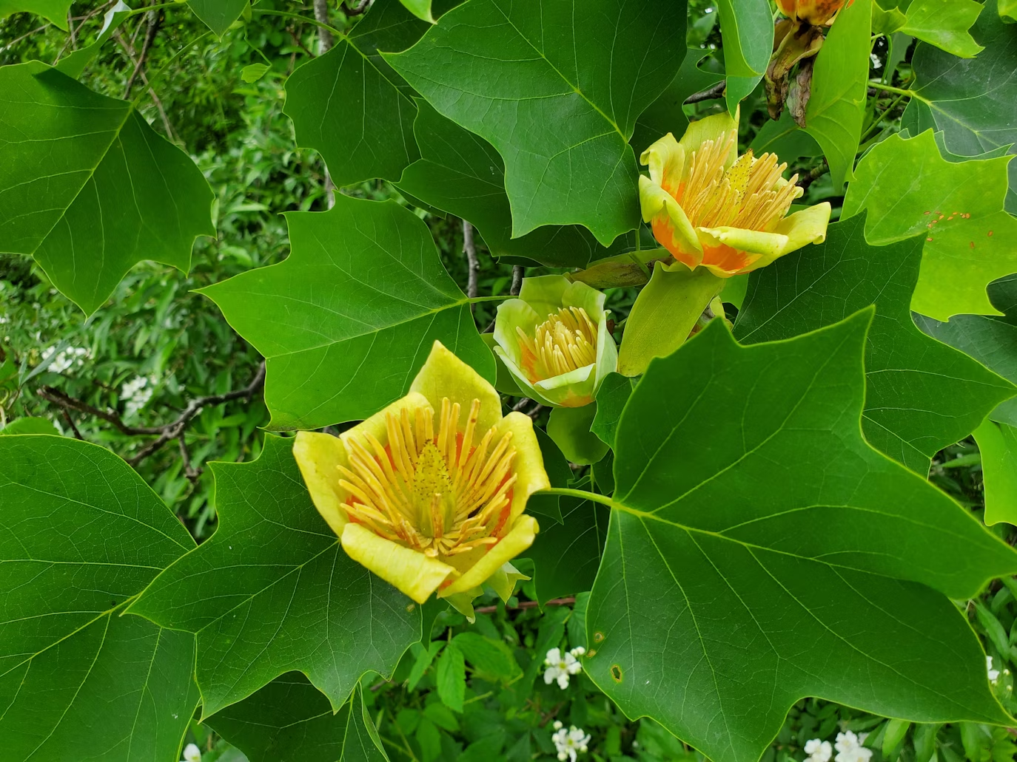
Tulip tree
Liriodendron tulipifera
In New York, flowers 27 days earlier than 200 years ago
Photo: Andrew Eroh via Unsplash, Public Domain
Source: Battle et al. 2022, Journal of Ecology
Notes:
In New York, tulip tree now flowers 27 days earlier than back in the early 1800s. That's a change of nearly a month over two centuries. This major shift appears to be largely the result of steadily increasing temperatures in this region.

Slide 8
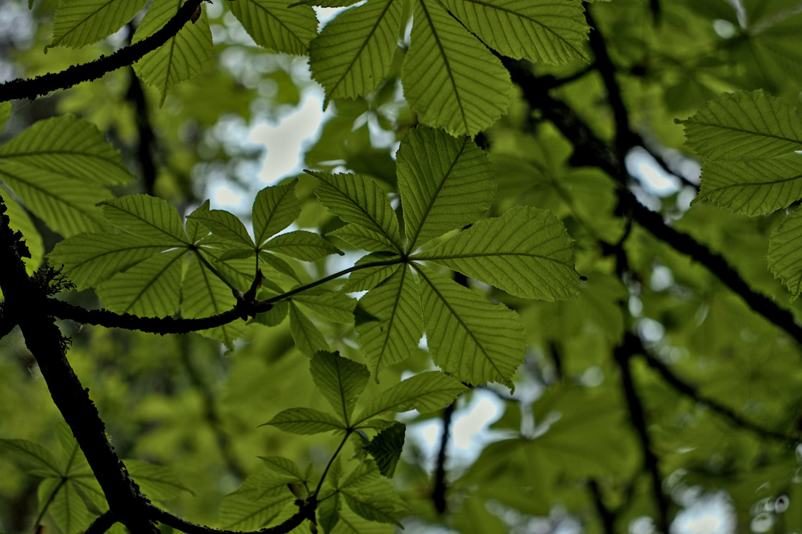
Horse chestnut
Aesculus hippocastanum
In Switzerland, leaf-out 11 days earlier than 200 years ago
Photo: Henry Schneider via Unsplash, Public Domain
Source: Vitasse et al. 2022 Nature Climate Change
Notes:
It's not just in North America, though. In Switzerland, horse chestnut trees now leaf out about 11 days earlier than they did in the 1800s.

Slide 9
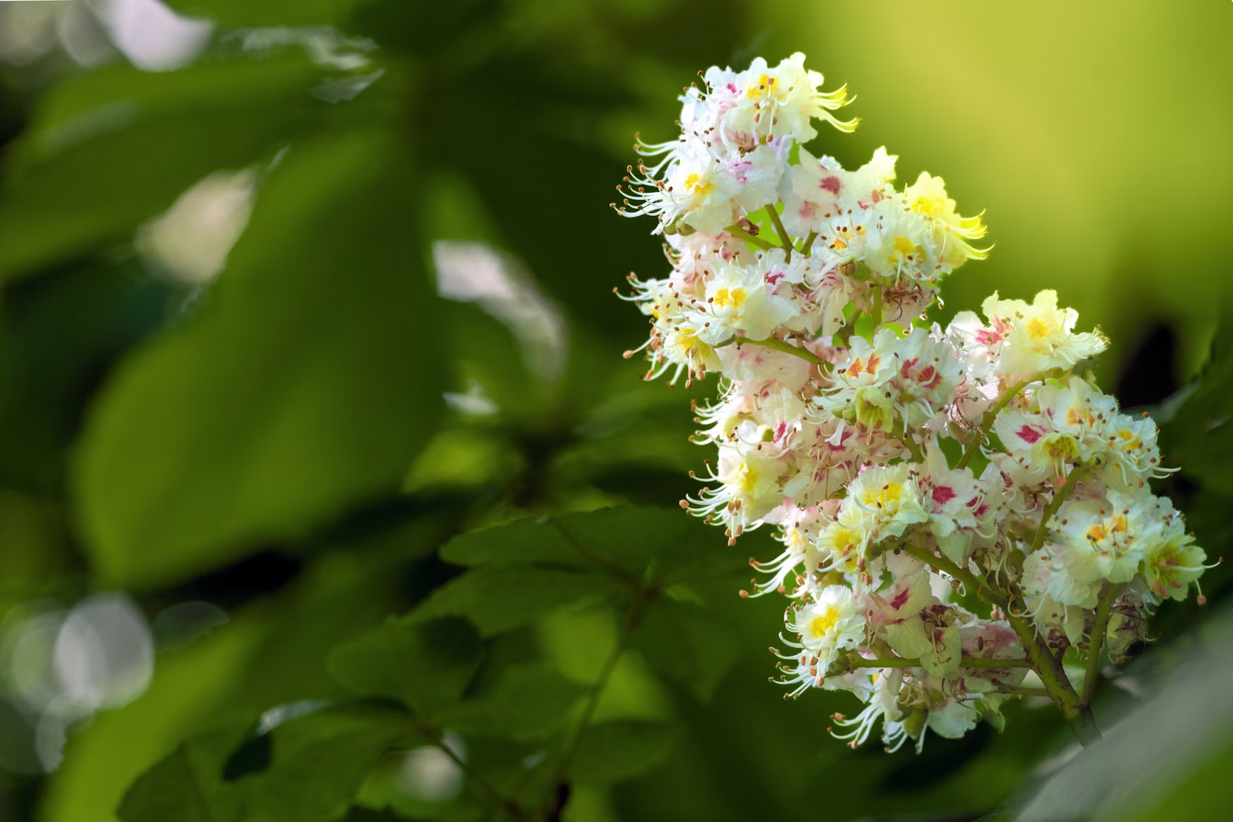
Horse chestnut
Aesculus hippocastanum
In Switzerland, leaf-out 11 days earlier than 200 years ago
Photo: Jevgeņijs Grigorjevs via Unsplash, Public Domain
Source: Vitasse et al. 2022 Nature Climate Change
Notes:
These trees, famous for their eye catching flower spikes, are also responding to warmer temperatures by starting their growing season measurably earlier.

Slide 10
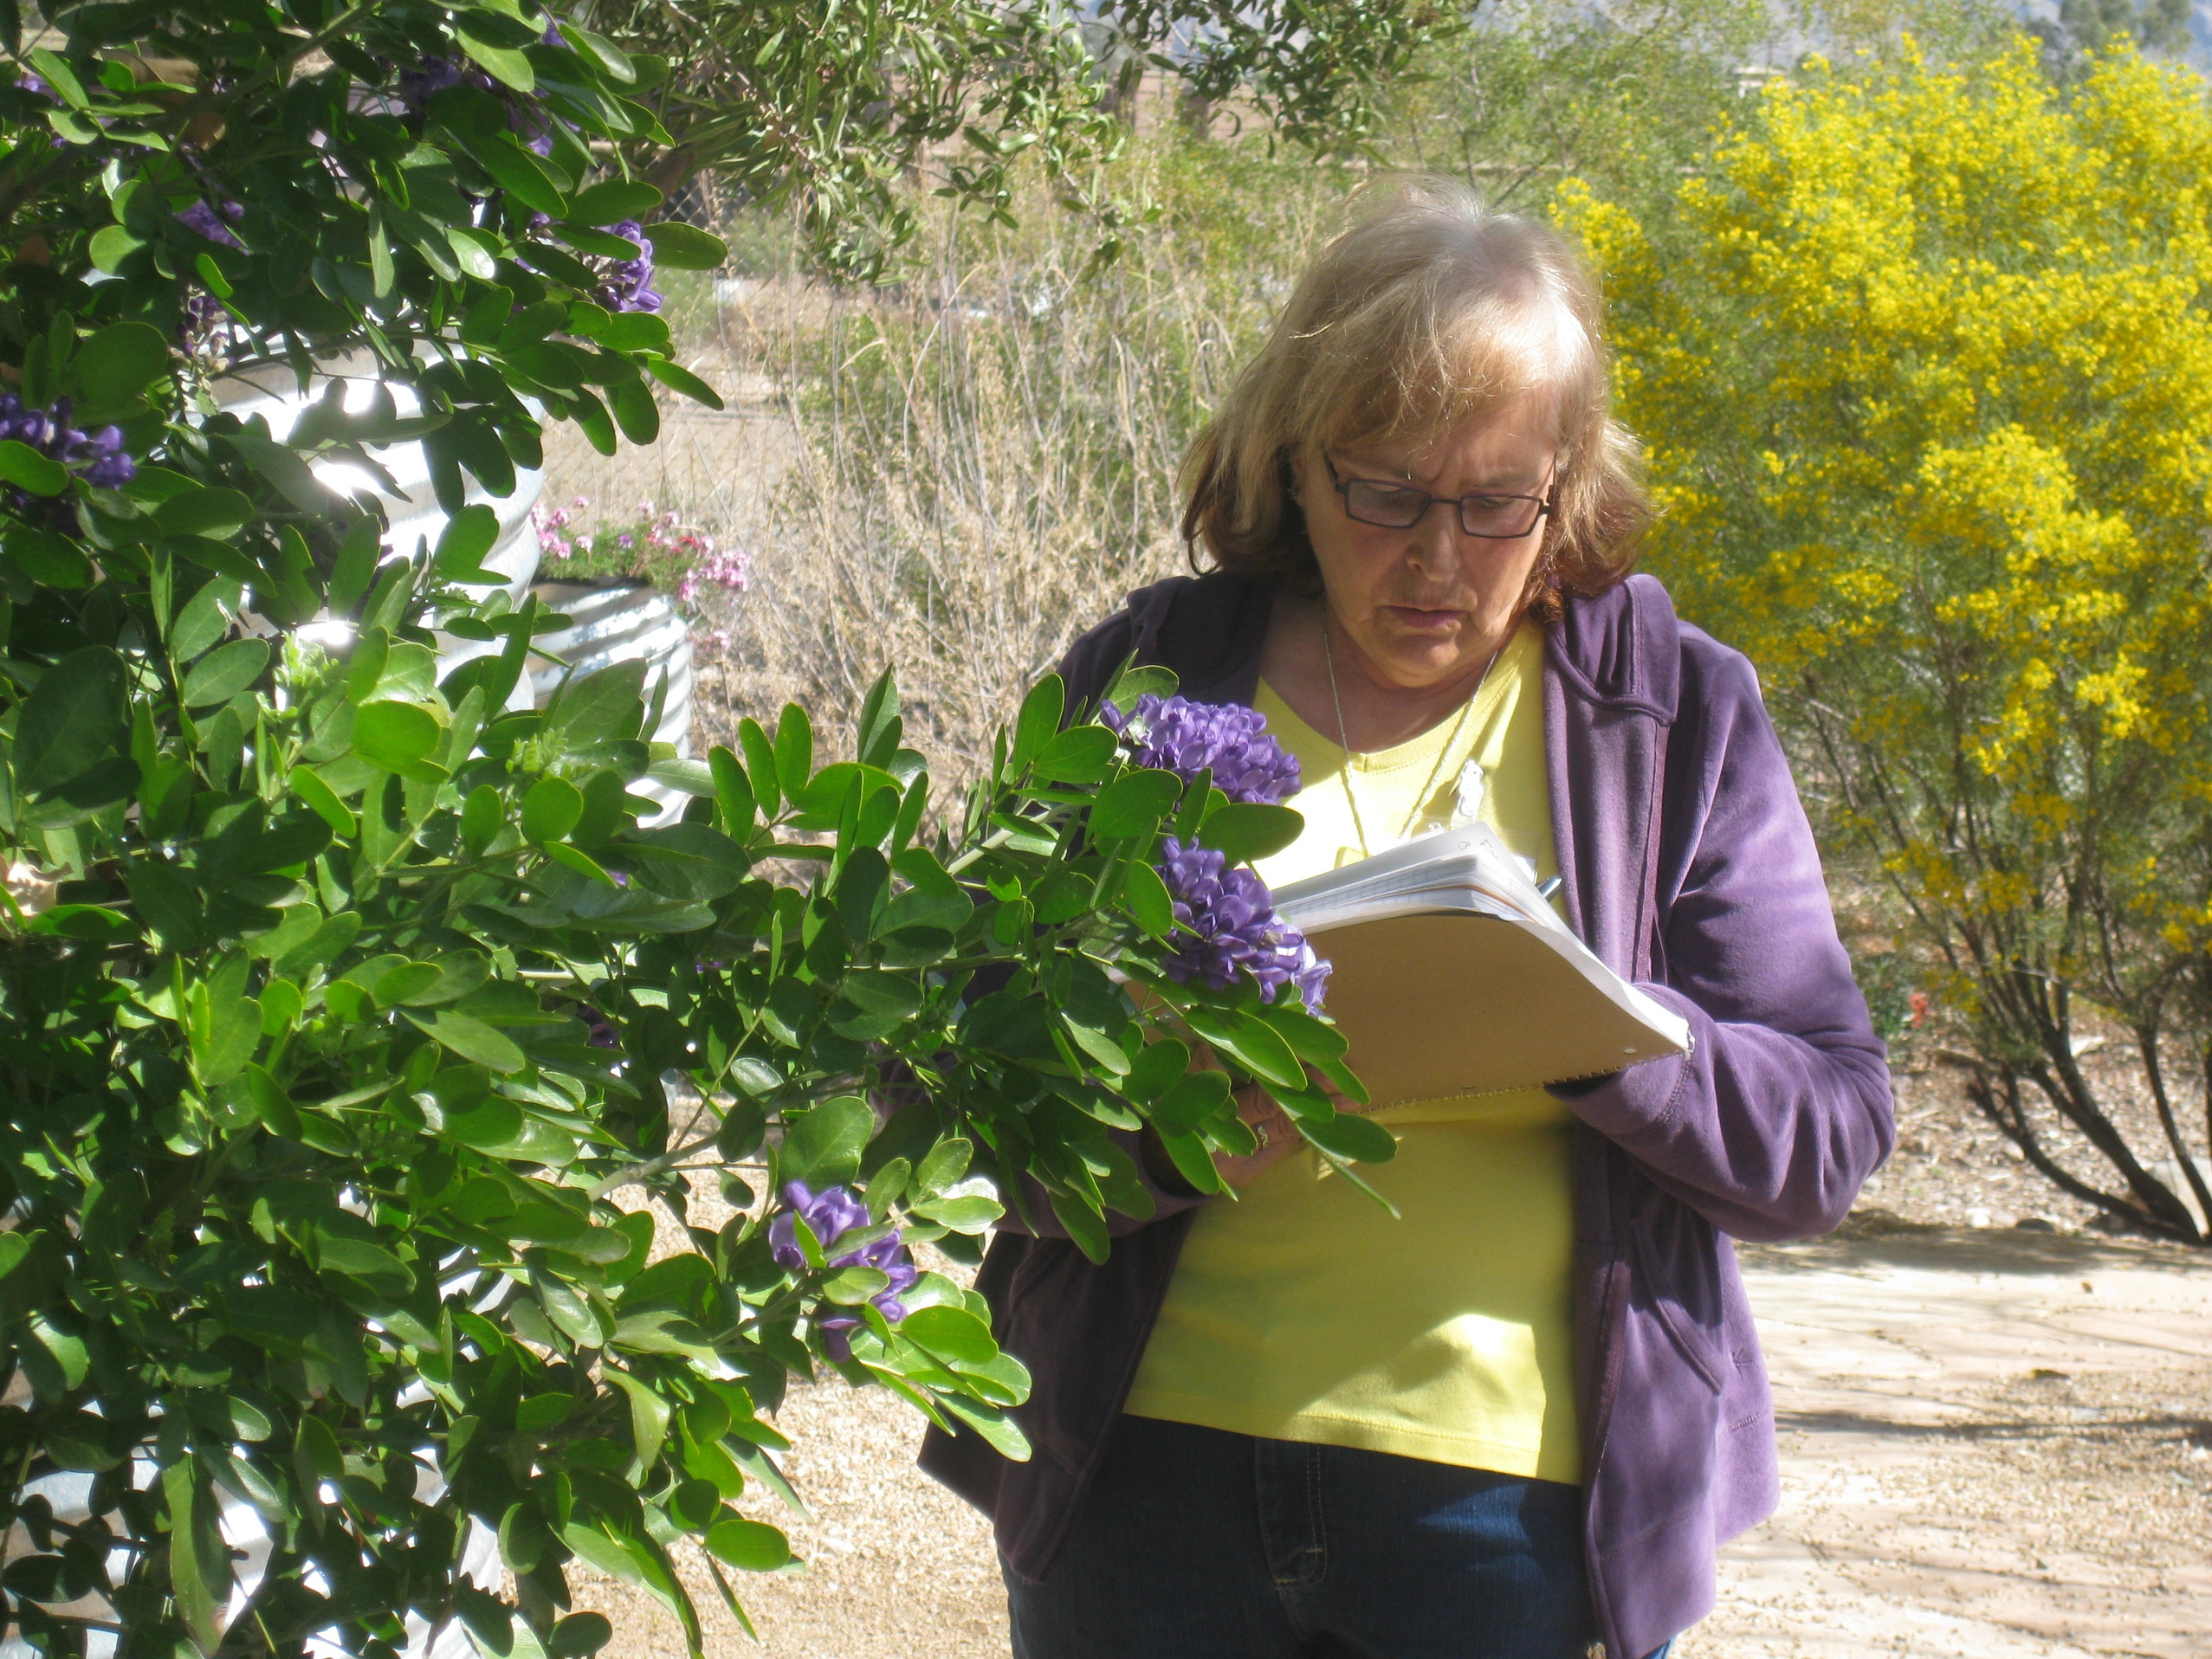
Photo: Echo Surina
Notes:
But the changes aren't uniform across species; while many plants are advancing their spring activities, some are demonstrating much larger shifts than others.

Slide 11
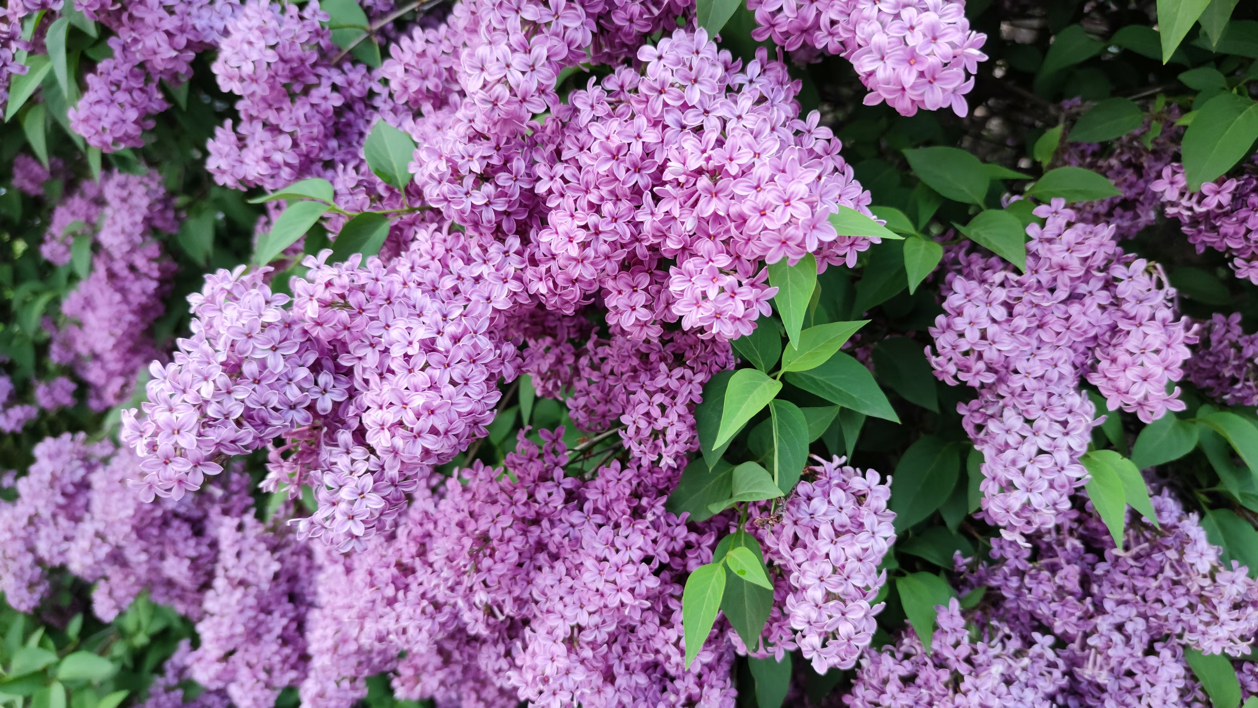
Common lilac
Syringa vulgaris
In New York, flowers 10 days earlier than 200 years ago
Photo: Karo K. via Unsplash, Public Domain
Source: Battle et al. 2022, Journal of Ecology
Notes:
Going back to New York, where tulip tree is demonstrating that very dramatic advancement, other species are showing more muted changes; common lilac is now flowering about 10 days earlier than it did 200 years ago.

Slide 12
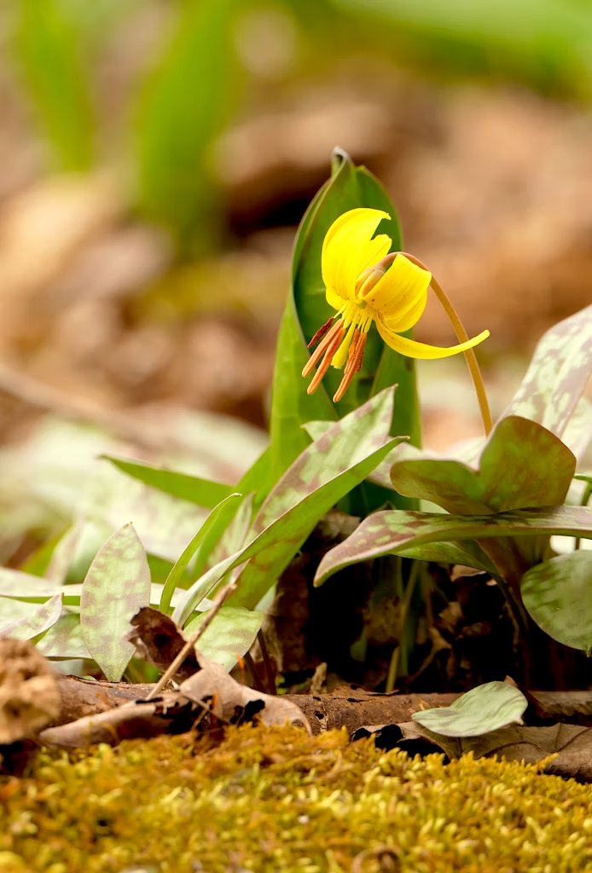
Yellow trout lily
Erythronium americanum
In New York, flowers one week earlier than 200 years ago
Photo: Patti Black via Unsplash, PUblic Domain
Source: Battle et al. 2022, Journal of Ecology
Notes:
Yellow trout lily is flowering about a week earlier.

Slide 13
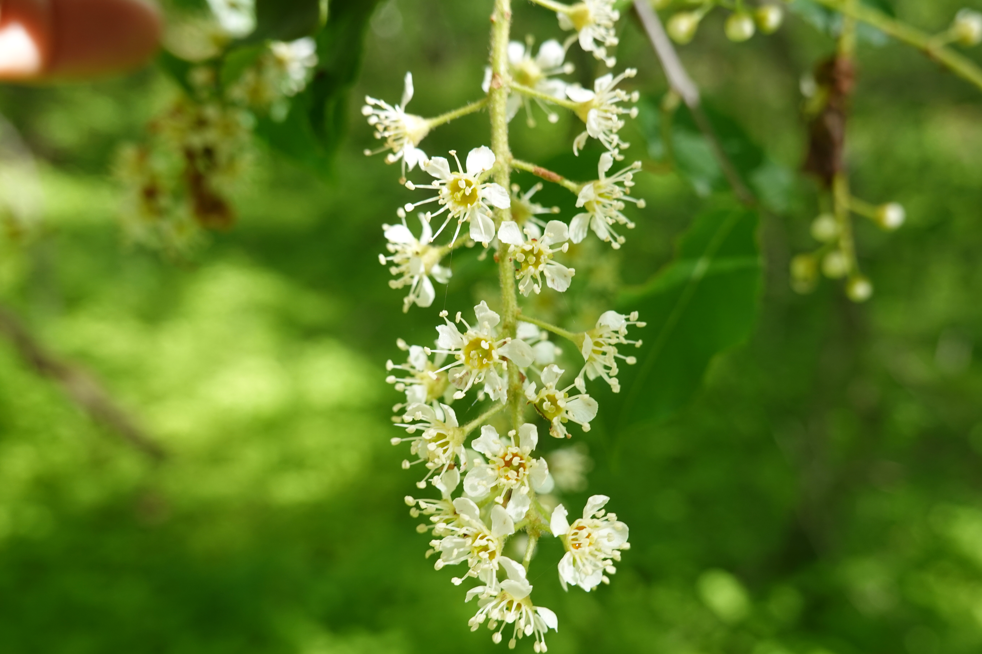
Black cherry tree
Prunus serotina
In New York, flowers three days earlier than 200 years ago
Photo: Ellen G Denny, CC BY-NC-SA 4.0
Source: Battle et al. 2022, Journal of Ecology
Notes:
And black cherry trees are flowering about three days earlier.

Slide 14
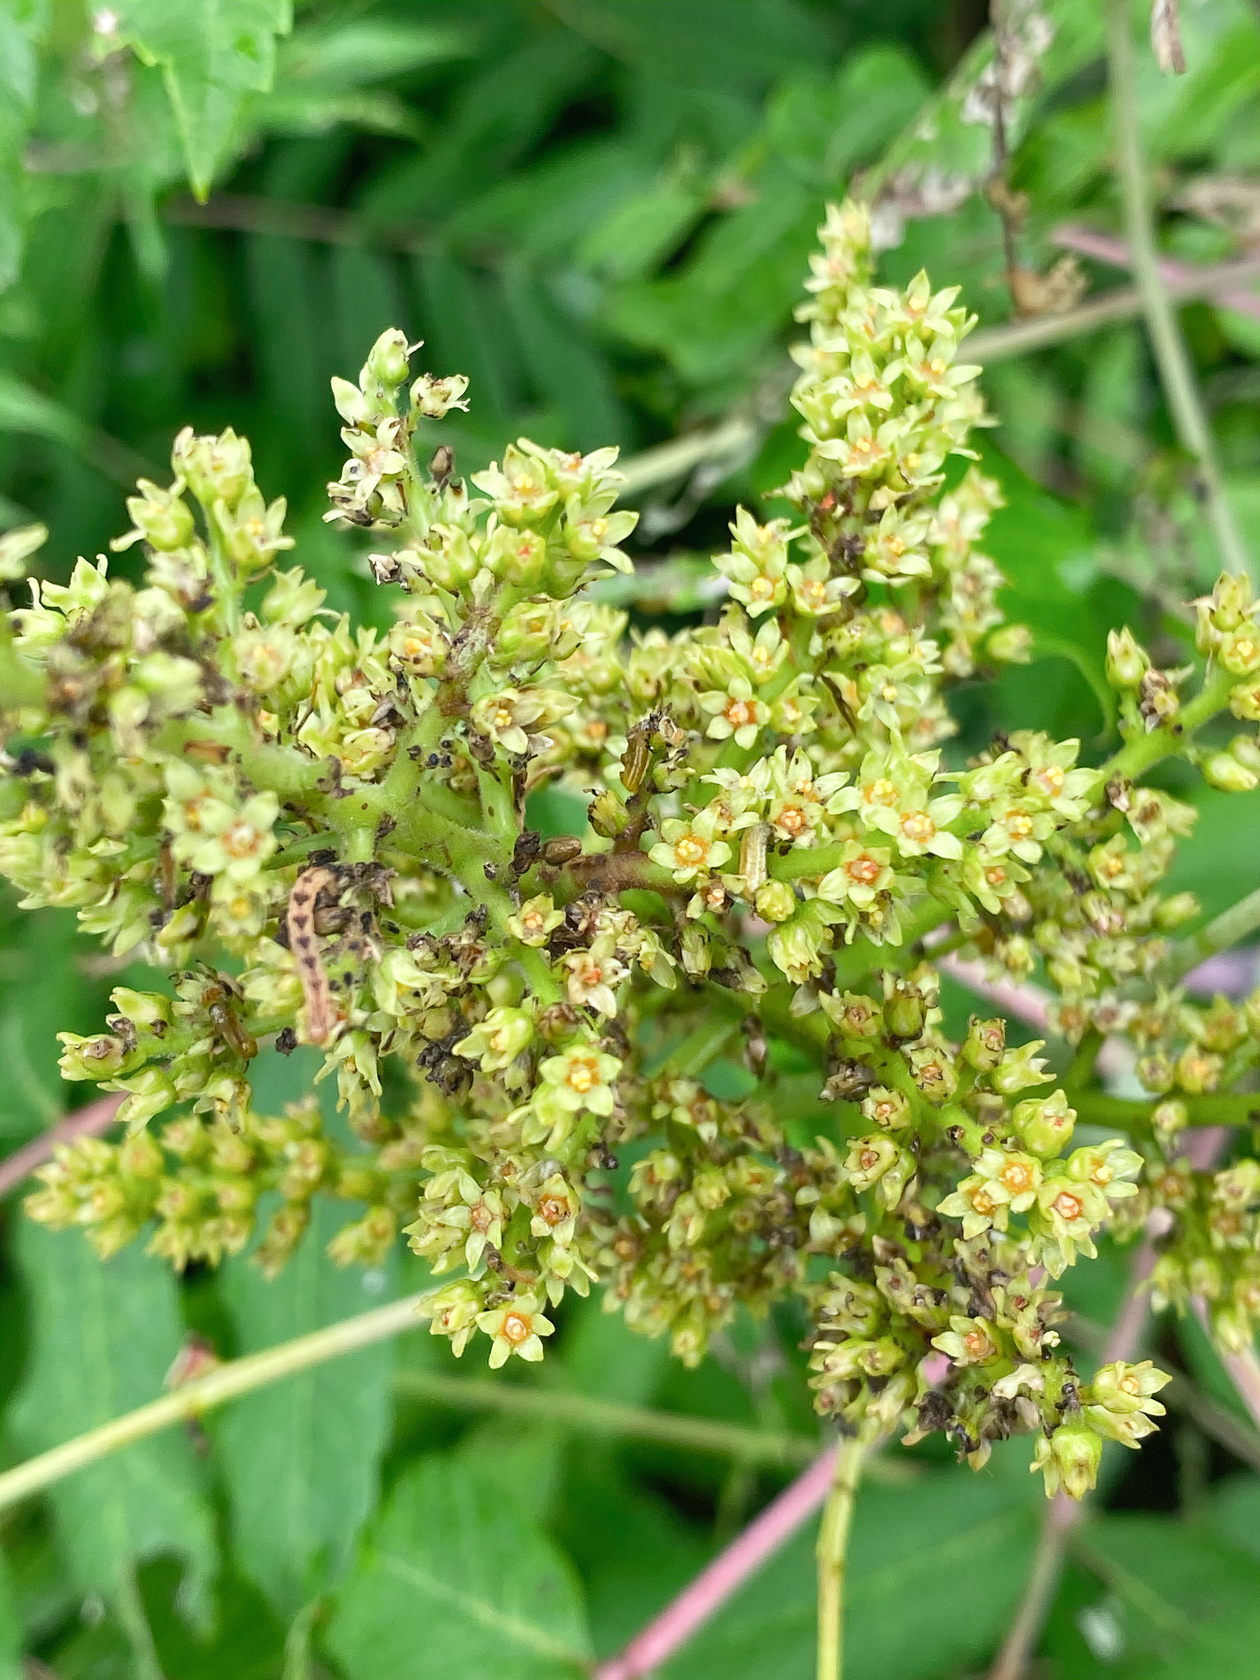
Smooth sumac
Rhus glabra
In North Dakota, flowers ten days later than 100 years ago
Photo: Dulcey Lima, The Morton Arboretum, CC BY-NC-SA 4.0
Source: Calinger and Curtis 2023, PLOS One
Notes:
And not all timing changes involve things happening earlier. Climate change can also push species in the opposite direction. For example, in North Dakota, smooth sumac now flowers about 10 days later than it did about 100 years ago.

Slide 15
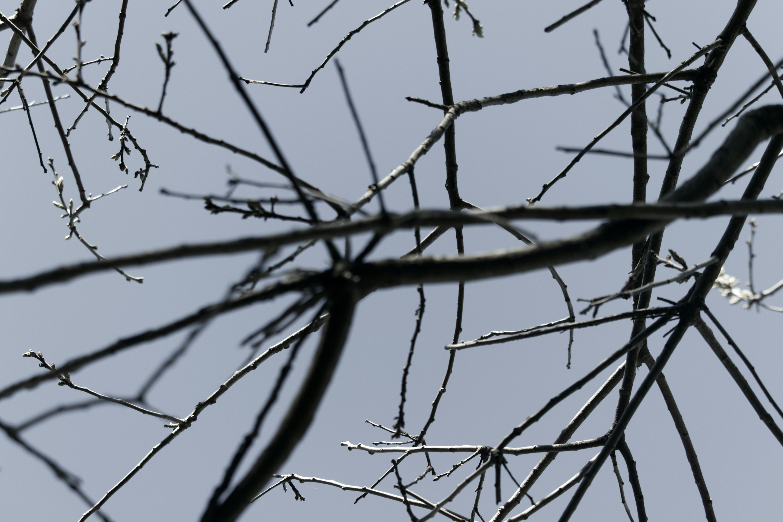
Photo: Tijan Manandhar via Unsplash, Public Domain
Notes:
Some species appear to be doing nothing at all, and this is turning out to be a poor survival strategy for them.

Slide 16
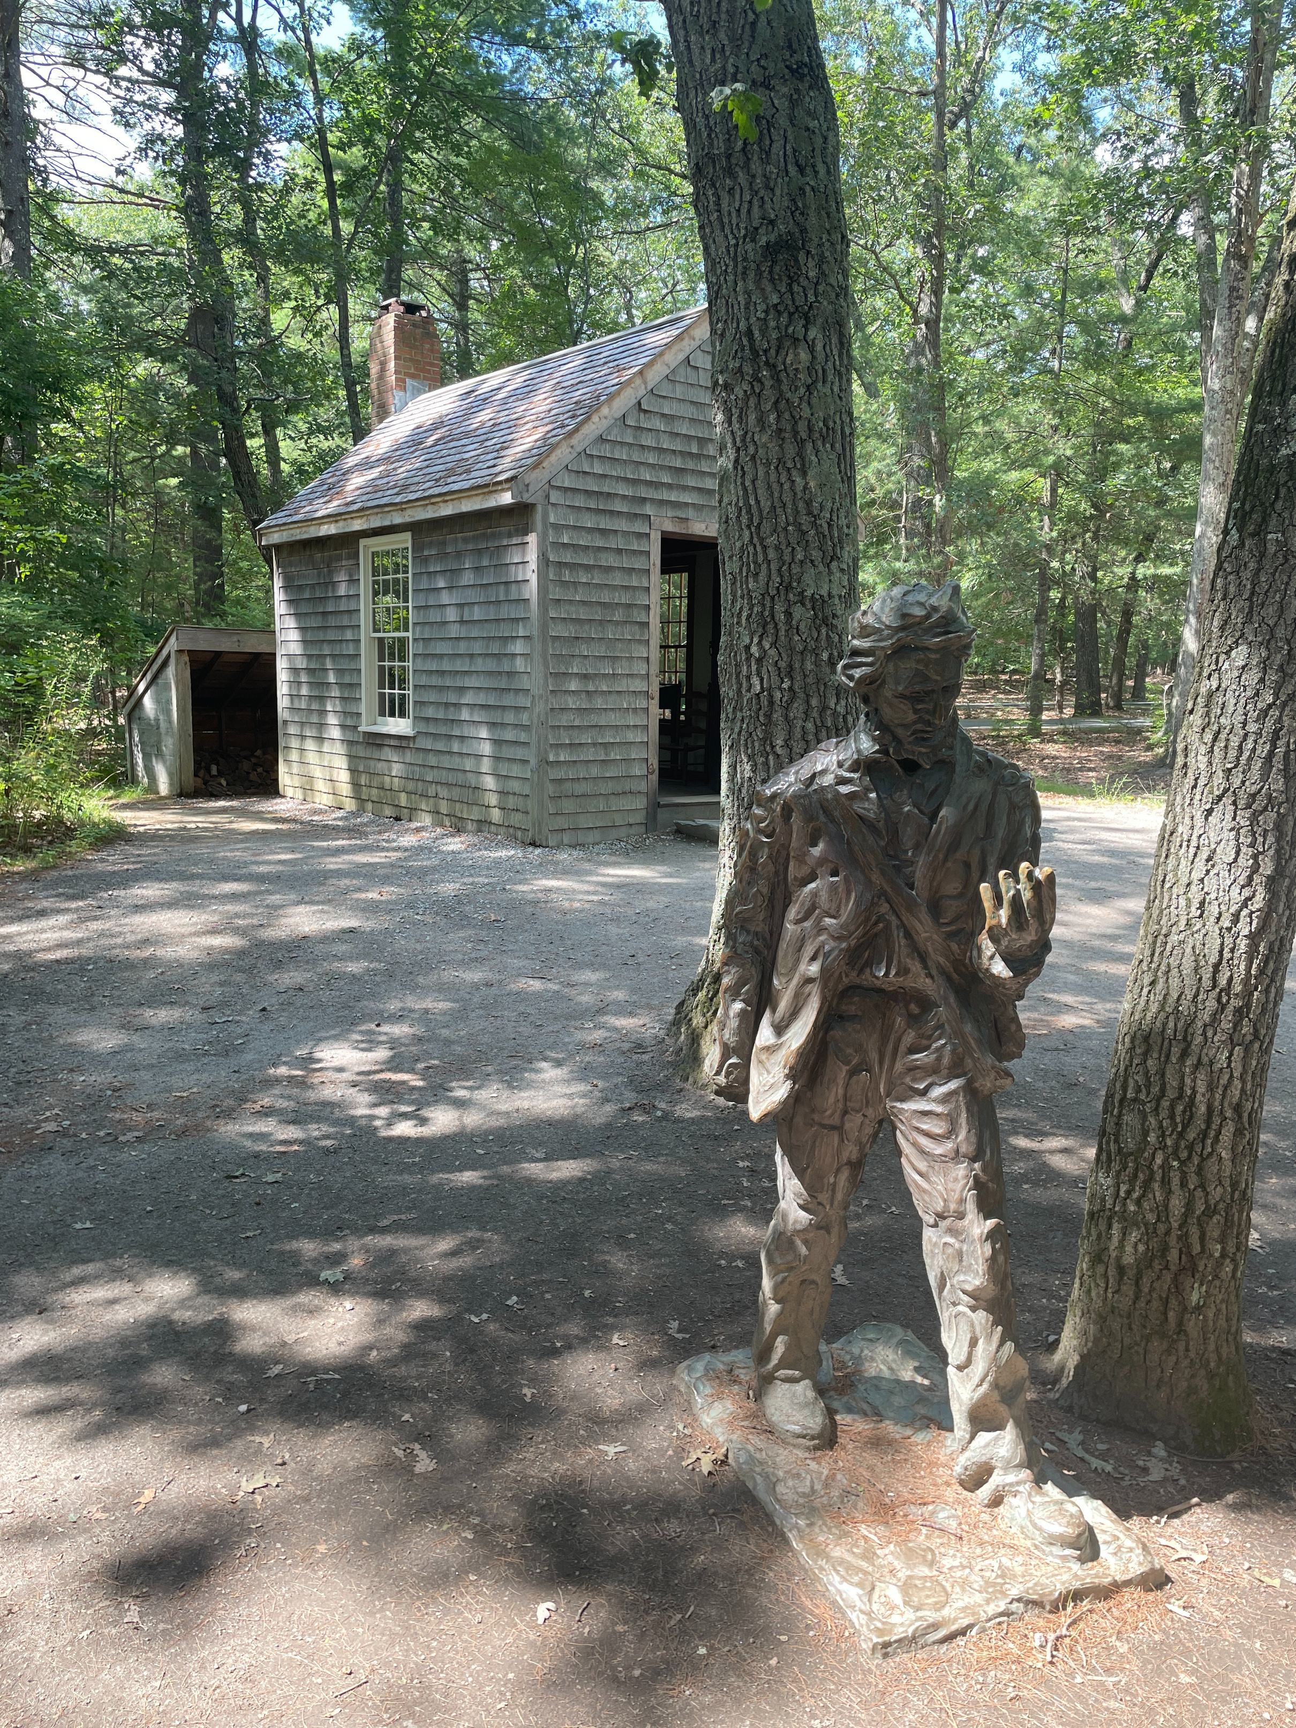
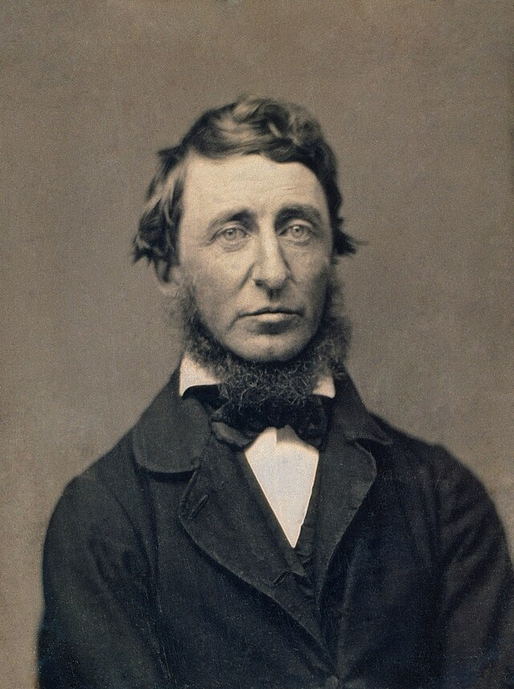
Henry David Thoreau
Photos: (left) Benjamin D. Maxham via Wikipedia, Public Domain; (background) Erin E Posthumus, CC BY-NC-SA 4.0
Notes:
Using observations collected in Concord, MS by Henry David Thoreau

Slide 17
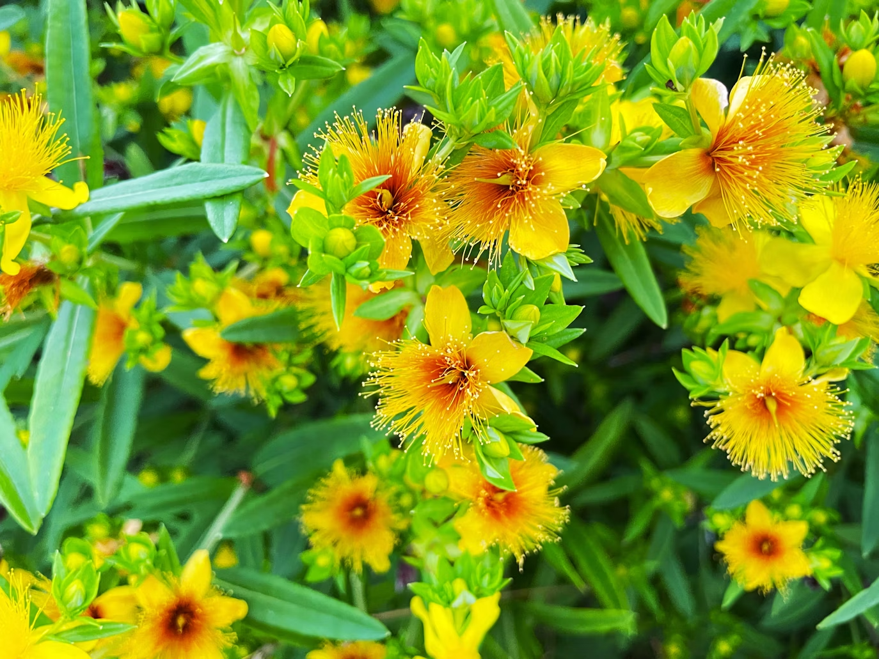
St. John’s wort
Hypericum perforatum
In Massachusettes, not keeping pace with changing temperatures
Photo: Ronin via Unsplash, Public Domain
Source: Willis et al. 2008, PNAS
Notes:
Researchers at Boston University have shown that St. John's wort, a perennial plant with bright yellow flowers, has not changed its flowering timing much at all since Thoreau's time and as a result it is far less abundant on the landscape than it was when Henry was tracking its flowers.

Slide 18
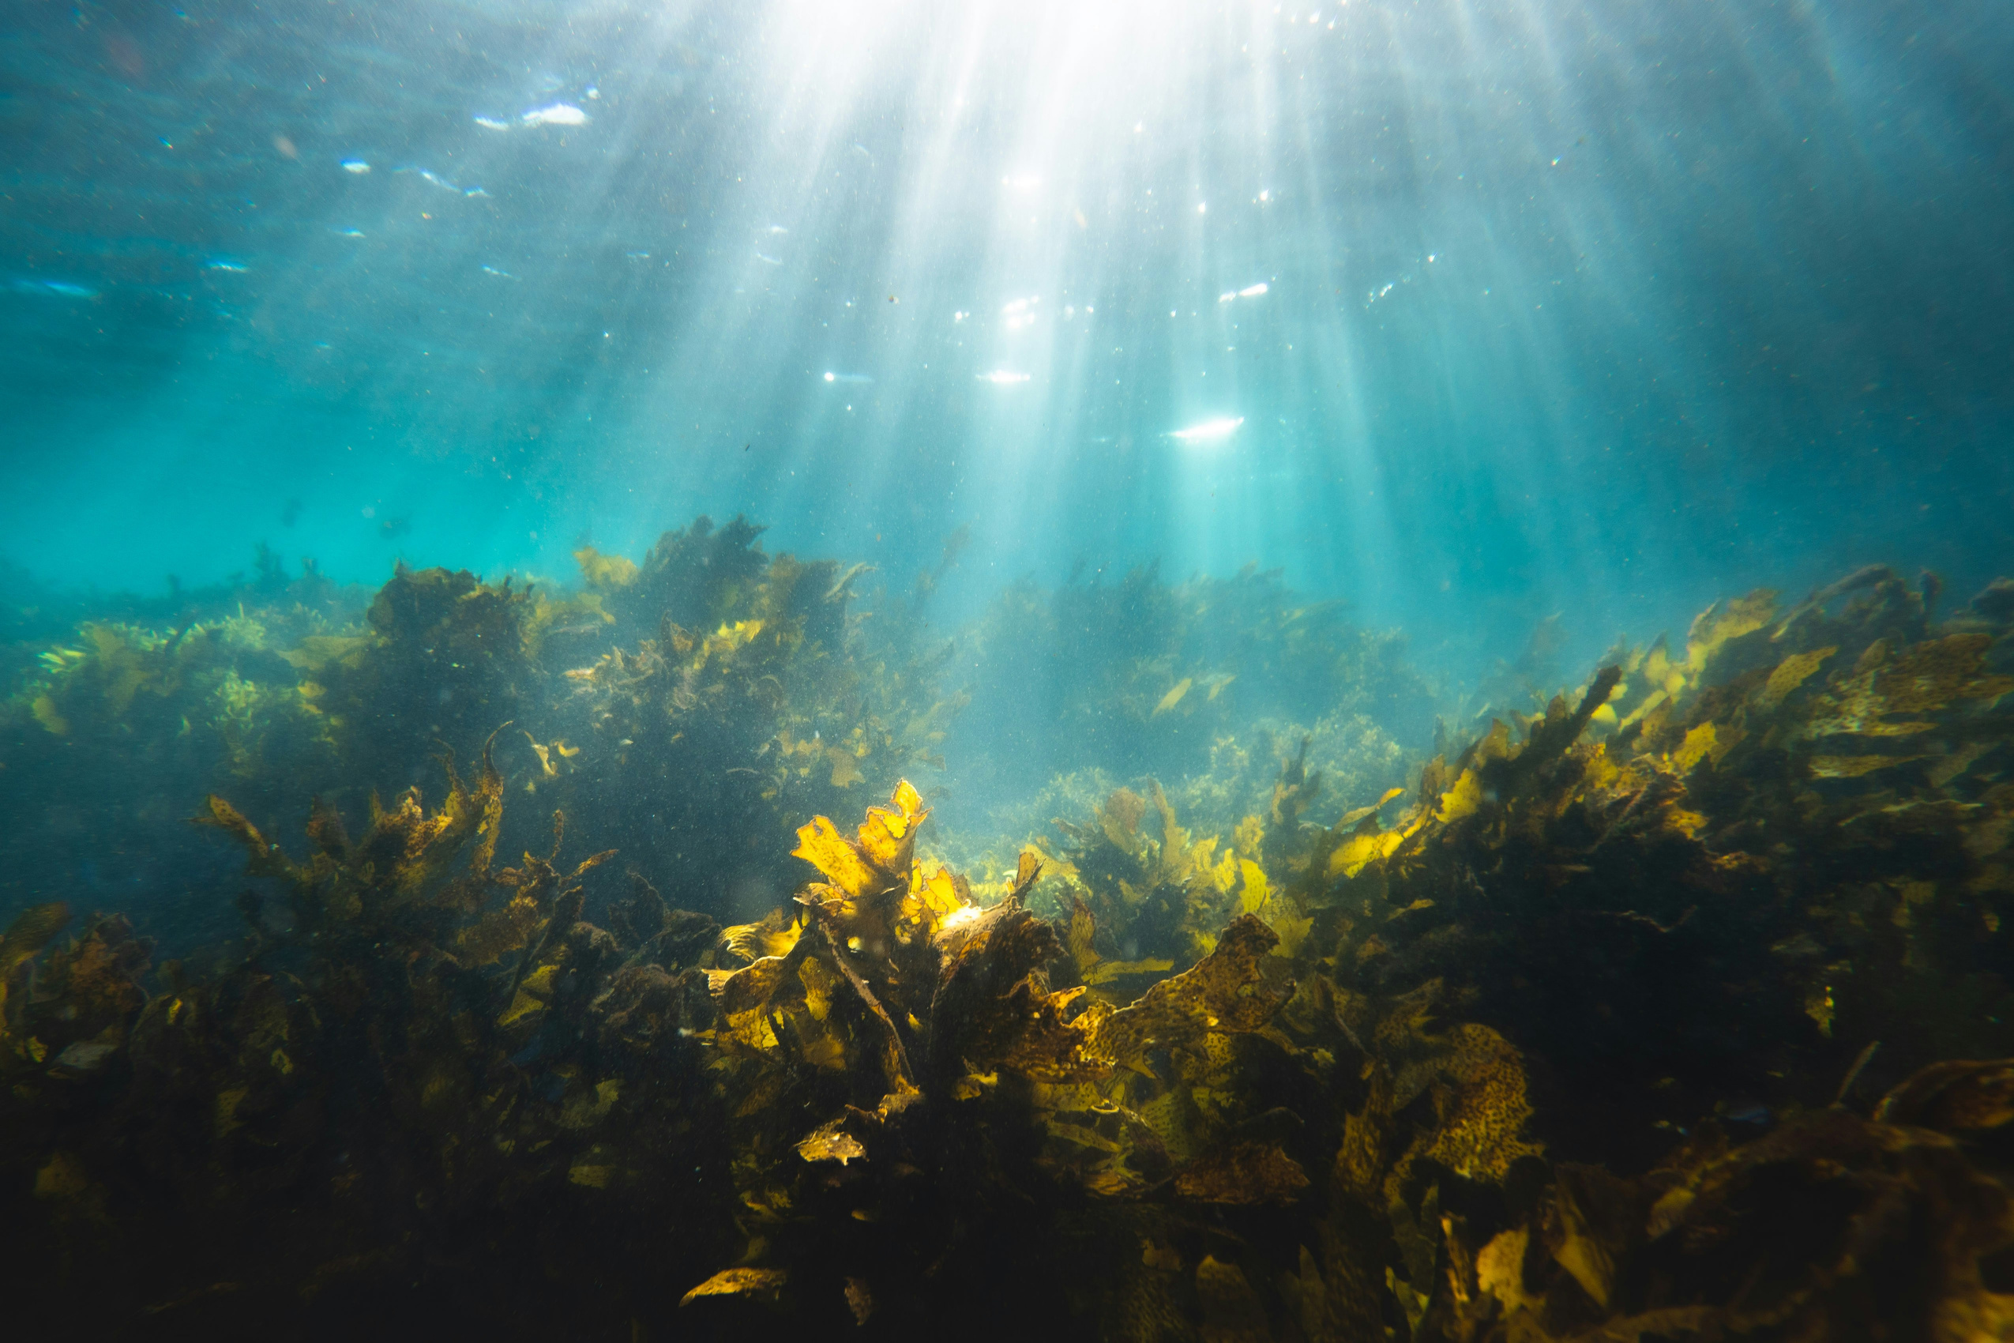
Photo: Silas Baisch via Unsplash, Public Domain
Notes:
Aquatic species are experiencing some of the most dramatic timing shifts of all.

Slide 19
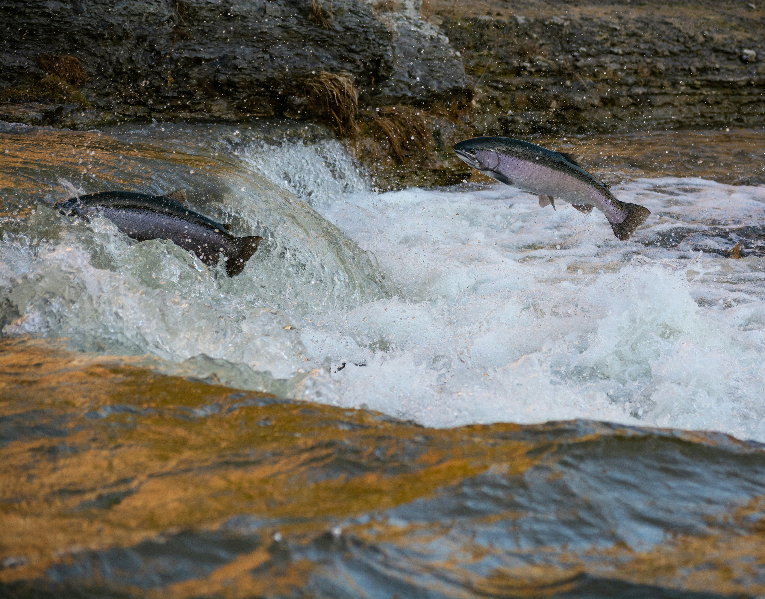
Photo: Brandon via Unsplash, Public Domain
Source: Lanagan et al. 2021, Marine Ecology Progress Series
Notes:
Fish are spawning earlier as water temperatures warm.

Slide 20
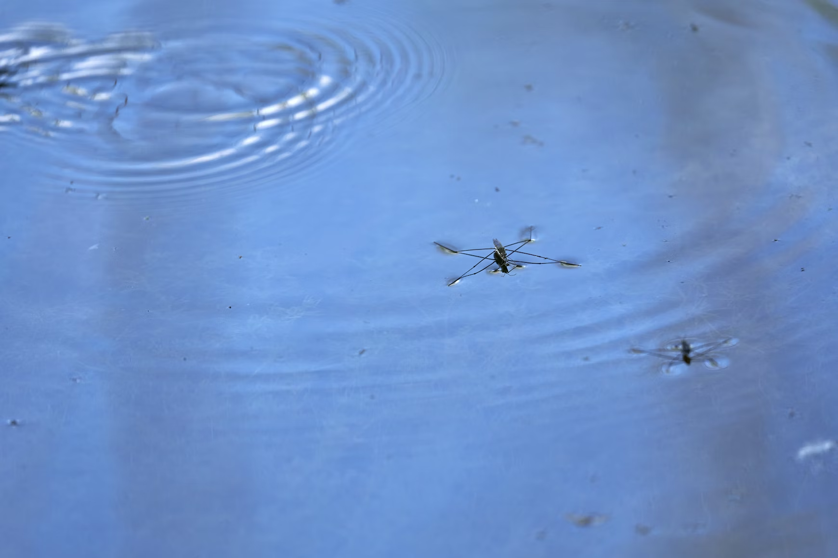
Photo: Wolfgang Hasselmann via Unsplash, Public Domain
Source: Lanagan et al. 2021, Marine Ecology Progress Series
Notes:
Aquatic insects are also emerging earlier, creating cascading effects throughout food webs.

Slide 21
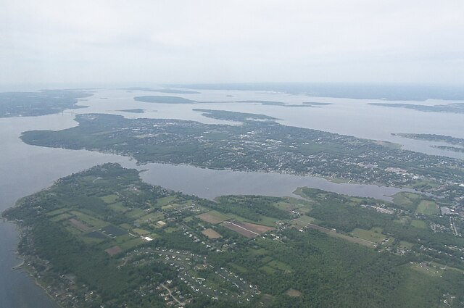
Narangansett Bay, Rhode Island
Average water temperatures 4 degrees F warmer since 1960s
Photo: Public Domain
Source: Lanagan et al. 2021, Marine Ecology Progress Series
Notes:
In Narangansett Bay, Rhode Island, the marine ecosystem is undergoing rapid and substantial changes. The average water temperature in Narangansett Bay has increased by about four degrees Fahrenheit since the 1960s.

Slide 22
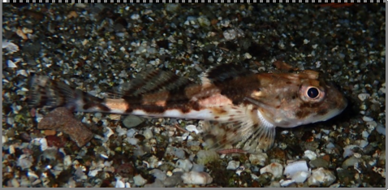
Longhorn sculpin
Myoxocephalus octodecemspinosus
Shorter wintertime stay by 118 days since the 1950s
Photo: Smithsonian Institute
Source: Lanagan et al. 2021, Marine Ecology Progress Series
Notes:
This seemingly minor change is driving massive shifts in which species live there and when they are active. Fish that migrate to the bay for the winter, like the longhorn sculpin and ocean pout, have dramatically shortened their stays, in some cases by 2-3 months.

Slide 23
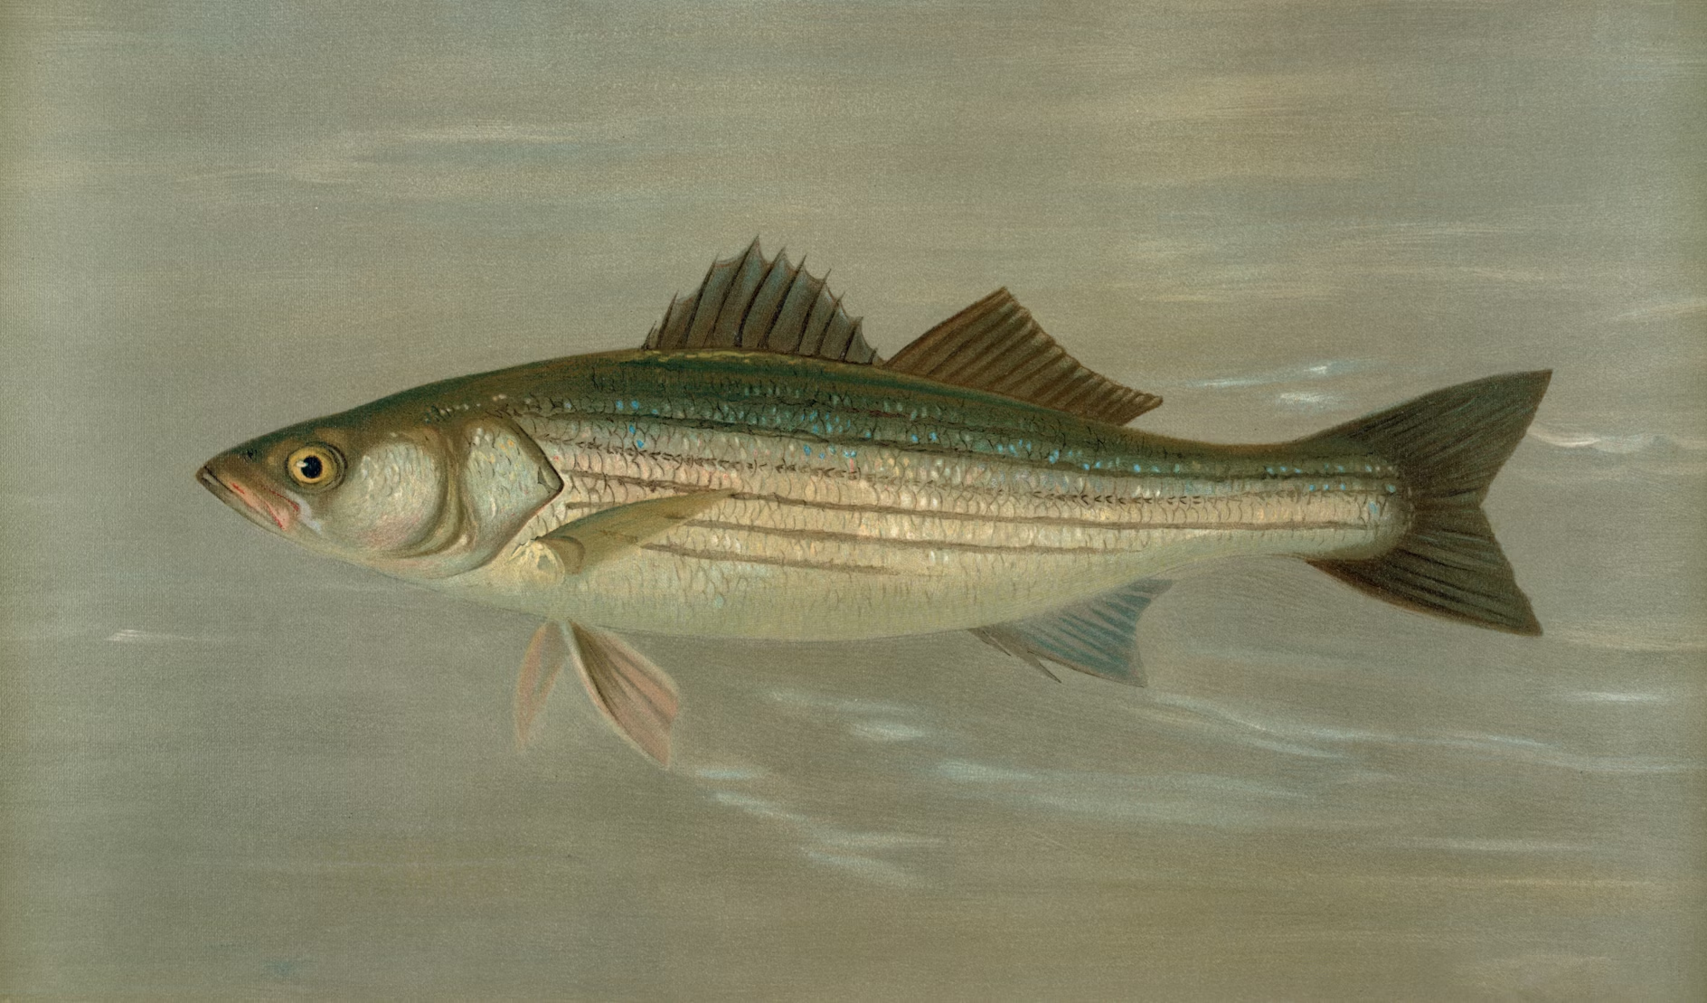
Striped bass
Morone saxatilis
Summertime resident, Staying 2 months longer
Photo: The New York Public Library via Unsplash, Public Domain
Source: Lanagan et al. 2021, Marine Ecology Progress Series
Notes:
And on the flip side, summertime residents are staying in the Bay much longer, in some cases by more than 2 months.

Slide 24
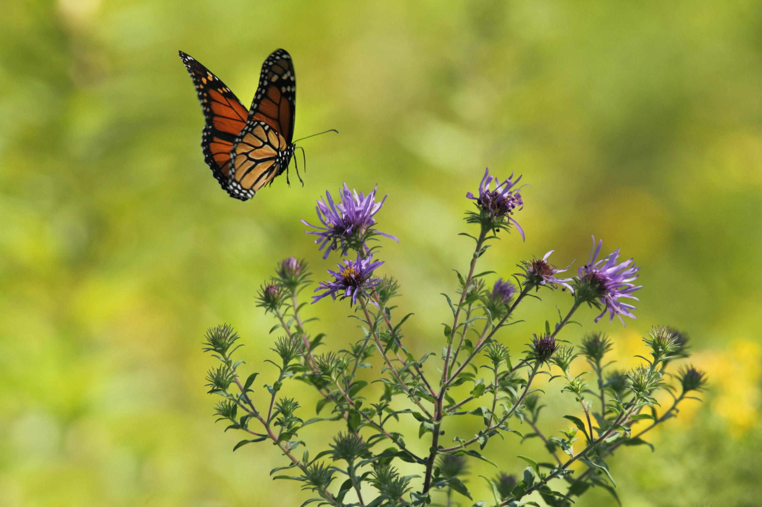
Photo: Gary Bendig via Unsplash, Public Domain
Notes:
These are just a few of the many examples of how species are adapting the timing of their activities to keep pace with rapidly changing conditions. There is a lot we know, but there is also a lot we don't know.

Slide 25
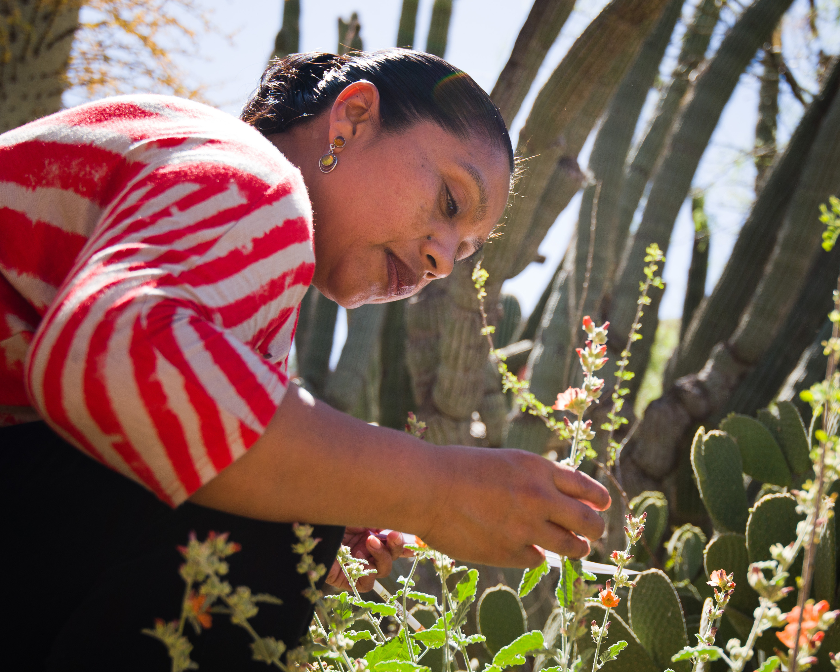
Photo: Brian F Powell
Notes:
We actually need many more observations of when plants and animals are undergoing their seasonal transitions to better understand how climate change is reshaping the timing of life on Earth and consequences for these changes.

Slide 26
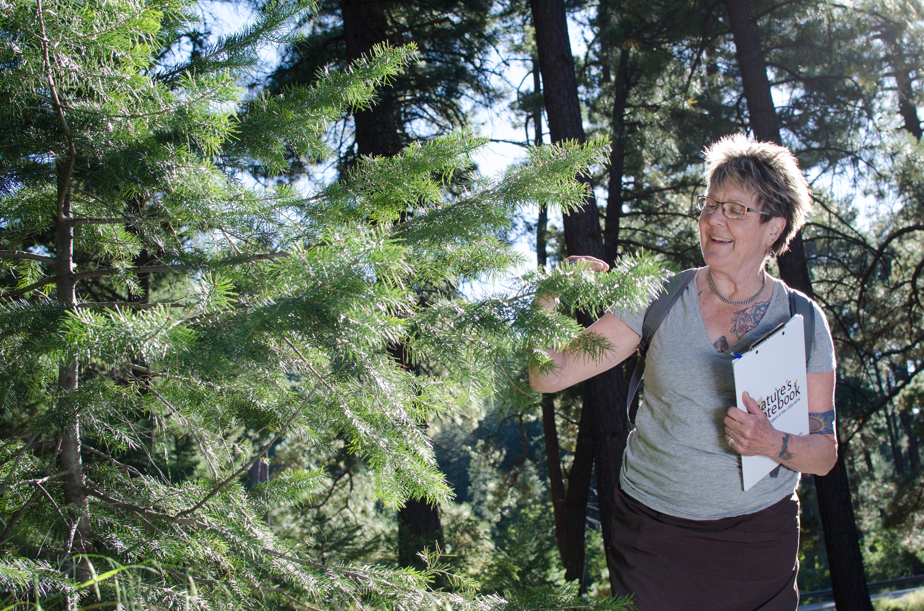
Thank you for your efforts!
Photo: Brian F Powell
Notes:
Your observations to Nature's Notebook are helping scientists to detect trends, predict future changes, and develop strategies to help both wildlife and human communities adapt to our changing climate.
Thank you for your efforts!

Slide 27

Learn more at
Photo: Brian F Powell
Notes:
Learn more at usanpn.org.

Slide 28
References (in order cited)
Battle, KF, Duhon A, Vispo CR, et al. 2022. Citizen science across two centuries reveals phenological change among plant species and functional groups in the Northeastern US. Journal of Ecology doi.org/10.1111/1365-2745.13926
Vitasse Y, Baumgarten F, Zohner CM, et al. 2022. The Great Acceleration of Plant Phenological Shifts. Nature Climate Change 12(4):300–302. doi.org/10.1038/s41558-022-01283-y
Calinger K and Curtis P. 2023. A Century of Climate Warming Results in Growing Season Extension: Delayed Autumn Leaf Phenology in North Central North America. PLOS One 18(3): e0282635. doi.org/10.1371/journal.pone.0282635
Willis CG, Ruhfel B, Primack RB, et al. 2008. Phylogenetic Patterns of Species Loss in Thoreau’s Woods Are Driven by Climate Change. Proceedings of the National Academy of Sciences 105(44): 17029–17033. doi.org/10.1073/pnas.0806446105
Lanagan JA, Puggioni G, Oviatt CA, et al. 2021. Climate alters the migration phenology of coastal marine species. Marine Ecology Progress Series. doi.org/10.3354/meps13612
This video was created September 2025

