Slide 1
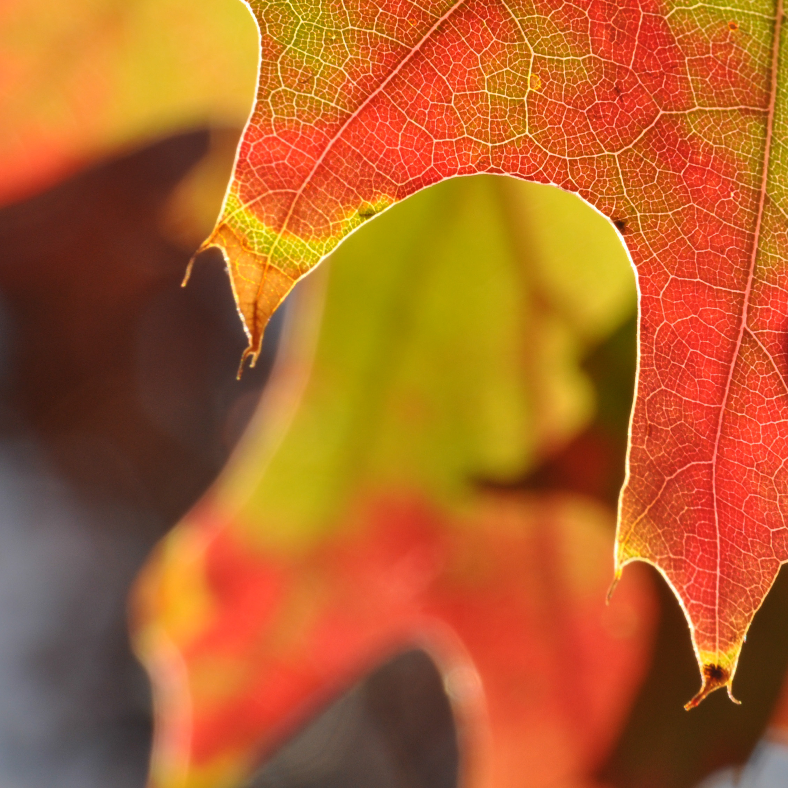

Introduction to Phenology
Nature’s Notebook video series

Slide 2
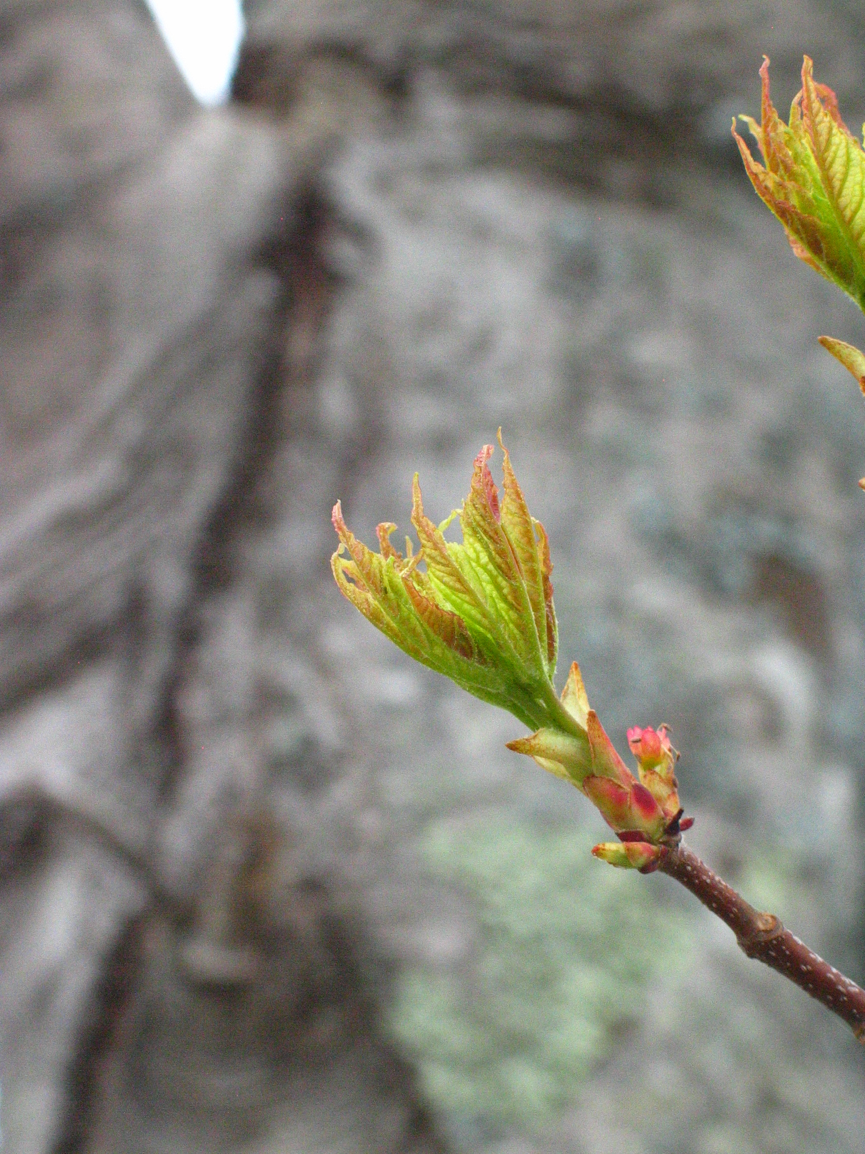


Photo: Ellen G Denny, CC BY-NC-SA 4.0
Notes:
such as leafing and flowering

Slide 3
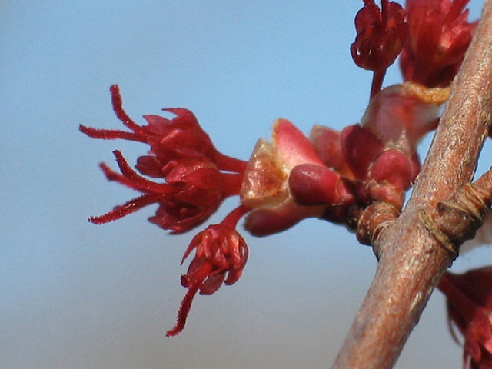
Photo: Ellen G Denny, CC BY-NC-SA 4.0

Slide 4
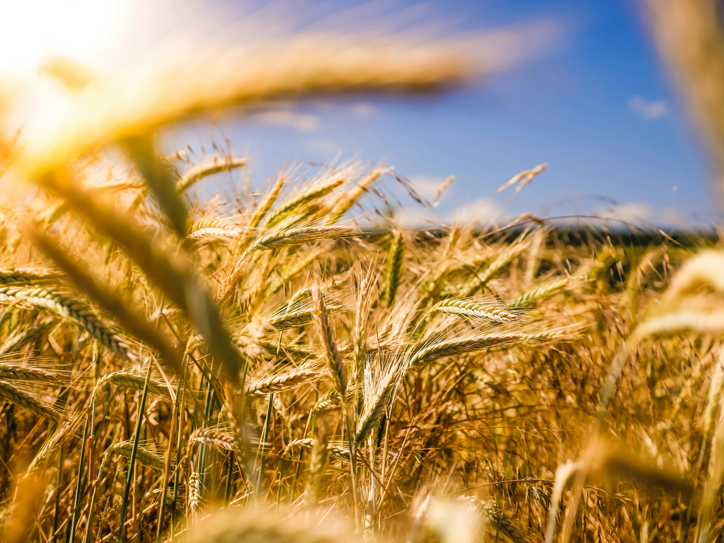
Photo: Raphael Rychetsky via Unsplash, Public Domain
Notes:
maturation of agricultural plants

Slide 5
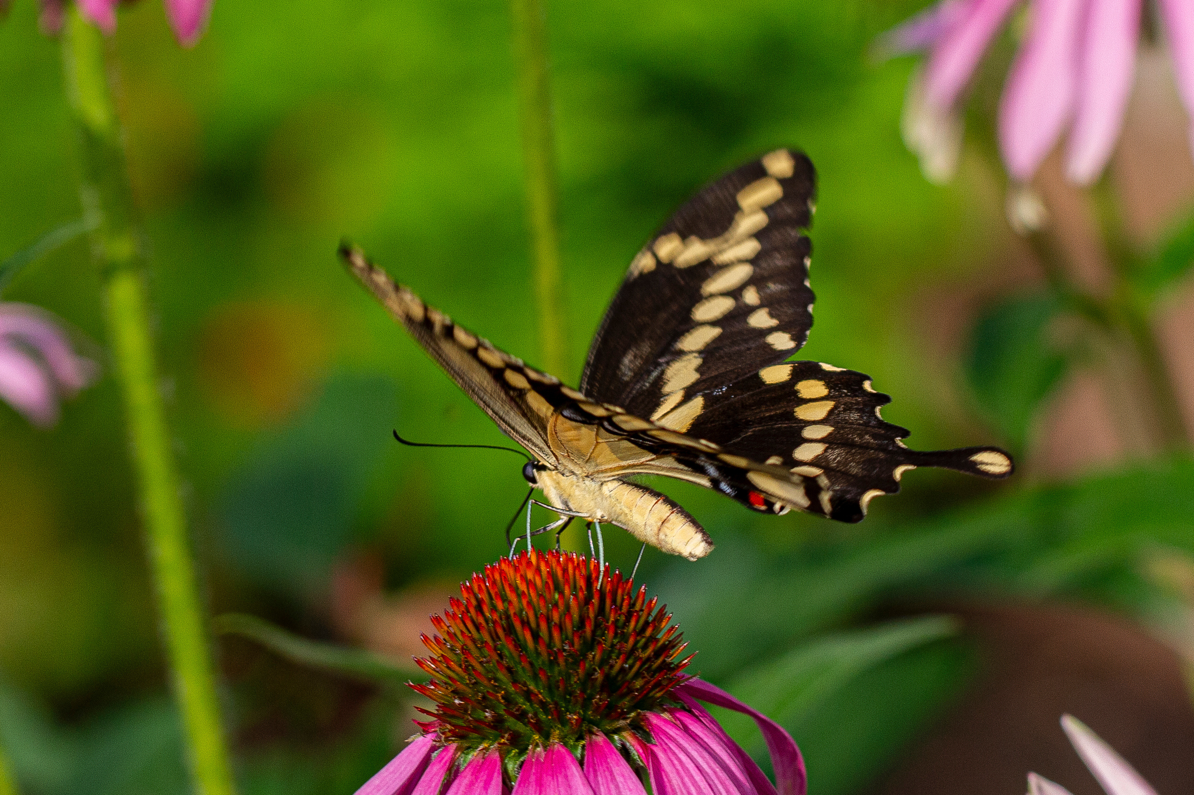
Photo: Dulcey Lima, The Morton Arboretum, CC BY-NC-SA 4.0
Notes:
emergence of insects, and migration of birds.

Slide 6
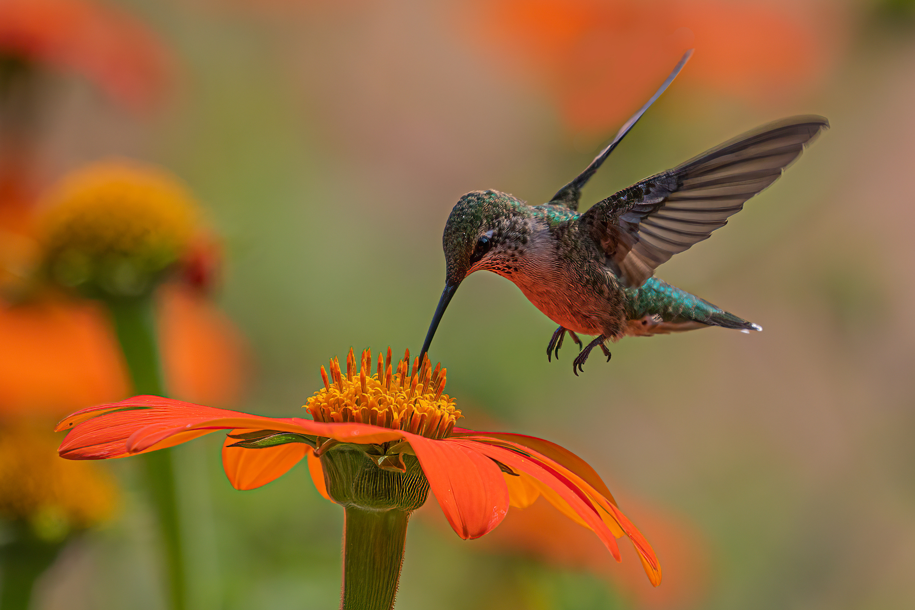
Photo: Dulcey Lima, The Morton Arboretum, CC BY-NC-SA 4.0

Slide 7
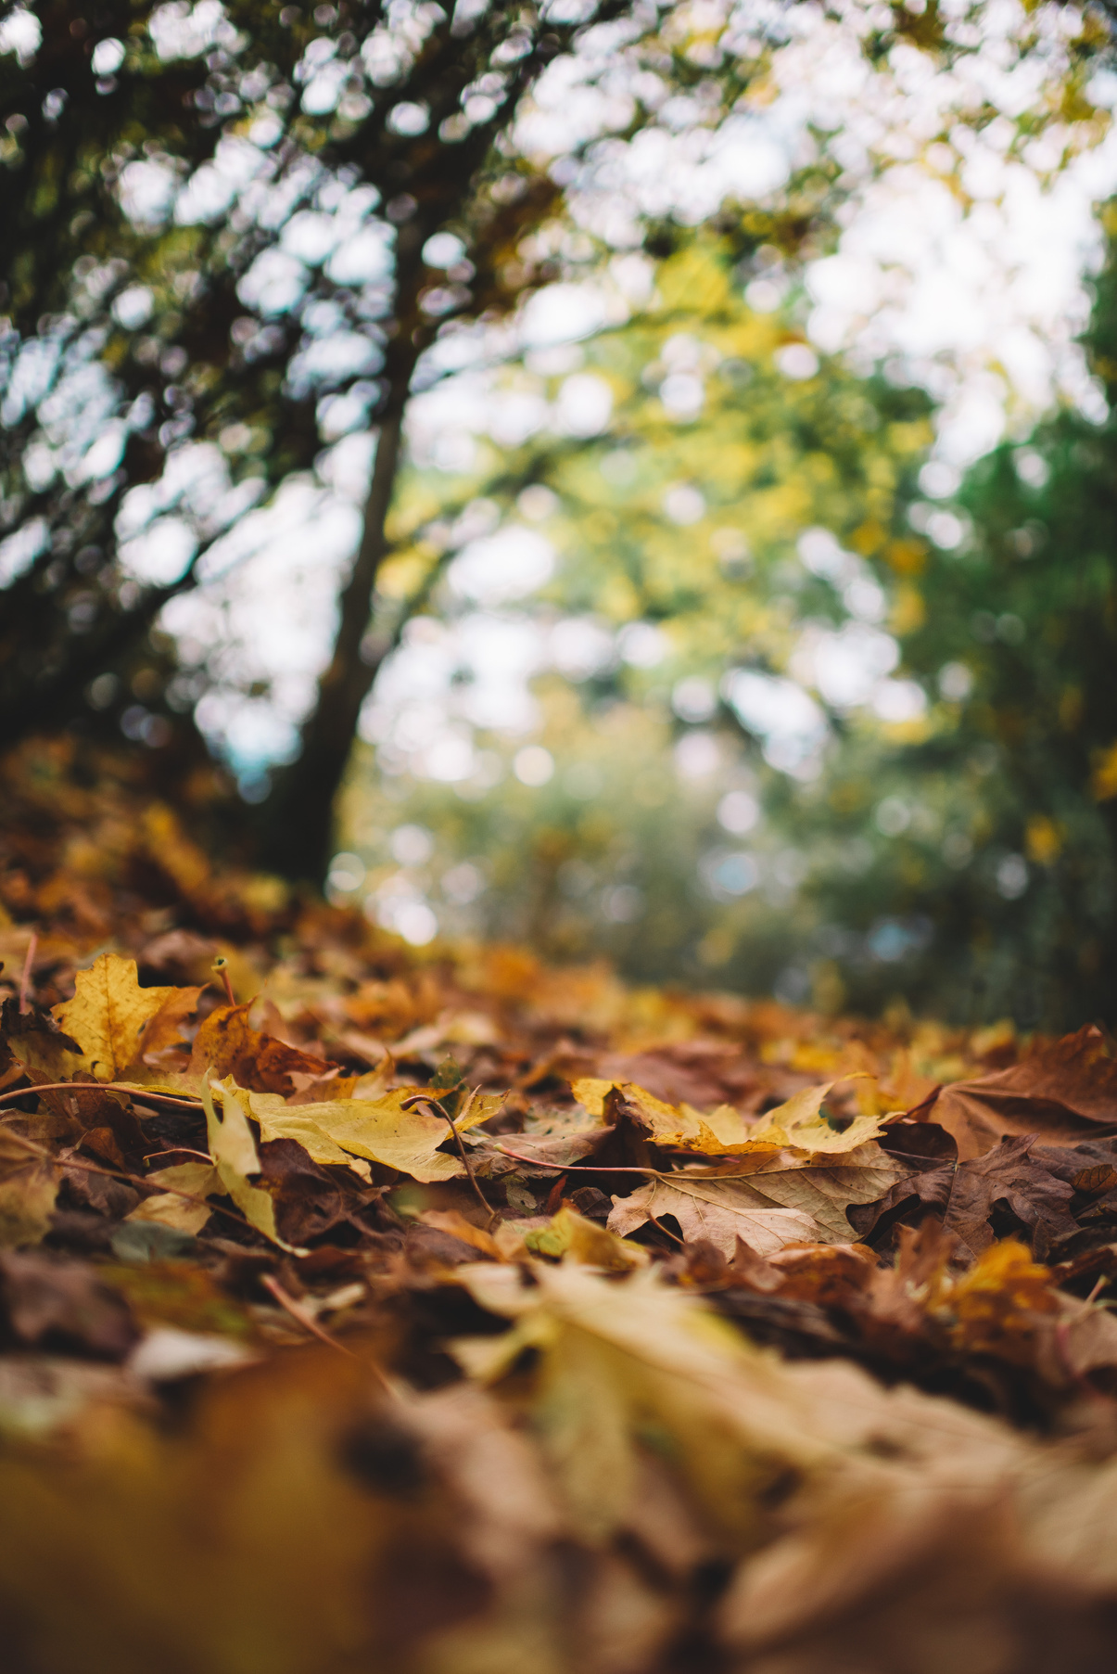
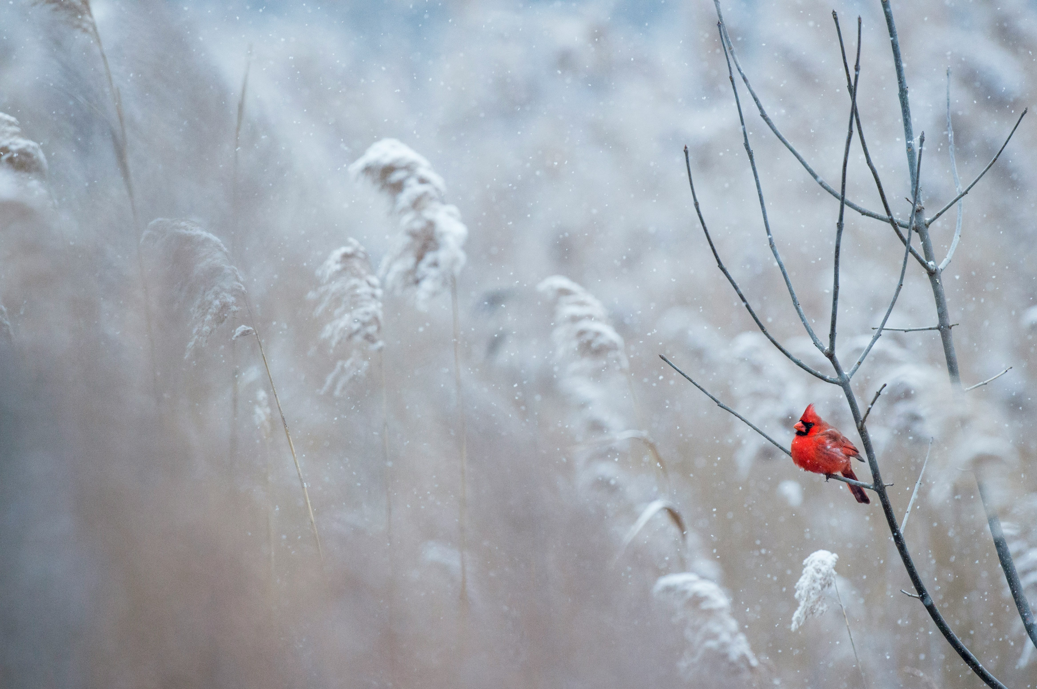
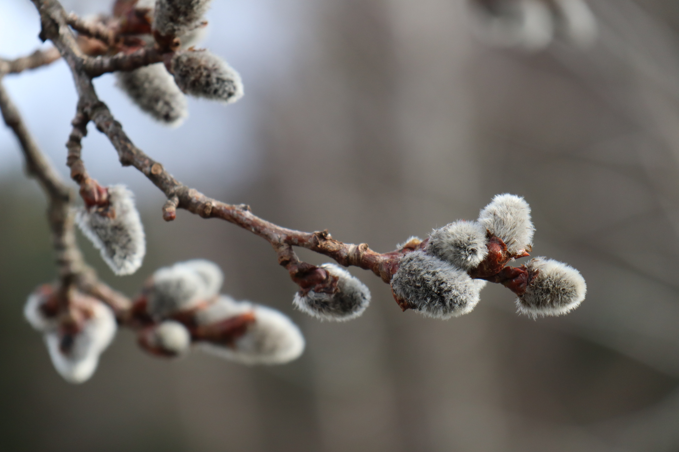
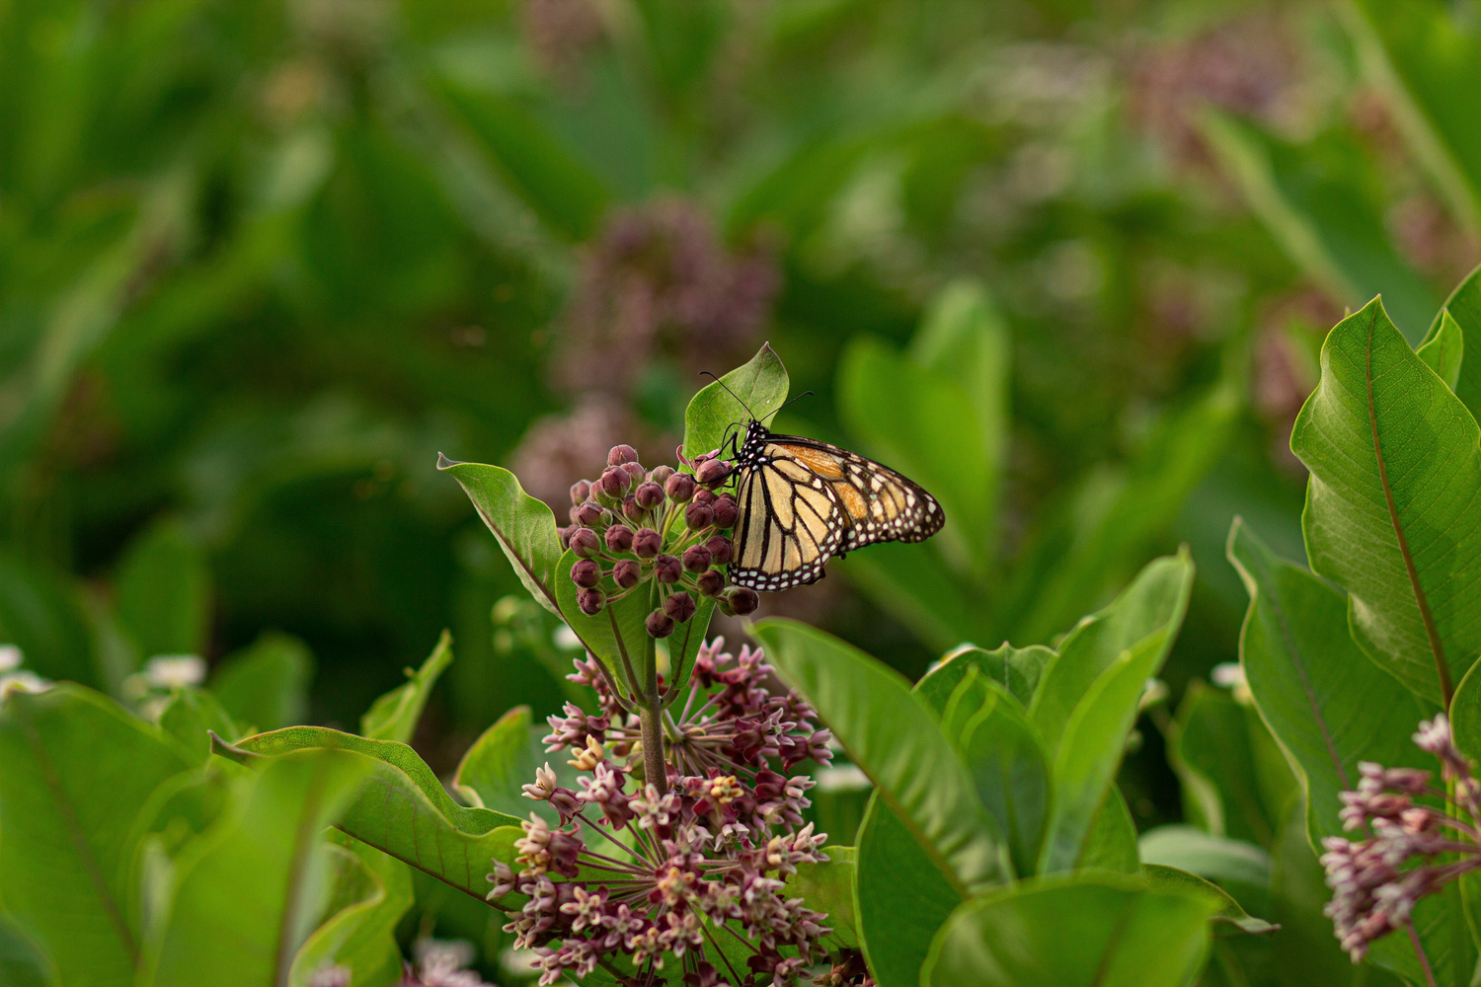
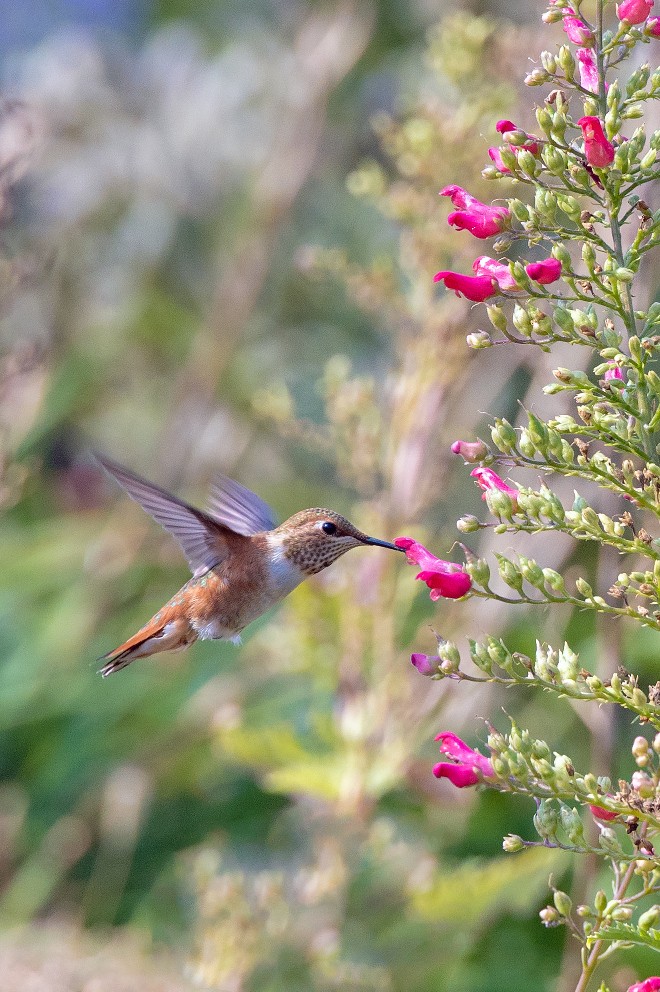
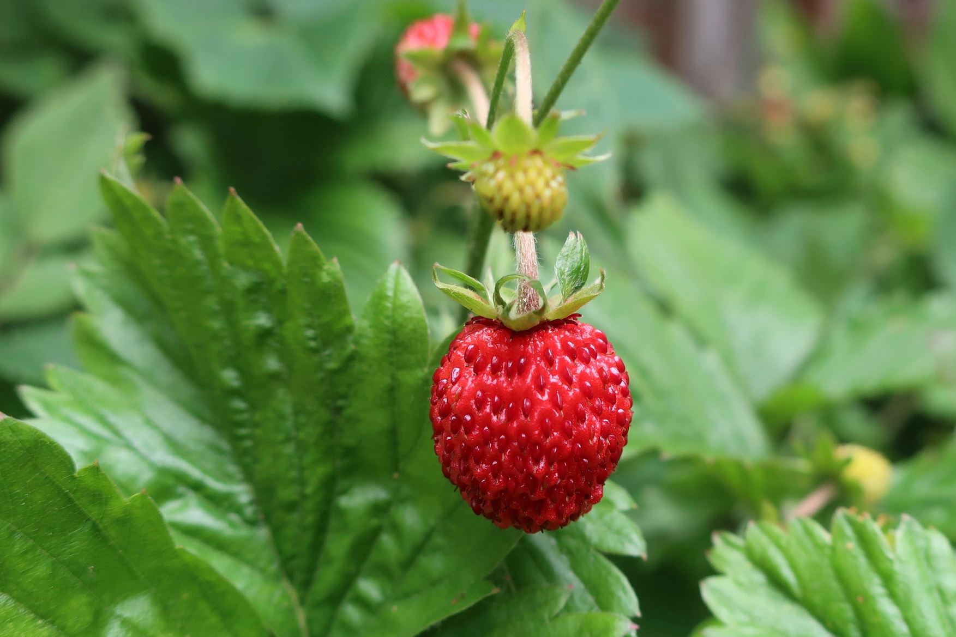
Photos via Unsplash, Public Domain
Notes:
Simply put, phenology is nature’s calendar.

Slide 8
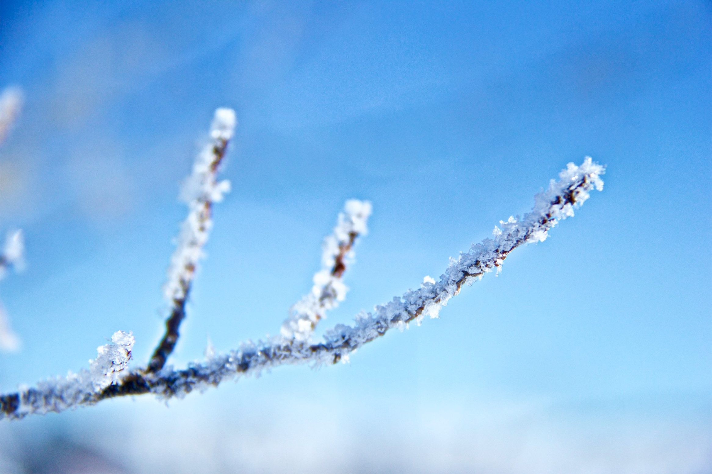
Photo: Bryson Hammer via Unsplash, Public Domain
Notes:
The timing of plant and animal seasonal activities is influenced by weather, climate, and other abiotic factors.

Slide 9
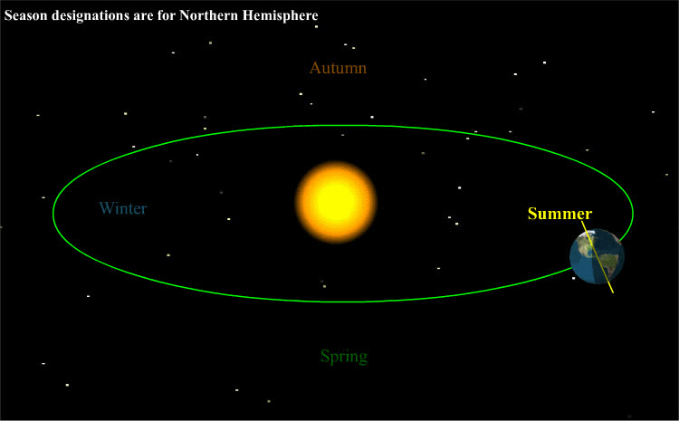

Credit: Tfr000 via Wikimedia Commons, CC BY-SA 3.0
Notes:
One of these factors is very predictable: the Earth is tilted at 23 and a half degrees, and as it rotates around the sun, this tilt creates our seasons. In the Northern Hemisphere, when that part of Earth is tilted toward the sun, that is our summer, where we experience longer days and generally warmer weather. When the Northern Hemisphere is tilted away from the sun that is when we have our shorter, cooler days in winter. This is consistent from one year to the next.

Slide 10
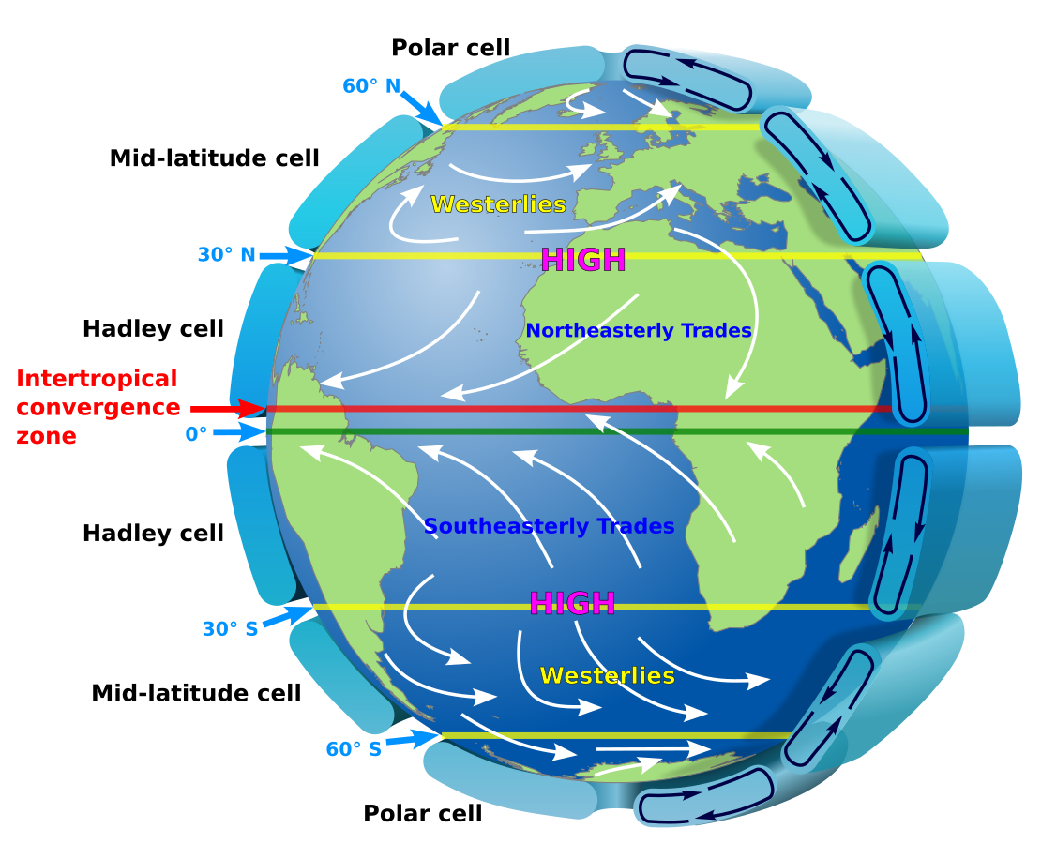
Credit: Kaidor, CC BY-SA 3.0
Notes:
Things get less consistent when we consider that Earth is covered in the layer of gases that makes up our atmosphere. As Earth spins, it creates complicated circulation patterns such as the jet stream, a high-altitude, fast-moving current of air that generally circles the globe from west to east. Together with ocean circulation, these large scale systems redistribute thermal energy across the globe.

Slide 11
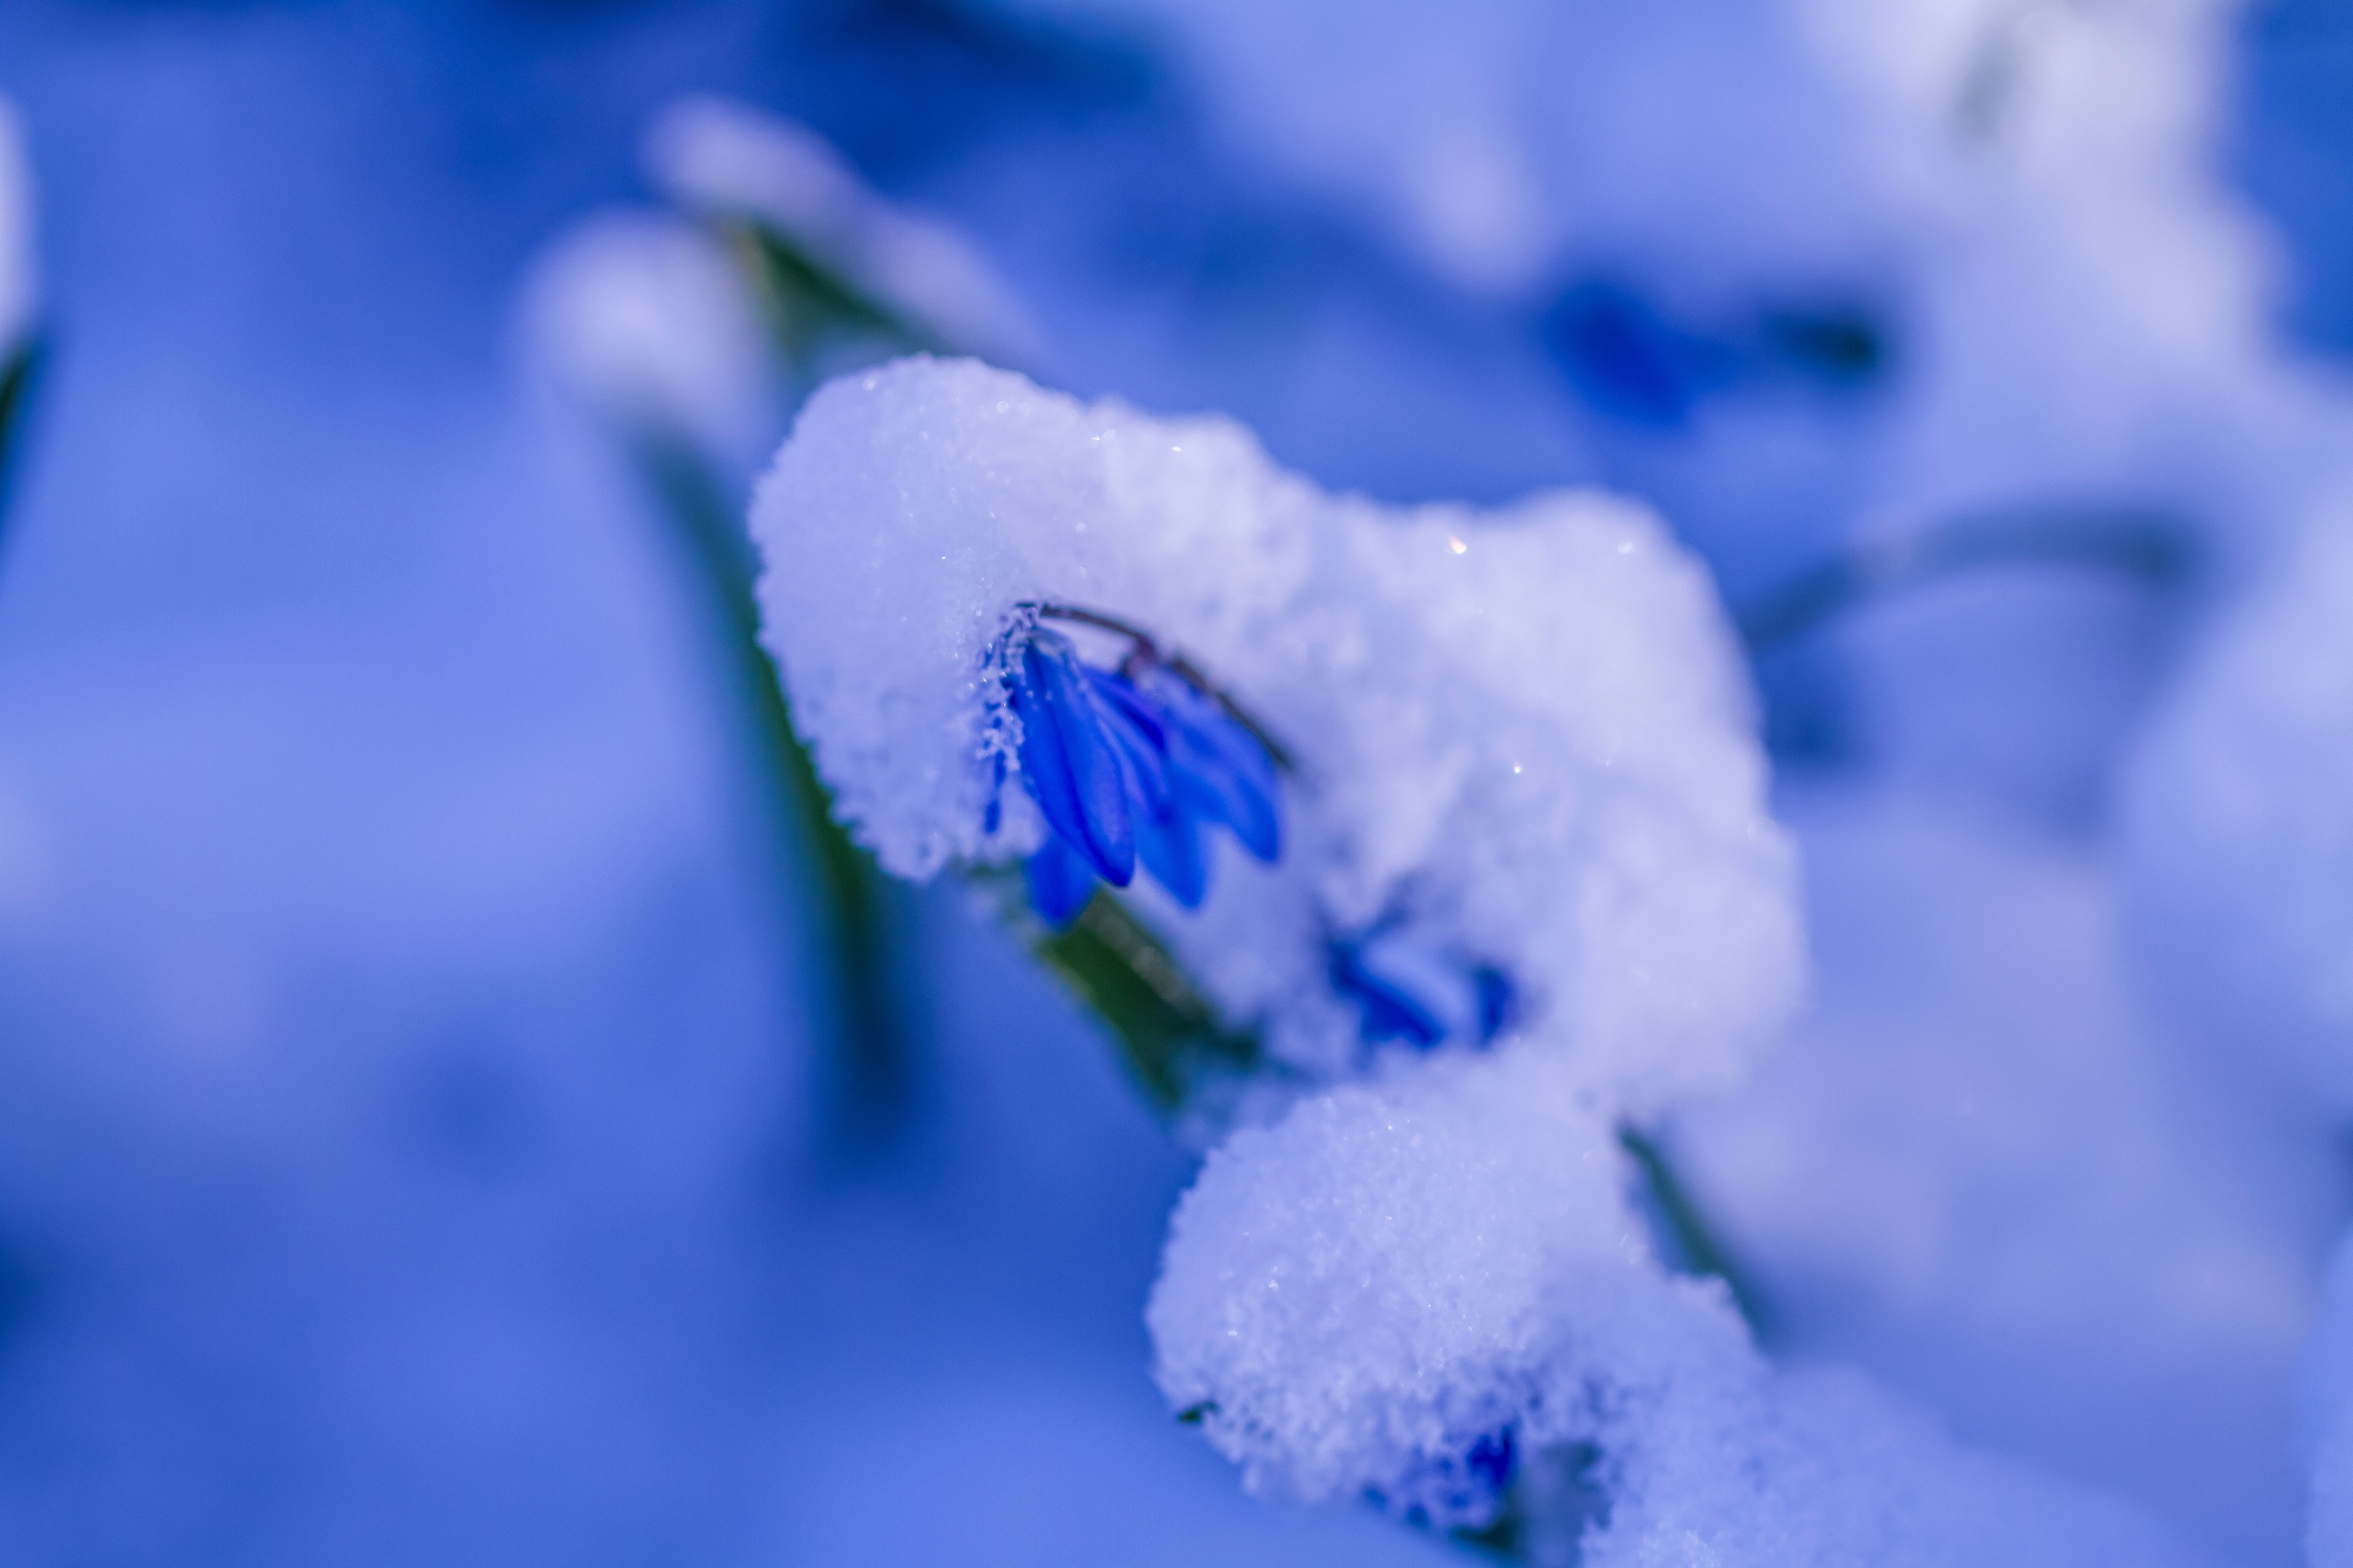
Photo: Dulcey Lima, The Morton Arboretum, CC BY-NC-SA 4.0
Notes:
At a smaller scale, weather systems have a large degree of variability, introducing a more inconsistent influence on plant and animal activity.

Slide 12
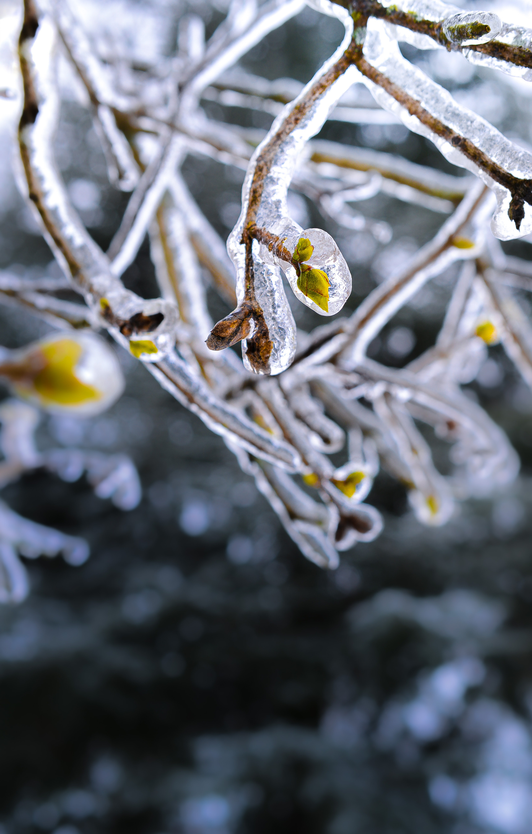
Photo: Kiwihug via Unsplash, Public Domain
Notes:
A colder spring may delay growth of plants

Slide 13
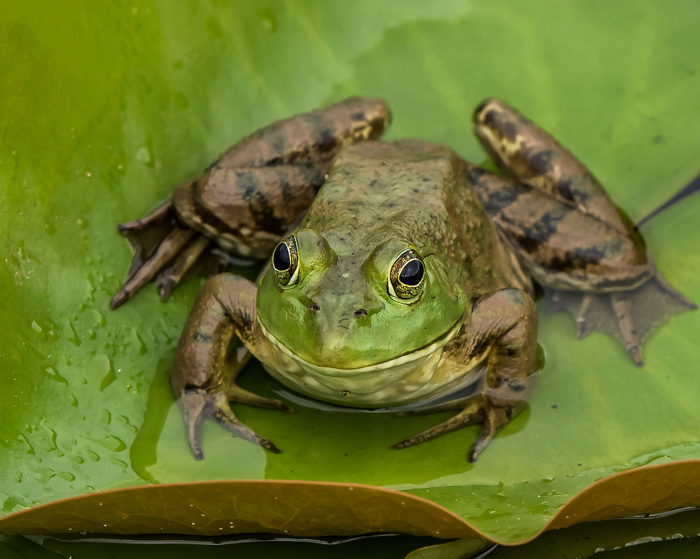
Photo: Dulcey Lima, The Morton Arboretum, CC BY-NC-SA 4.0
Notes:
A wetter summer may extend the activity of frogs or insects.

Slide 14
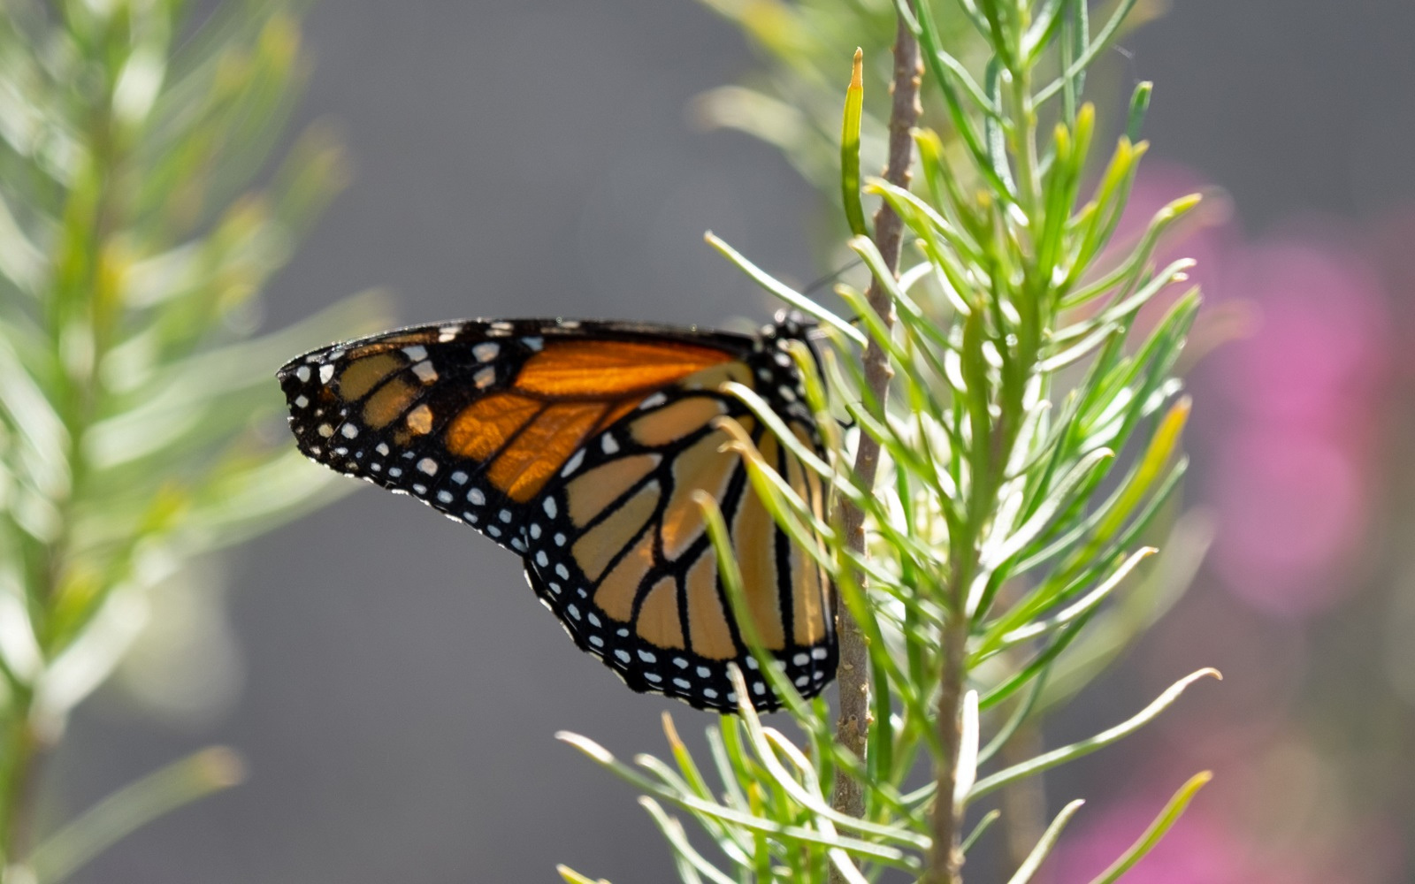
Photo: Brian F Powell
Notes:
Phenology is tied to nearly all aspects of the environment

Slide 15
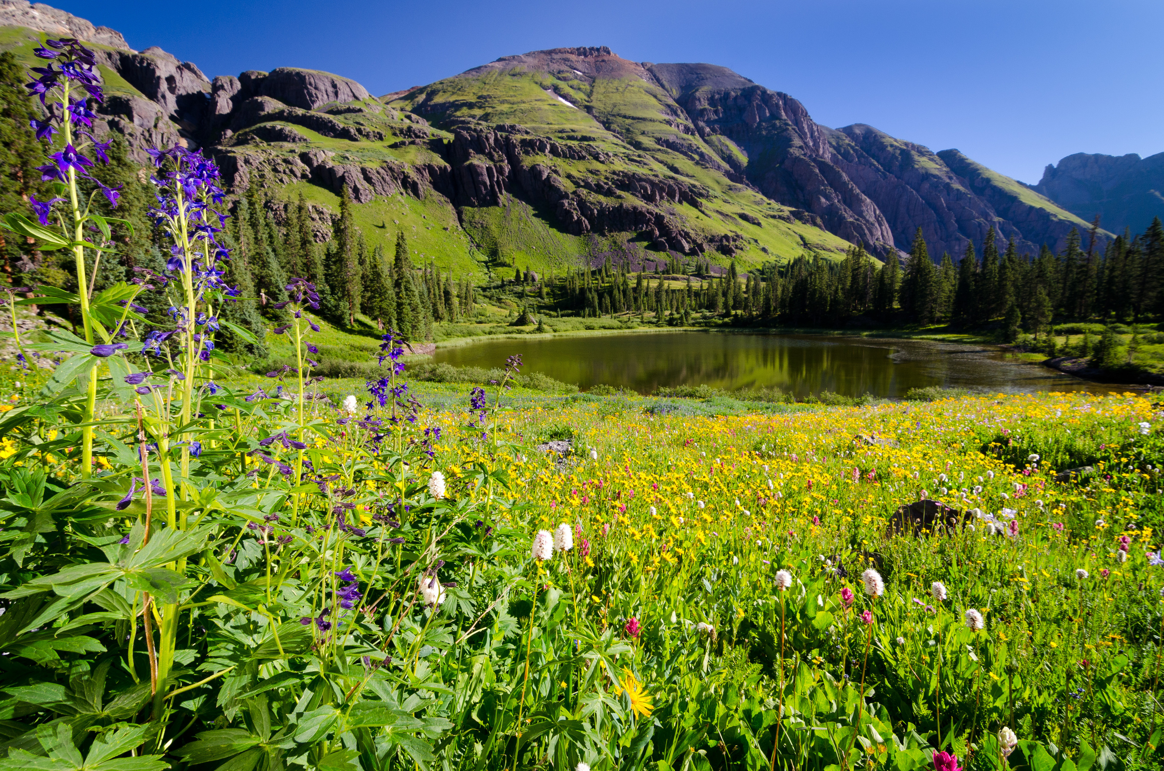
Photo: Brian F Powell
Notes:
Their functions in food webs, and their seasonal behavior

Slide 16
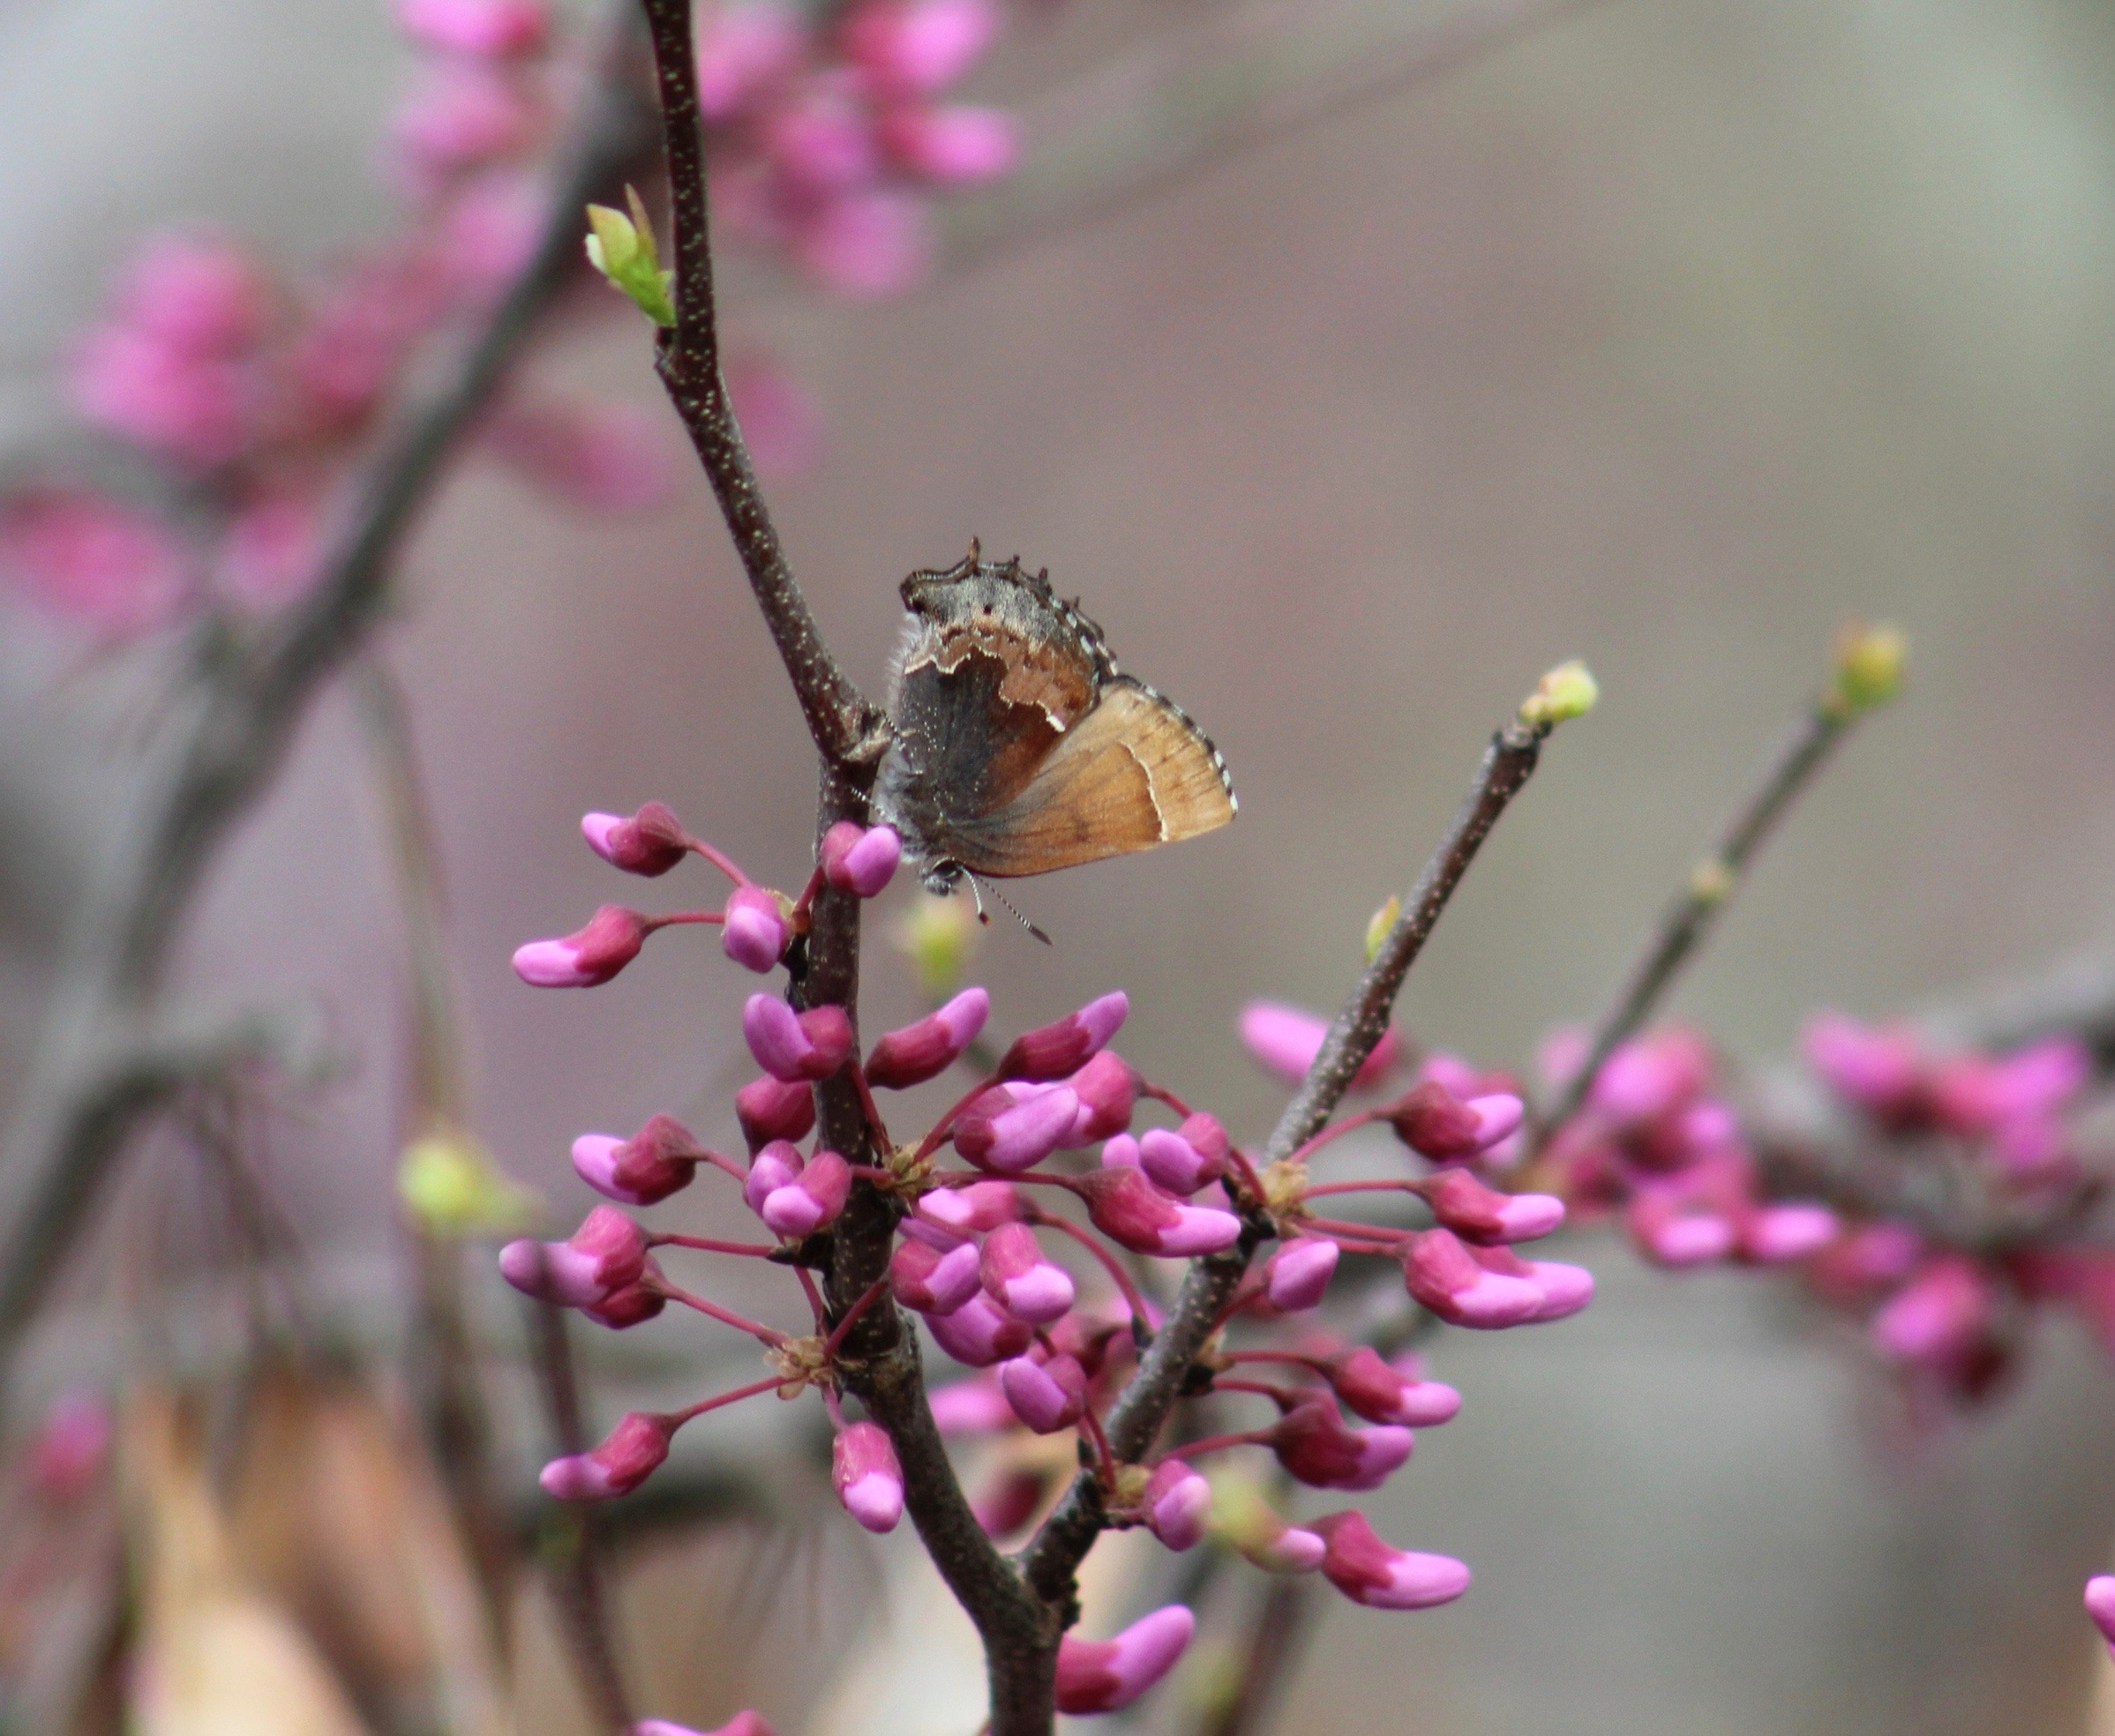
Photo: David Gwin
Notes:
Their interactions with one another

Slide 17
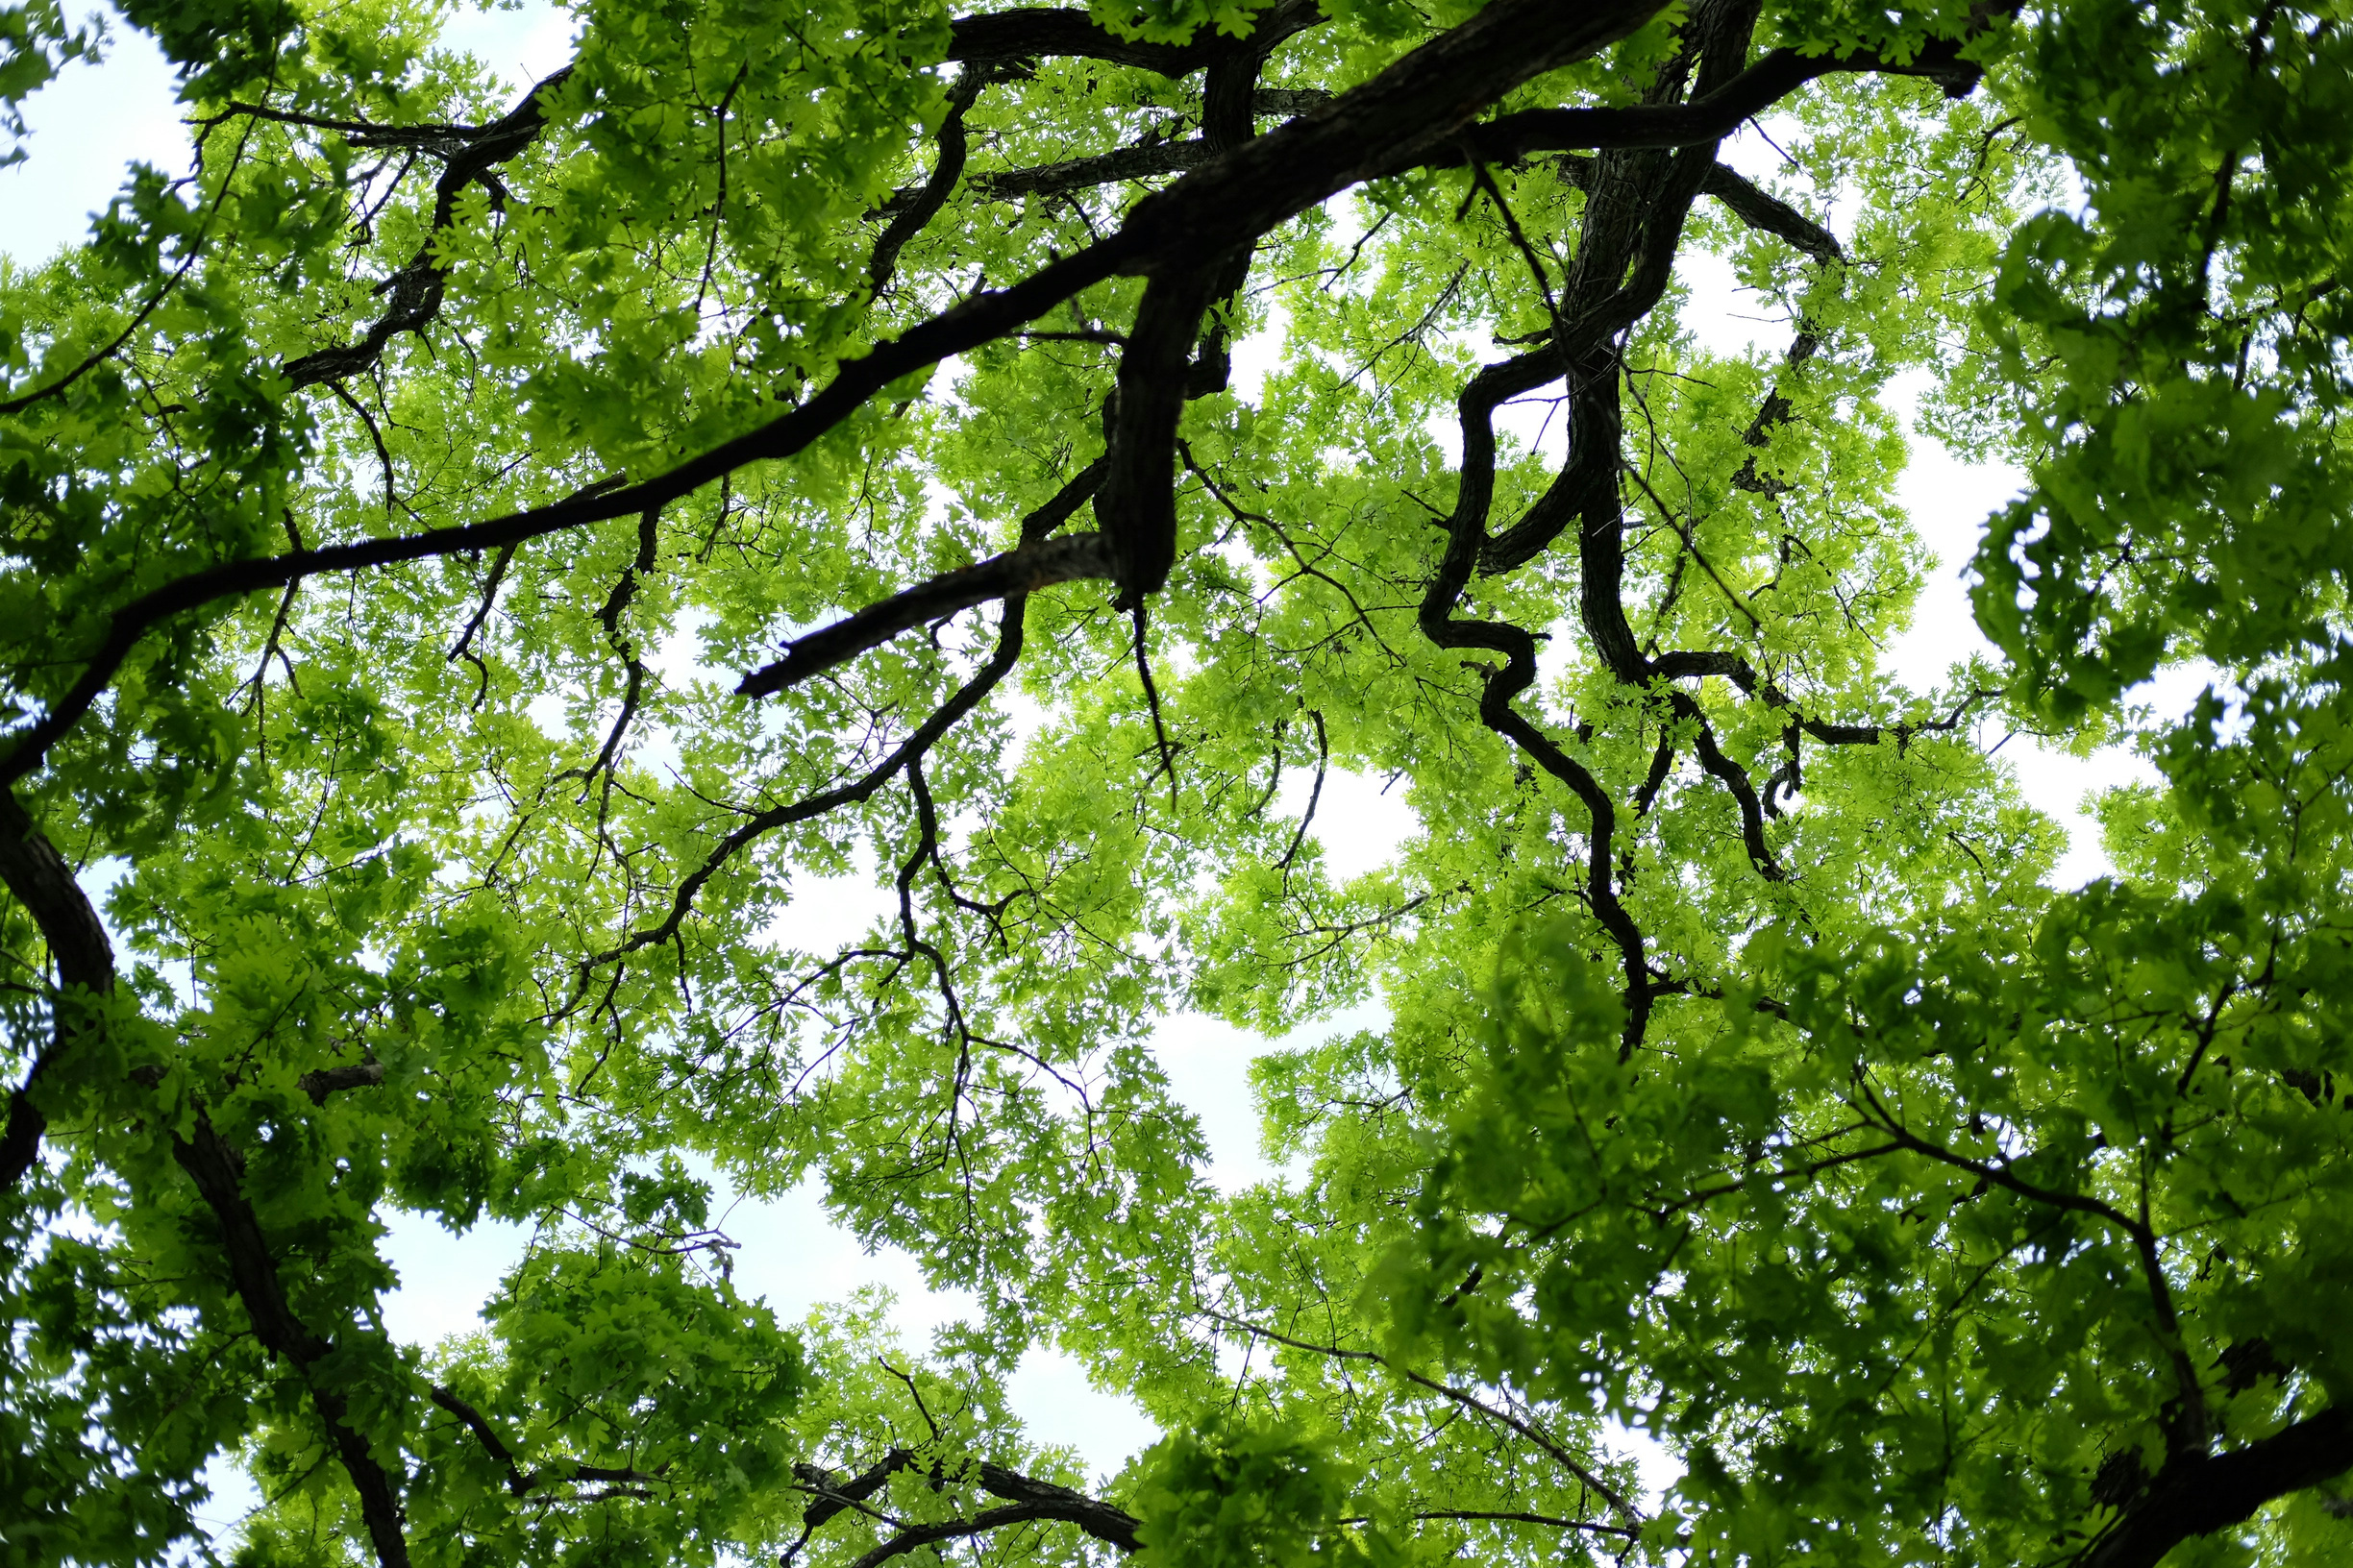
Photo: John Reed via Unsplash, Public Domain
Notes:
And global-scale cycles of carbon, water, and other chemical elements.

Slide 18
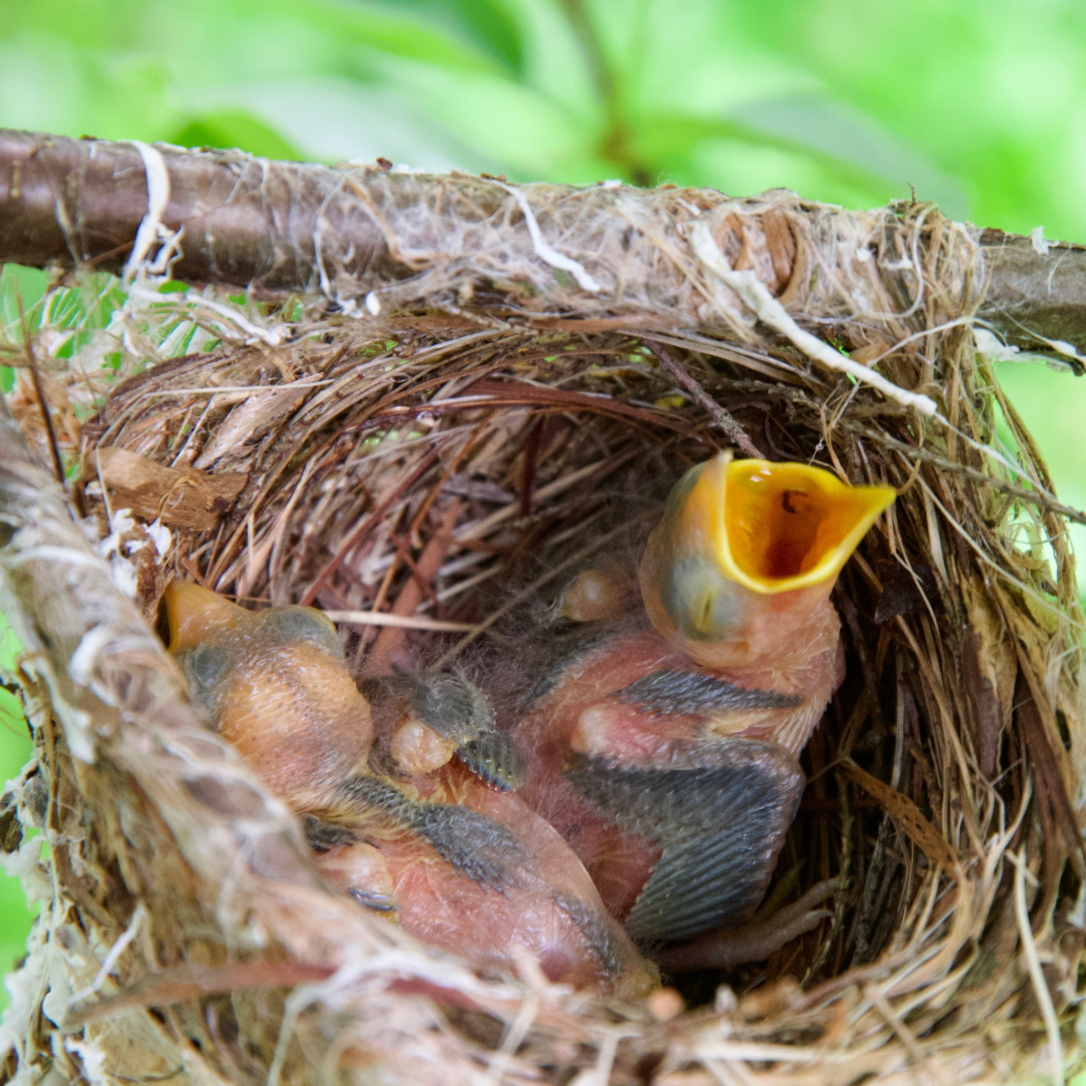
Photo: Michael Nerrie via iNaturalist, CC BY 4.0
Notes:
Many birds time their nesting so that eggs hatch when insects are available to feed nestlings.

Slide 19
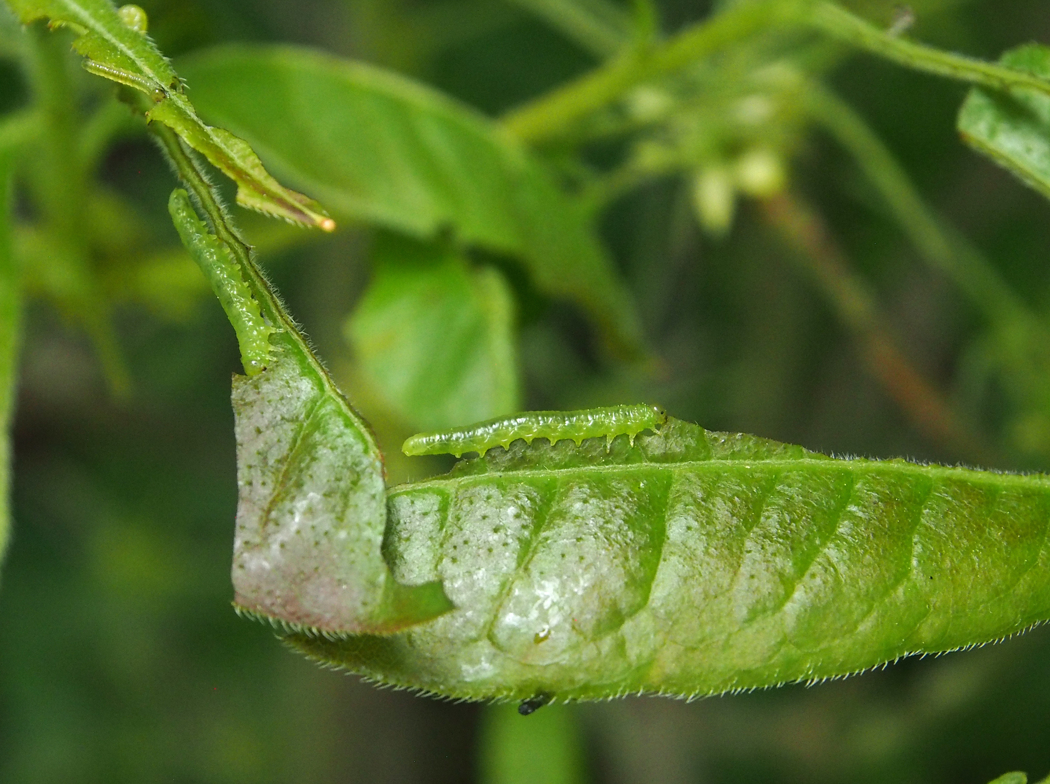
Photo: Michael G. Shepard via iNaturalist, CC BY-NC 4.0
Notes:
In turn, insect emergence is often synchronized with leafing out in their host plants.

Slide 20

Photo via Adobe Stock Images
Notes:
For many people, allergy season starts when particular plants bloom—earlier flowering means earlier allergies.

Slide 21
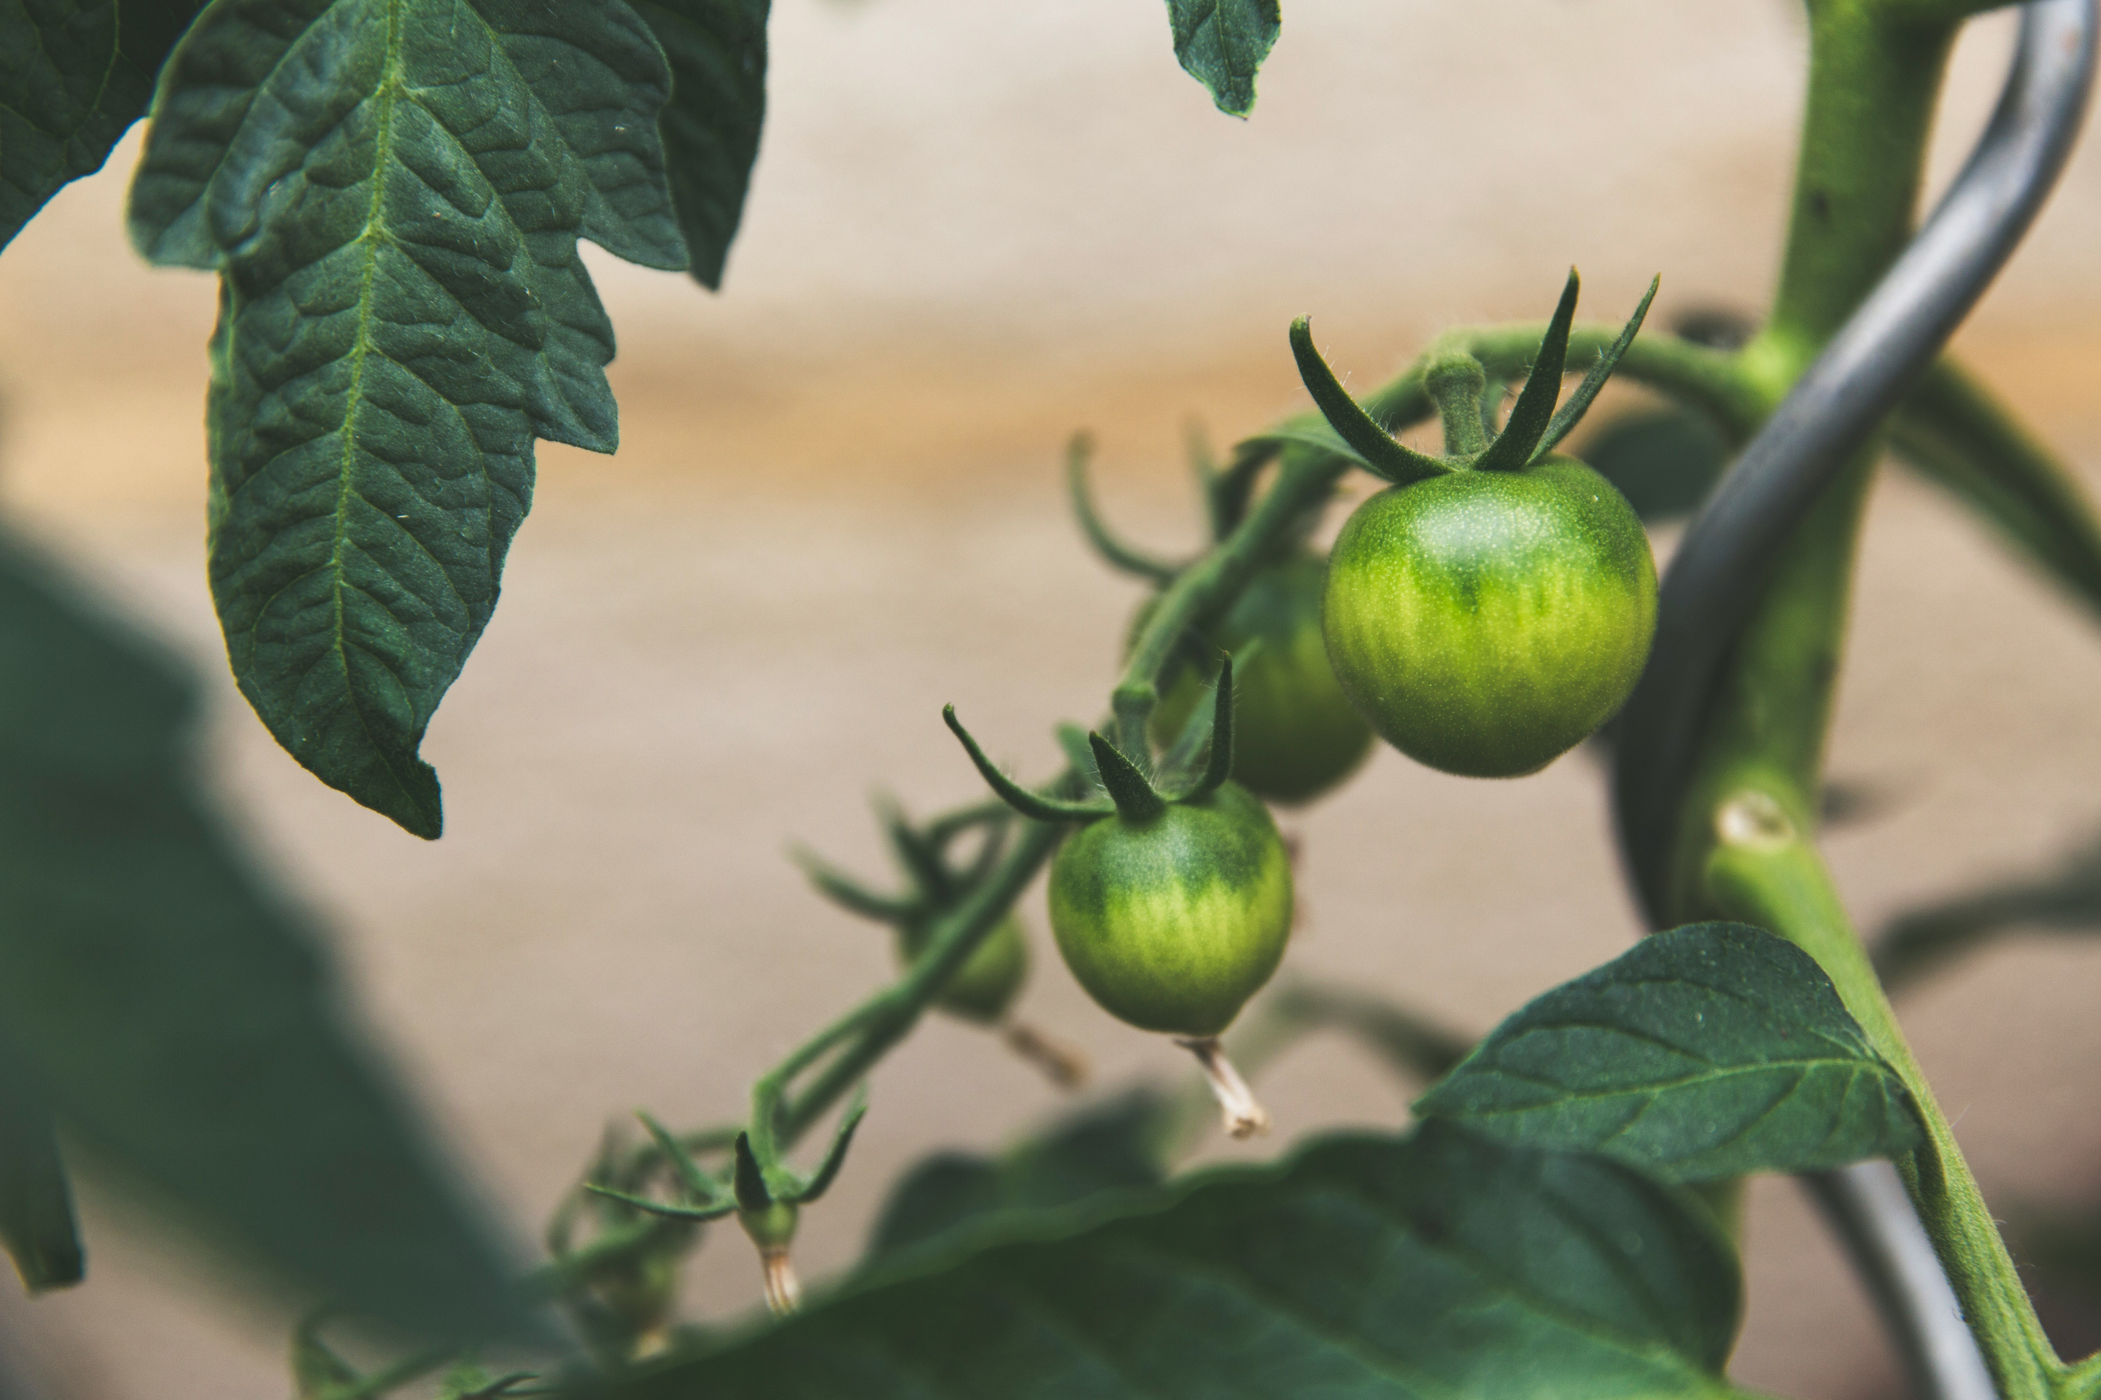
Photo: Markus Spiske via Unsplash, Public Domain
Notes:
Farmers and gardeners need to know when to plant to avoid frosts, and they need to know the schedule of plant and insect development to decide when to apply fertilizers and pesticides.

Slide 22
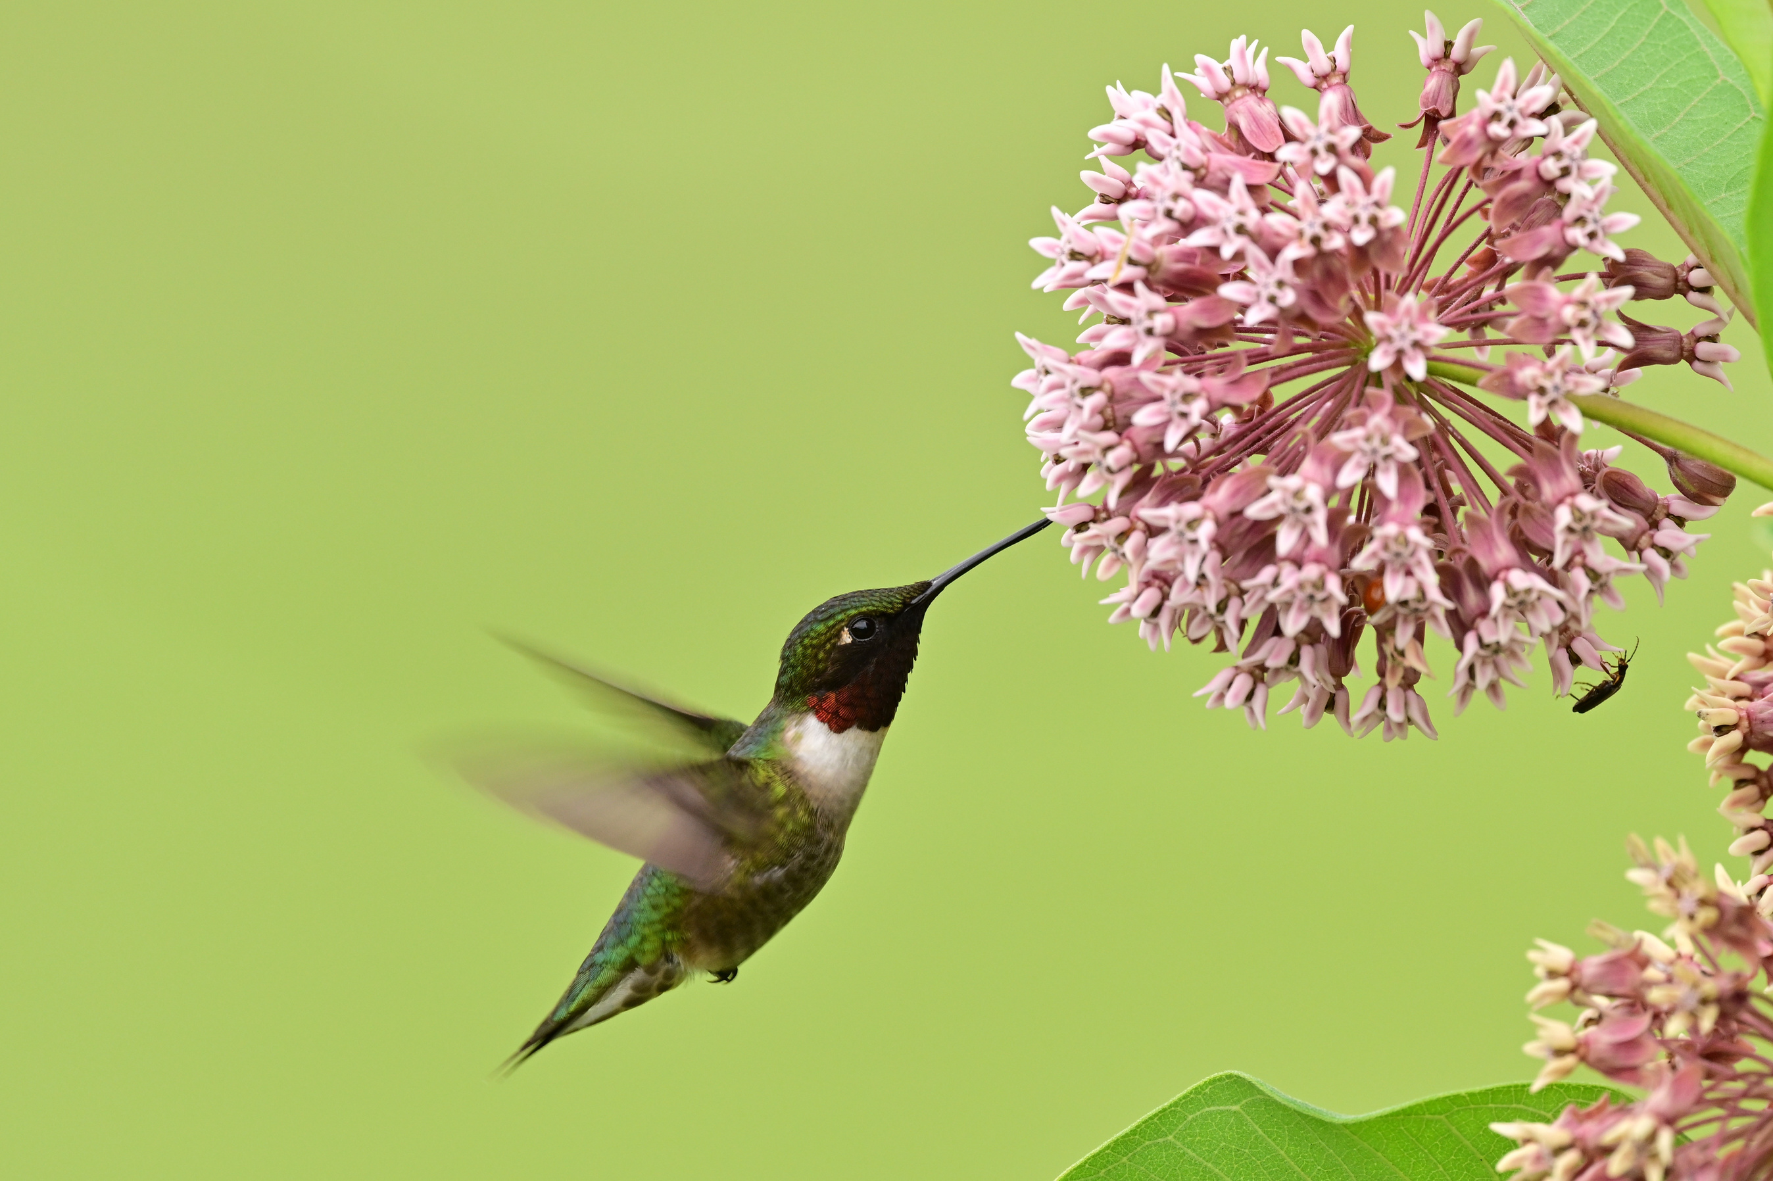
Photo: Kent Jager, CC BY-NC-SA 4.0
Notes:
Changes in phenological events like flowering and bird migrations are among the most sensitive biological responses to climate change.

Slide 23
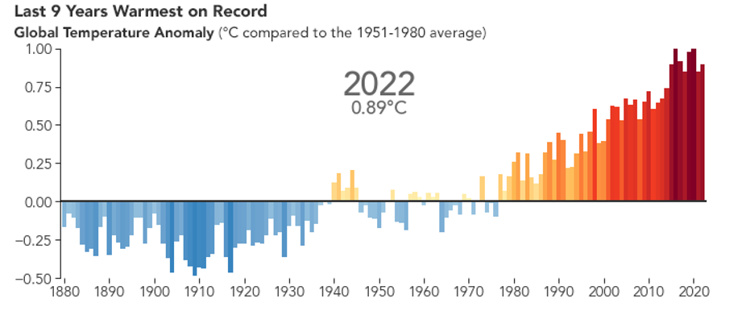
Credit: earthobservatory.nasa.gov/world-of-change/global-temperatures
Notes:
As global temperatures increase, many spring events are occurring earlier—and fall events are happening later—than they did in the past.

Slide 24
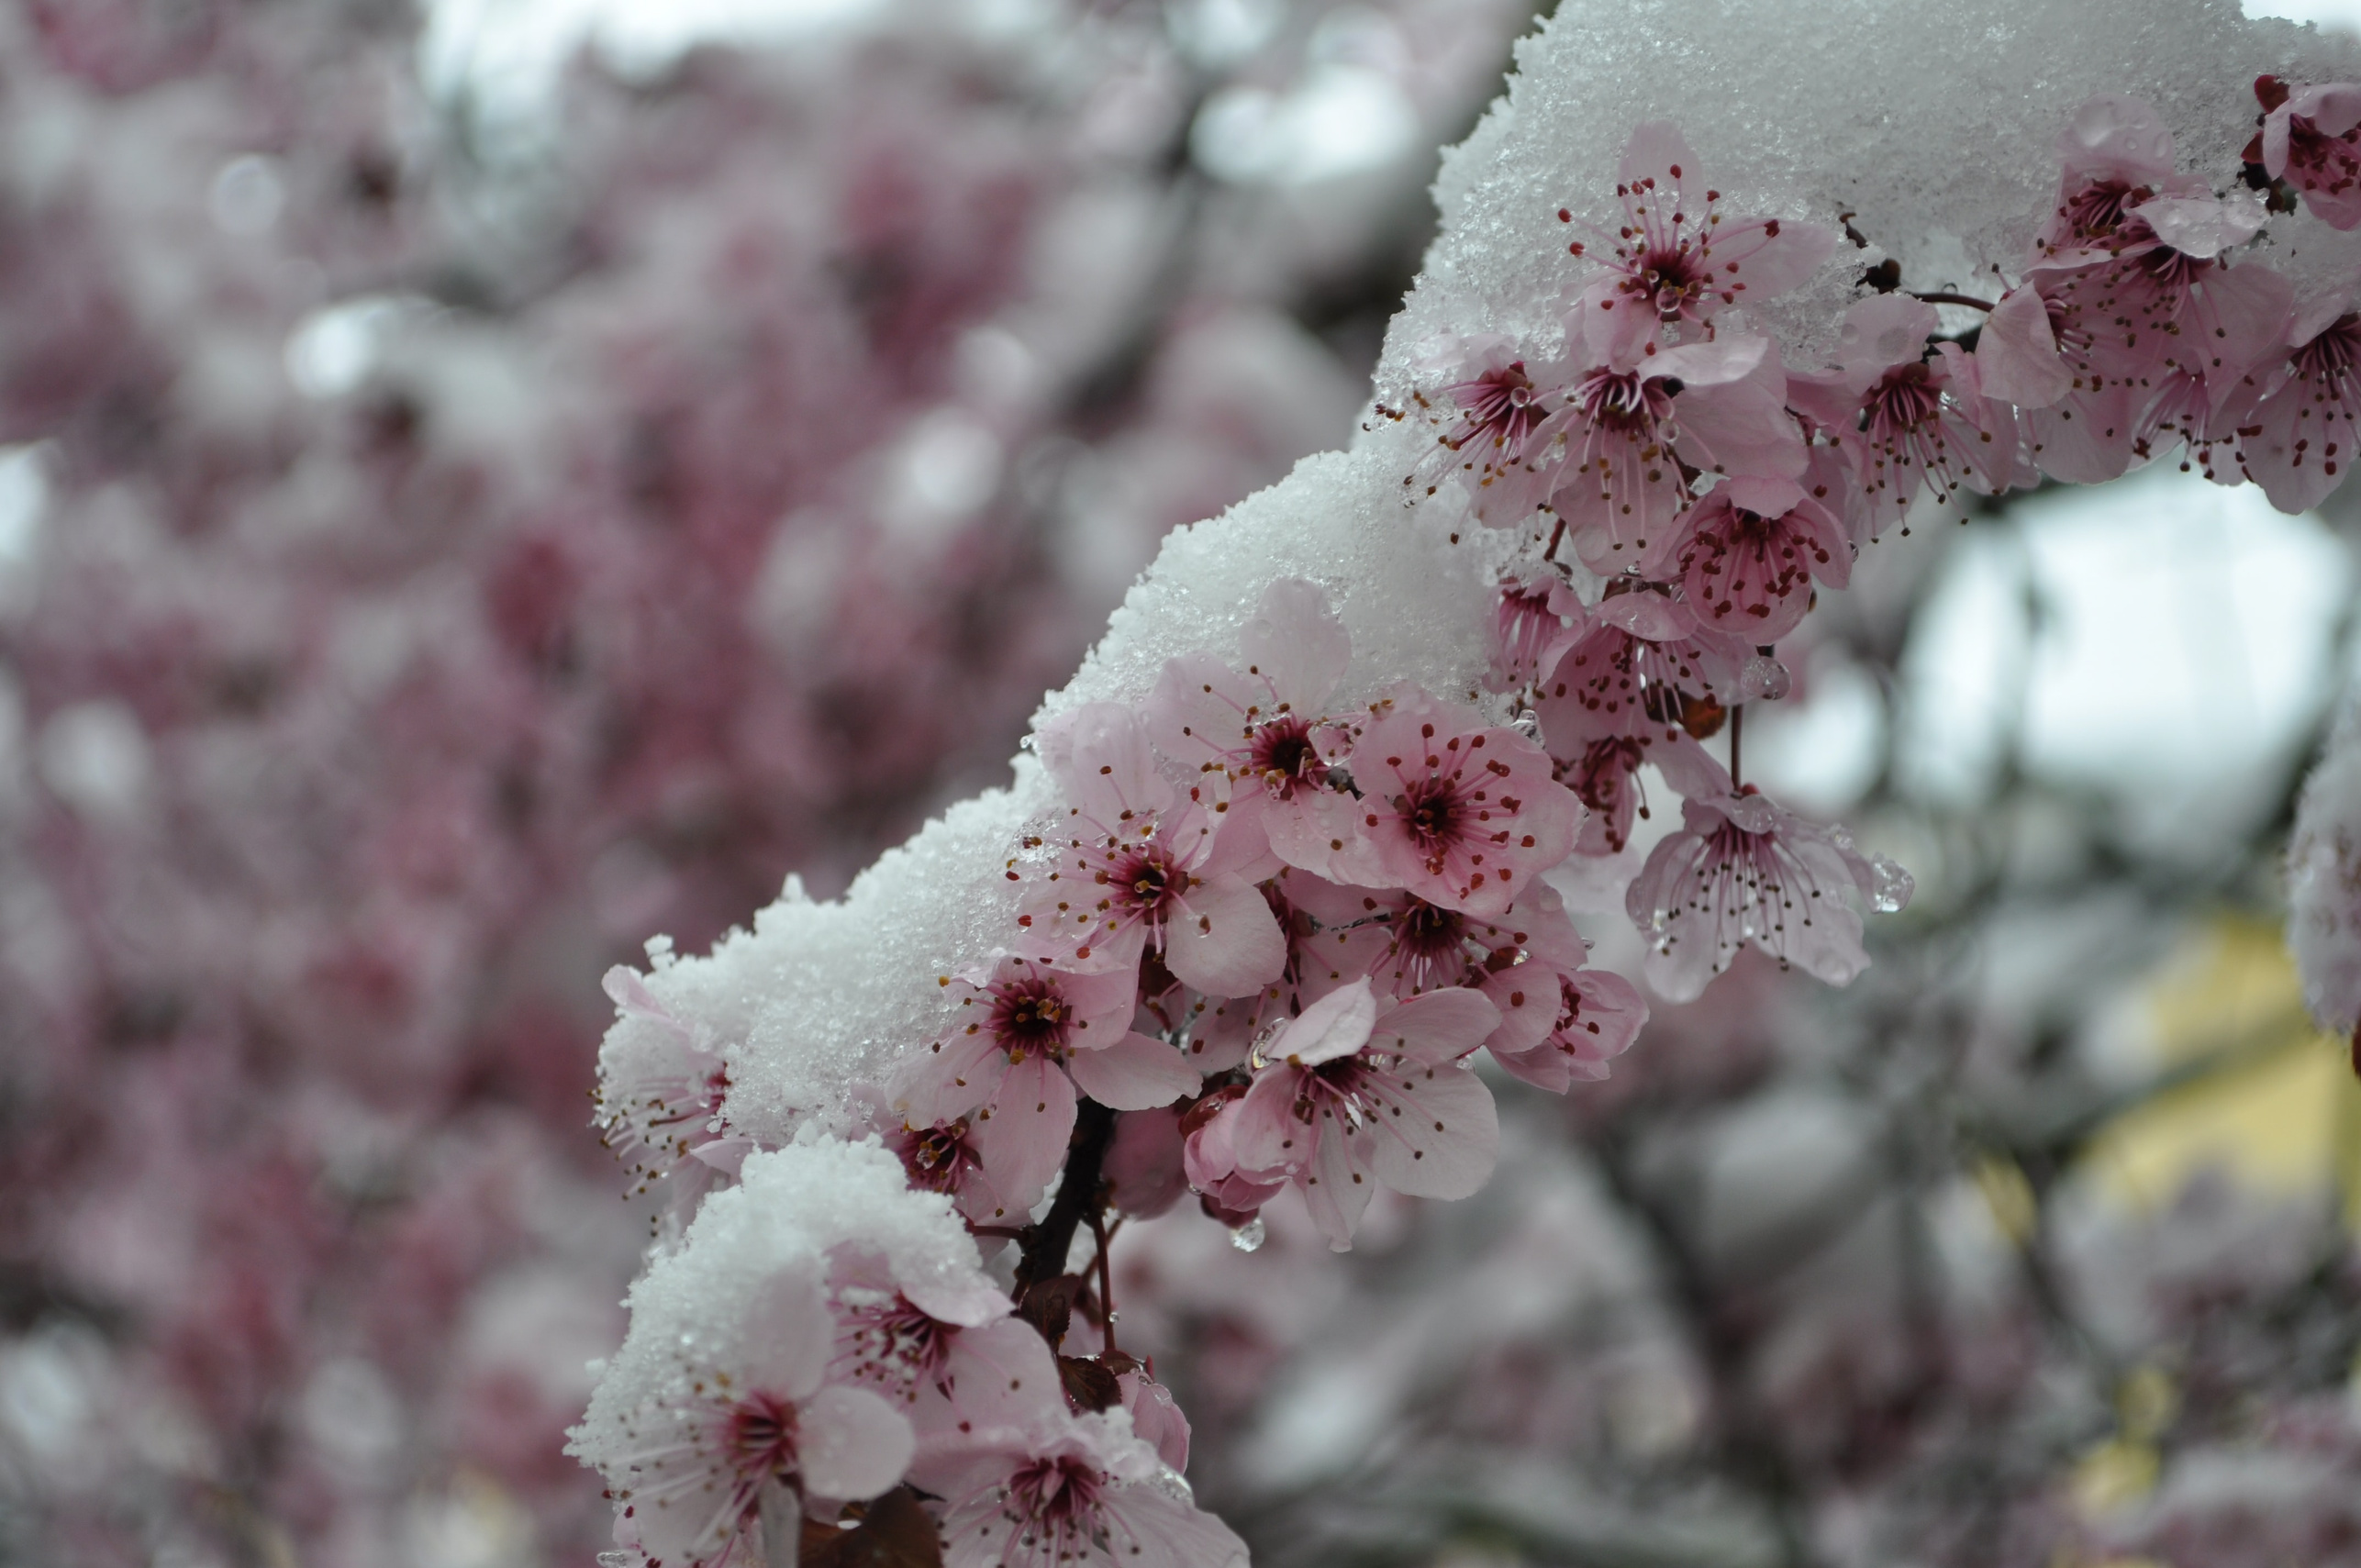
Average global shift of 4 days, across plants and animals
Source: Phenology, Theresa Crimmins;
Photo: Maria Cassagne via Unsplash, Public Domain
Notes:
It is estimated that globally, across different types of plants and animals, we have already seen a shift of 4 days in activity.

Slide 25
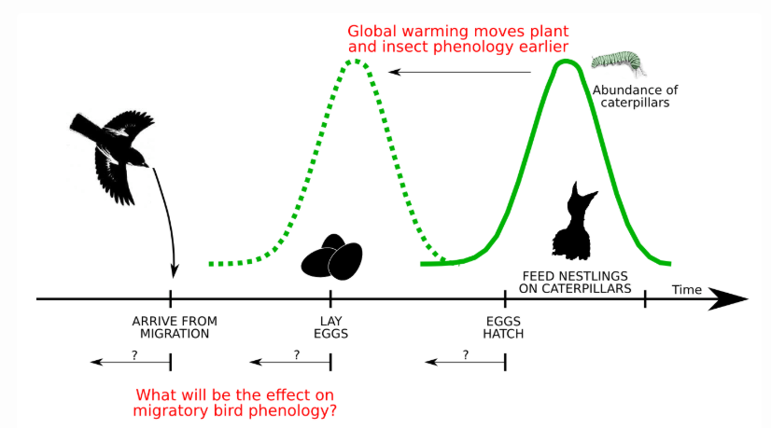
Credit: nadiah.org/2015/05/23/migratory-bird-phenology
Notes:
However, not all species and regions are changing at the same rate, leading to mismatches. How plants and animals respond to climate can help us predict whether their populations will grow or shrink

Slide 26
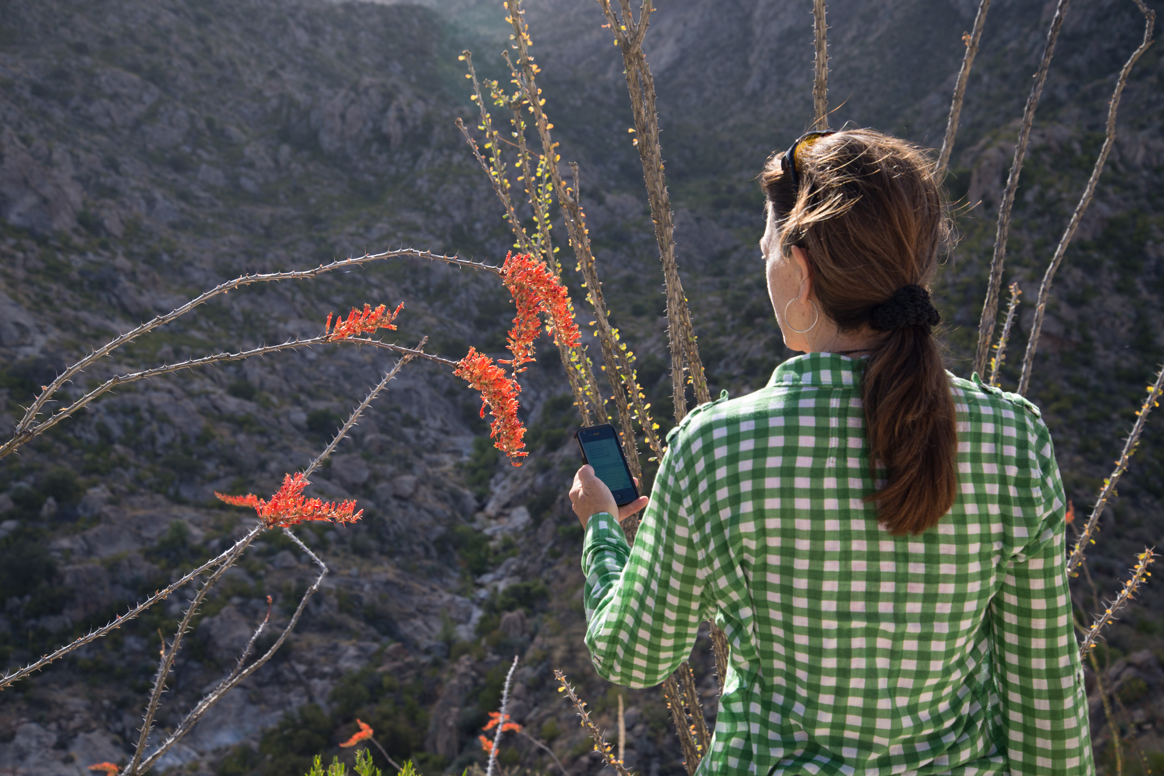
Phenology is “perhaps the simplest process in which to track changes in the ecology of species in response to climate change”
Intergovernmental Panel on Climate Change, 2007
Photo: Brian F Powell
Notes:
making phenology a leading indicator of climate change impacts.

Slide 27
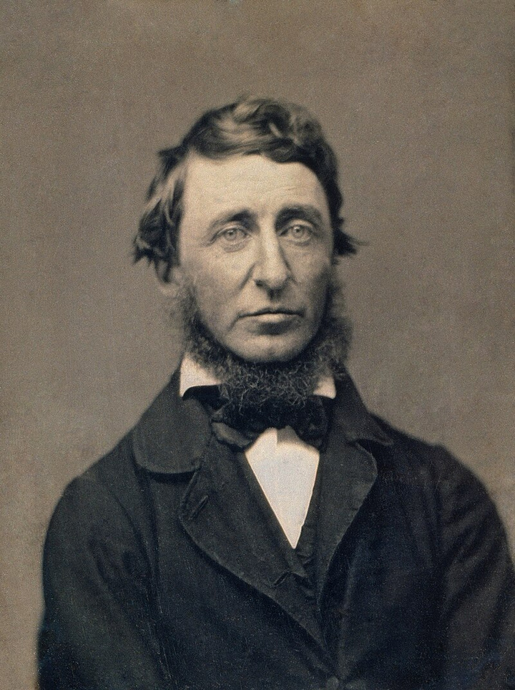
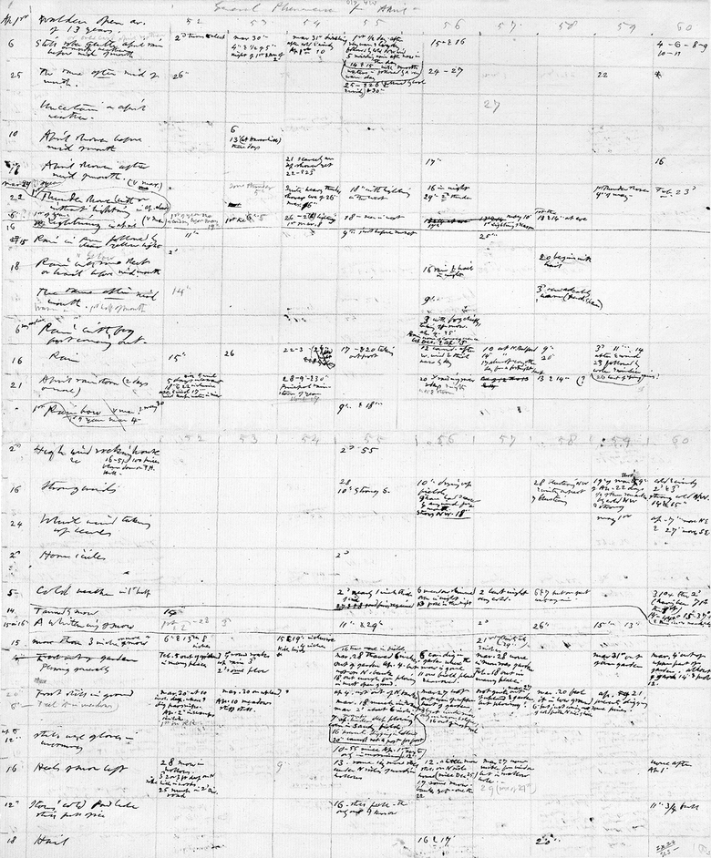
Henry David Thoreau
Photo (left): Benjamin D. Maxham via Wikipedia, Public Domain
Credit (right): The Pierpont Morgan Library New York
Notes:
There are different types of phenological data that we can use to understand these changes. These include journals from early naturalists who recorded events of plants and animals

Slide 28
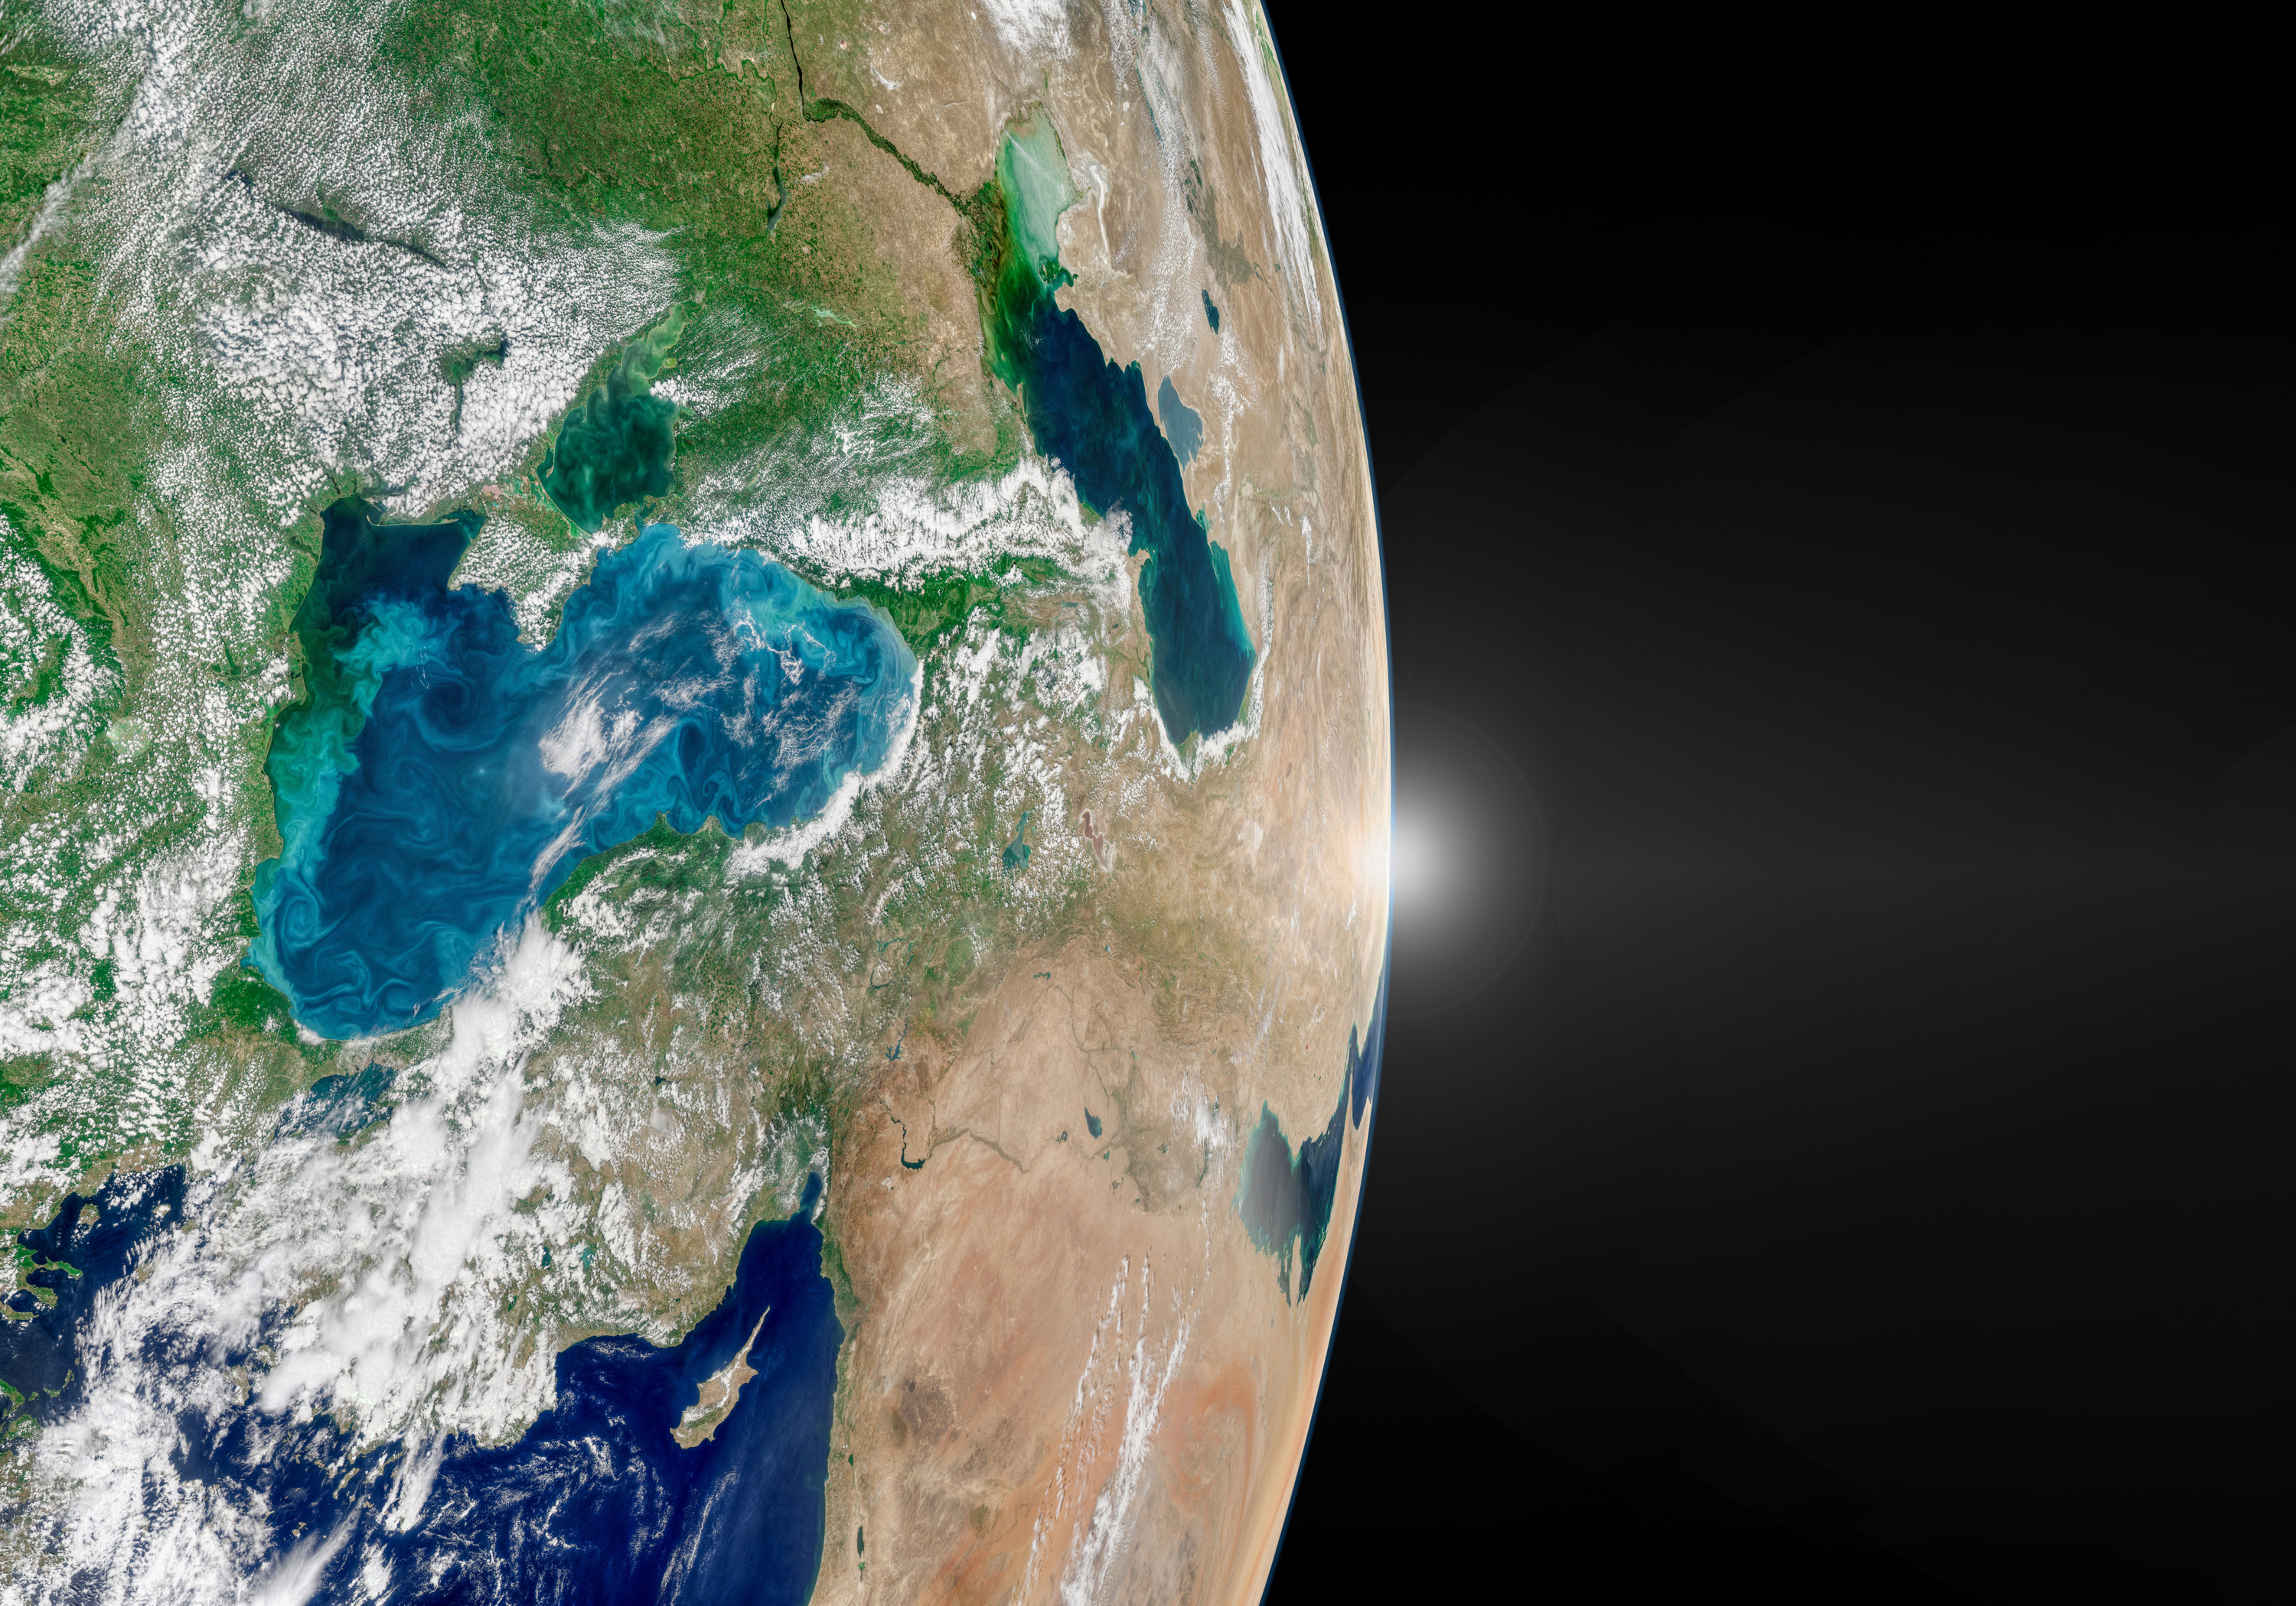
Photo via Adobe Stock Images
Notes:
Satellite data that can show landscape scale plant green up in the spring or loss of color in the autumn

Slide 29
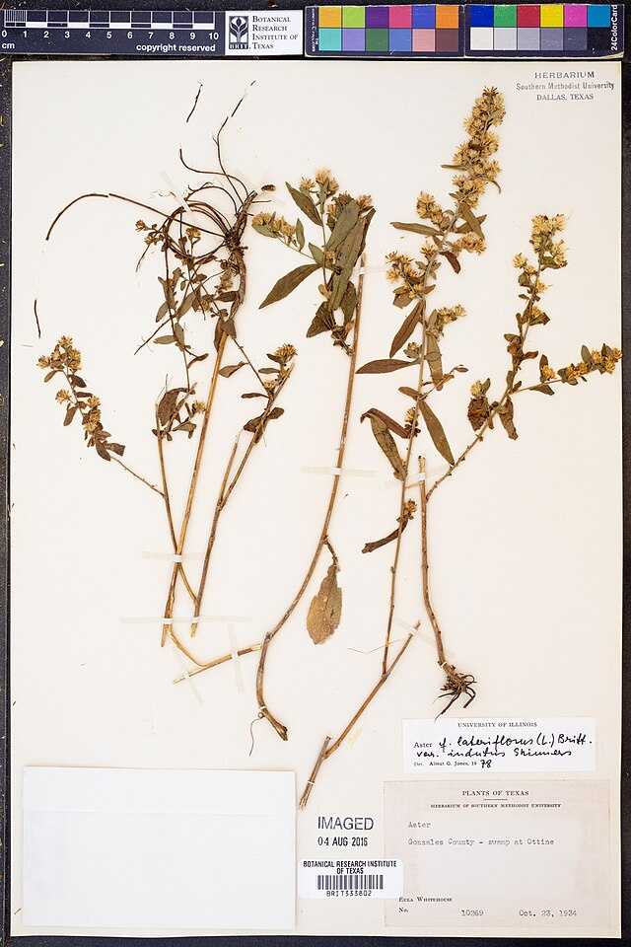
Credit: Botanical Research Institute of Texas via Wikipedia, Public Domain
Notes:
Herbaria which are filled with plant specimens collected at a particular location, sometimes centuries ago

Slide 30
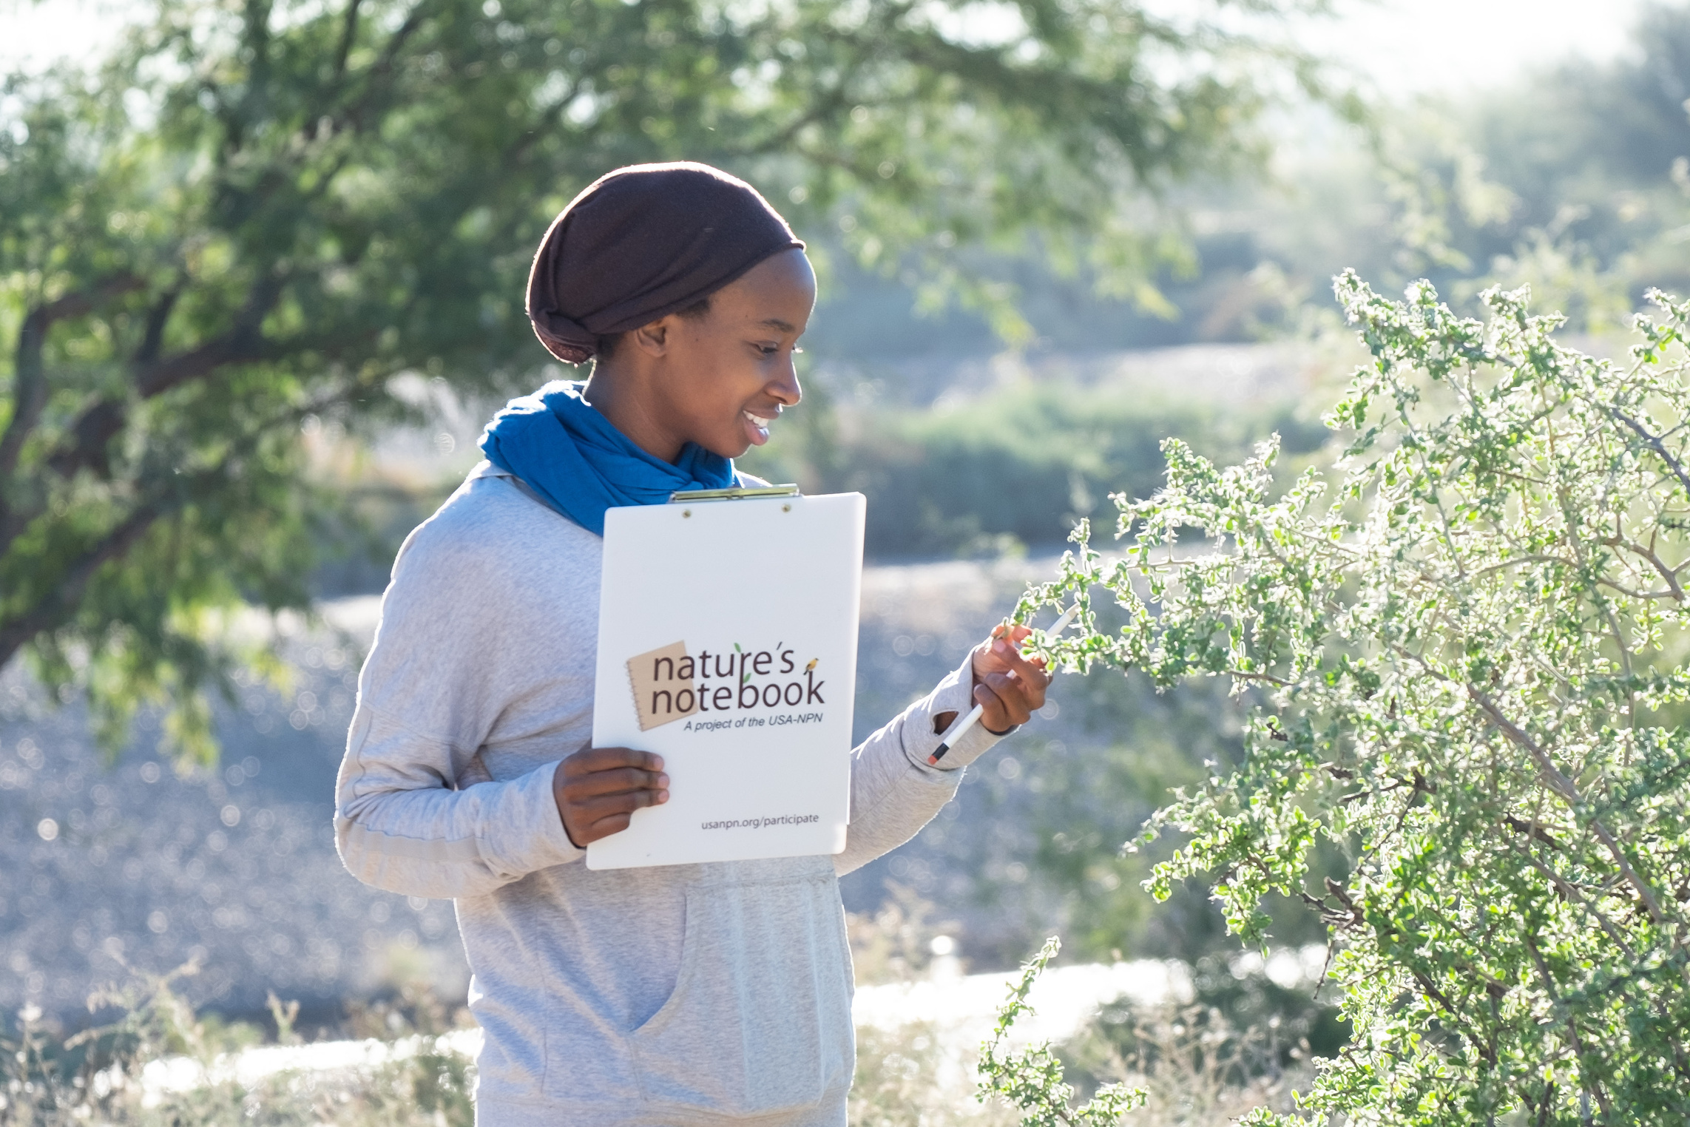
Photo: Brian F Powell
Notes:
And on the ground observations like those collected through the USA National Phenology Network’s Nature’s Notebook program.

Slide 31

Photo: Brian F Powell
Notes:
Many people observe phenology without even knowing it.

Slide 32
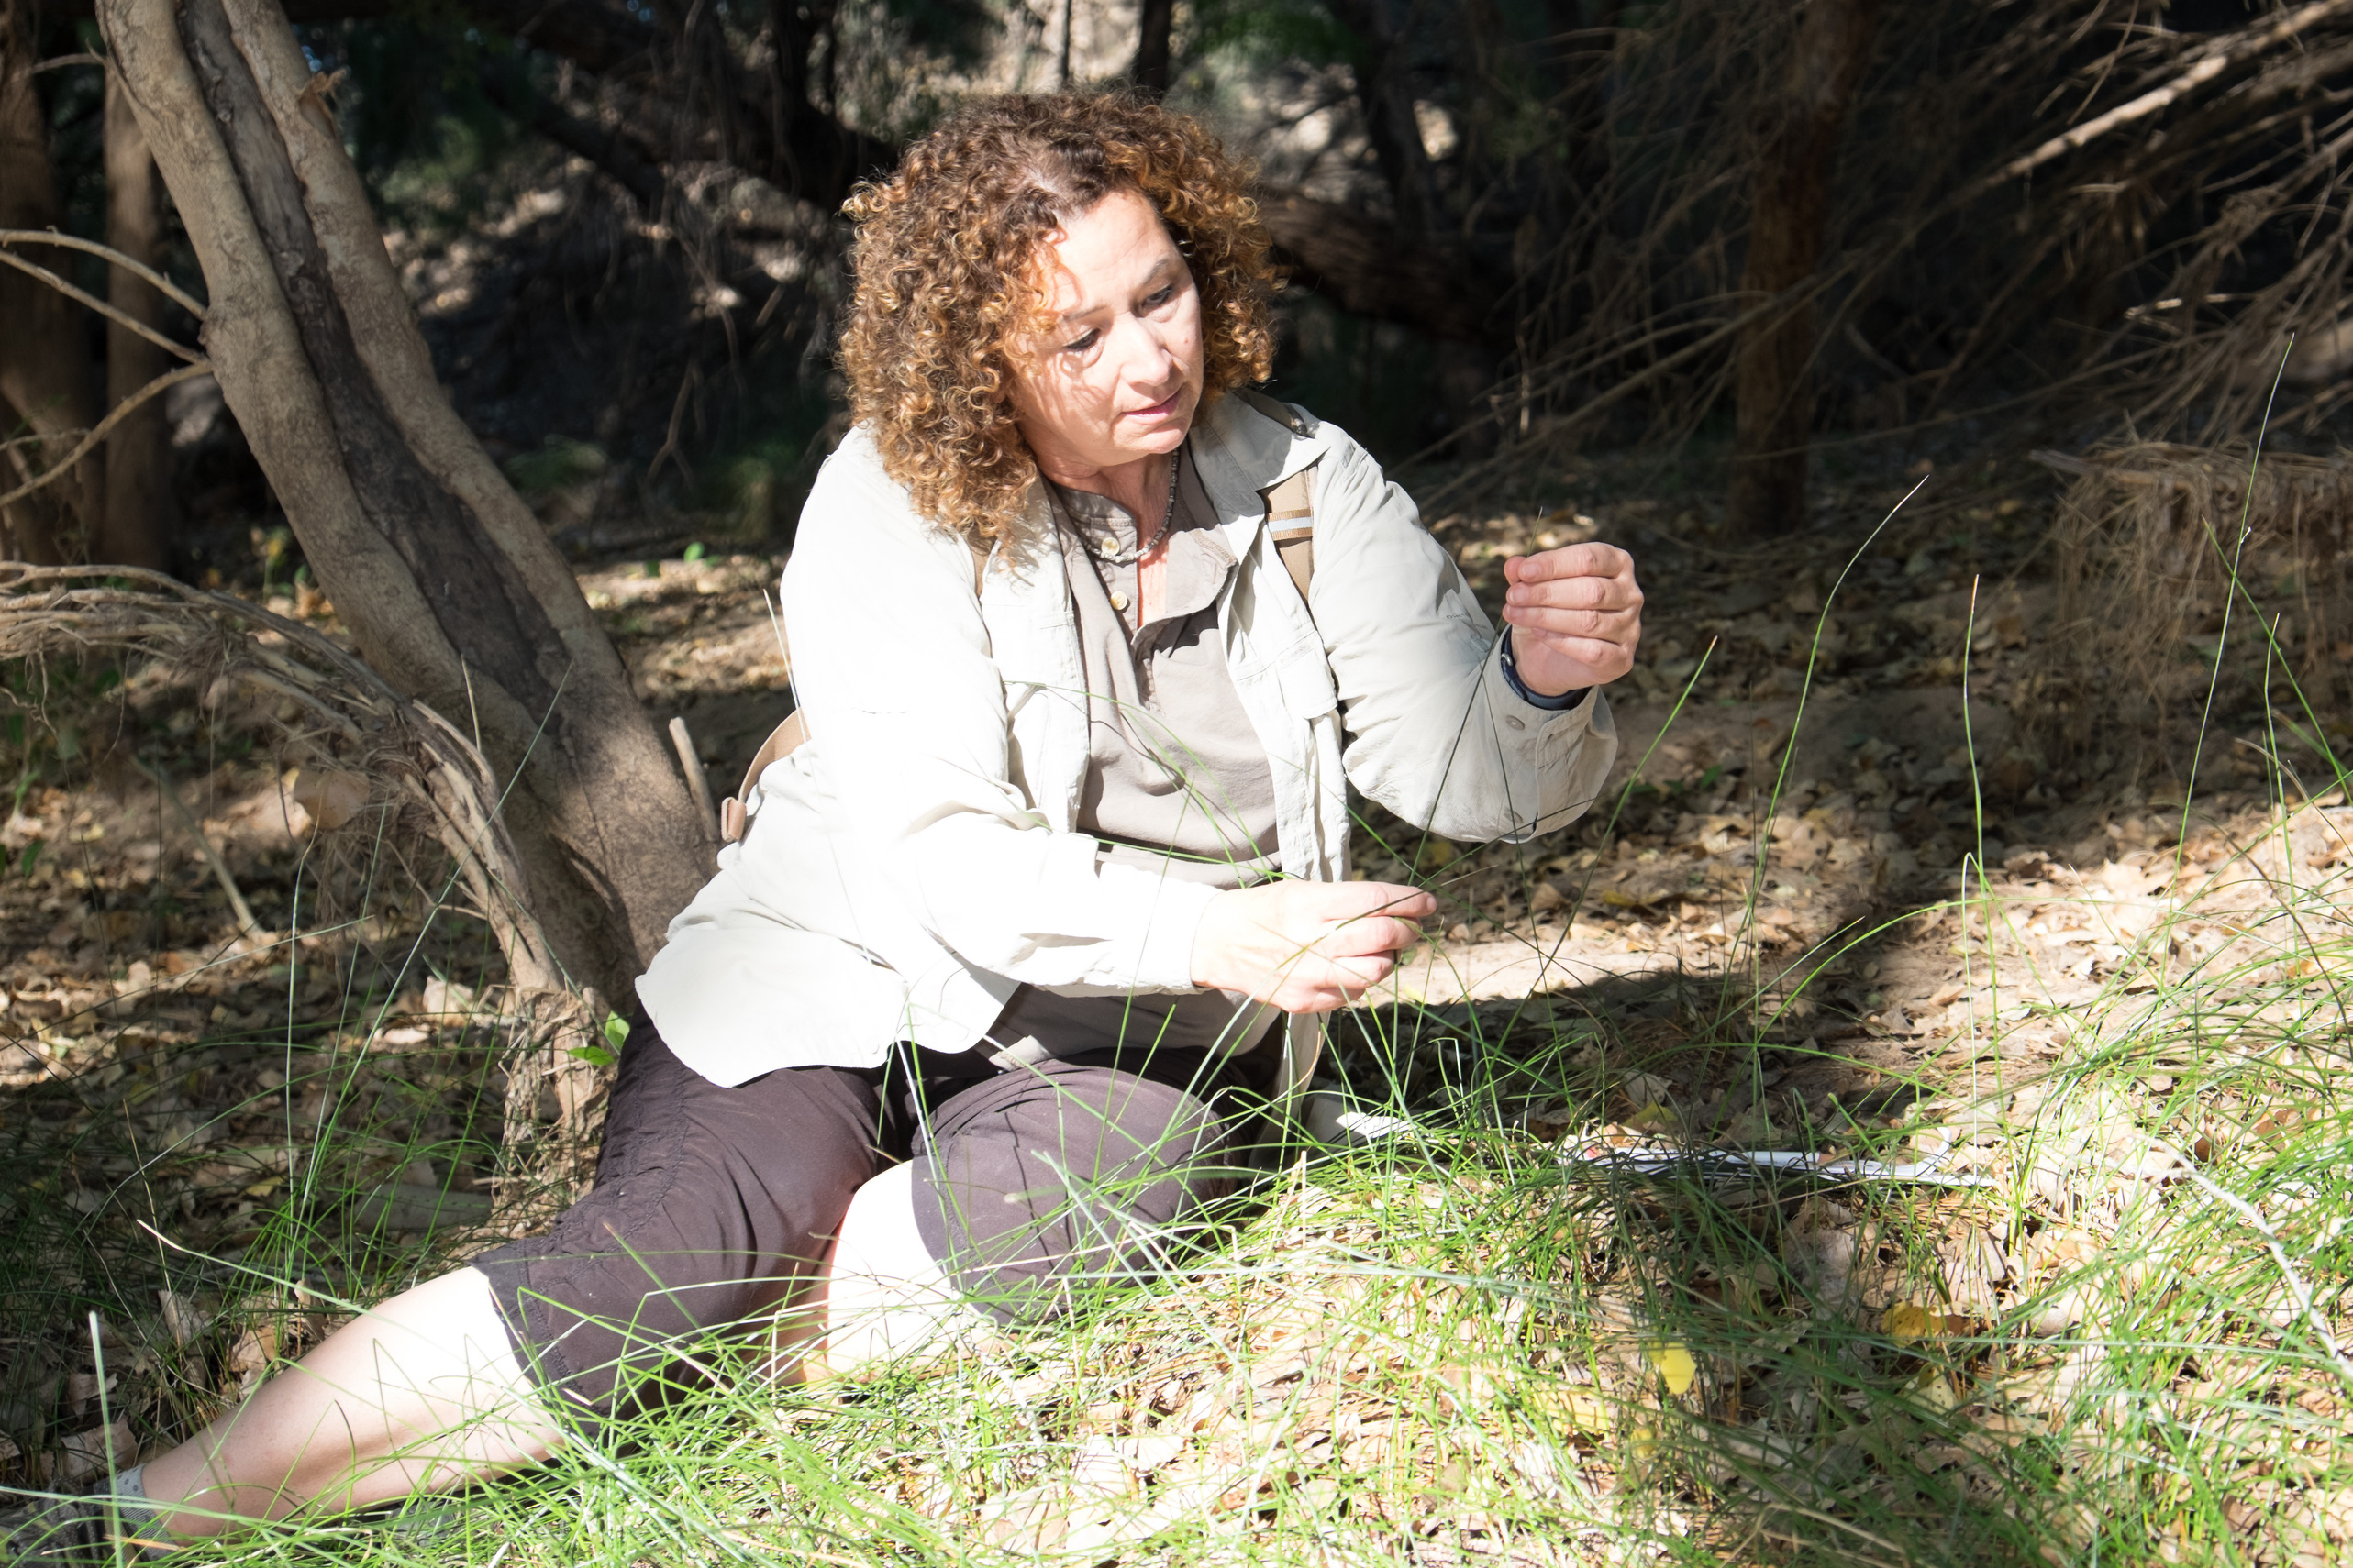
Photo: Brian F Powell
Notes:
If you have noticed changes in the natural world around you then you have observed phenology too!

Slide 33
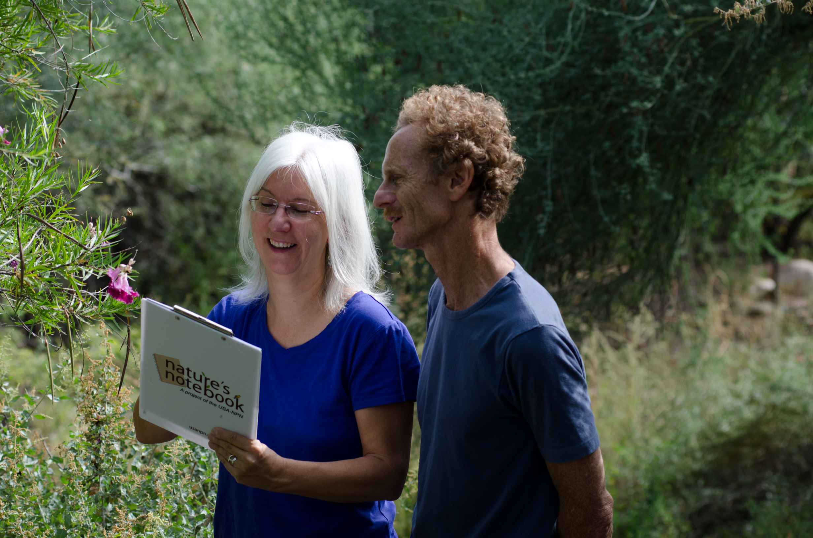
Photo: Brian F Powell
Notes:
There is still a lot to learn about phenology. You can help advance the field by collecting data for Nature’s Notebook in your yard or a nearby area that you visit frequently.

Slide 34
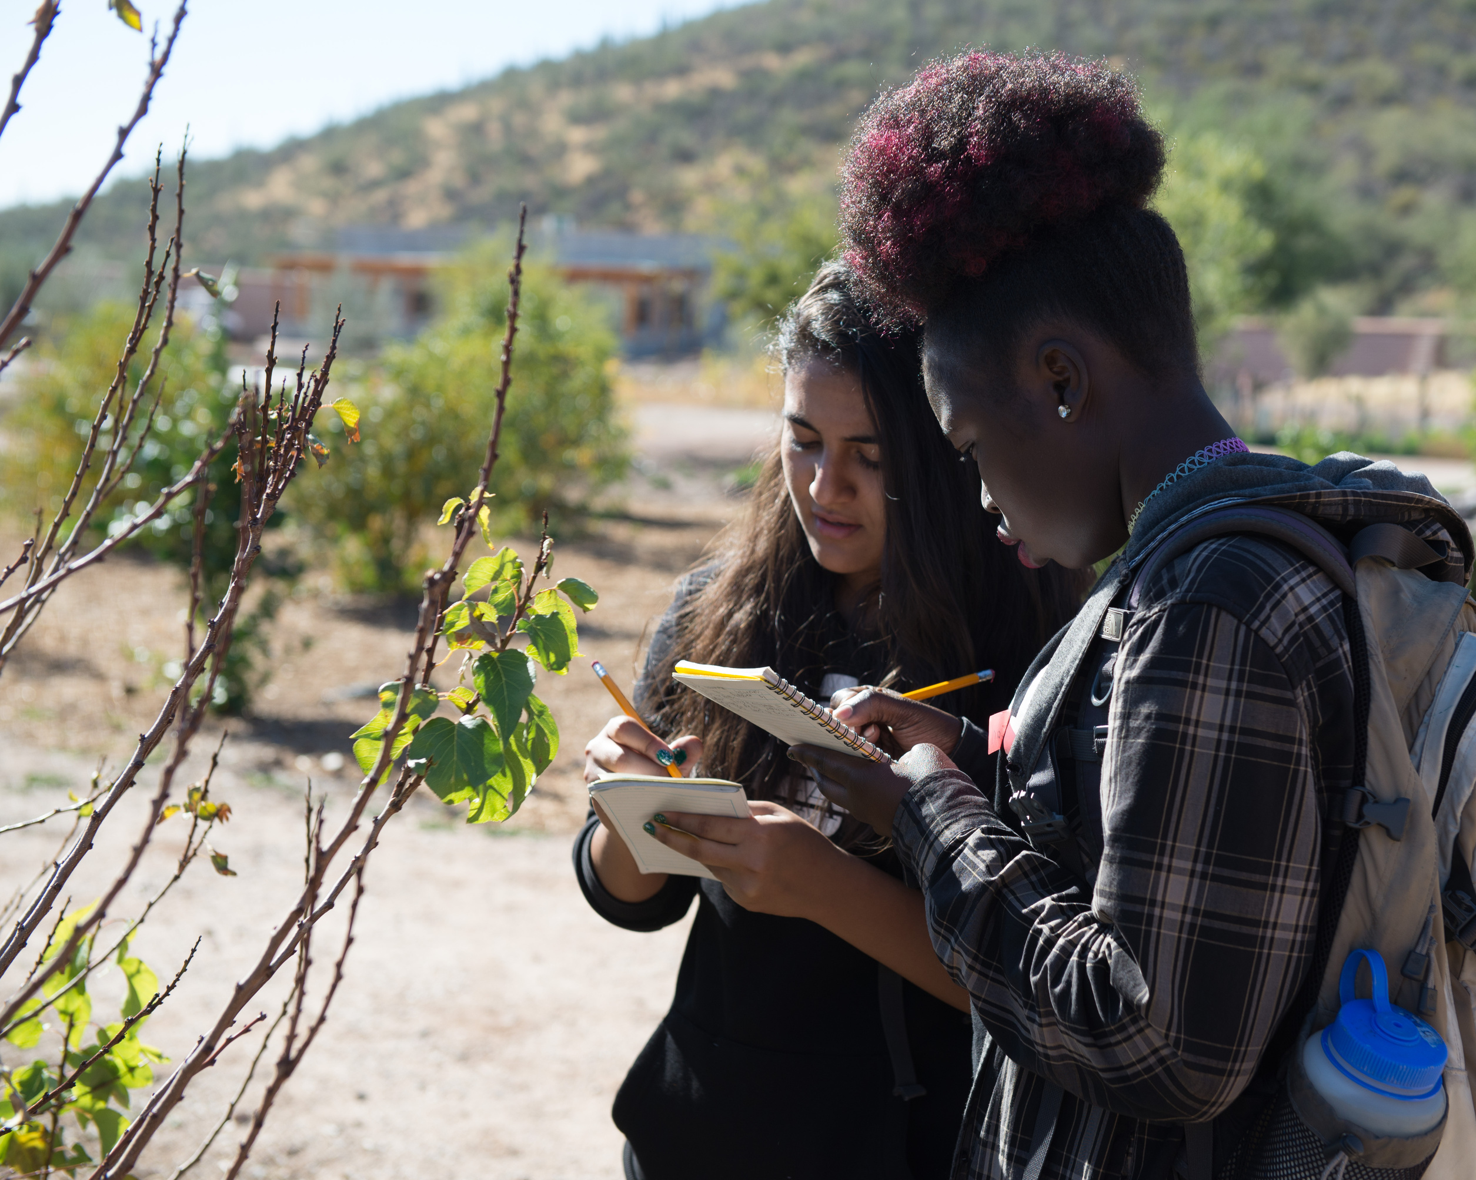
Photo: Brian F Powell
Notes:
Or, organize a phenology effort locally for data collection, research or education.

Slide 35


Learn more at
Notes:
Learn more at usanpn.org.

Slide 36
References (in order cited)
Crimmins, Theresa M. Phenology. Cambridge, Massachusetts : The MIT Press, 2025.
IPCC, 2007: Climate Change 2007: Impacts, Adaptation and Vulnerability. Contribution of Working Group II to the Fourth Assessment Report of the Intergovernmental Panel on Climate Change, M.L. Parry, O.F. Canziani, J.P. Palutikof, P.J. van der Linden and C.E. Hanson, Eds., Cambridge University Press, Cambridge, UK, 976pp.
This video was created September 2025

