Slide 1
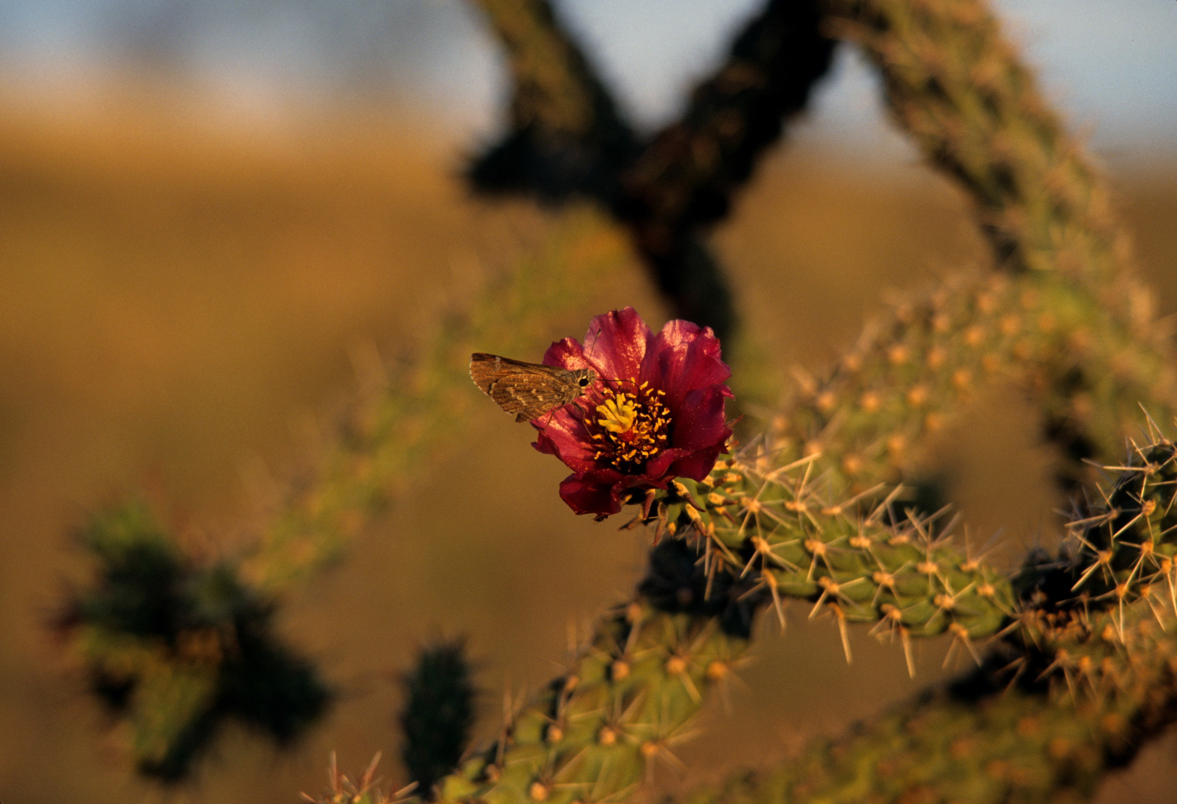
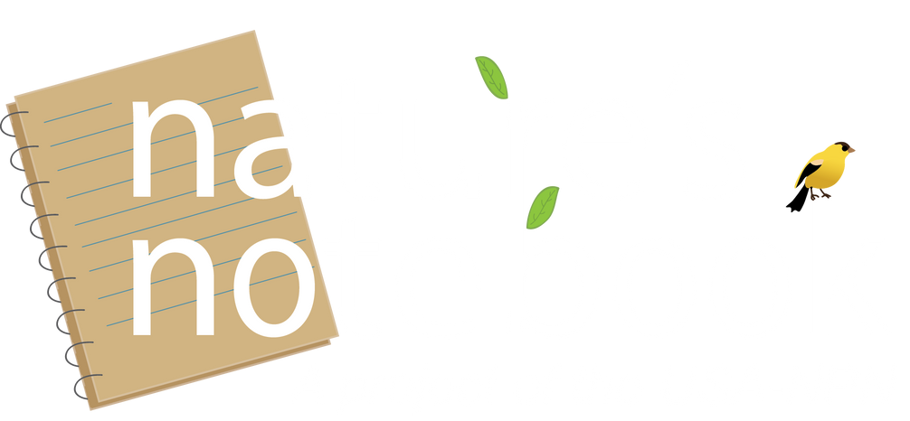


Introduction to USA-NPN and Nature’s Notebook
Nature’s Notebook video series

Slide 2


Photos: Ellen G Denny
Notes:
The USA National Phenology Network was established in 2007.

Slide 3
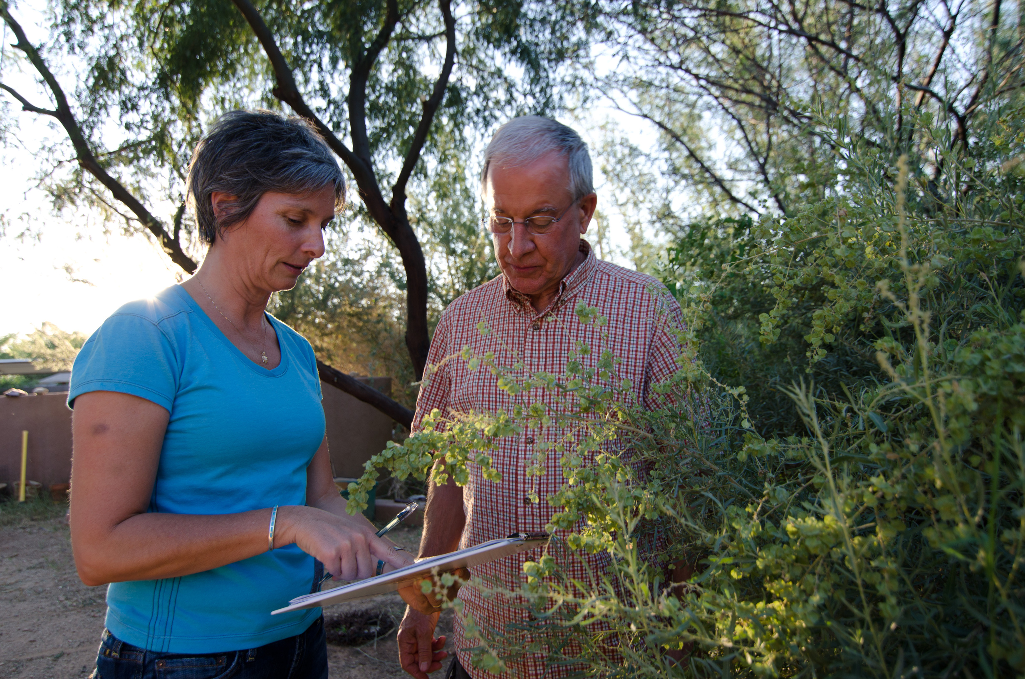
Phenology: The timing of seasonal activities in plants and animals
Photo: Brian F Powell
Notes:
To fill the need for standardized data collection on the timing of seasonal activity in plant and animals, called phenology, in the United States.

Slide 4
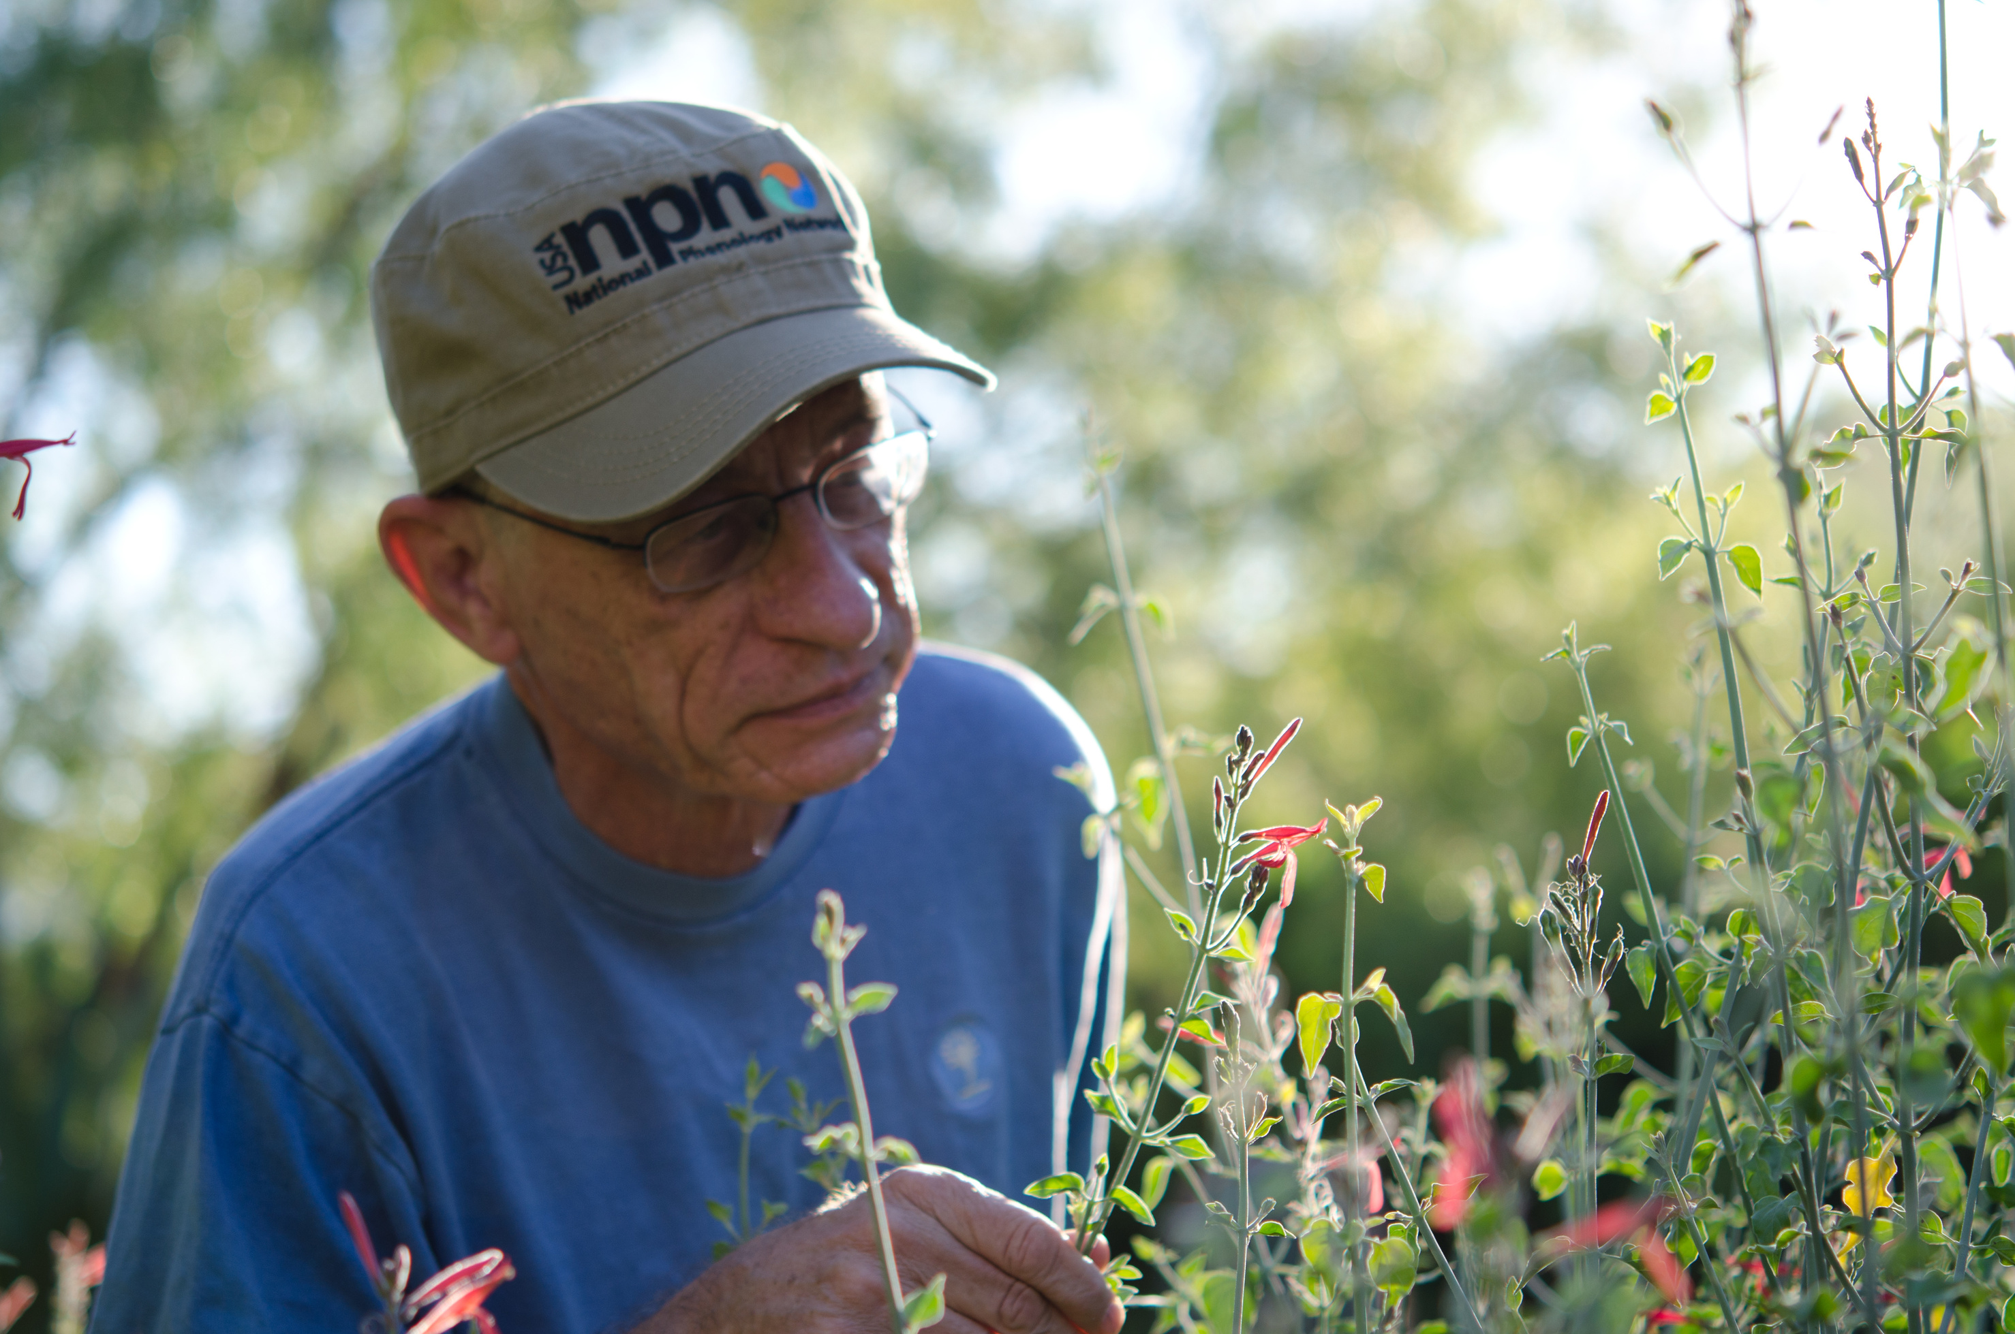
Enhance and support scientific discovery regarding species and ecosystem responses to changing climate and environmental conditions
Photo: Brian F Powell
Notes:
The USA-NPN seeks to: enhance and support scientific discovery regarding species and ecosystem responses to changing climate and environmental conditions.

Slide 5
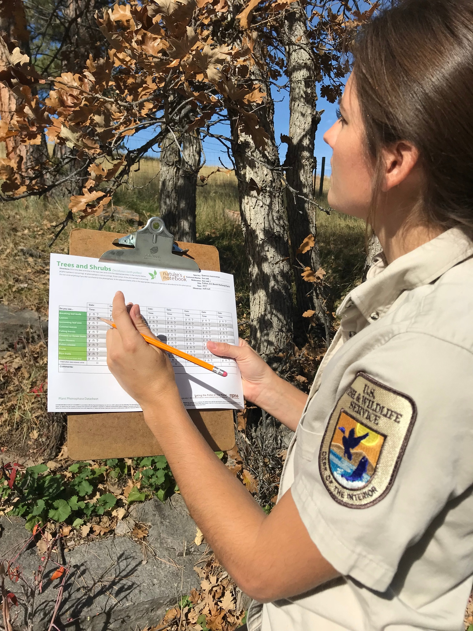
Inform decisions in natural resource conservation and management, human health, recreation, and land use
Photo: USFWS, CC BY-NC-SA 4.0
Notes:
The USA-NPN seeks to:
Inform decisions in natural resource conservation and management, human health, recreation, and land use.

Slide 6
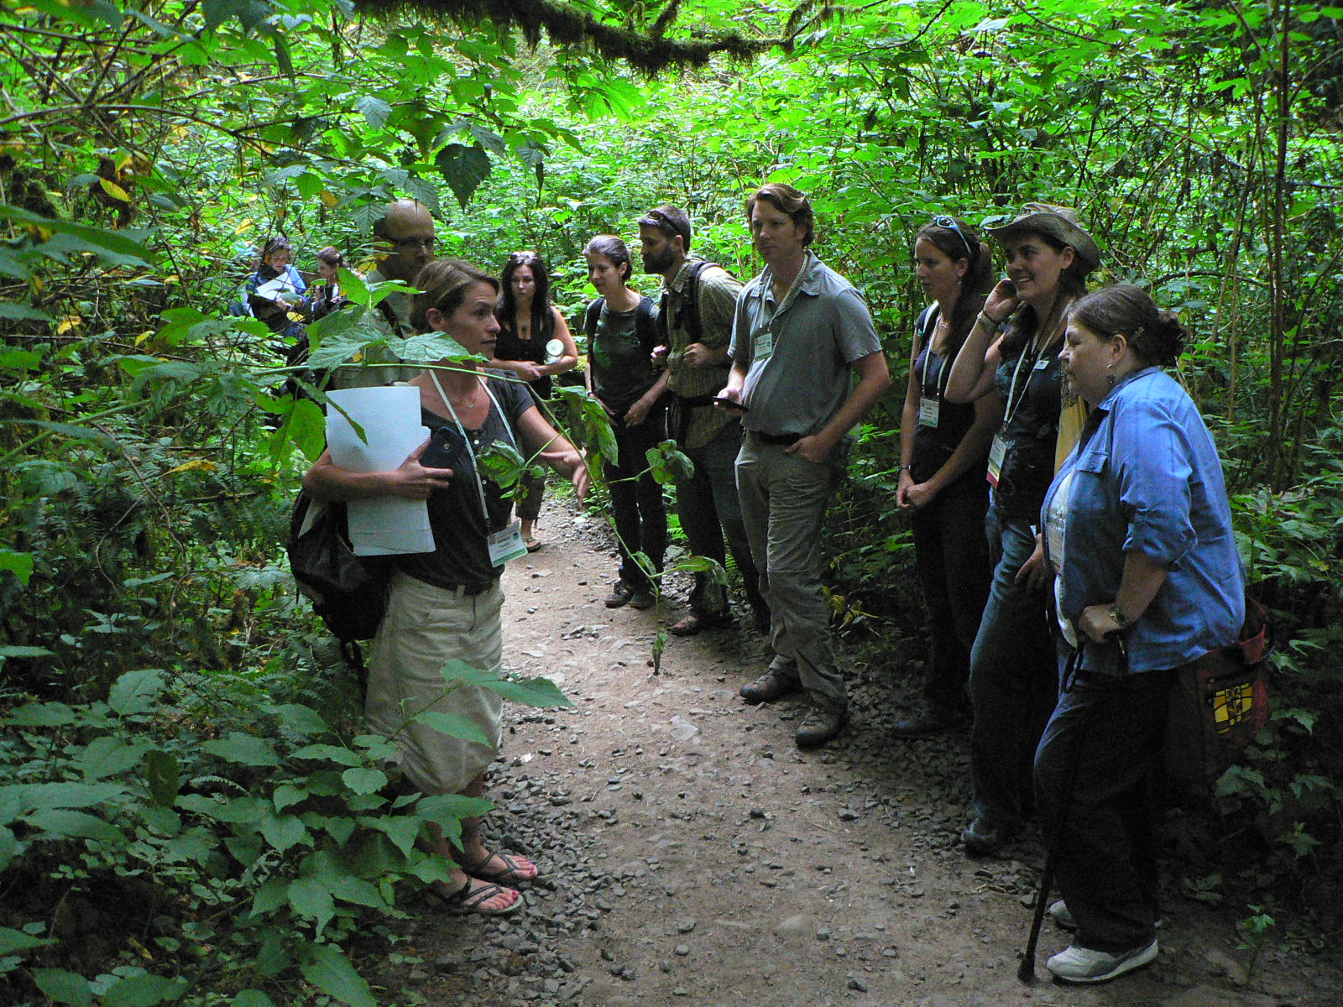
Communicate and connect with individuals and partners to ensure that they have an improved understanding of the value of phenology and sustain long-term participation in monitoring phenology
Photo: CC BY-NC-SA 4.0
Notes:
The USA-NPN seeks to: Communicate and connect with individuals and partners to ensure that they have an improved understanding of the value of phenology and sustain long-term participation in monitoring phenology.

Slide 7
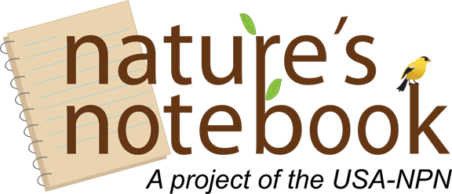
Notes:
Nature’s Notebook is the USA-NPN’s data collection platform.

Slide 8
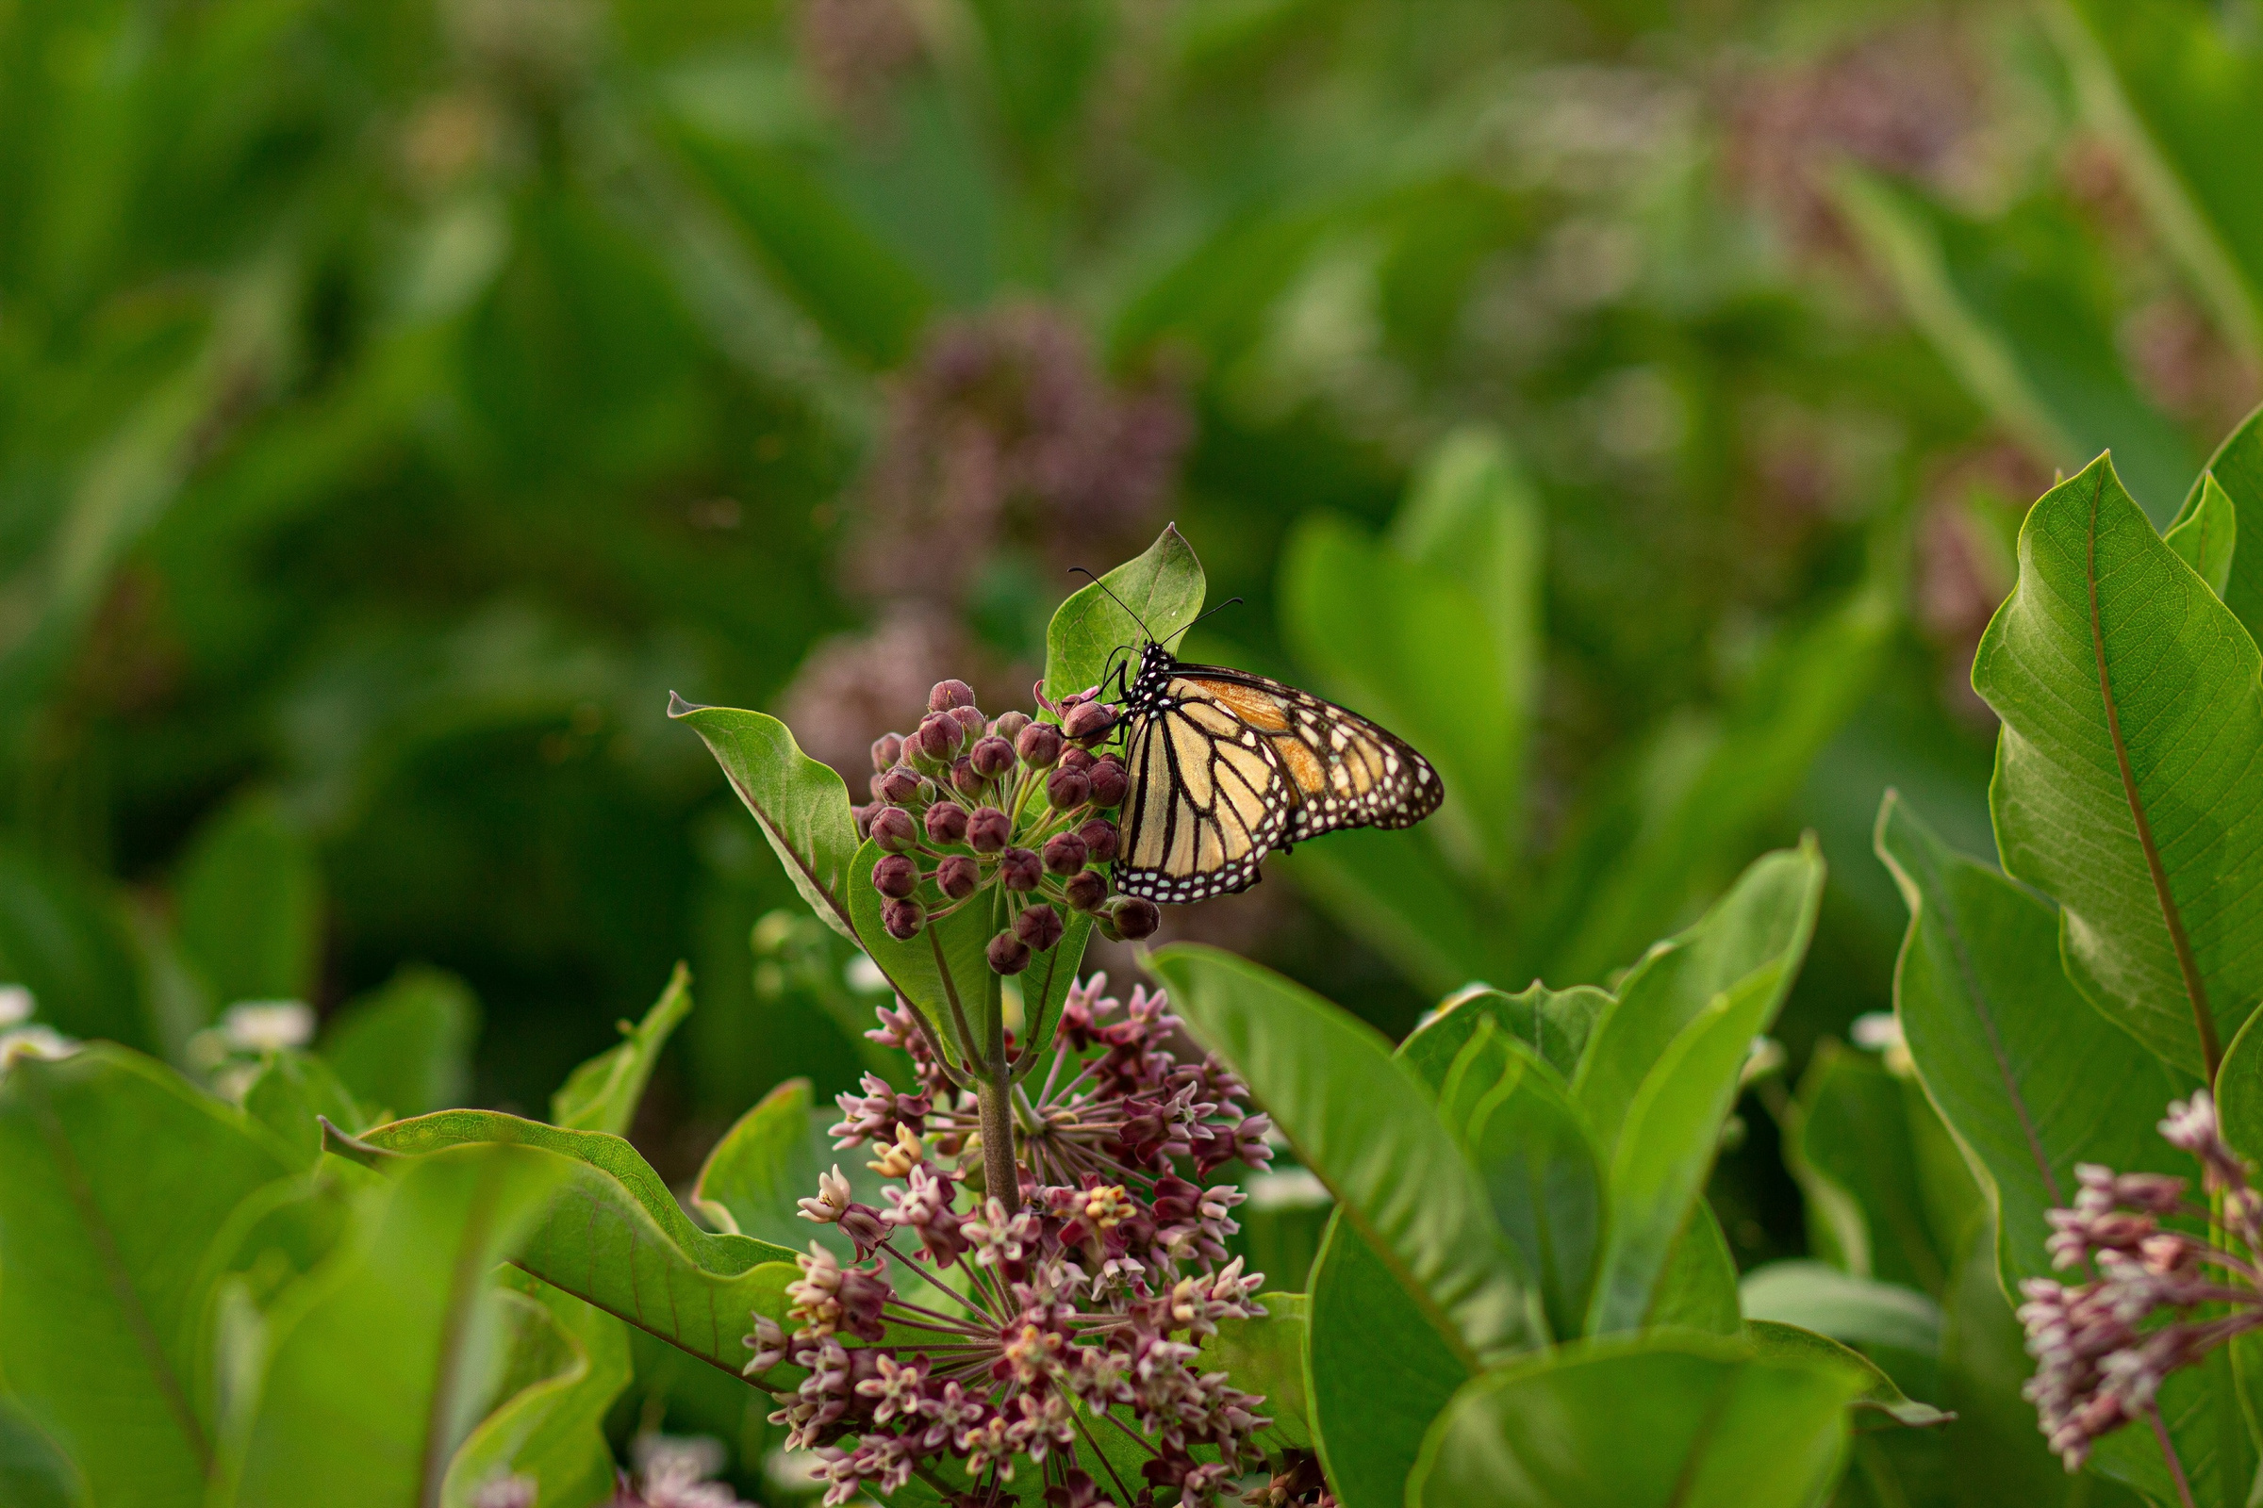
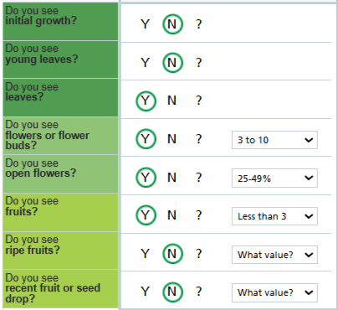
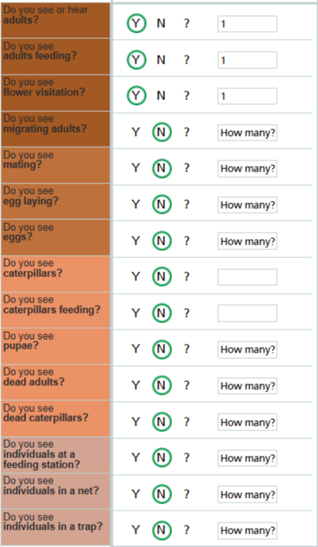
Milkweed
Nearly 2,000 species of plants and animals
Monarch
Photo: Lasclay via Unsplash, Public Domain
Notes:
Nature’s Notebook provides scientifically vetted, standardized protocols for phenological monitoring of nearly 2000 species of plants and animals (species list available at www.usanpn.org/nn/species_search).

Slide 9
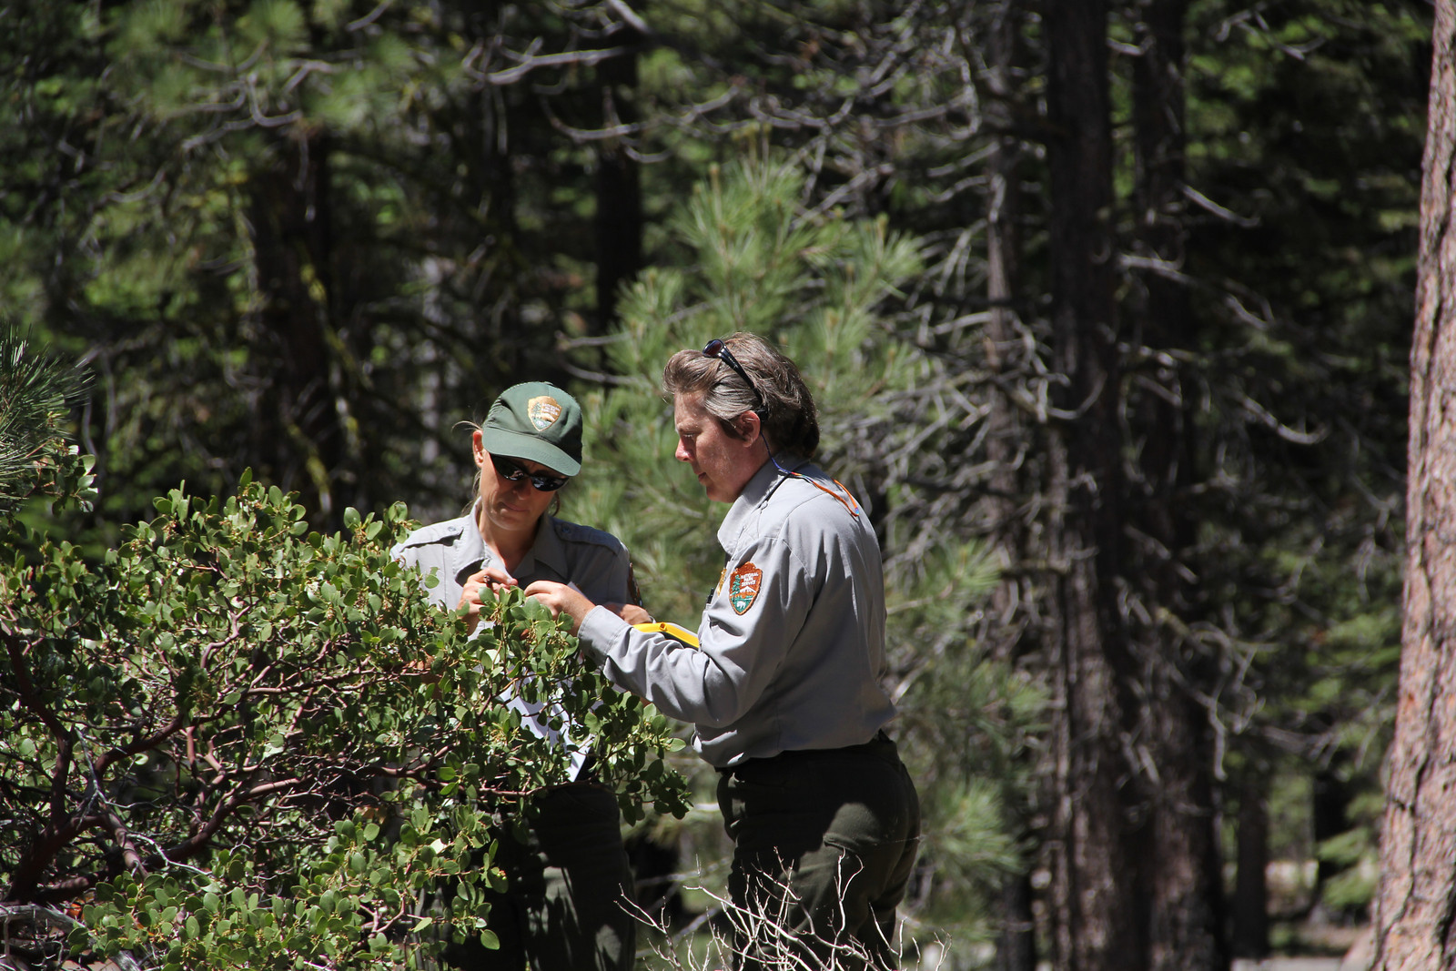
Photo: NPS, CC BY-NC-SA 4.0
Notes:
Partners such as the National Park Service, land trusts, Master Naturalist chapters

Slide 10
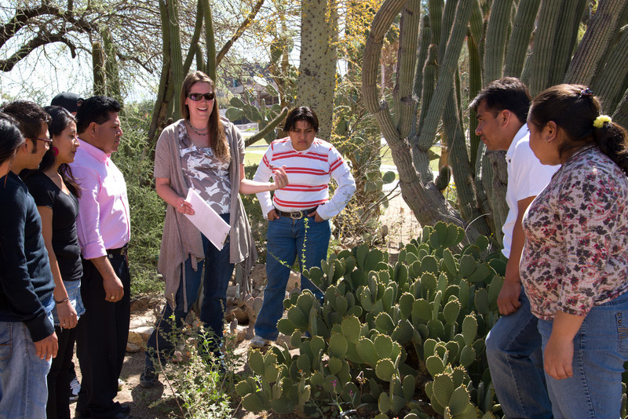
Photo: Brian F Powell
Notes:
And University classrooms as well as professional scientists collect phenology data directly

Slide 11
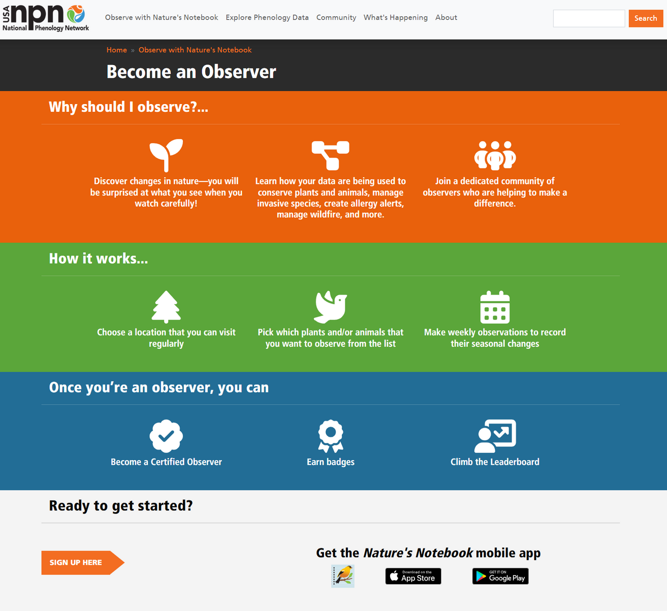
10
Notes:
Through the Nature’s Notebook plant and animal observation platform.

Slide 12
Monarch
Milkweed #1
Notes:
These protocols include a list of phenophases questions that ask about the phenology activity occurring on an individual plant, or observed in an animal species.

Slide 13
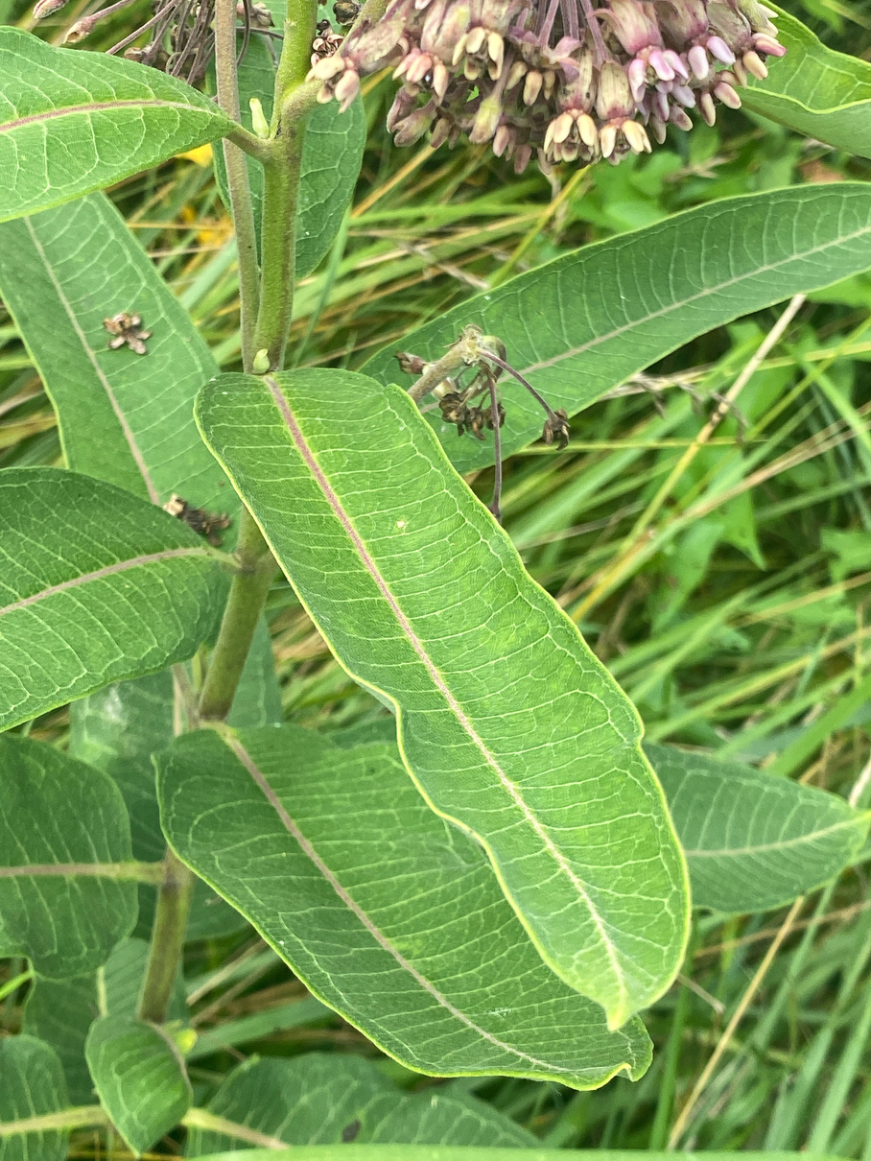
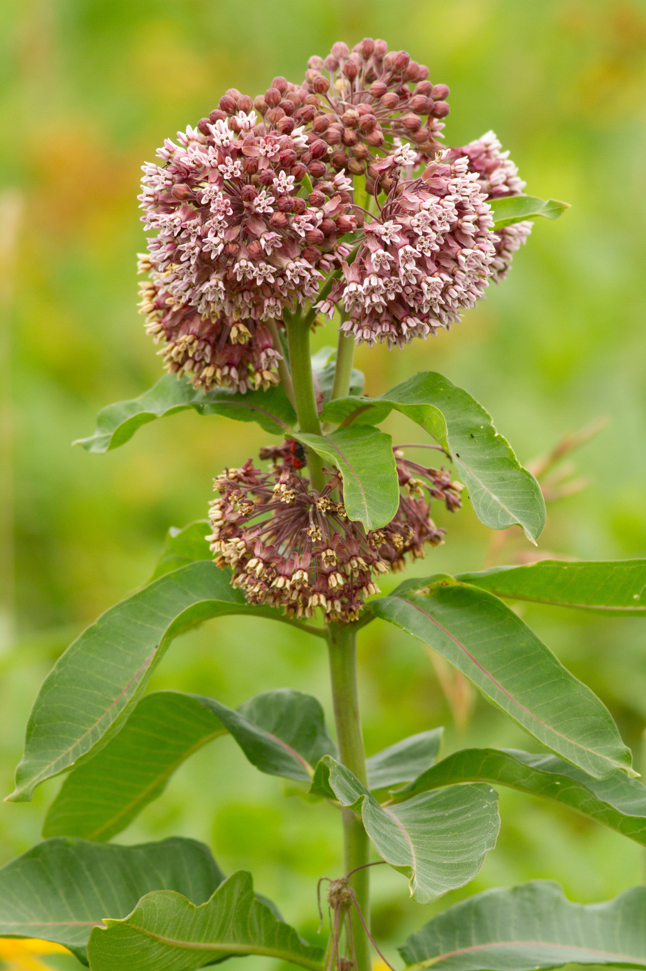
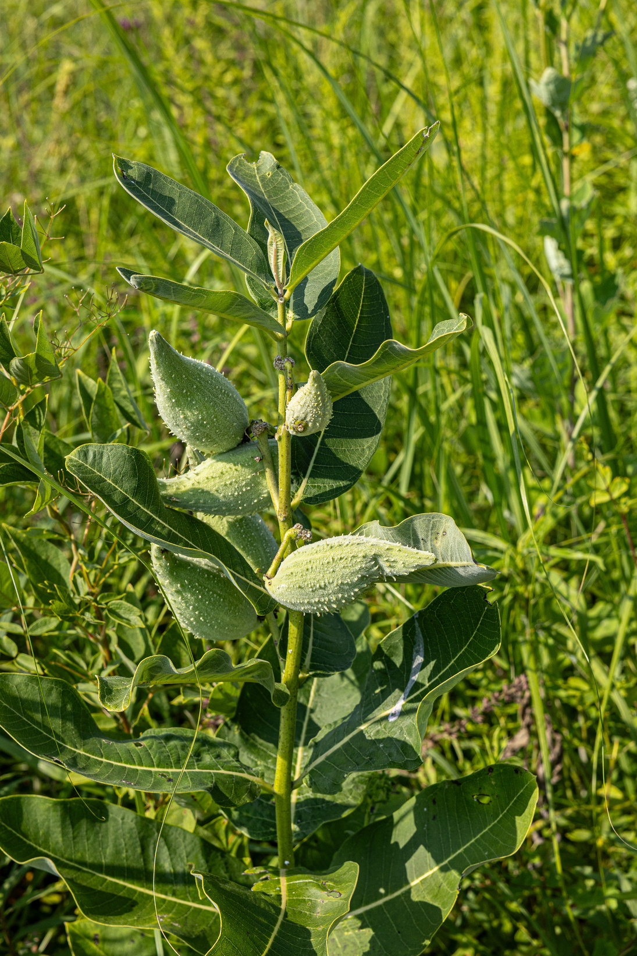
Leaves
Flowers
Fruits
Photos: Dulcey Lima, The Morton Arboretum, CC BY-NC-SA 4.0
Notes:
For plants, observers track the Leaves, Flowers, and Fruits of the life cycle.

Slide 14
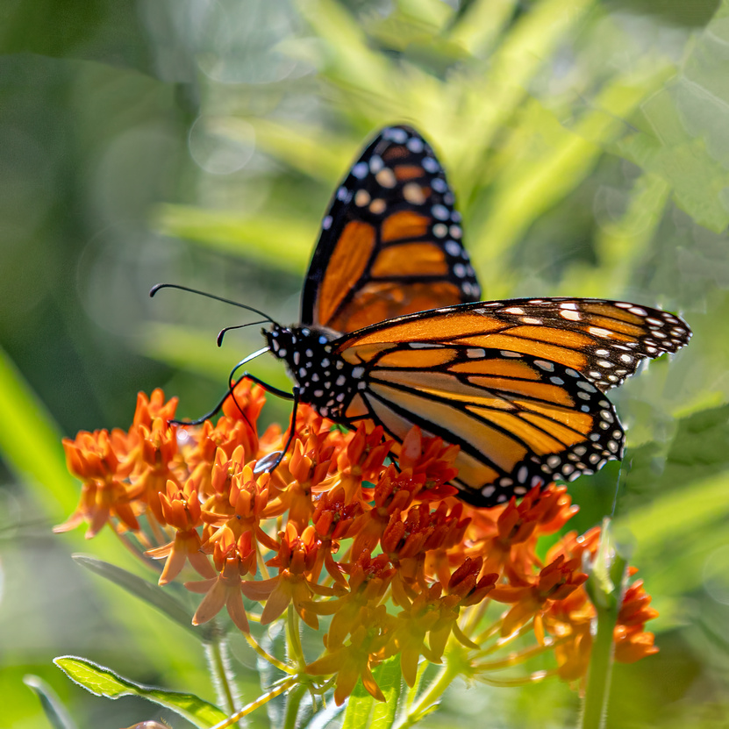
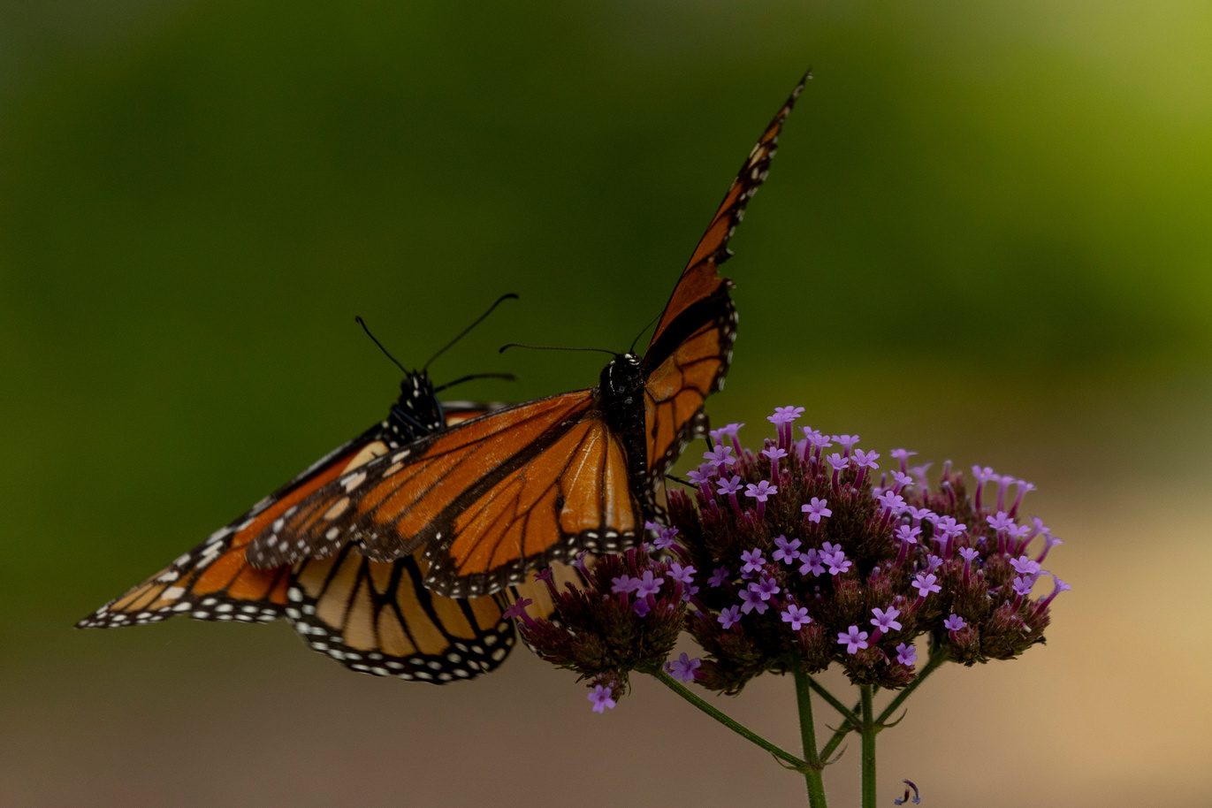
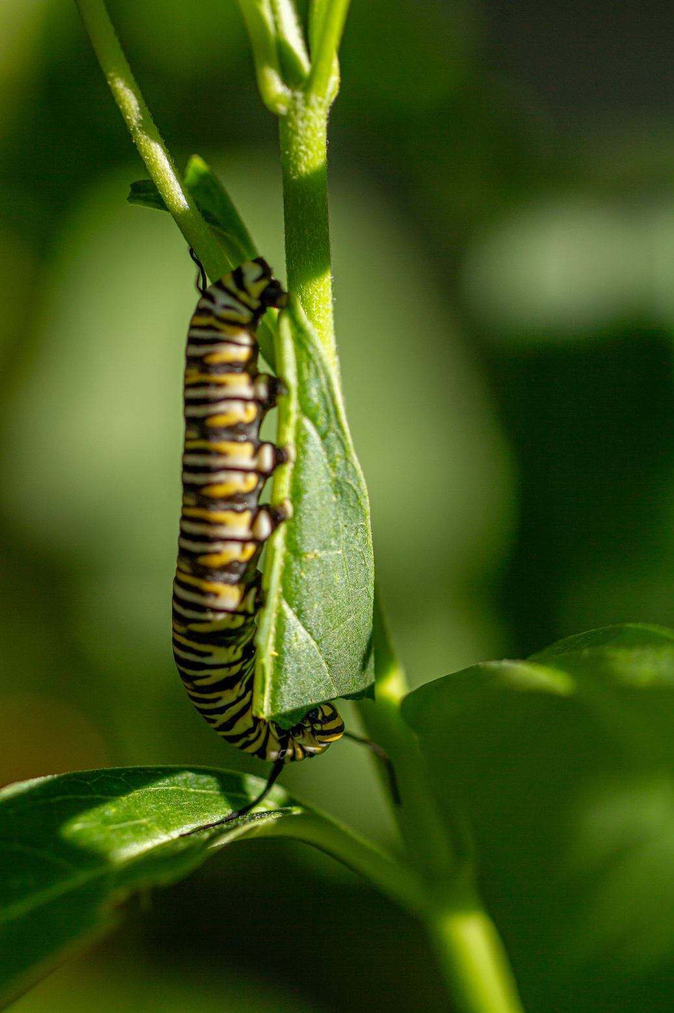
Feeding
Reproduction
Development
Photos: Dulcey Lima, The Morton Arboretum, CC BY-NC-SA 4.0
Notes:
For animals, observers record details about feeding, reproduction, and development.

Slide 15
Common milkweed, Asclepias syriaca
Do you see Fruits?
Phenophase Definition:
One or more fruits are visible on the plant.
For Asclepias syriaca, the fruit is large and pod-like and changes from green to tan or brown and splits open to expose seeds with fluff. Do not include empty fruits that have already dropped all of their seeds.
Yes
No
?
Notes:
Each of these phenophases is defined in detail, often with species-specific information to assist observers.
Observers indicate whether or not they see the phenophases occurring

Slide 16
Common milkweed, Asclepias syriaca
Do you see Fruits?
Yes
No
?
How many fruits are present?
Less than 3
3 to 10
11 to 100
101 to 1,000
More than 1,000
Notes:
And also can answer an optional question about the intensity, or degree to which the phenophases are occurring.

Slide 17
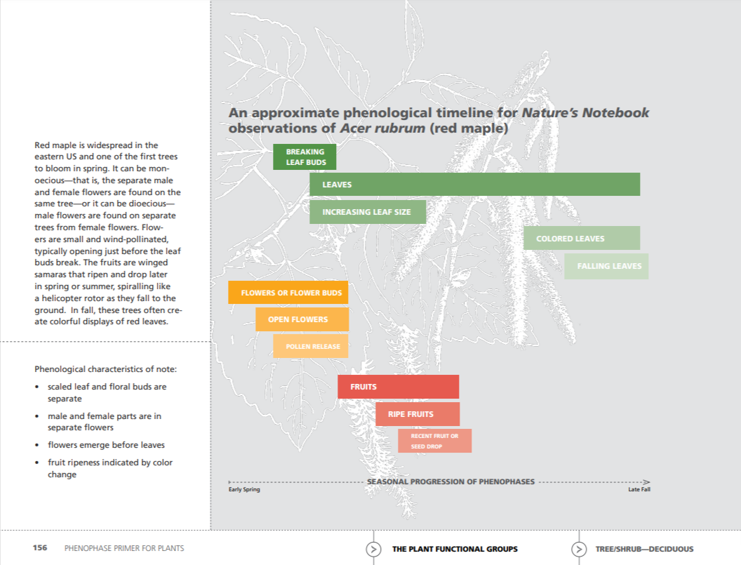
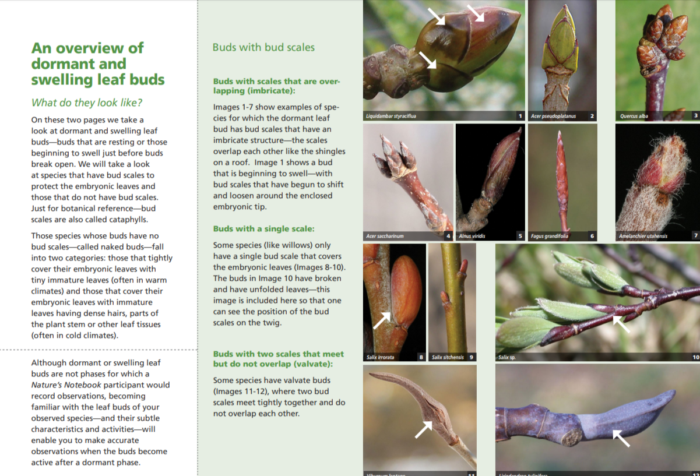
Training Resources Available
Notes:
The USA-NPN has a variety of training resources to assist observers to use Nature’s Notebook

Slide 18
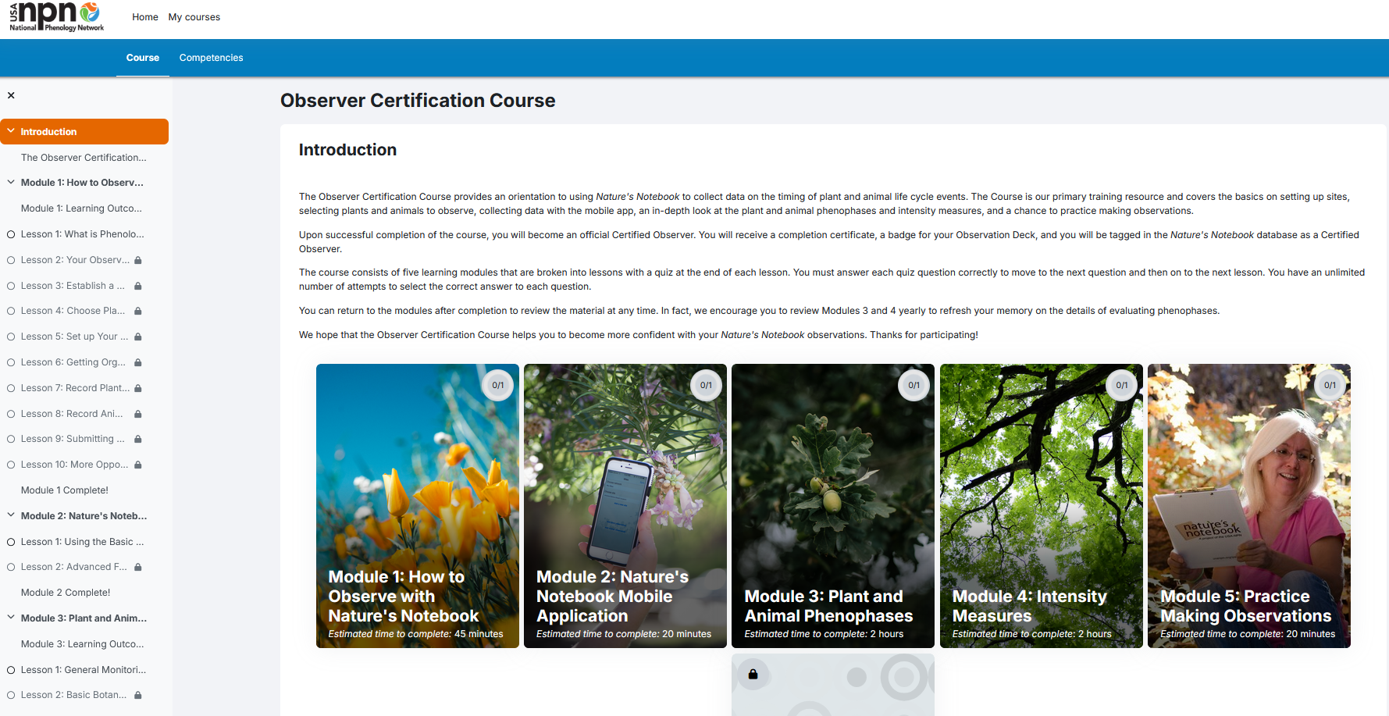
Notes:
Including an online Observer Certification Course

Slide 19
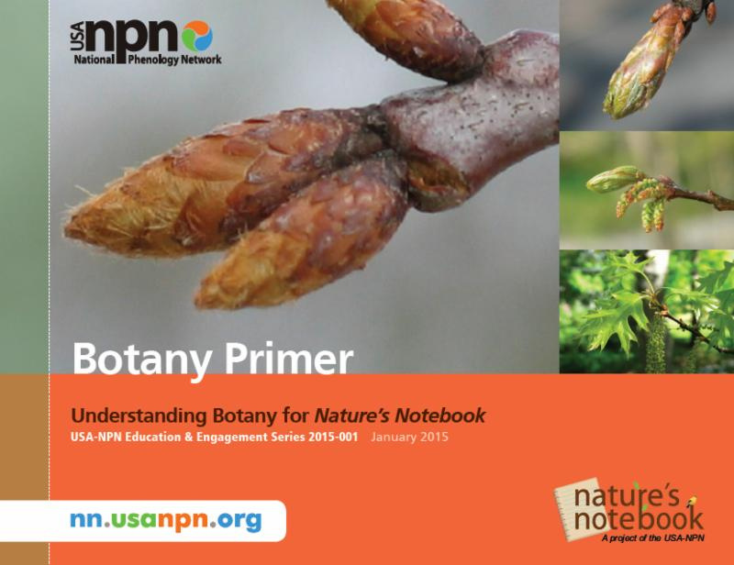
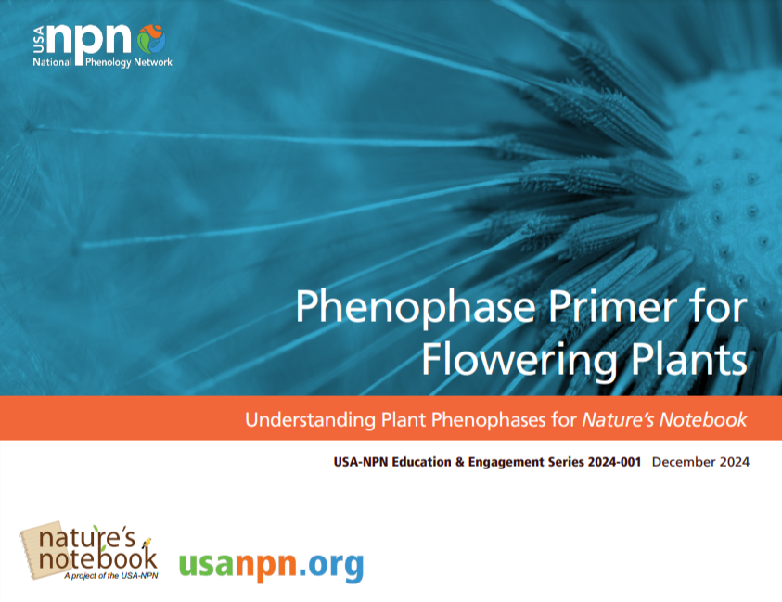
Notes:
And printed materials such as our indepth Botany and Phenophase Primers.

Slide 20
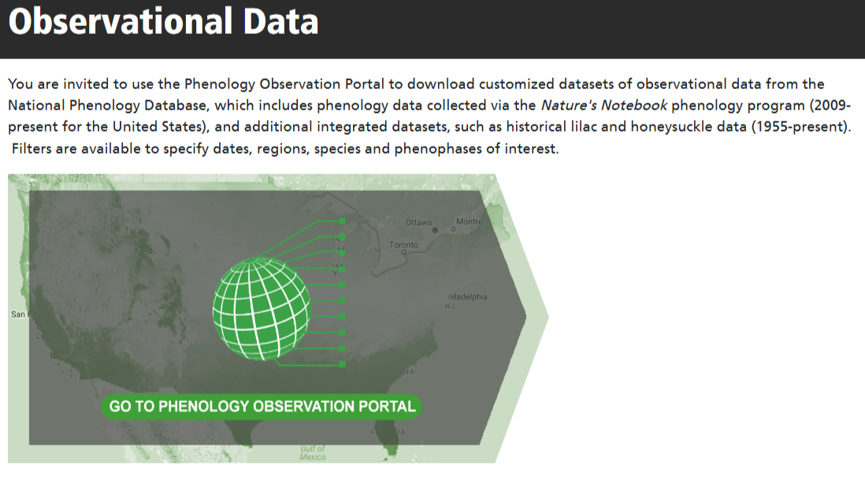
Notes:
All records are deposited in the National Phenology Database, which is securely maintained by the USA-NPN.

Slide 21
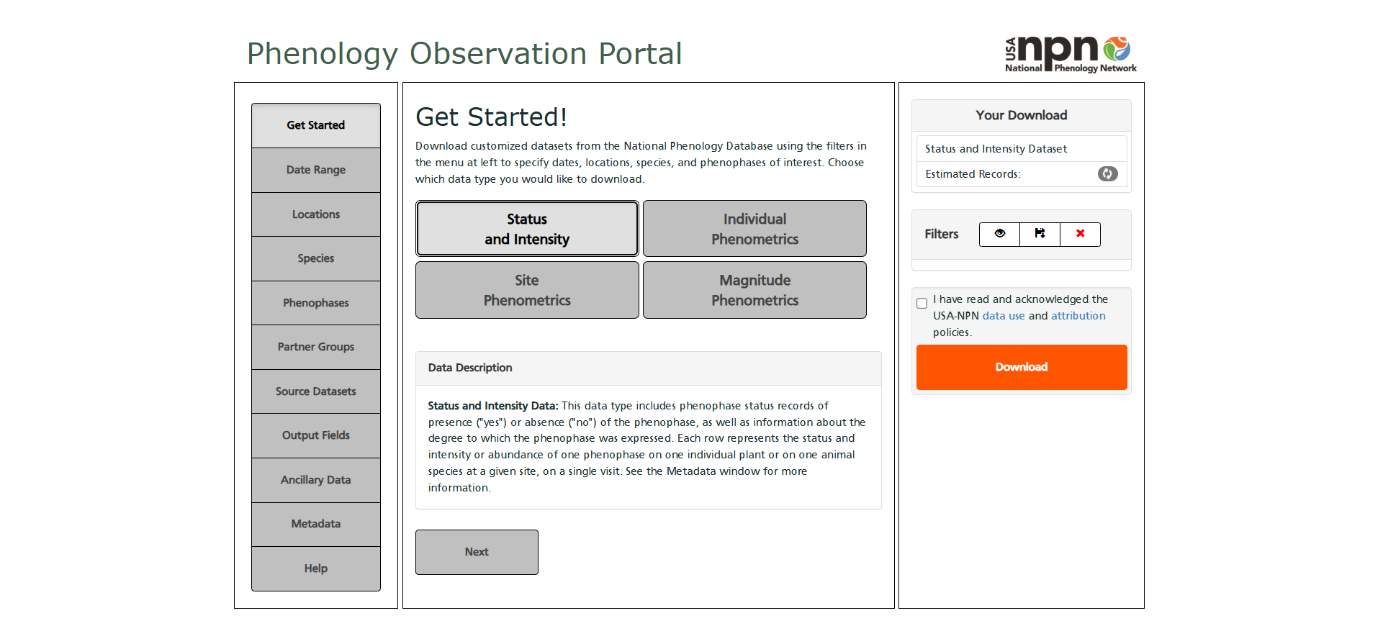
19
Notes:
Customized raw and summarized datasets can be freely downloaded to support scientific discovery and ecosystem management decisions.

Slide 22
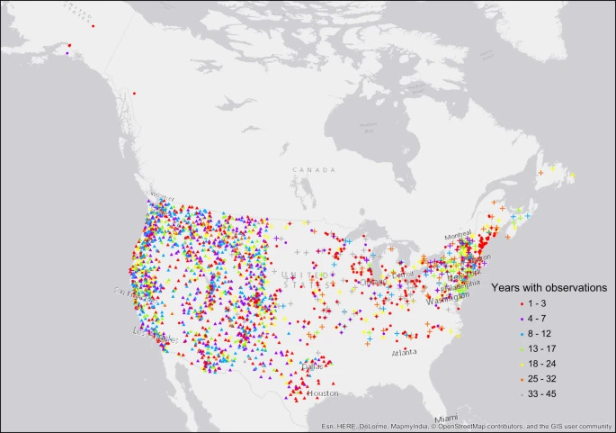
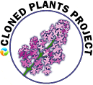
Source: Rosemartin et al. 2015, Nature Scientific Data
Notes:
The Database also supports historic and non-standard datasets such as the historic cloned lilac dataset which dates back to the 1950s.

Slide 23
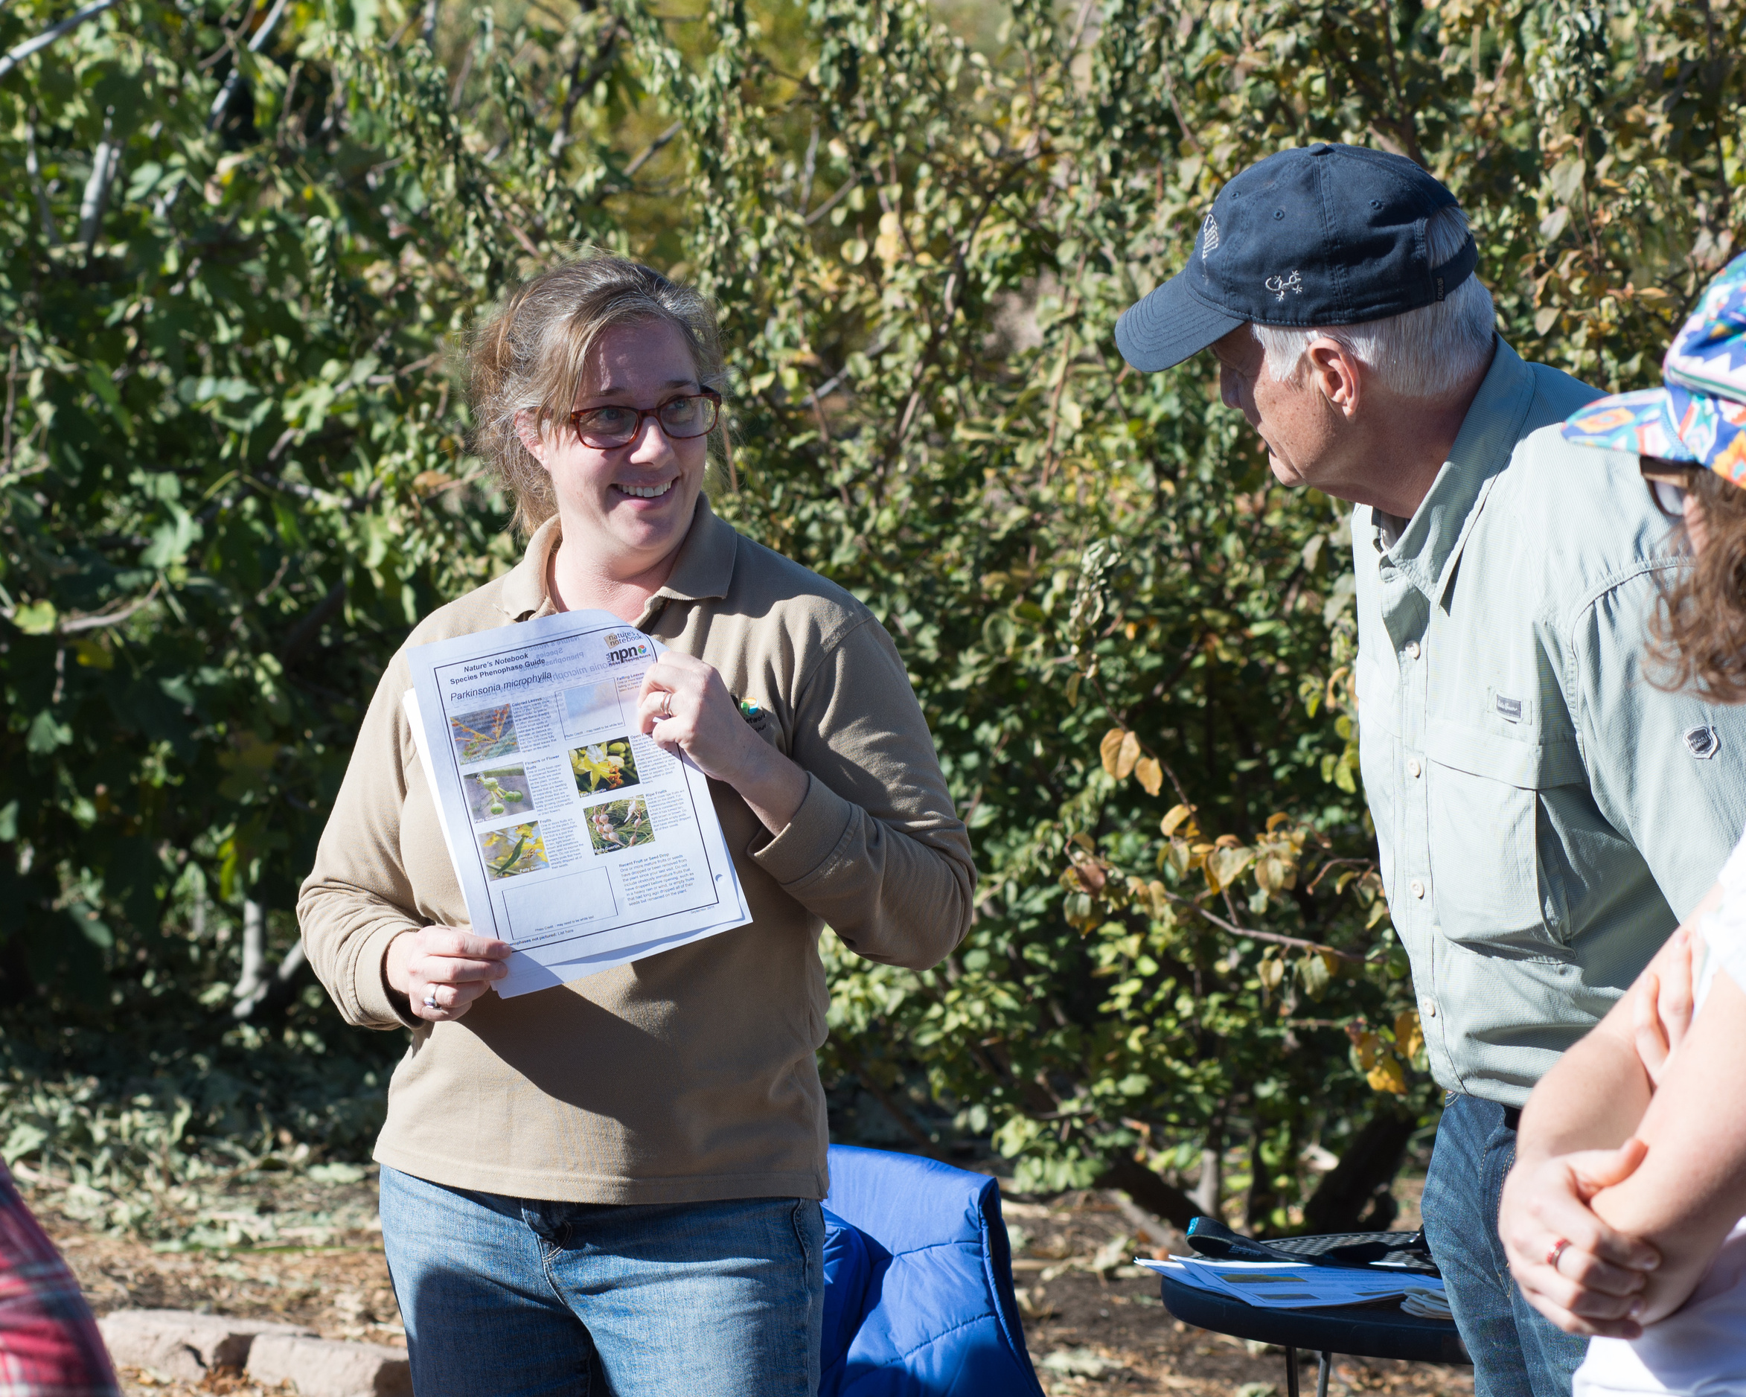
Photo: Brian F Powell
Notes:
We have various measures that we take to ensure the highest quality data, including quality assurance to ensure that the data are collected in a standardized way by trained volunteers

Slide 24
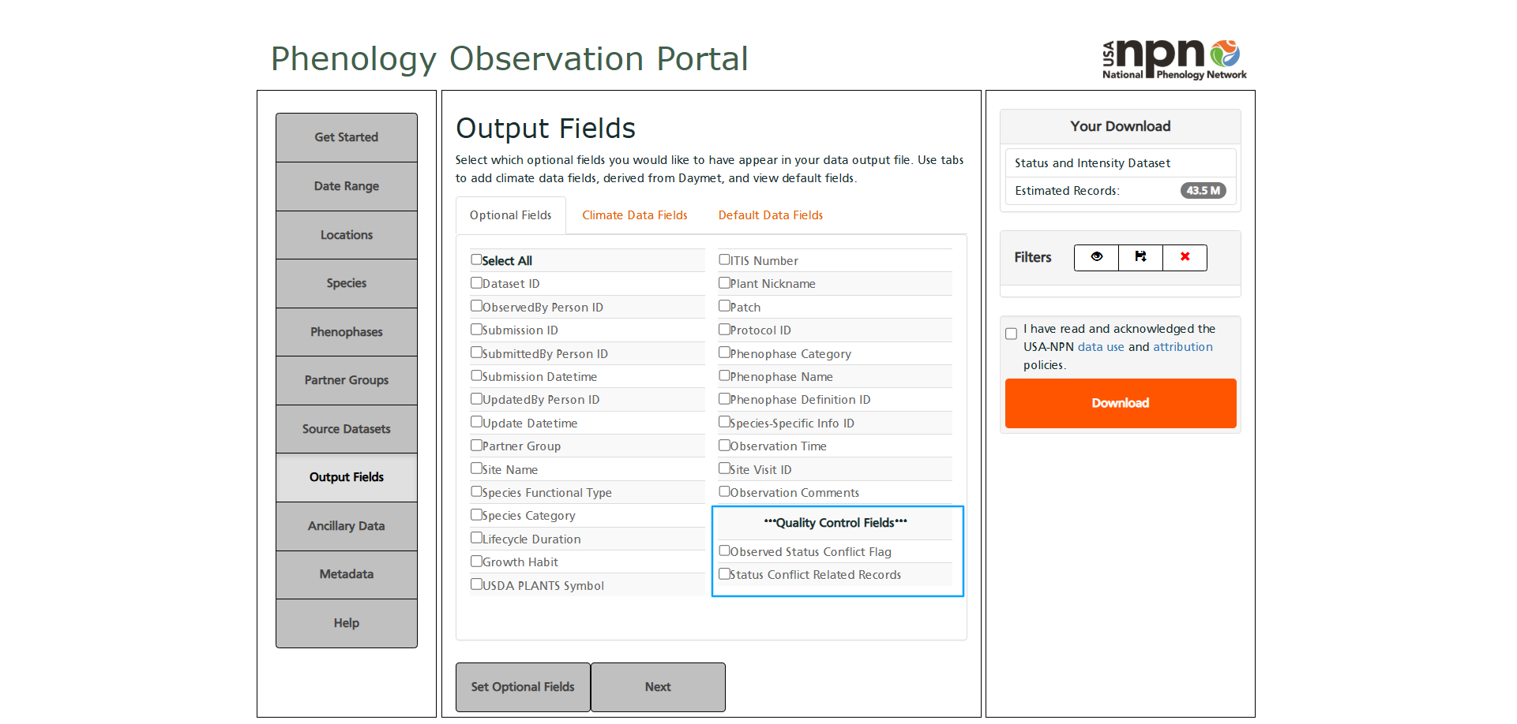
Notes:
And quality control, which includes flags that are available in the data downloaded from the USA-NPN Database.

Slide 25
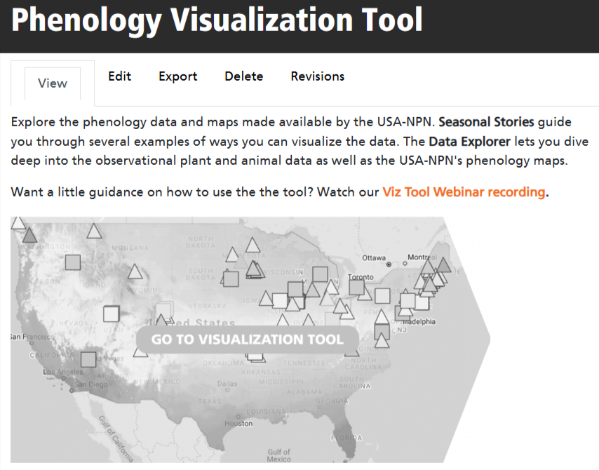
Notes:
The USA-NPN Phenology Visualization tool allows researchers and the public

Slide 26
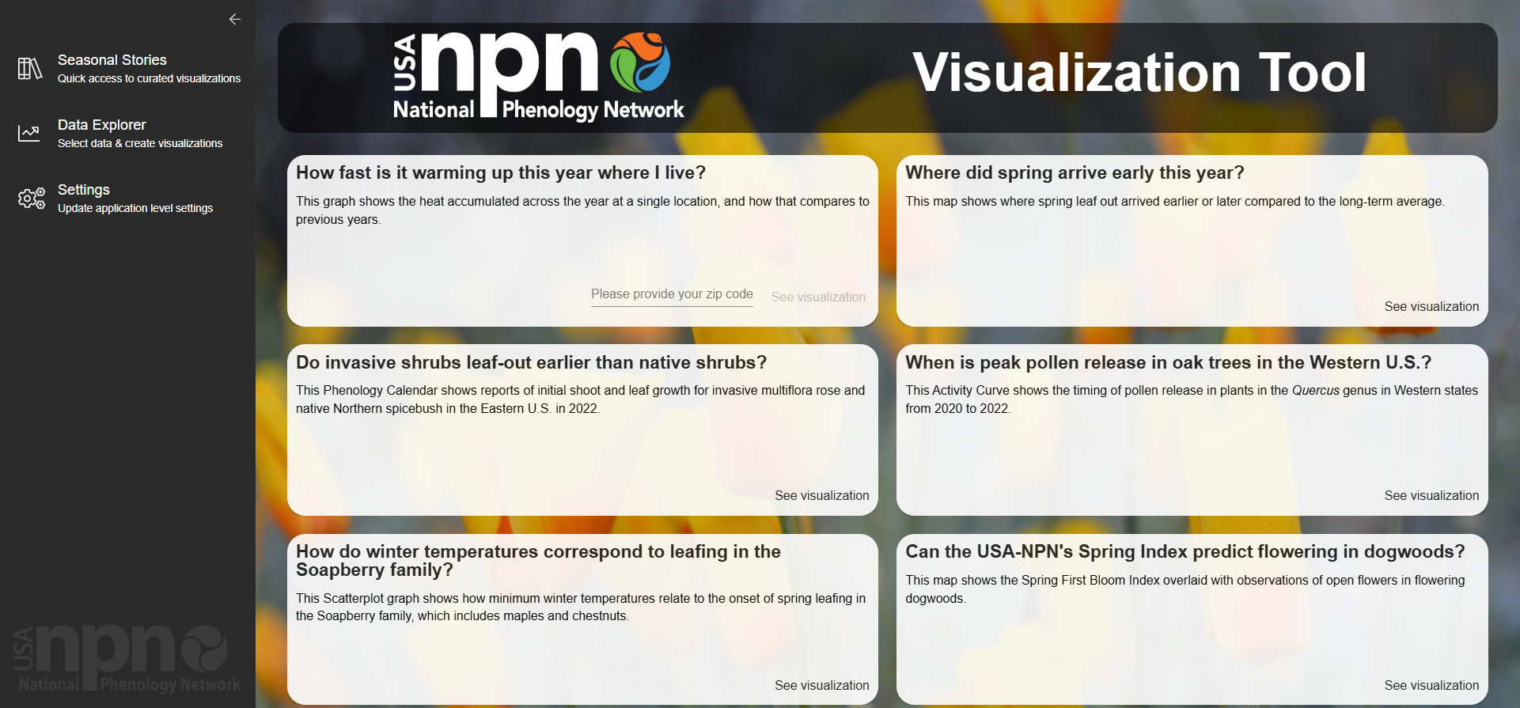
Notes:
To explore patterns in the data of the National Phenology Database.

Slide 27
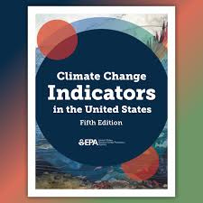

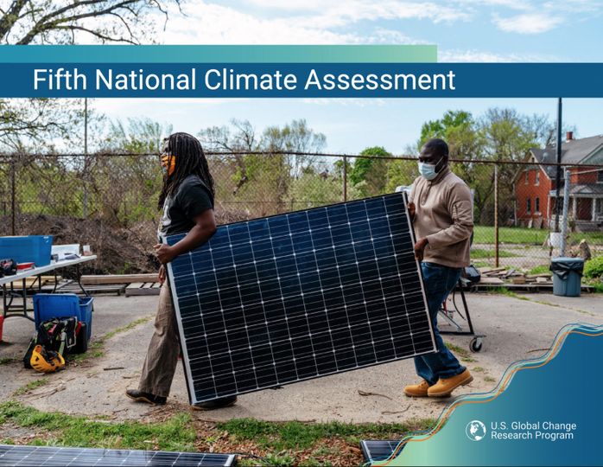
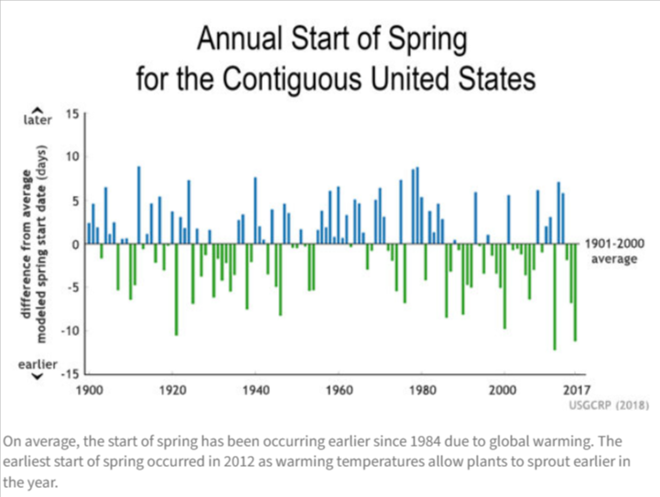
Notes:
USA-NPN data products have been highlighted in Fifth National Climate Assessment, EPA Climate Indicators of the United States, and the US Global Change and Research Program’s Indicators of Climate Change.

Slide 28
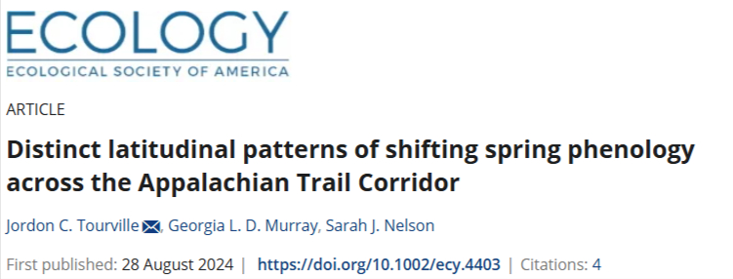
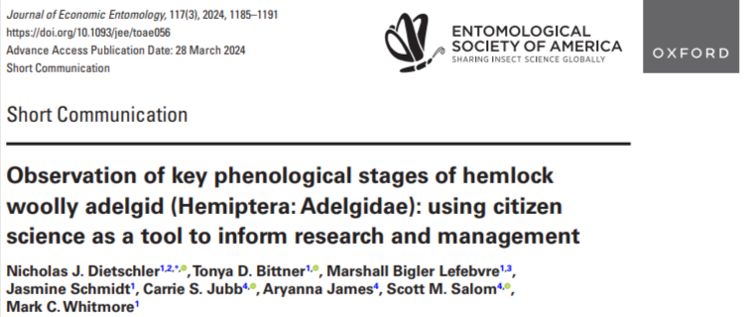
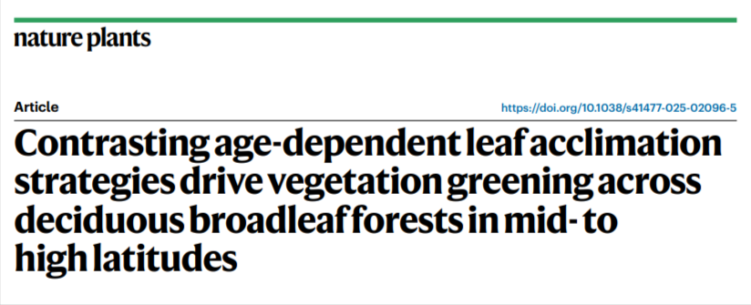
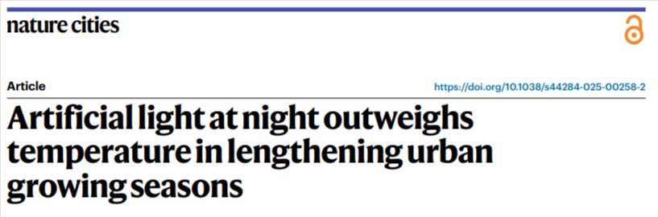
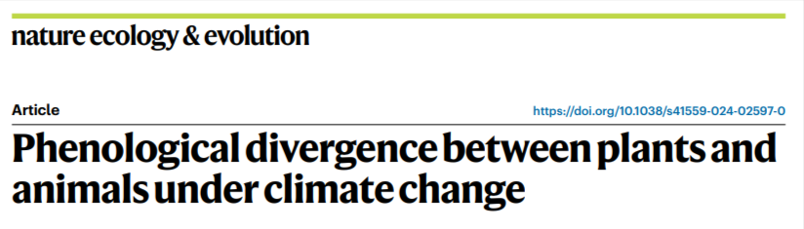
Over 200 peer-reviewed publications
Notes:
To date, over 200 published research studies have used data collected through Nature’s Notebook.

Slide 29
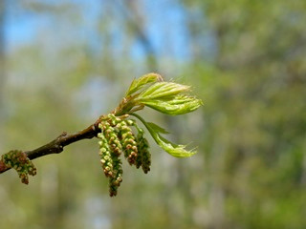
  Improve invasive species management
  Warmer winters affect timing of spring leaf out in plants
  Daytime temperatures - rather than nighttime – trigger leafing in temperate plants
  Springs are arriving earlier and the growing season is getting longer than in the past
  and more!
1
2
3
4
5
Source: 1: Gerst et al. 2021, Ecological Solutions and Evidence, Chapman et al. 2014, Global Change Biology; 2: Fu et al. 2015, Global Change Biology, Mazer et al. 2015 Ecosphere; 3: Piao et al. 2015 Nature Communications; 4: Allstadt et al. 2015 Environmental Research Letters
Notes:
These studies have demonstrated that phenology observations improve invasive species management, warmer winters affect timing of spring leaf out in plants, daytime temperatures - rather than nighttime – trigger leafing in temperate plants, and springs are arriving earlier and the growing season is getting longer than in the past.

Slide 30
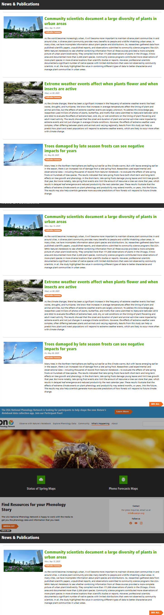
usanpn.org/news
Notes:
You can read about these studies and others on our website.

Slide 31

Become a backyard observer in Nature’s Notebook
Notes:
You too can become part of the USA National Phenology Network. Join Nature’s Notebook and track the seasonal timing of plants and animals where you live.

Slide 32
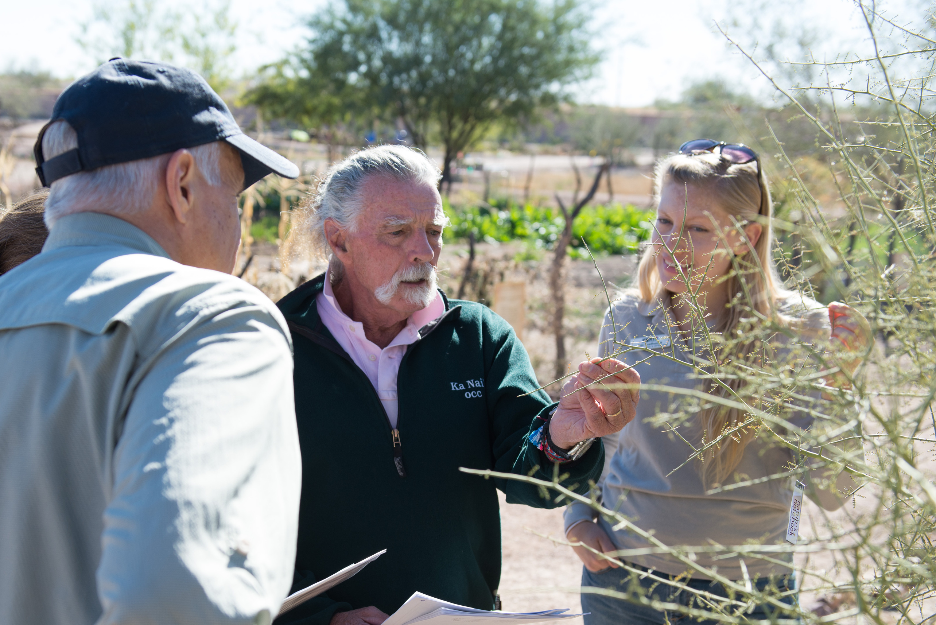
Start a Local Phenology Program
Notes:
Organize others in a local phenology program for research or outreach purposes.

Slide 33
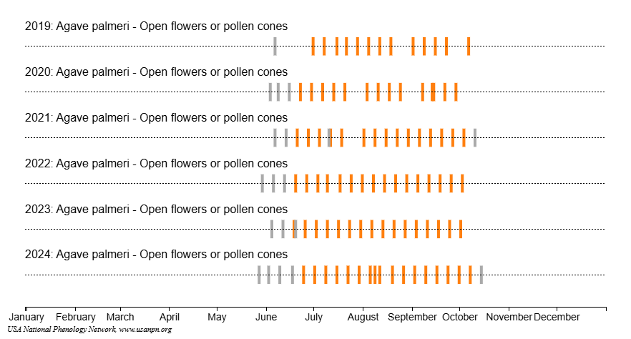
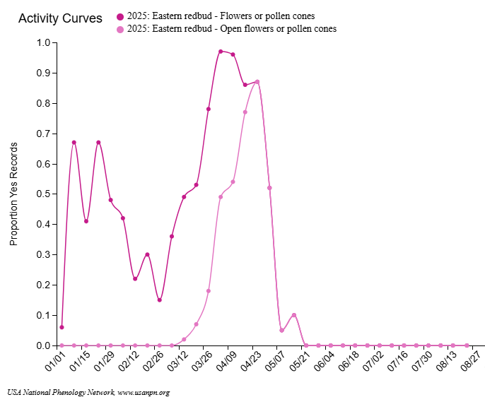
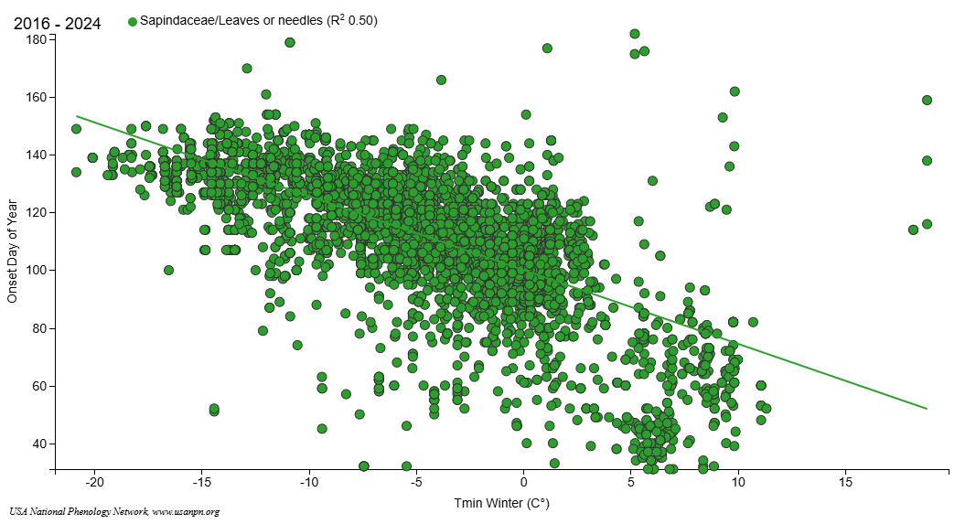
Download and explore Nature’s Notebook data
Notes:
Or download and explore phenological data on species of interest. We invite you to join us!

Slide 34

Learn more at
Notes:
Learn more at usanpn.org.

Slide 35
References (in order cited)
Rosemartin, A, Denny, E, Weltzin, J et al. 2015. Lilac and honeysuckle phenology data 1956–2014. Nature Scientific Data. doi.org/10.1038/sdata.2015.38
Gerst, KL, Crimmins, TM, Posthumus, EE, et al. 2021. The USA National Phenology Network's Buffelgrass Green-up Forecast map products. Ecological Solutions and Evidence e12109. doi.org/10.1002/2688-8319.12109
Chapman, DS, Haynes, T, Beal, S, et al. 2014. Phenology predicts the native and invasive range limits of common ragweed. Global Change Biology 20(1):192–202.doi.org/10.1111/gcb.12380.
Fu, Y, Piao, S, Vitasse, Y, et al. 2015. Increased heat requirement for leaf flushing in temperate woody species over 1980-2012: effects of chilling, precipitation and insolation. Global Change Biology. doi.org/10.1111/gcb.12863
Mazer, SJ, Gerst, KL, Matthews, ER, et al. 2015. Species-specific phenological responses to winter temperature and precipitation in a water-limited ecosystem. Ecosphere 6 (6). doi.org/10.1890/ES14-00433.1
Piao, S, Tan, J, Chen, A, et al. 2015. Leaf onset in the northern hemisphere triggered by daytime temperature. Nature Communications 6. doi.org/10.1038/ncomms7911
Allstadt, AJ, Vavrus, SL, Heglund, PJ, et al. 2015. Spring plant phenology and false springs in the conterminous US during the 21st century. Environmental Research Letters 10. doi.org/10.1088/1748-9326/10/10/104008
This video was created September 2025

