Slide 1
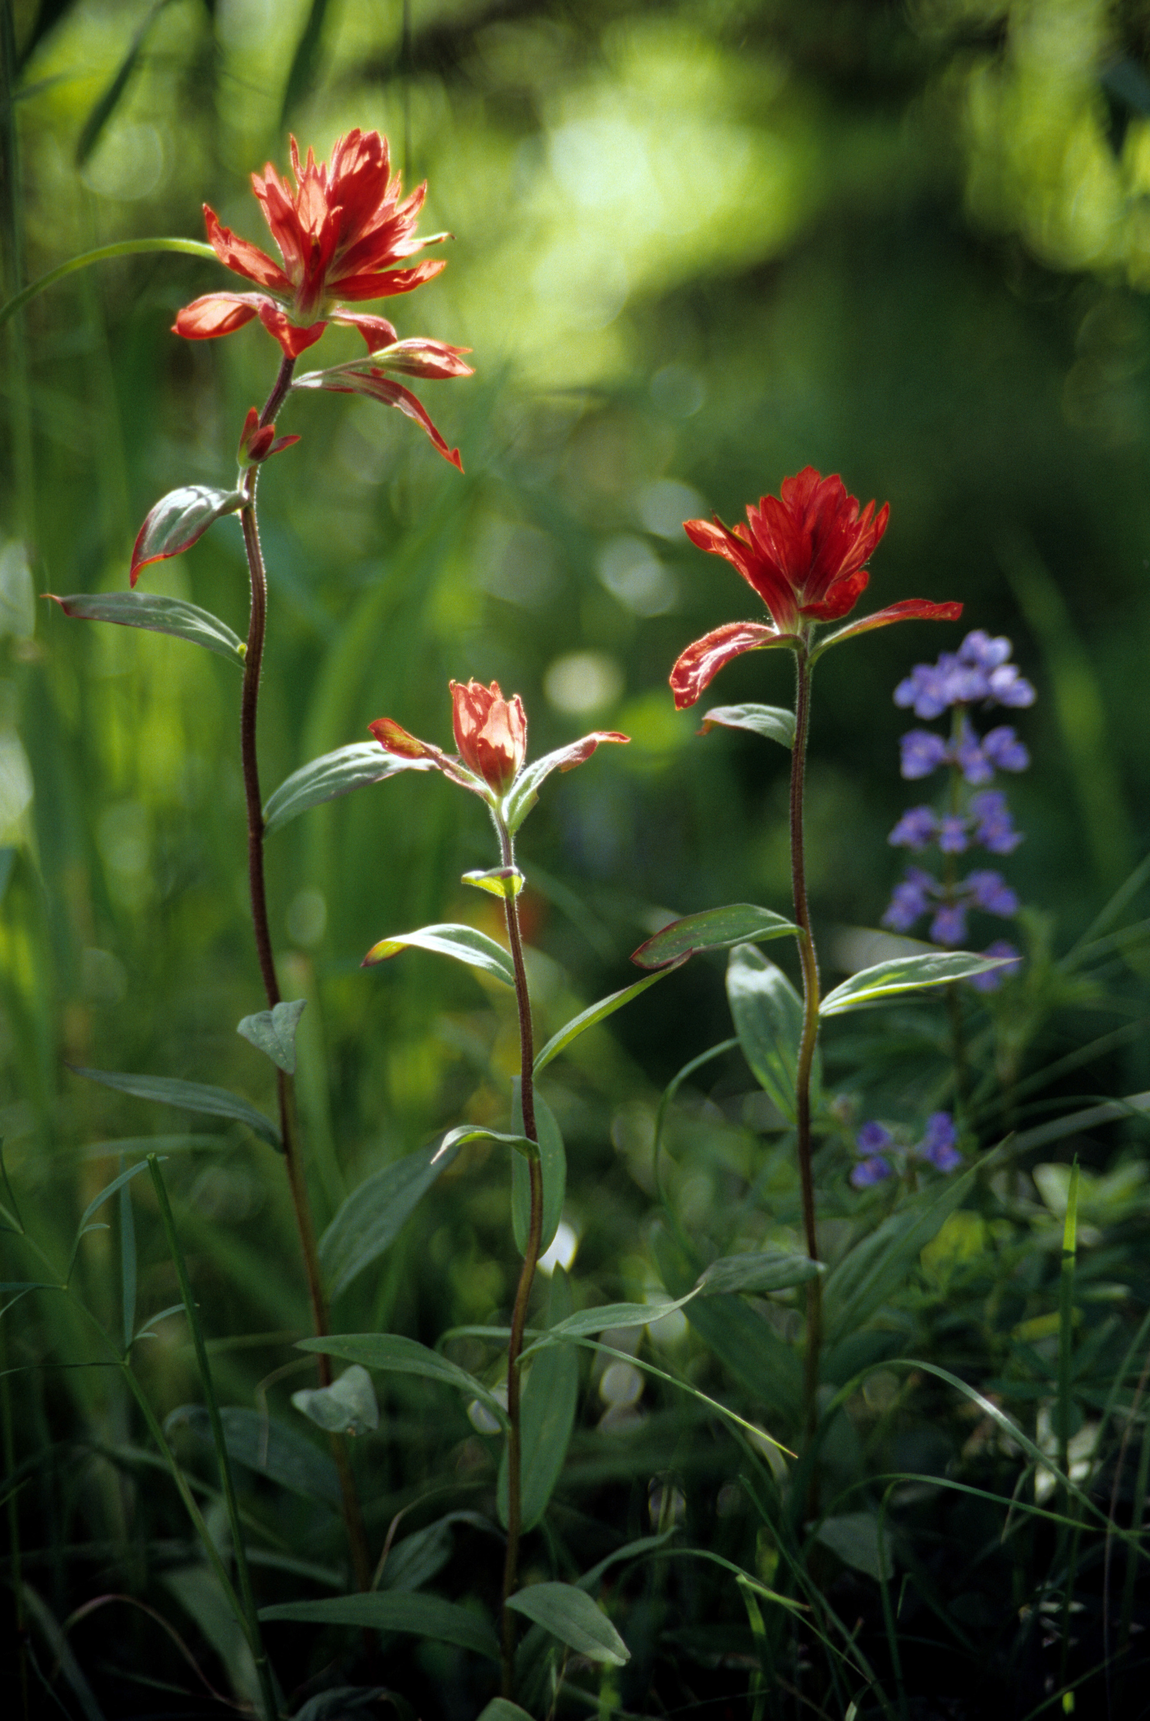
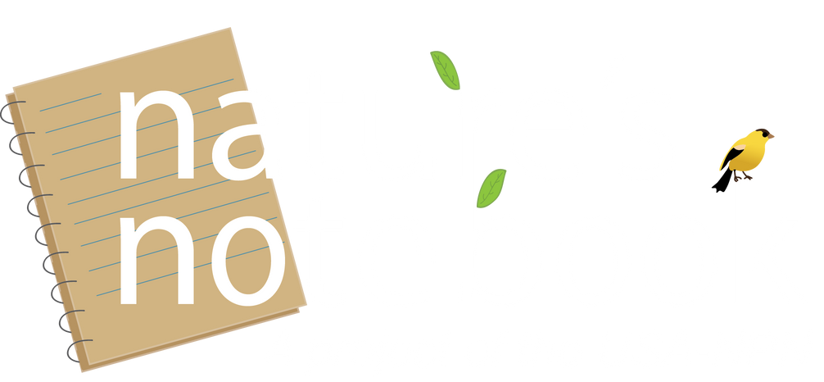


Who observes phenology?
Nature’s Notebook video series
Notes:
Phenology is the study of recurring plant and animal life cycle stages

Slide 2
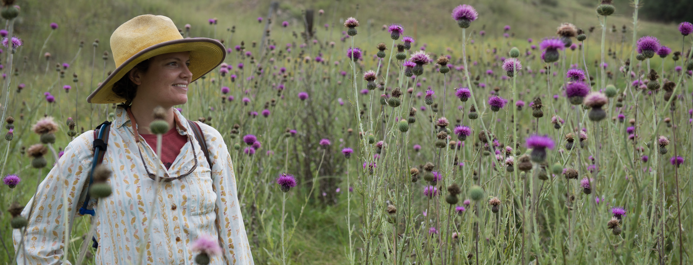


Photo: Brian F Powell
Notes:
Phenology, the study of the timing of plant and animal seasonal cycles, can be observed by anyone who has an interest in nature. Phenology has a rich and deep history.

Slide 3
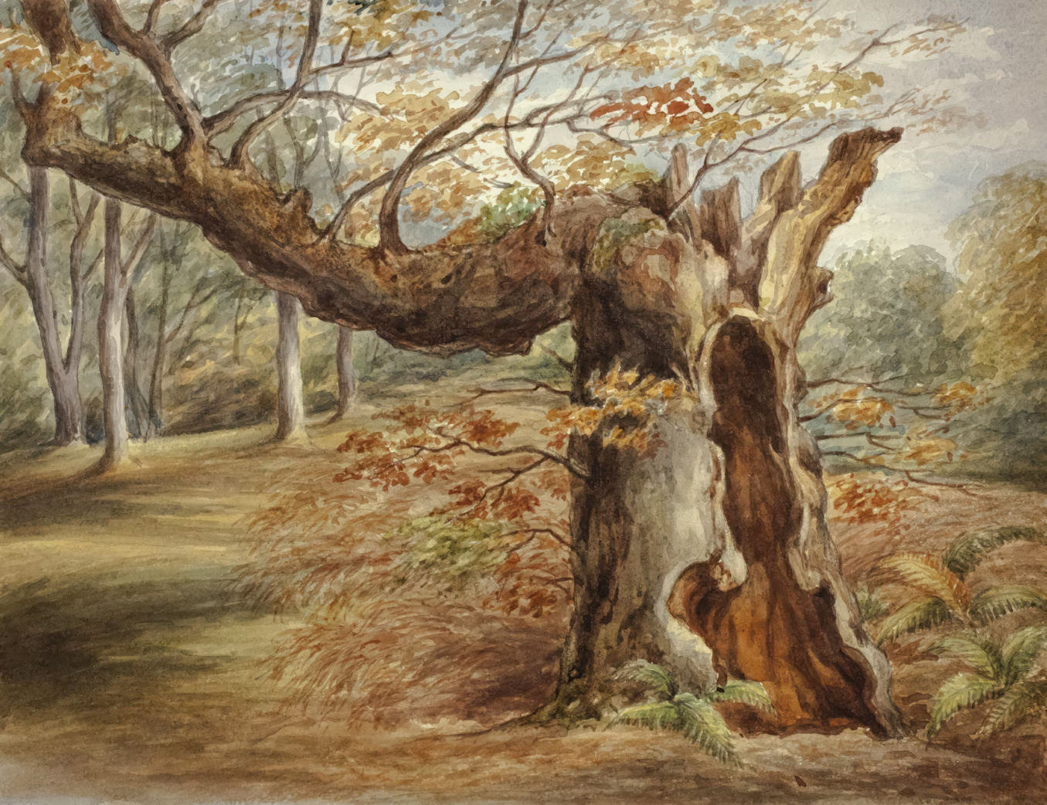
Photo: Elizabeth Murray English via Unsplash, Public Domain
Notes:
Phenology has a rich and deep history.

Slide 4
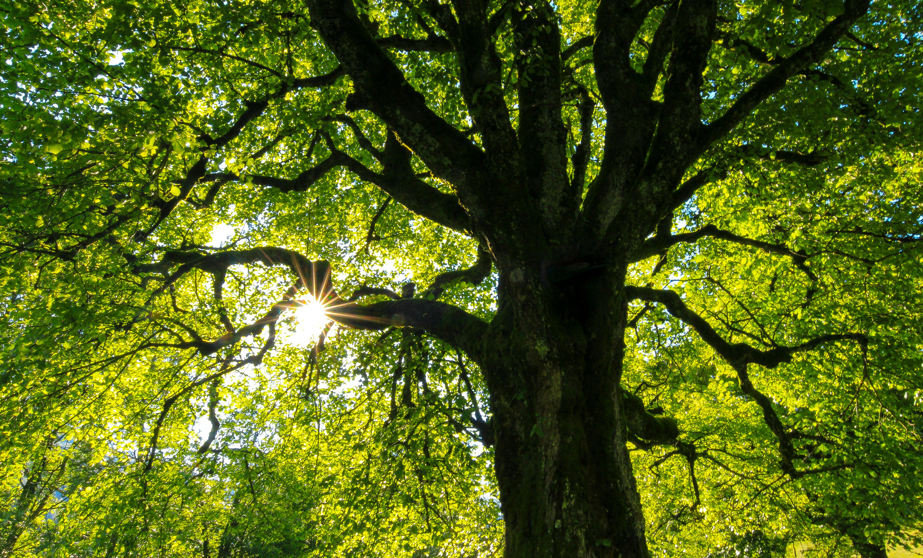
Photo: Jan Huber via Unsplash, Public Domain
Notes:
The first phenologists were Indigenous Peoples who carefully tracked the seasonal events of plants and animals, passing down their ecological knowledge through generations. You may have heard adages such as “plant corn when oak leaves are the size of a squirrel’s ear”, which was observed by Native Americans centuries ago.

Slide 5
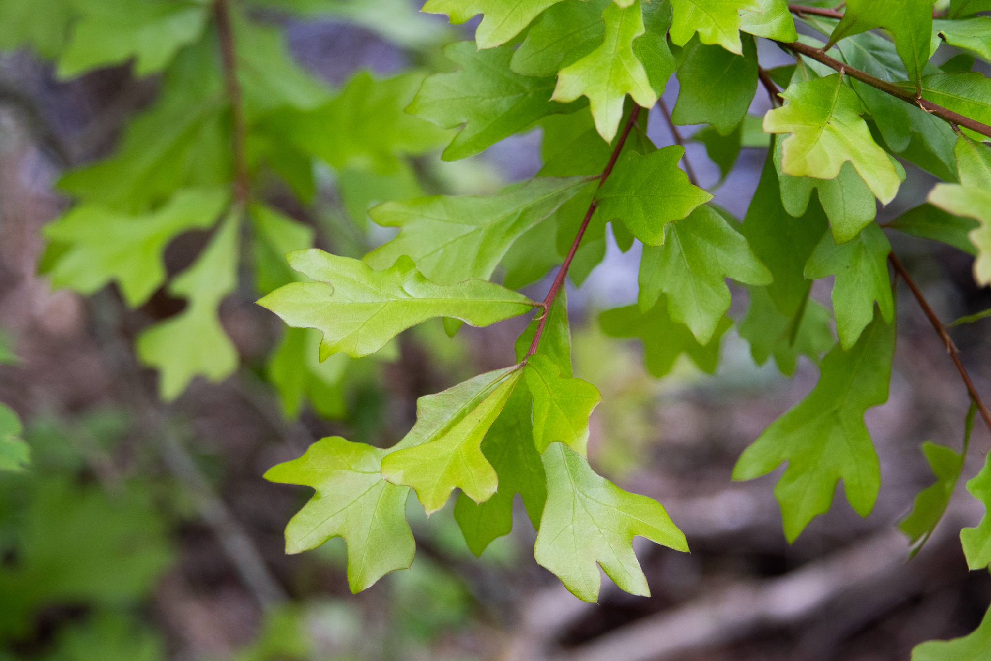
Plant corn when oak leaves are the size of a squirrel’s ear
Photo: Gina Lloyd via SmugMug, CC-BY-NC-SA 4.0
Notes:
The first phenologists were Indigenous Peoples who carefully tracked the seasonal events of plants and animals, passing down their ecological knowledge through generations. You may have heard adages such as “plant corn when oak leaves are the size of a squirrel’s ear”, which was observed by Native Americans centuries ago.

Slide 6
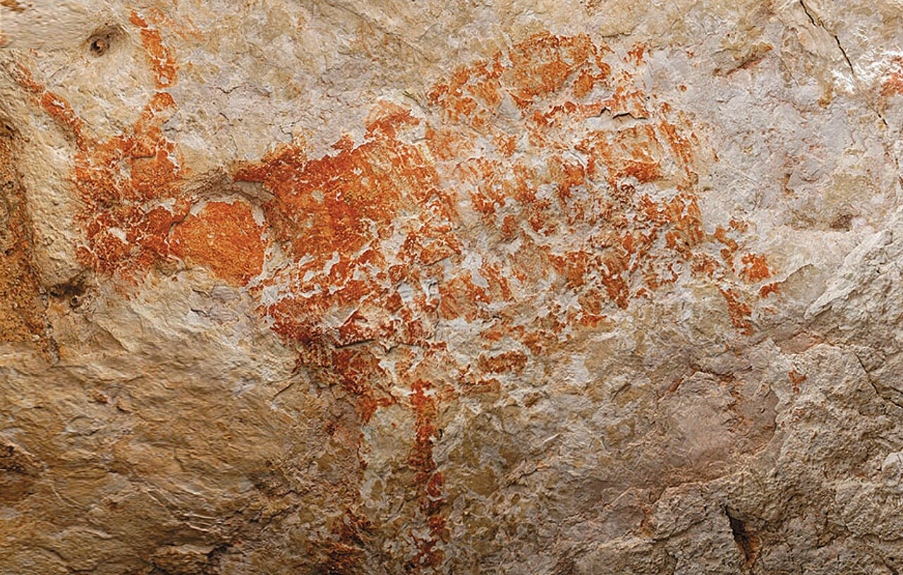
Photo: Luc-Henri Fage via Wikipedia, Public Domain
Notes:
The first known written evidence of phenology can be found in Upper Paleolithic Cave Paintings in Europe dating back 37,000 years ago. Early people placed symbols denoting the lunar calendar next to images of animals to record their seasonal timing.

Slide 7
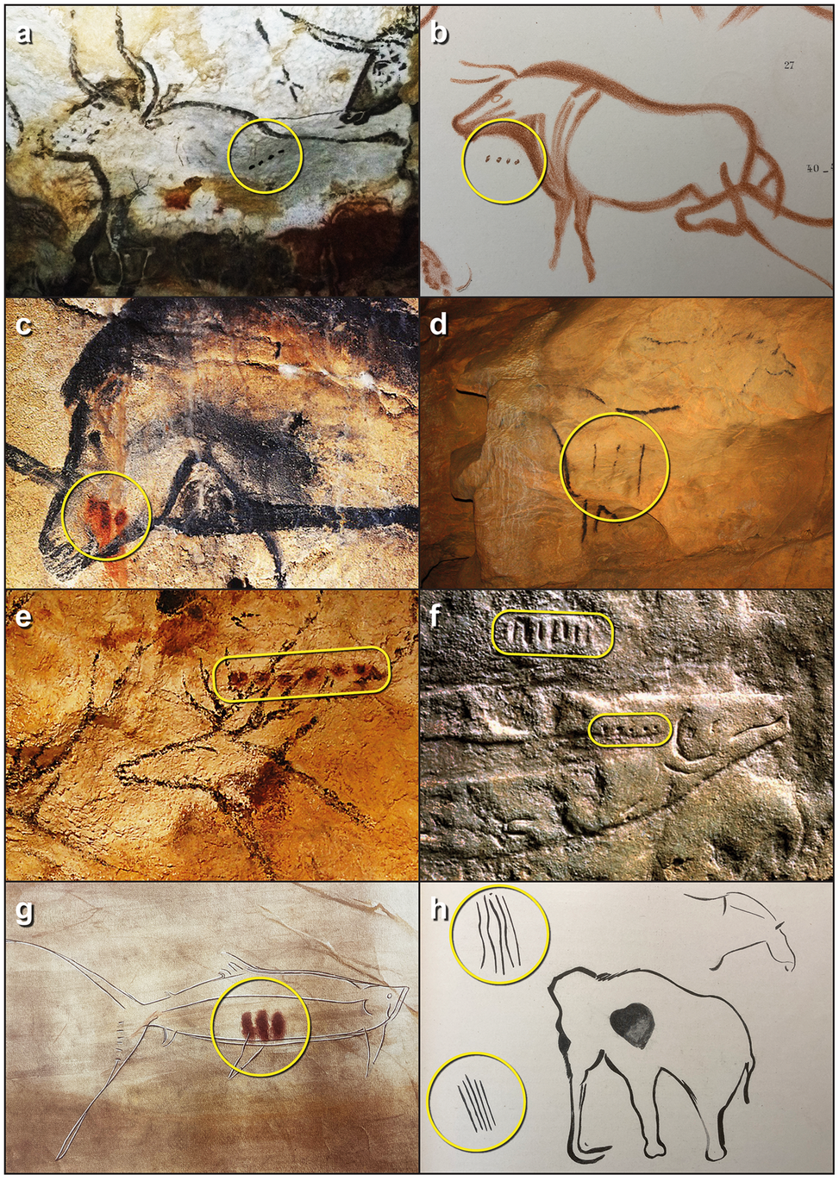
Credit: Bacon et al. 2023, Cambridge Archaeological Journal
Notes:
The first known written evidence of phenology can be found in Upper Paleolithic Cave Paintings in Europe dating back 37,000 years ago. Early people placed symbols denoting the lunar calendar next to images of animals to record their seasonal timing.
doi: 10.1017/S0959774322000415

Slide 8
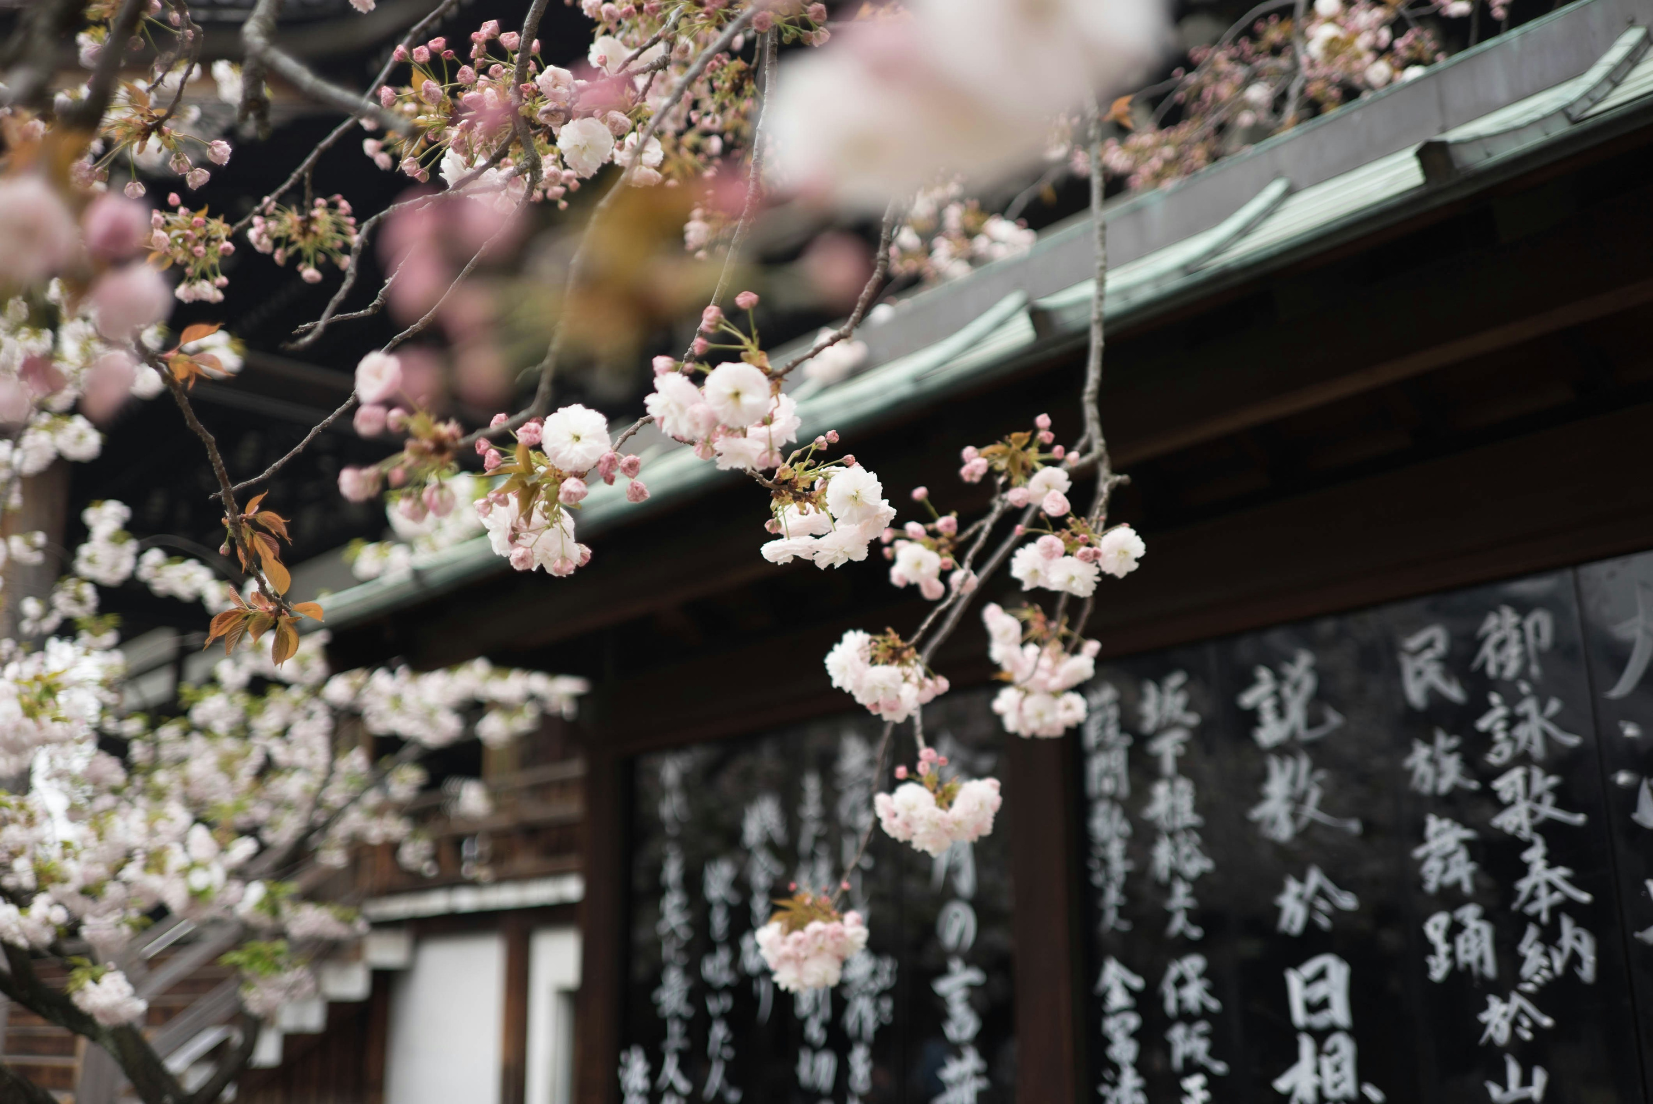
Photo: Galen Crout via Unsplash, Public Domain
Notes:
In Japan, the bloom timing of iconic cherry trees has been recorded consistently since the 9th century. These records demonstrate a striking shift in recent decades.

Slide 9
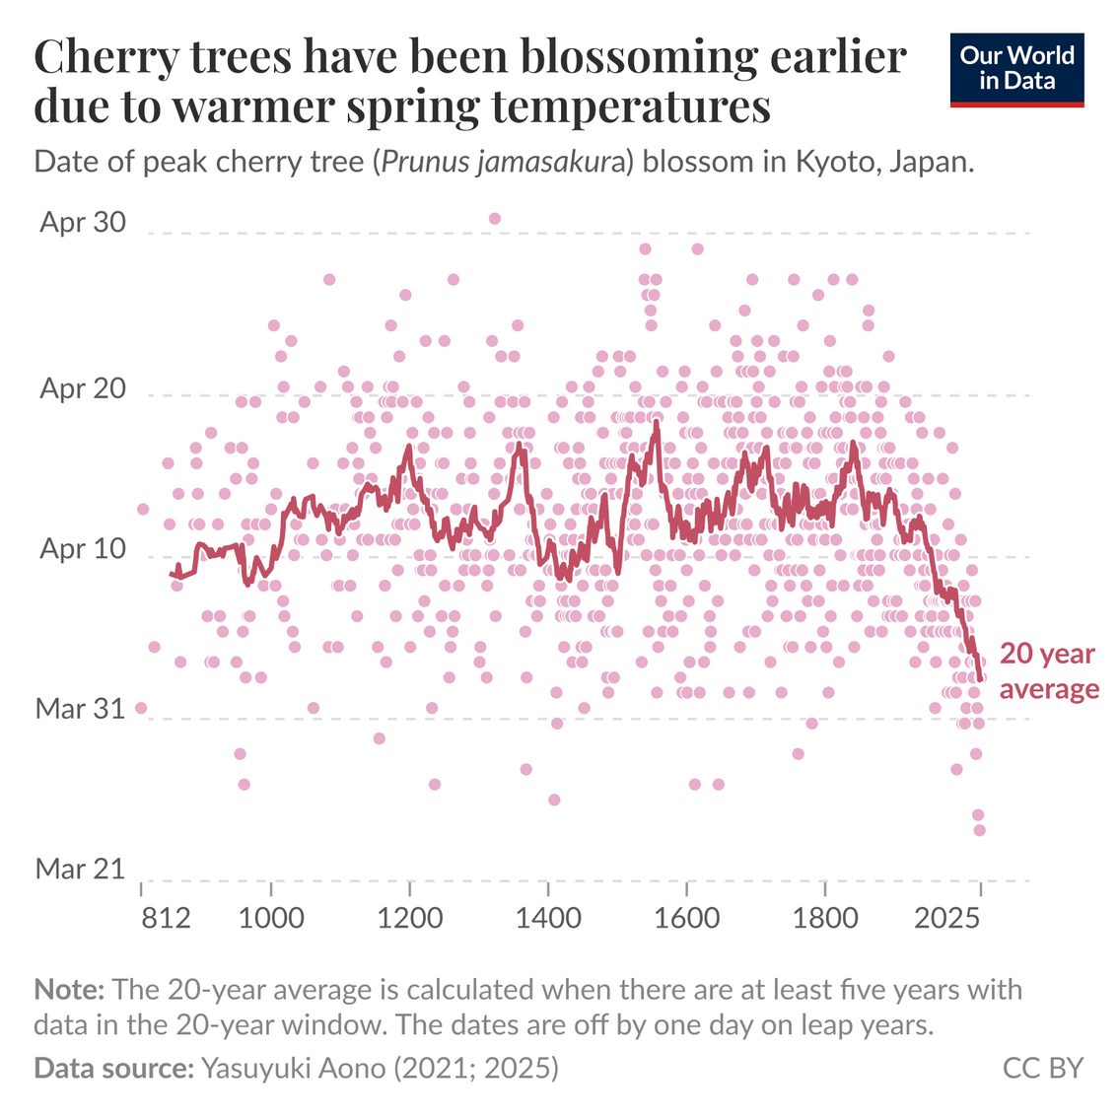
Credit: ourworldindata.org/data-insights/japans-cherry-trees-have-been-blossoming-earlier-due-to-warmer-spring-temperatures
Notes:
In Japan, the bloom timing of iconic cherry trees has been recorded consistently since the 9th century. These records demonstrate a striking shift in recent decades.

Slide 10
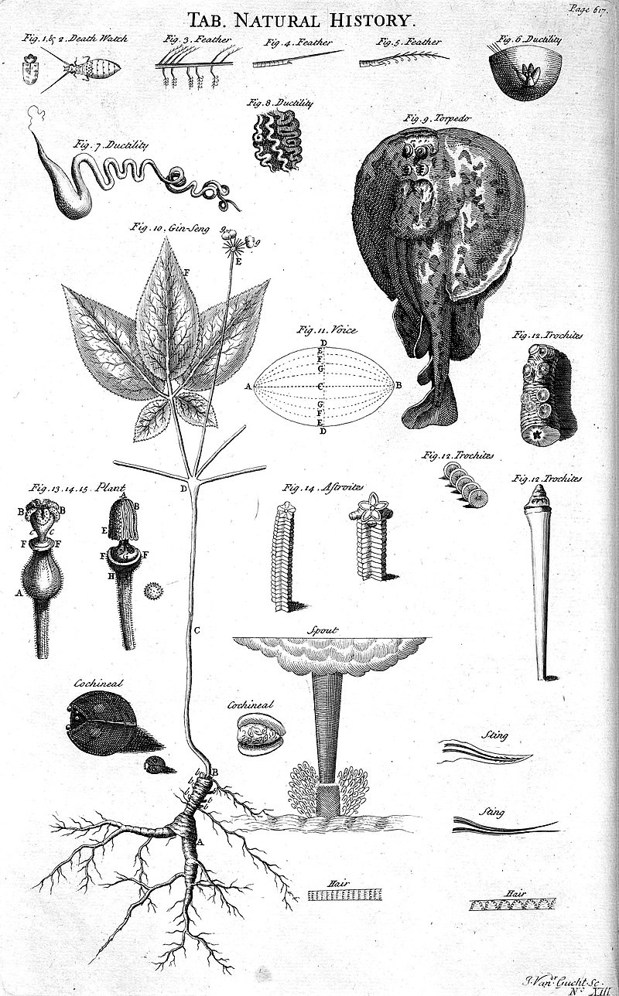
Credit: Ephraim Chamber's 1728 Cyclopaedia via Wikipedia, Public Domain
Notes:
Starting in the mid-18th century, western science approaches were used to understand phenology. French entomologist René de Réaumur established that plants must be exposed to a particular amount of warmth to flower.

Slide 11
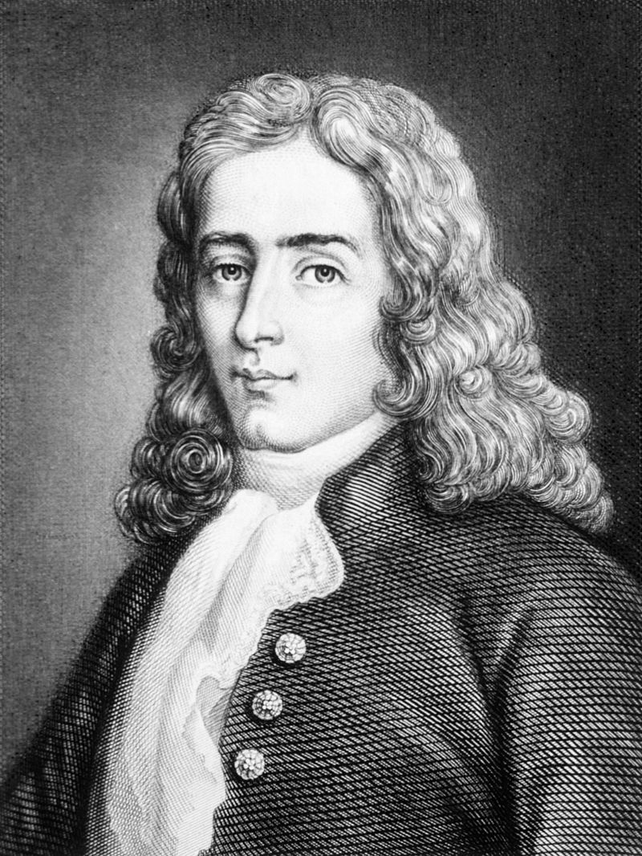
René de Réaumur
Photo: Metzeroth via Wikipedia, Public Domain
Notes:
Starting in the mid-18th century, western science approaches were used to understand phenology. French entomologist René de Réaumur established that plants must be exposed to a particular amount of warmth to flower.

Slide 12
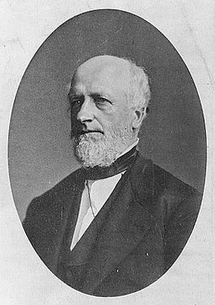
Franklin Hough
Photo: Library of Congress via Wikipedia, Public Domain
Notes:
In the mid-19th century, Franklin Hough of the Smithsonian Institute coordinated historical phenology collection by volunteer observers all across the Eastern US.

Slide 13
phe·​nol·​o·​gy
Notes:
Around this same time, the term ‘phenology’ was brought into the lexicon, coined by botanist Charles Morren to refer to the study of recurring seasonal cycles of plants and animals. The word phenology is derived from the Greek “phaino”, meaning to show, bring to light, or appear.

Slide 14
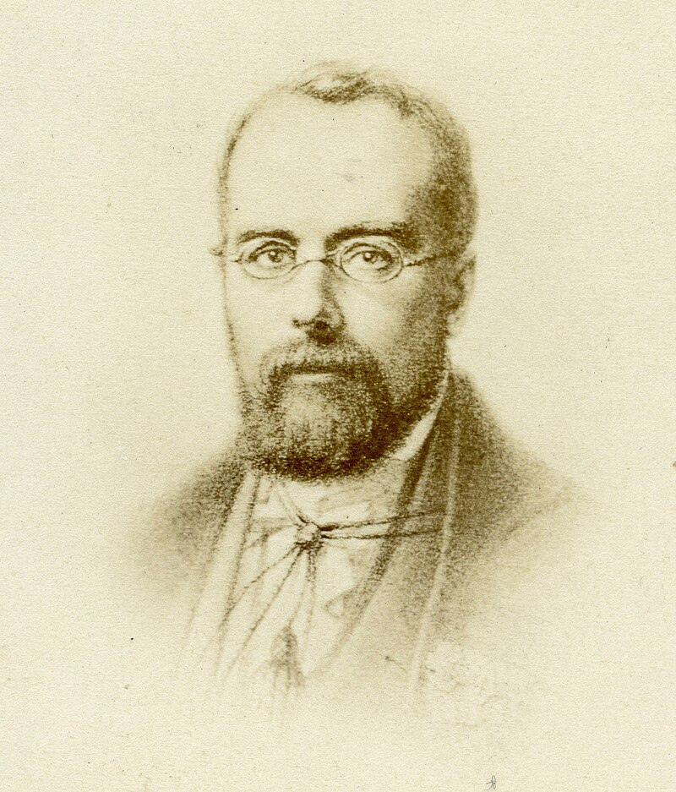
Charles Morren
The study of recurring seasonal cycles of plants and animals
Photo: Walter Damry via Wikipedia, Public Domain
Notes:
Around this same time, the term ‘phenology’ was brought into the lexicon, coined by botanist Charles Morren to refer to the study of recurring seasonal cycles of plants and animals. The word phenology is derived from the Greek “phaino”, meaning to show, bring to light, or appear.

Slide 15
phaínō
to show, bring to light, appear
Notes:
Around this same time, the term ‘phenology’ was brought into the lexicon, coined by botanist Charles Morren to refer to the study of recurring seasonal cycles of plants and animals. The word phenology is derived from the Greek “phaino”, meaning to show, bring to light, or appear.

Slide 16
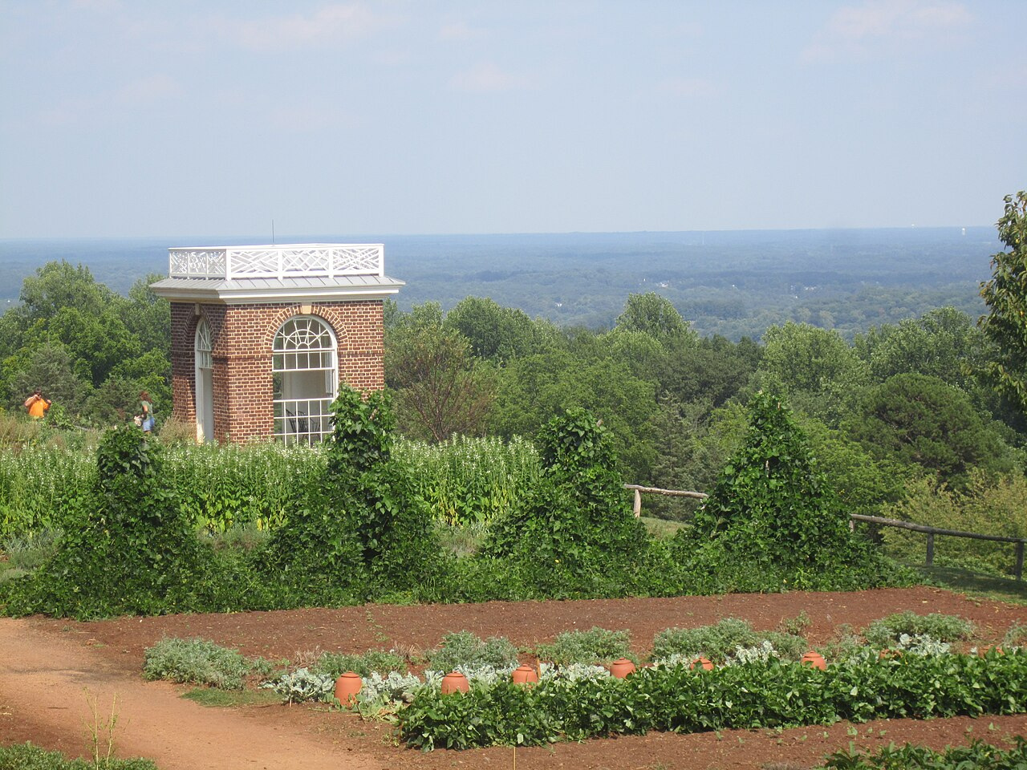
Monticello
Photo: Billy Hathorn viaWikipedia, CC BY-SA 3.0
Notes:
Several early western naturalists paid careful attention to phenological happenings.
Thomas Jefferson kept detailed records of crops at his home in Monticello

Slide 17
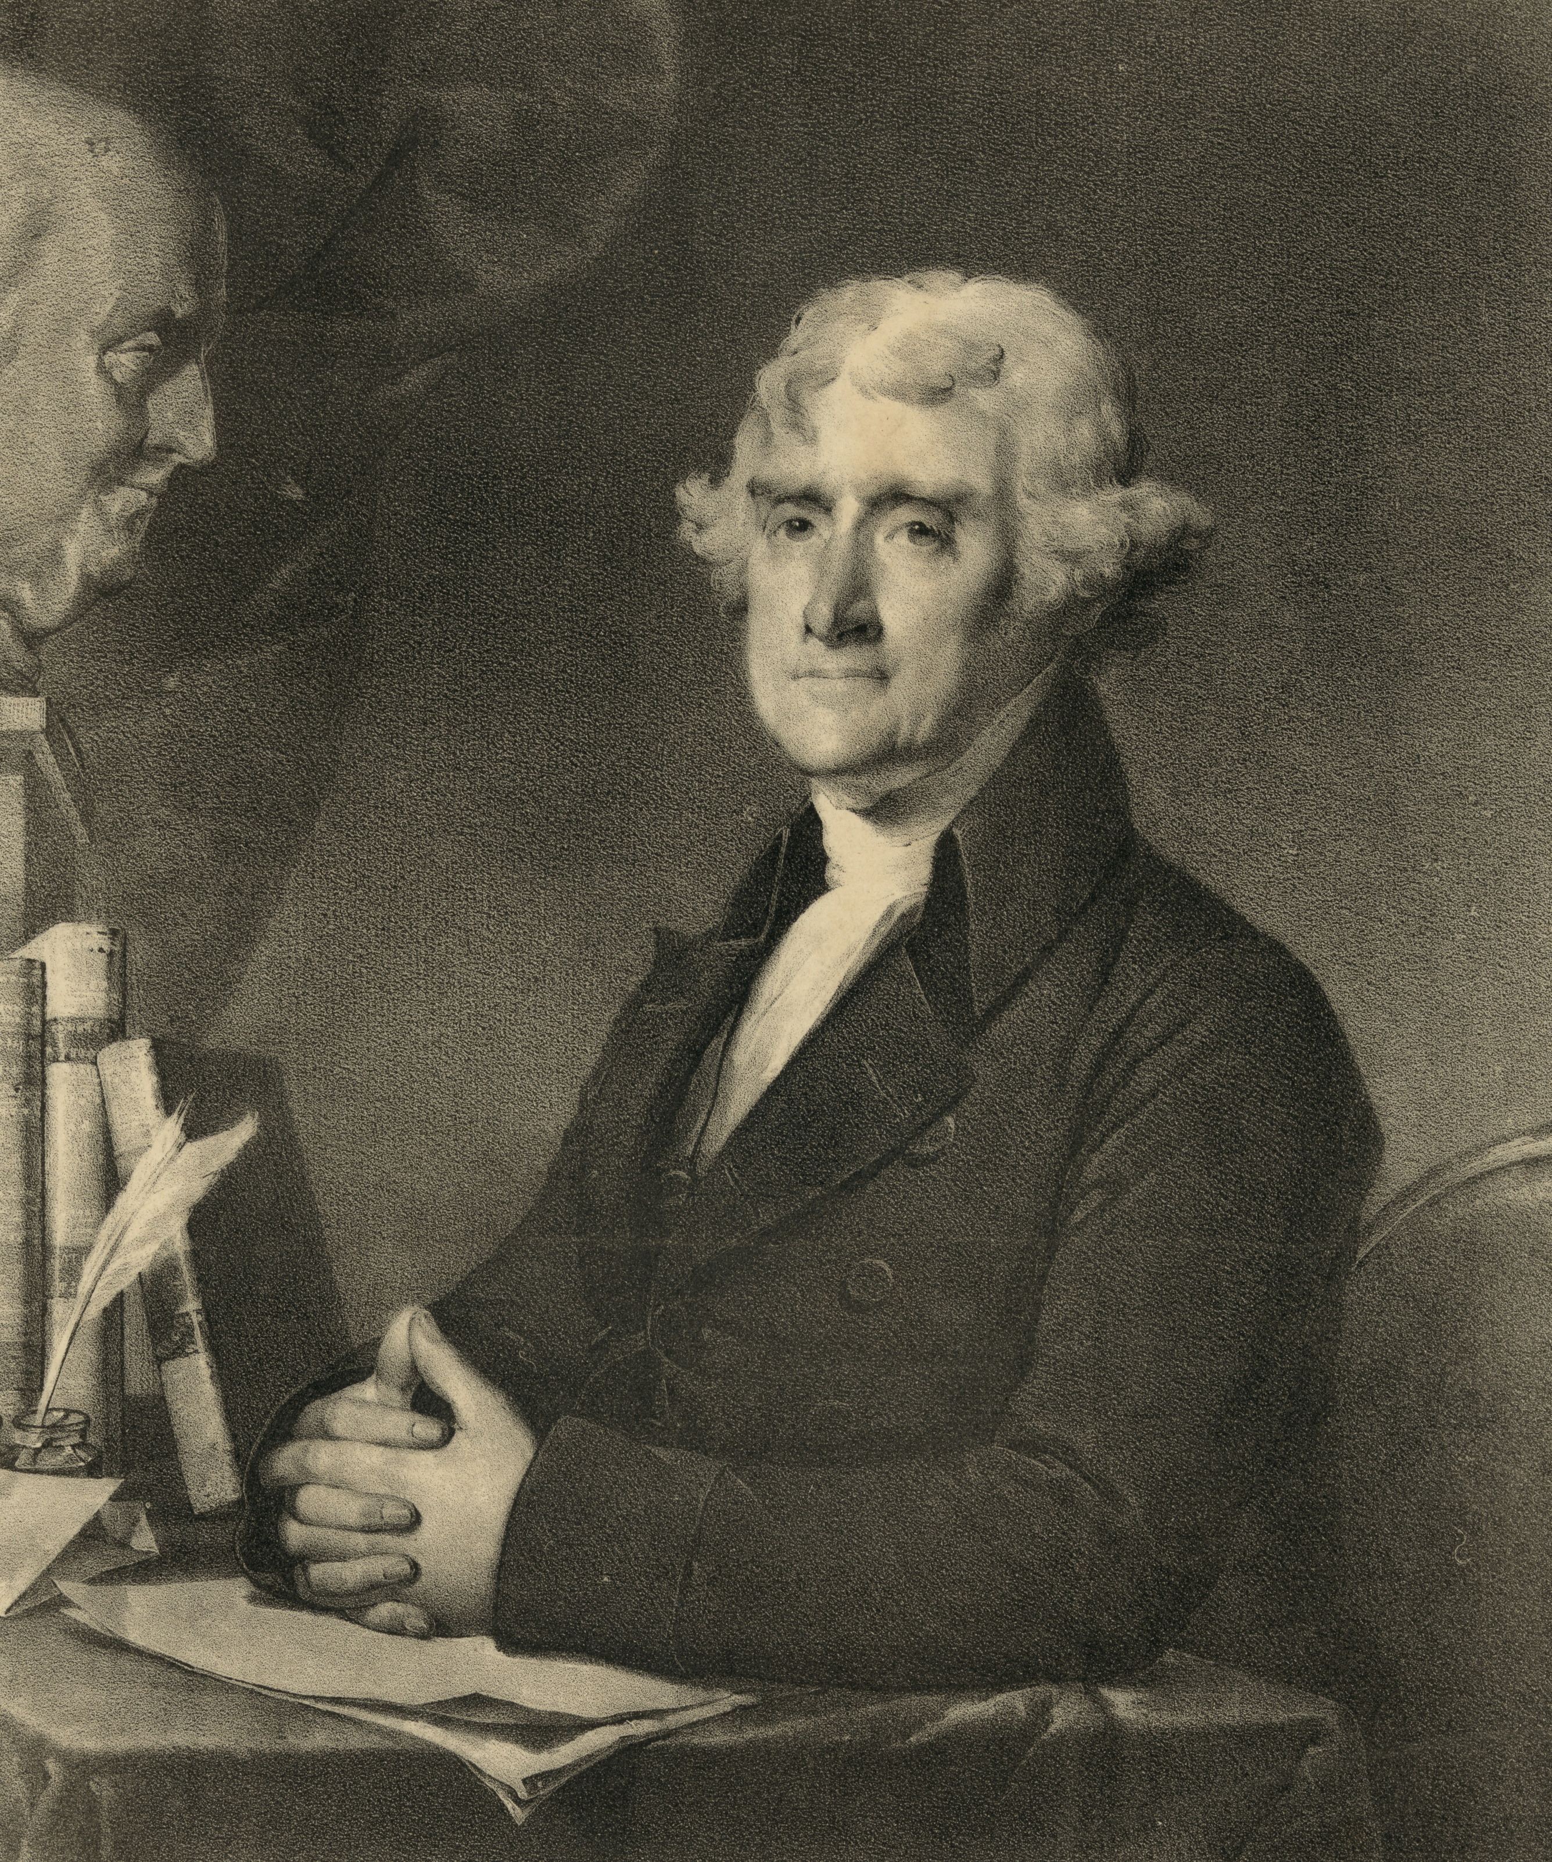
Thomas Jefferson
Photo: Library of Congress via Unsplash, Public Domain
Notes:
Several early western naturalists paid careful attention to phenological happenings.
Thomas Jefferson kept detailed records of crops at his home in Monticello

Slide 18
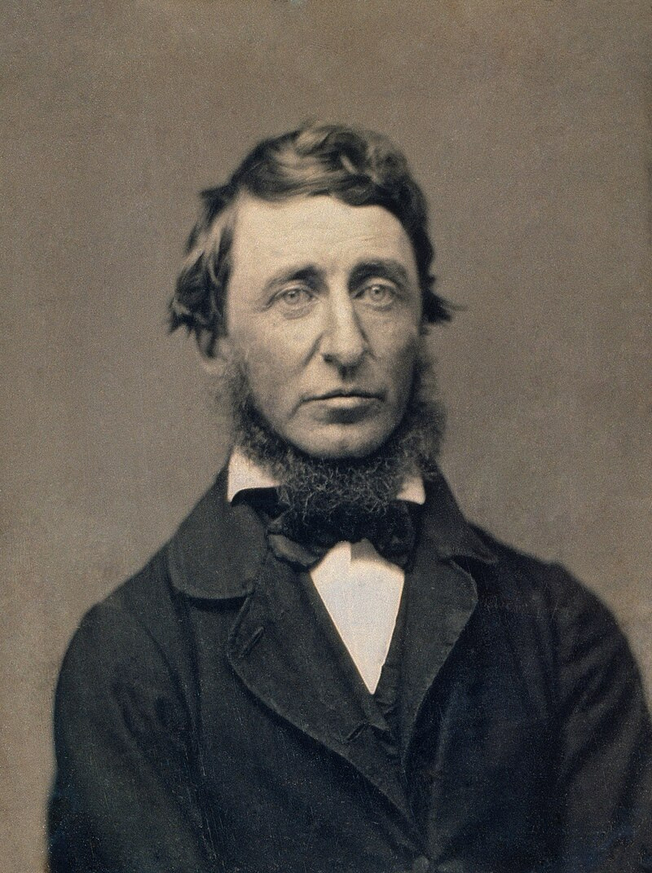
Henry David Thoreau
Credit: Benjamin D. Maxham via Wikipedia, Public Domain
Notes:
Henry David Thoreau wrote detailed records of plant phenology at Walden pond

Slide 19
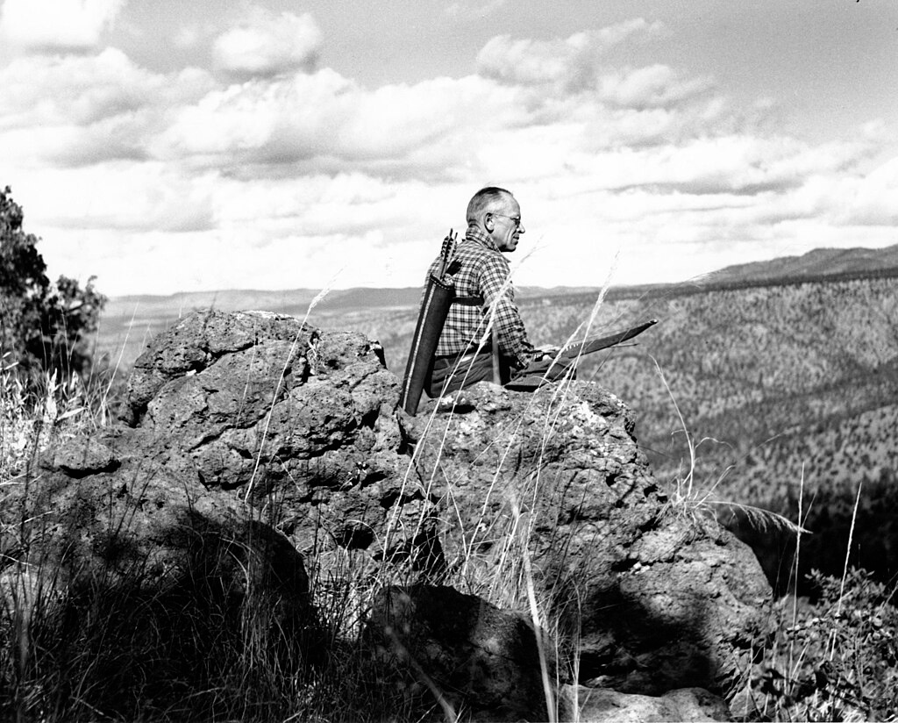
Aldo Leopold
Photo: USDA via Wikipedia, Public Domain
Notes:
Aldo Leopold and later, his daughter Nina Leopold Bradley, recorded detailed records at The Shack in Wisconsin of plant and animal phenology, including arrival times of migratory birds

Slide 20
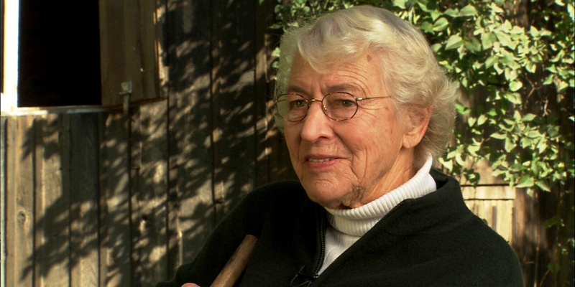
Nina Leopold Bradley
Photo: Wisconsin Conservation Hall of Fame, CC-BY-NC-ND 3.0
Notes:
Aldo Leopold and later, his daughter Nina Leopold Bradley, recorded detailed records at The Shack in Wisconsin of plant and animal phenology, including arrival times of migratory birds

Slide 21
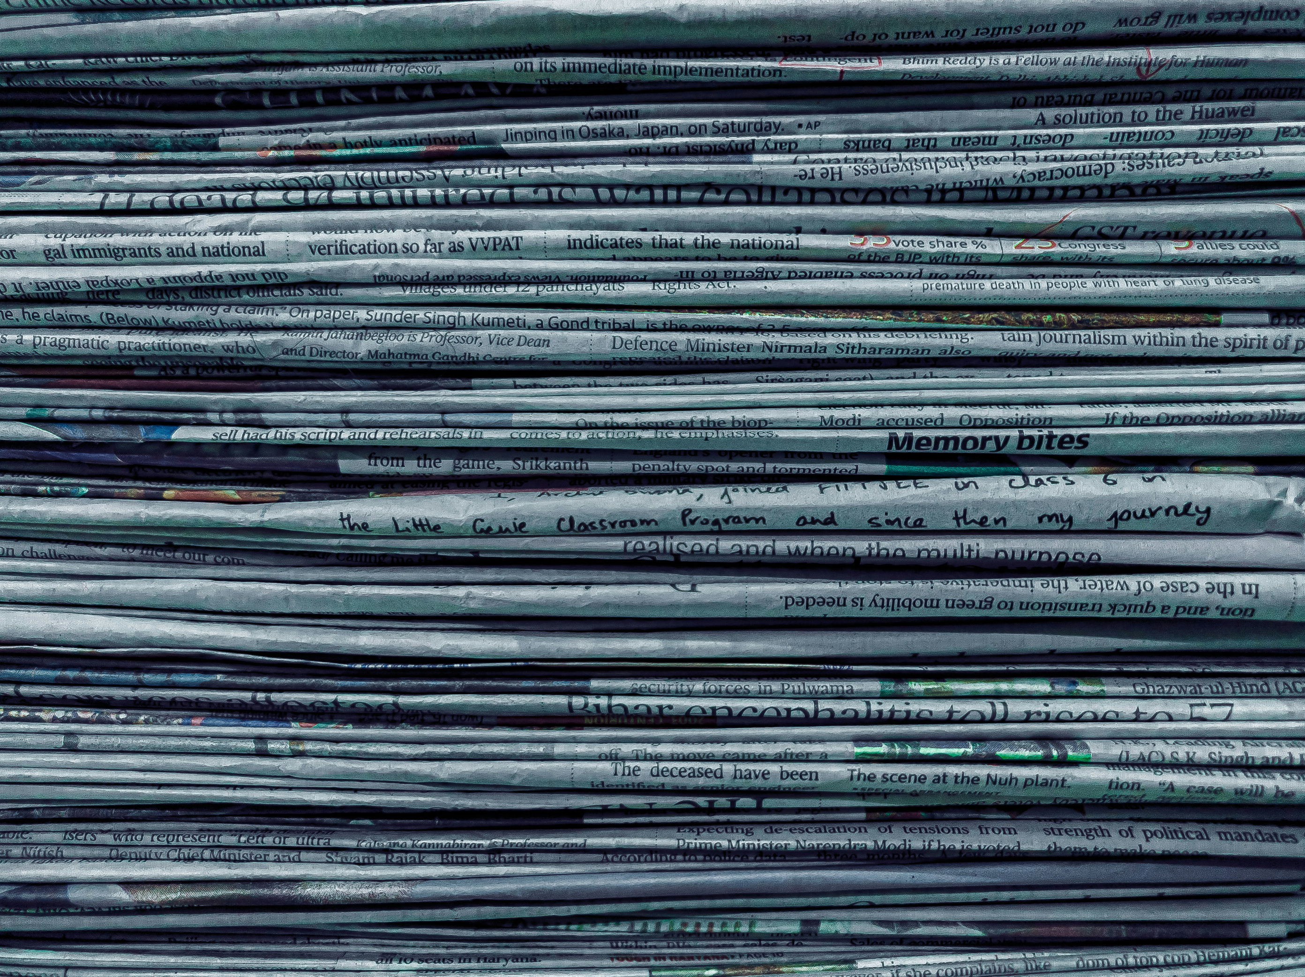
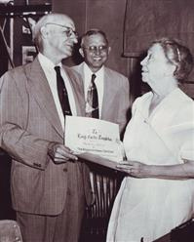
Lucy Templeton
Photo: KNS Archive
Notes:
Lucy Templeton, a columnist with the Knoxville Sentinel newspaper in Knoxville, TN wrote a weekly column called the "Country Calendar" between the 1930s and 1970s that included her observations of seasonal activity

Slide 22
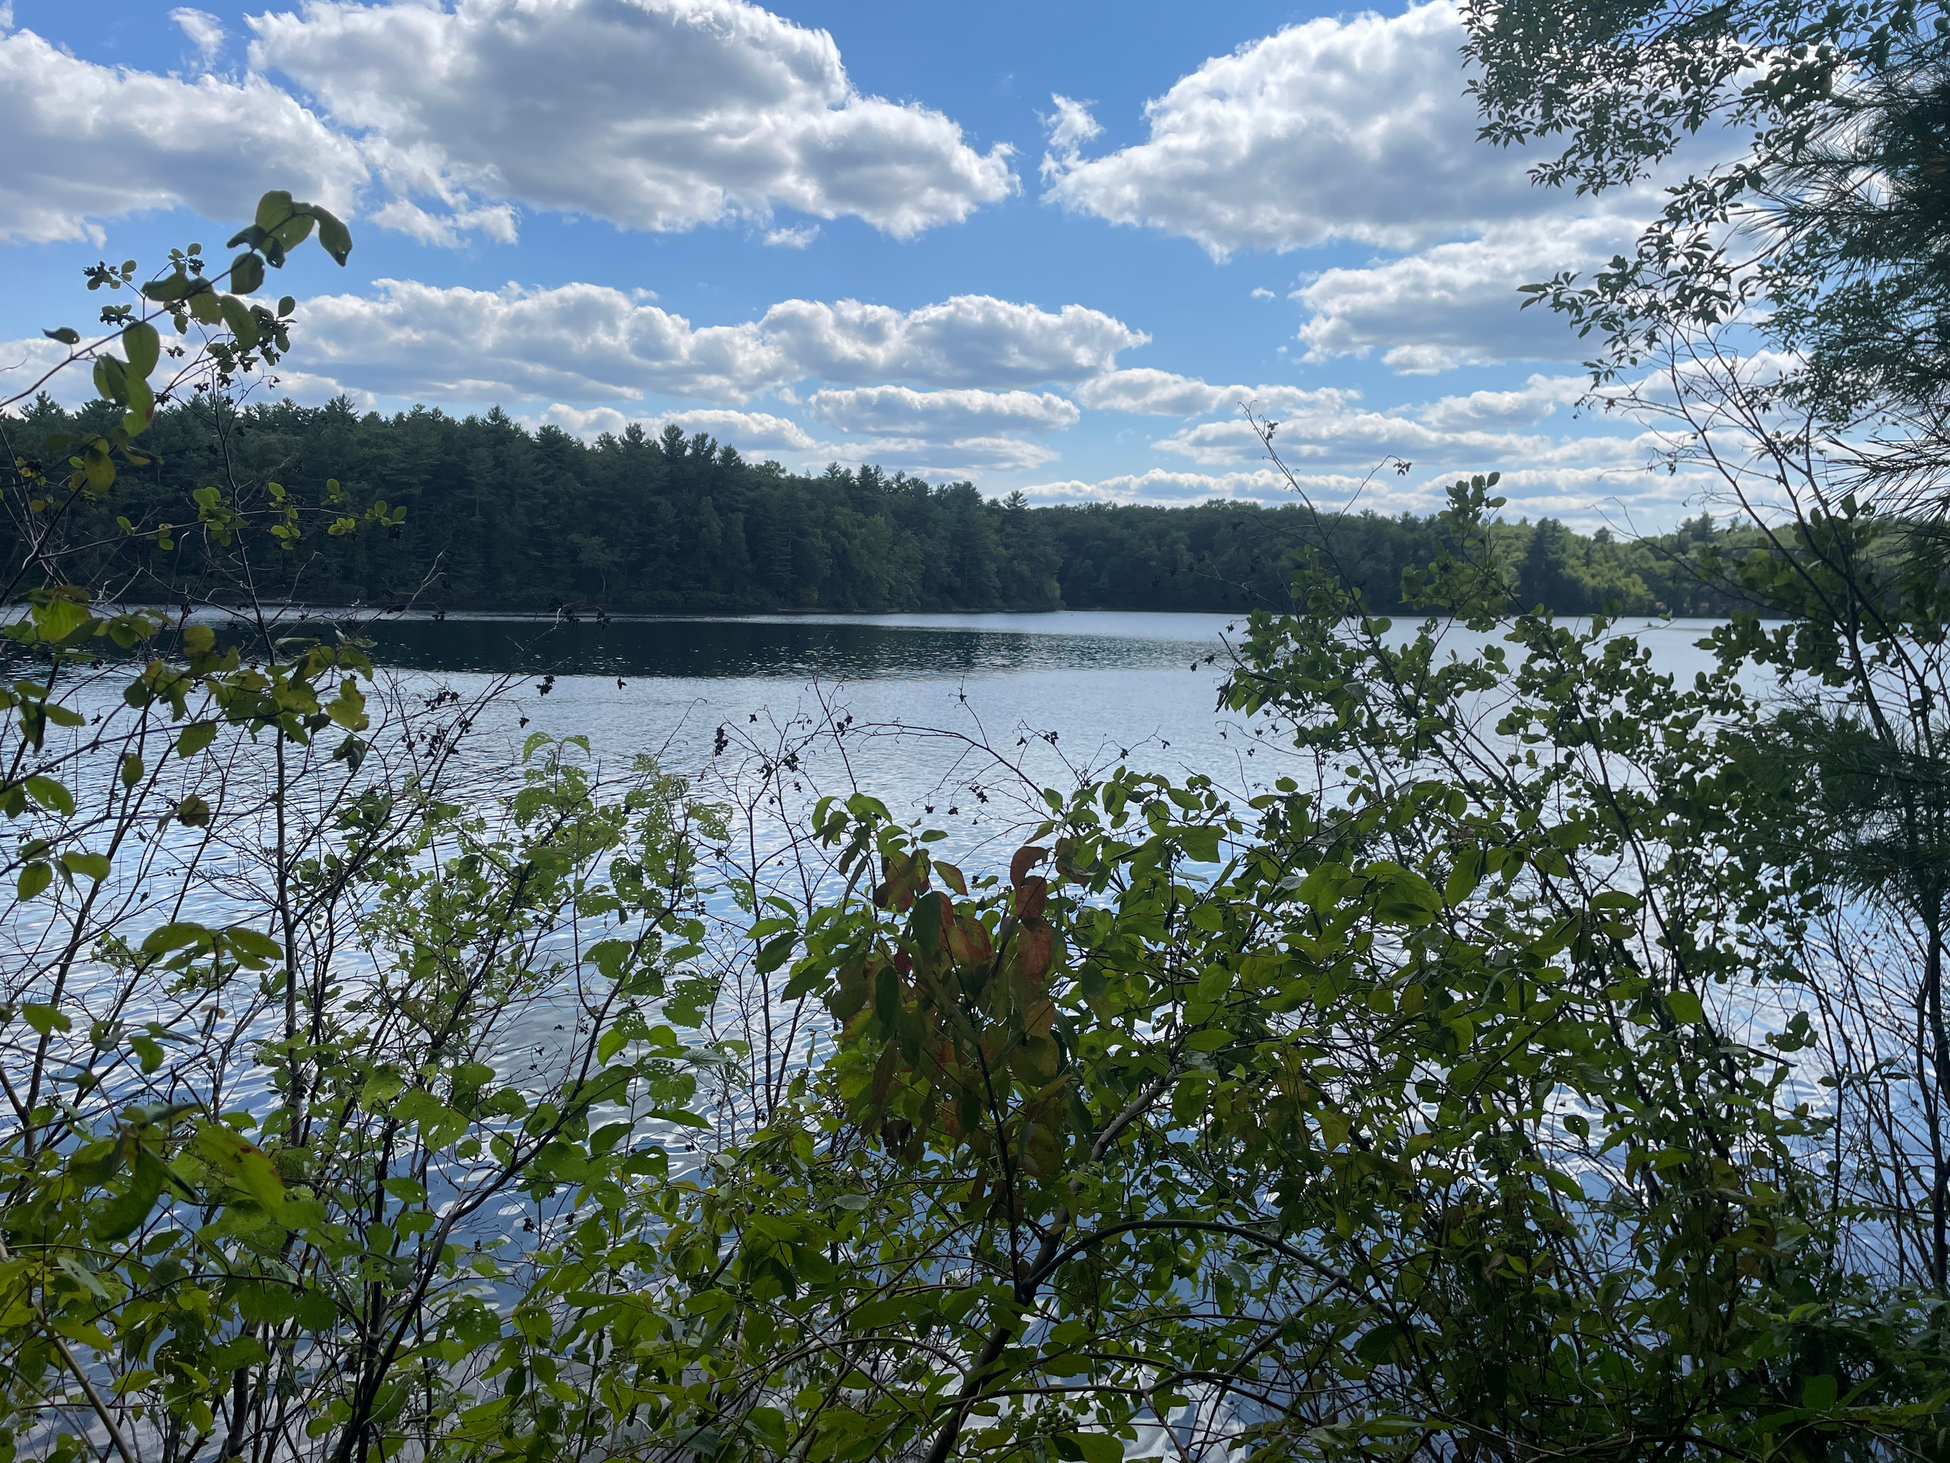
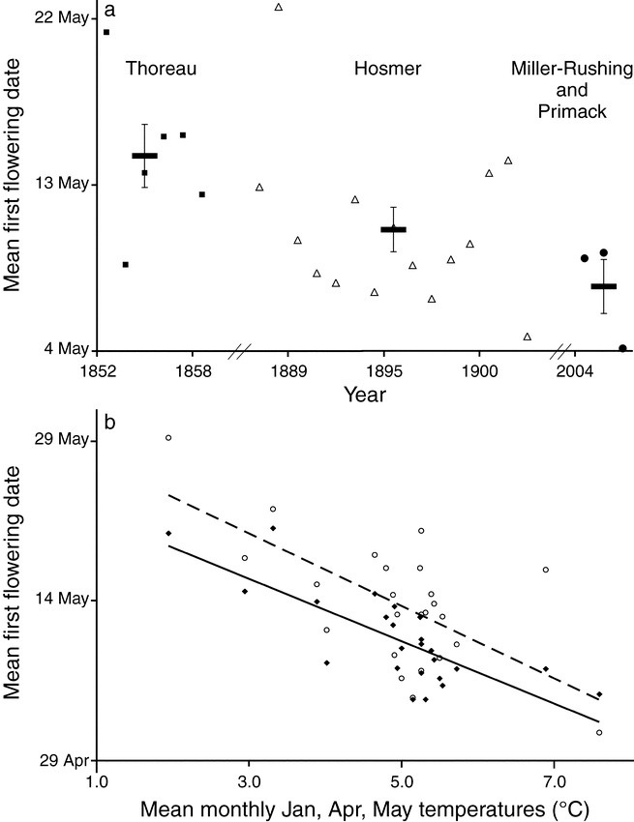
7 days earlier
Credit: Primack and Miller-Rushing 2012, BioScience
Notes:
We can learn a lot from these carefully kept records of seasonal cycles. For example, scientists have compared Thoreau’s observations of flowering plants that he recorded in his journals in the 1840s to the same species at Walden pond in recent years. They found that, on average, species are flowering about 7 days earlier than they did in Thoreau’s time.

Slide 23
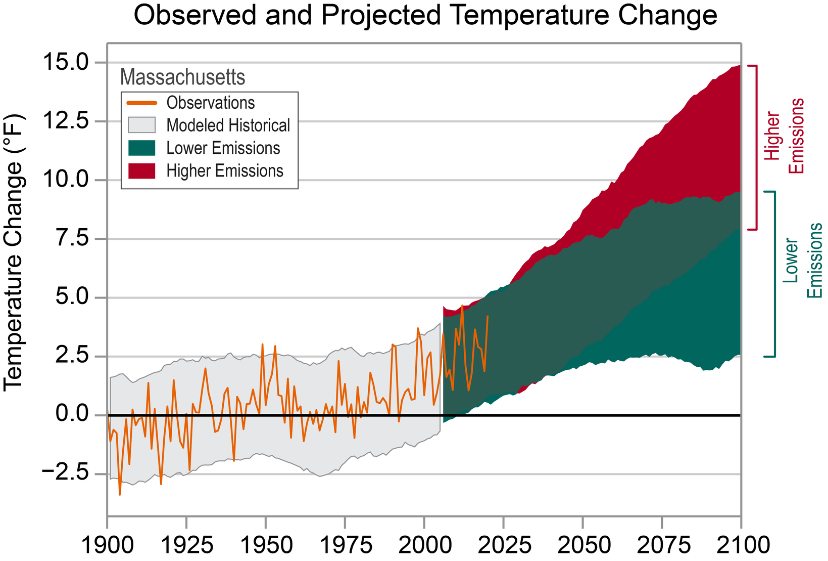
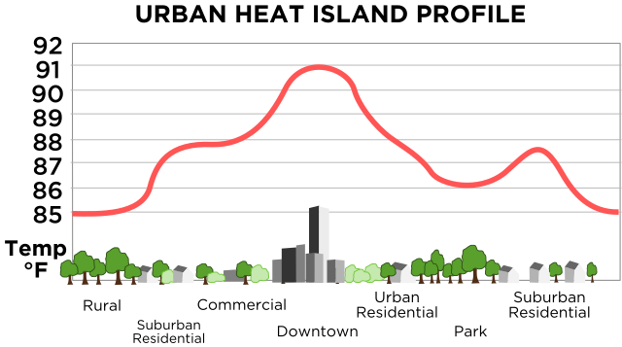
Source: Primack, R. B, Miller-Rushing, A.J. 2012. BioScience
Credit: (left) statesummaries.ncics.org, (right) The New Phobia via Wikipedia, Public Domain
Notes:
There are a number of potential reasons for this, including the rise in annual temperature due to climate change and the influence of the urban heat island in proximity to Walden Pond. However, the important thing to note is that without his valuable dataset, we would not have information about what happened in the past.

Slide 24
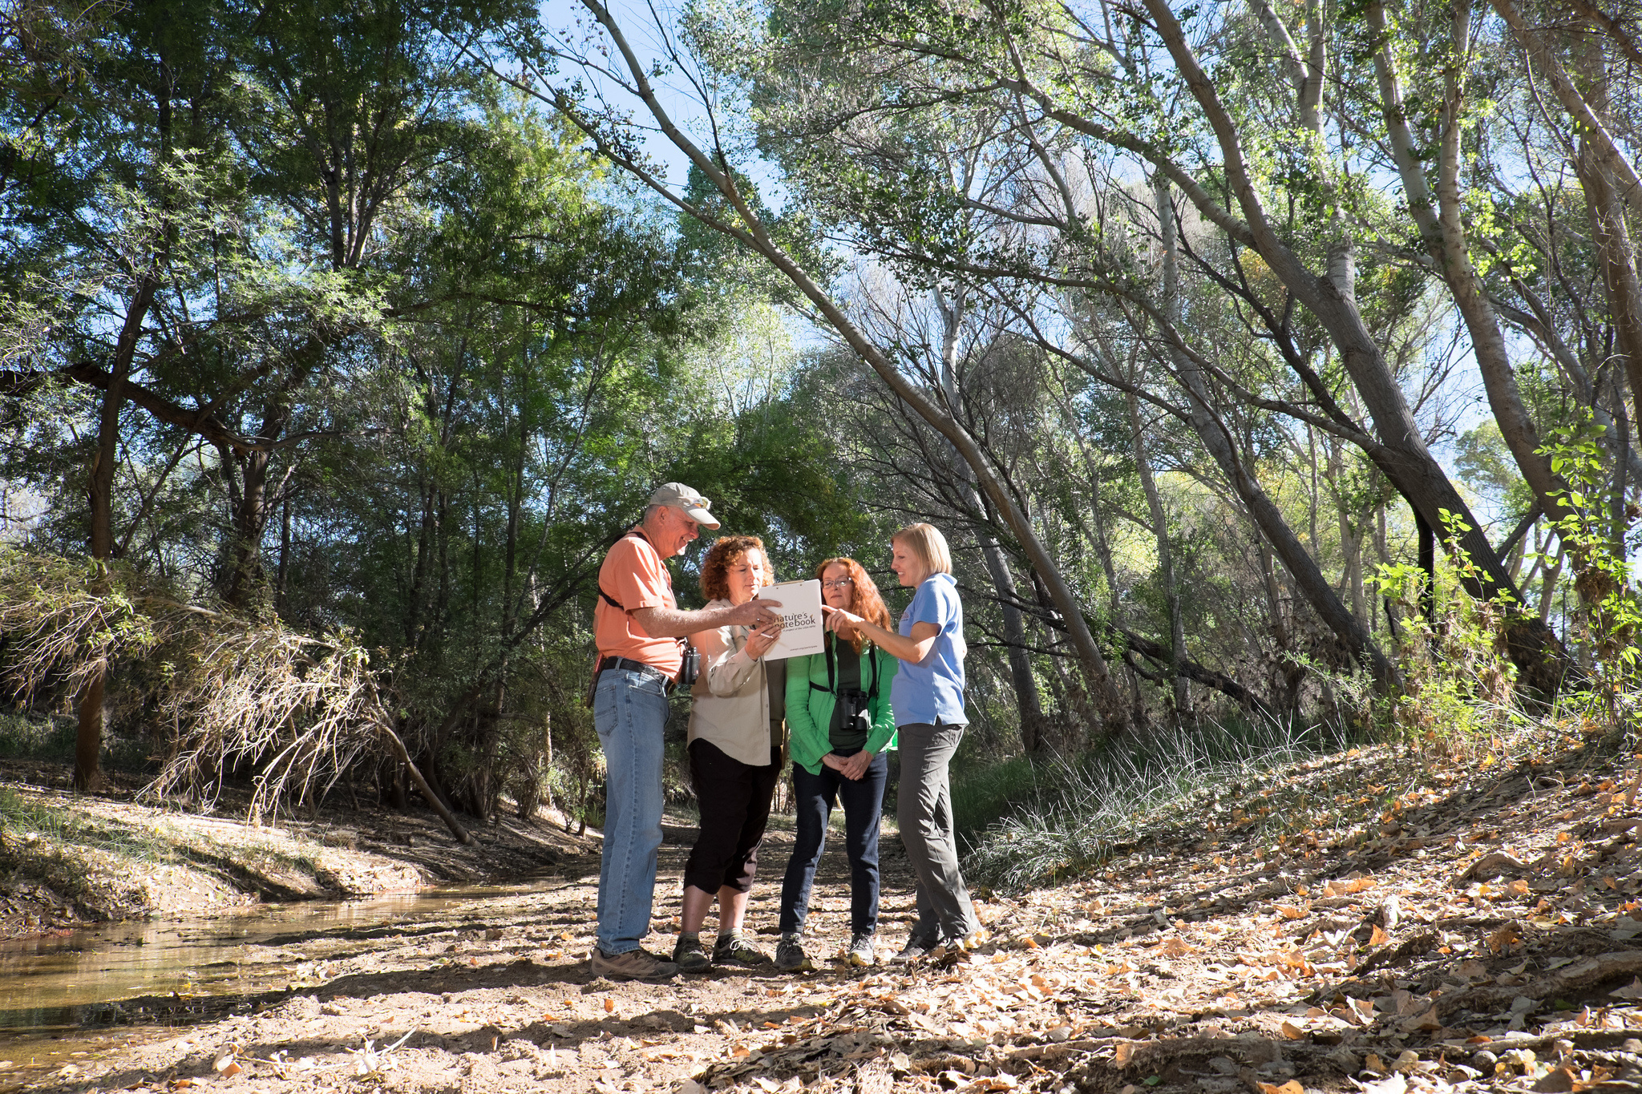
Photo: Brian F Powell
Notes:
In recent decades, more and more volunteer scientists are becoming involved in tracking phenology.

Slide 25
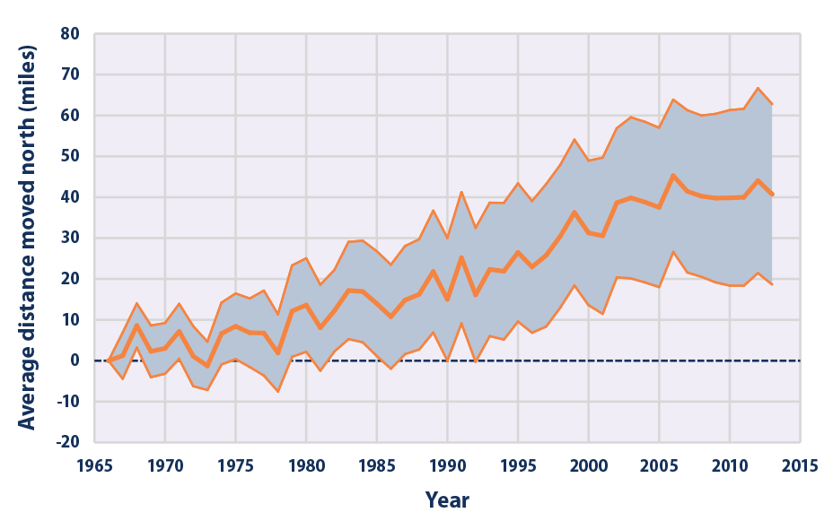
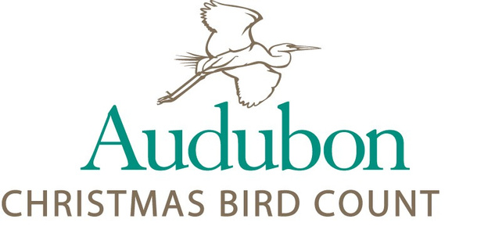
Credit: www.epa.gov/climate-indicators/climate-change-indicators-bird-wintering-ranges
Notes:
We can learn a lot from data collected by volunteer scientists, as shown in this graph depicting change in the center of bird abundance for 305 widespread species over the last 50 years. These data were collected by volunteer scientists through the Audubon Christmas Bird Count. We can see that the center of abundance has moved 40 miles north over the last 50 years.

Slide 26
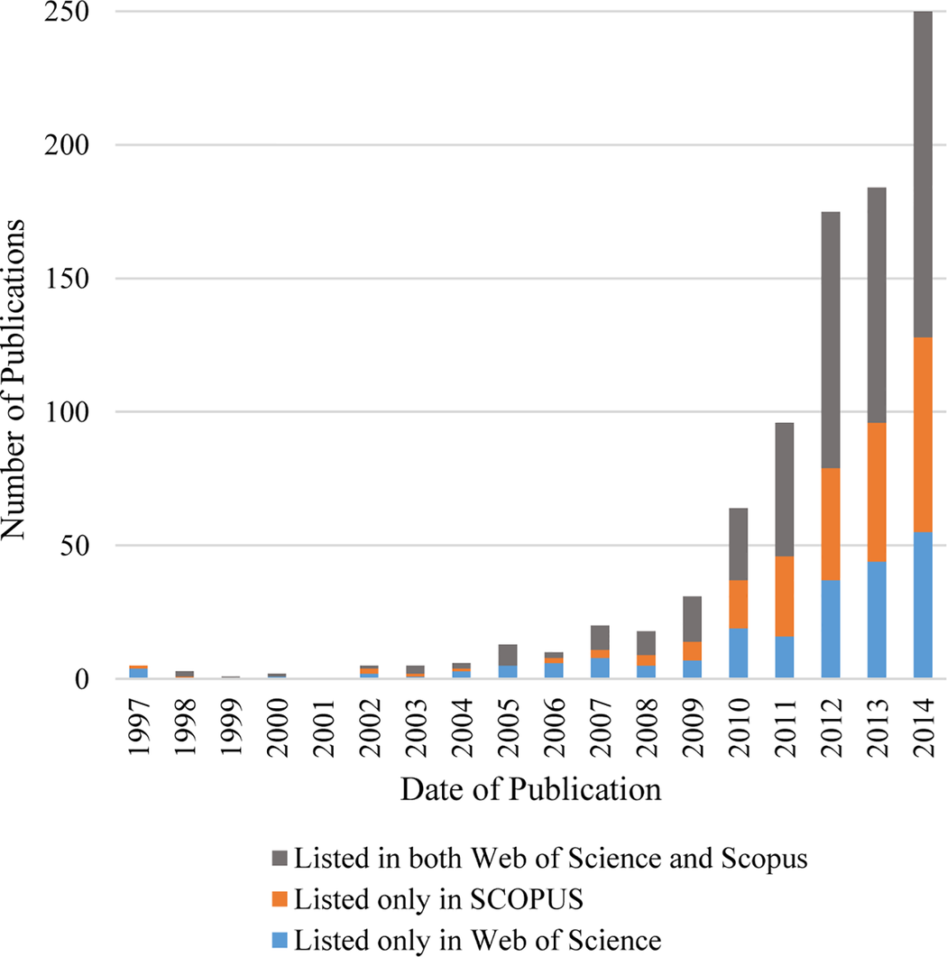
Number of publications featuring citizen science
Credit: Follet and Strezov 2015, PLoS ONE
Notes:
Volunteer science, also called citizen science, is becoming increasingly prevalent in the peer-reviewed literature. There was dramatic growth between 1997 and 2014 in the number of publications featuring citizen science (Follett and Strezov 2015), including dozens featuring Nature’s Notebook data!

Slide 27
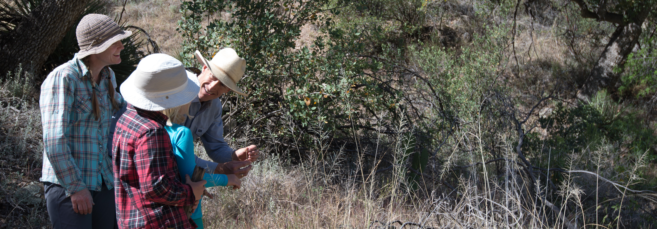
“Quality of data collected by volunteers, on a project-by-project basis, has generally been found as reliable as the data collected by professionals.”
Source: Cooper et al 2014, PLoS ONE; Photo: Brian F Powell
Notes:
Data collected by volunteers are extremely useful. Authors of a study published (by Cooper et al in Plos One) in 2014 found the “Quality of data collected by volunteers, on a project-by-project basis, has generally been found as reliable as the data collected by professionals.”

Slide 28
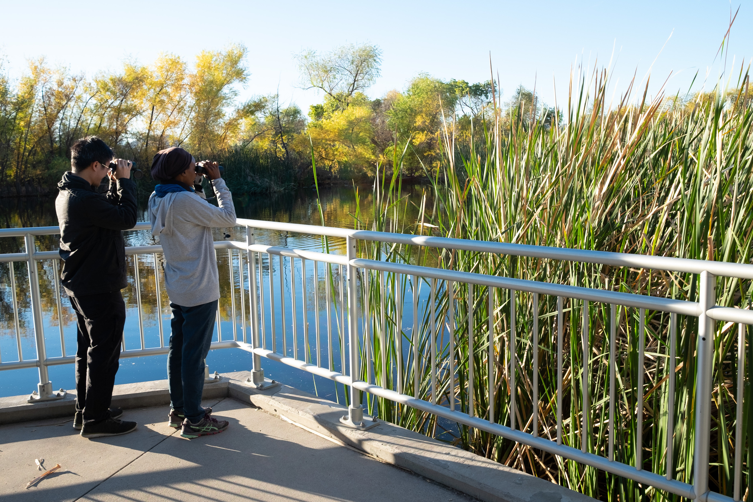
Source: Theobald et al. 2015, Biological Conservation
Volunteers contribute an estimated 2 and a half billion dollars each year to biodiversity research
20
Photo: Brian F Powell
Notes:
There is great value in these volunteer efforts as well; volunteers contribute an estimated 2 and a half billion dollars each year to biodiversity research (Theobald et al 2015).

Slide 29
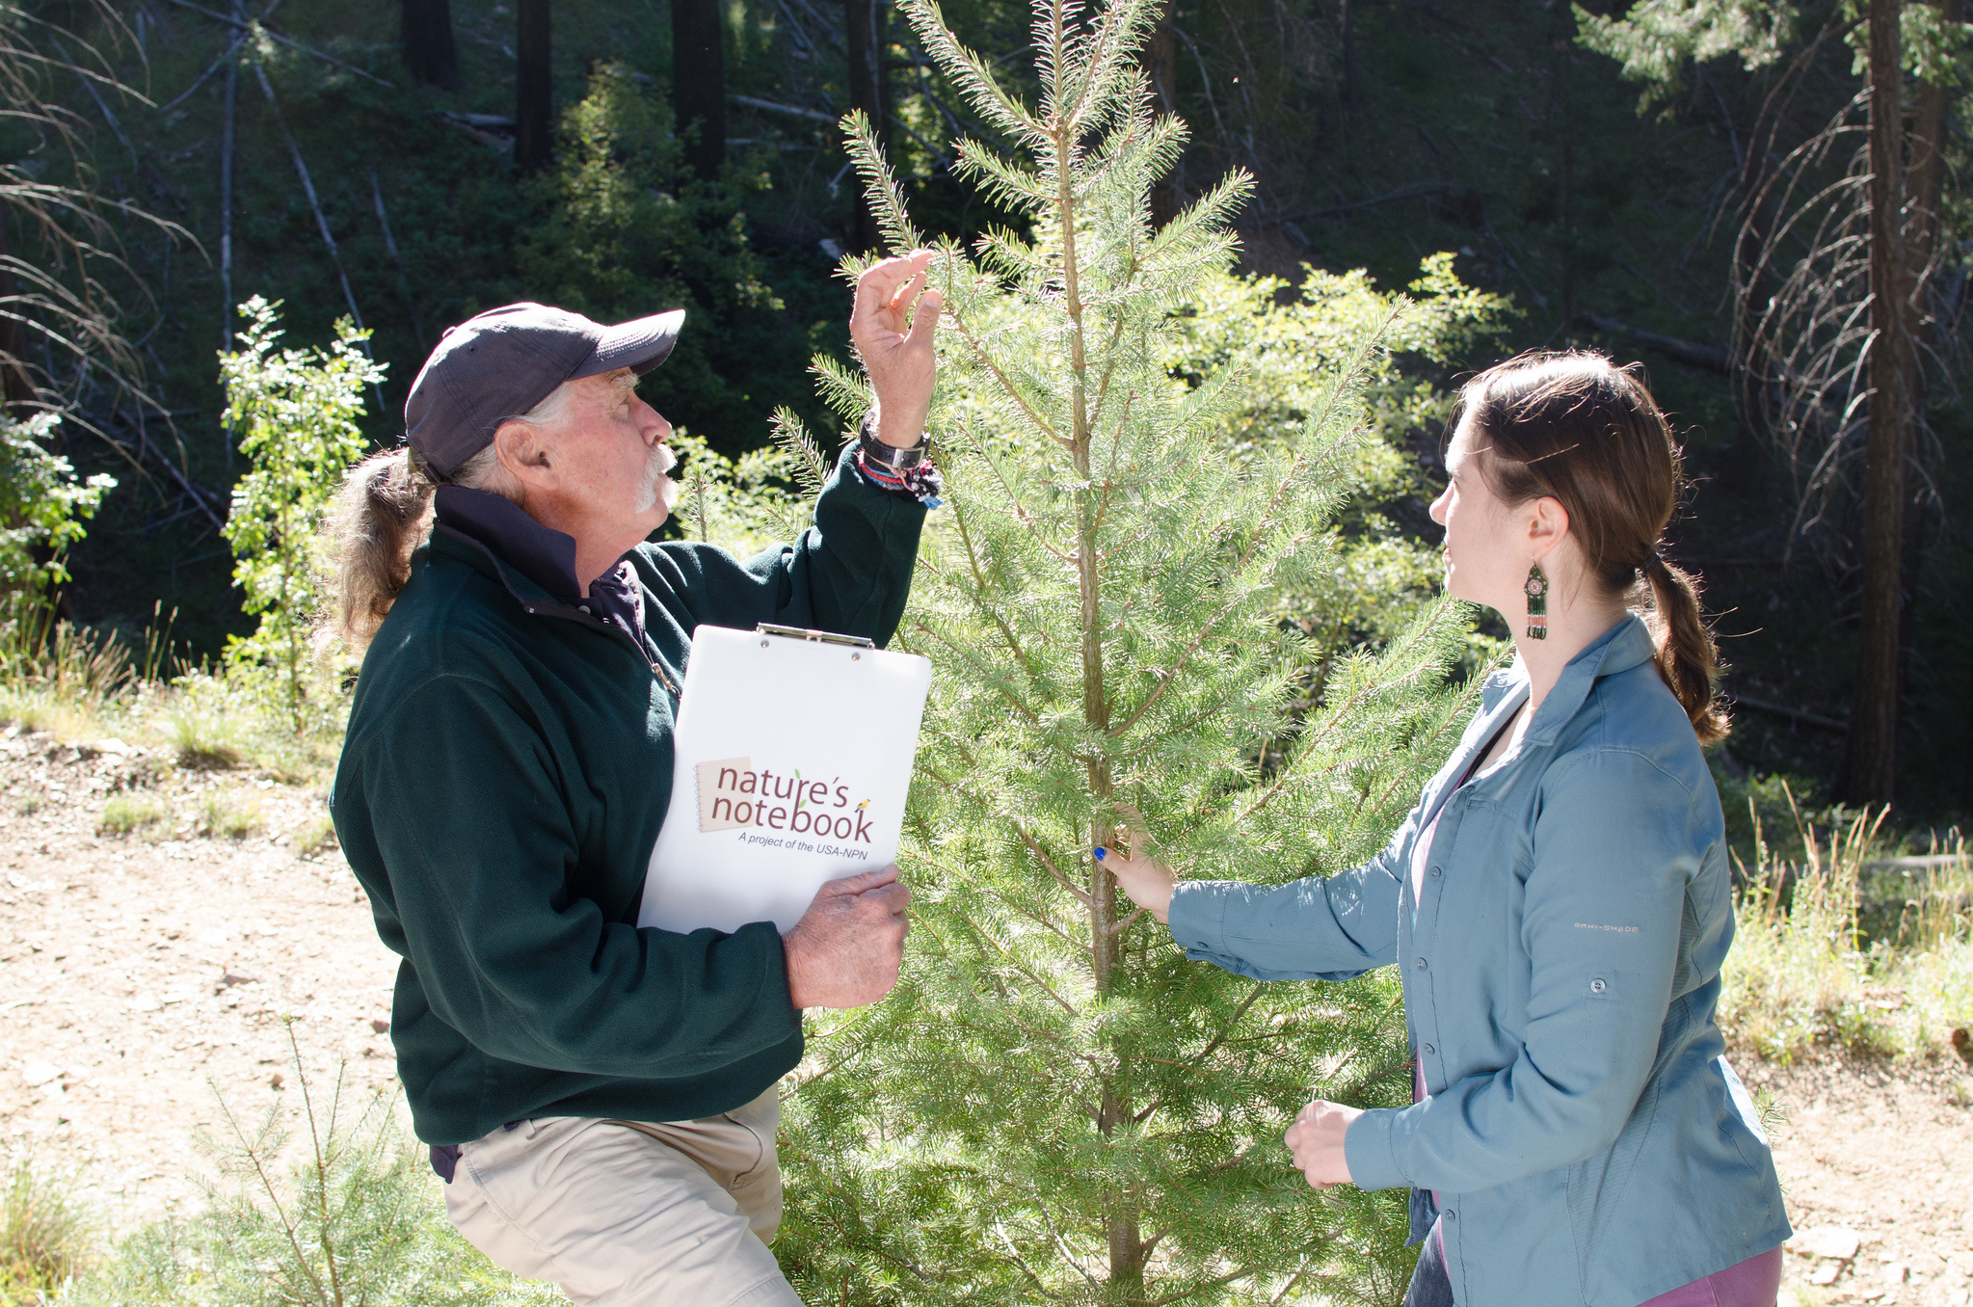
Photo: Brian F Powell
Notes:
You too can track phenology as a volunteer scientist! Join Nature’s Notebook and track the seasonal timing of plants and animals where you live.

Slide 30

Learn more at
Notes:
Learn more at usanpn.org.

Slide 31
References (in order cited)
Bacon B, Khatiri A, Palmer J, Freeth T, Pettitt P, Kentridge R. 2023. An Upper Palaeolithic Proto-writing System and Phenological Calendar. Cambridge Archaeological Journal 33(3):371-389. doi.org/10.1017/S0959774322000415
Primack RB, Miller-Rushing AJ. 2012. Uncovering, Collecting, and Analyzing Records to Investigate the Ecological Impacts of Climate Change: A Template from Thoreau's Concord. BioScience 62(2):170–181. doi.org/10.1525/bio.2012.62.2.10
Follett R, Strezov V. 2015 An Analysis of Citizen Science Based Research: Usage and Publication Patterns. PLOS ONE 10(11). doi.org/10.1371/journal.pone.0143687
Cooper CB, Shirk J, Zuckerberg B. 2014 The Invisible Prevalence of Citizen Science in Global Research: Migratory Birds and Climate Change. PLOS ONE 9(9). doi.org/10.1371/journal.pone.0106508
Theobald EJ, Ettinger AK, Burgess HK, et al. 2015. Global change and local solutions: Tapping the unrealized potential of citizen science for biodiversity research. Biological Conservation 181:236-244. doi.org/10.1016/j.biocon.2014.10.021
This video was created September 2025

